Slide 1
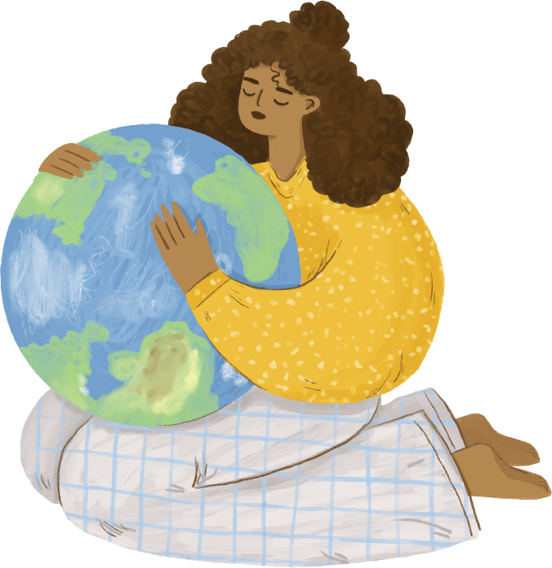
Let’s save our world with... a BIKE

Slide 2
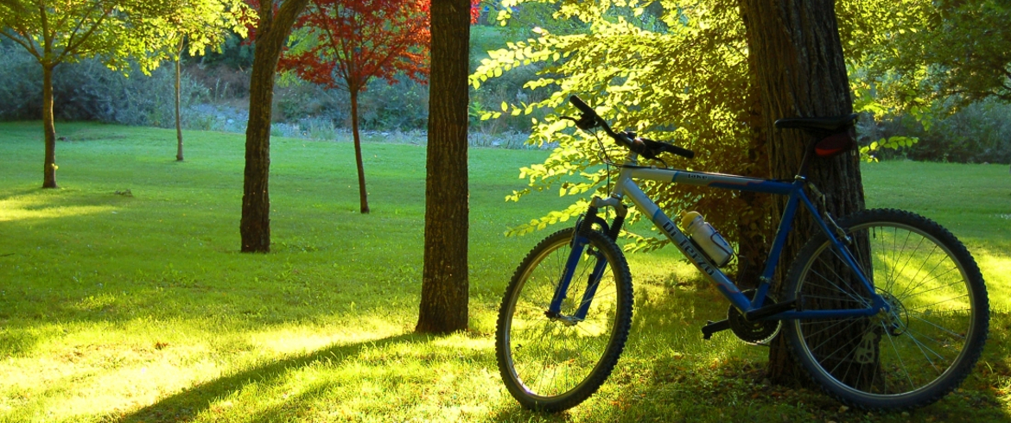
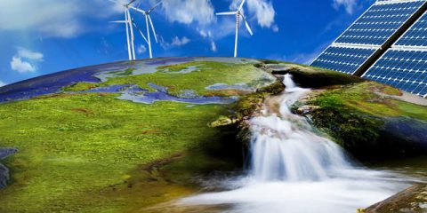
Bike as a means of transport
Nowadays is really spread the problem of climate changing; because of the use of not renewable energy (like fossil fuels) our world is suffering a lots. Let’s think about how factories produce goods that we use everyday: they use carbon fossil to work with all the machineries that they need. Or let’s think about the combustible car: they emit dangerous dusts in the atmosphere. All of them cause air pollution and they are harmful for environmental.
The solution? To use eco-friendly products both to produce goods and to move from a place to
another. Regarding to movement, we can say that the best eco-friendly means of transport are: electric cars, movement by foot, but the best is the bike; because it cannot pollute in no way.

Slide 3
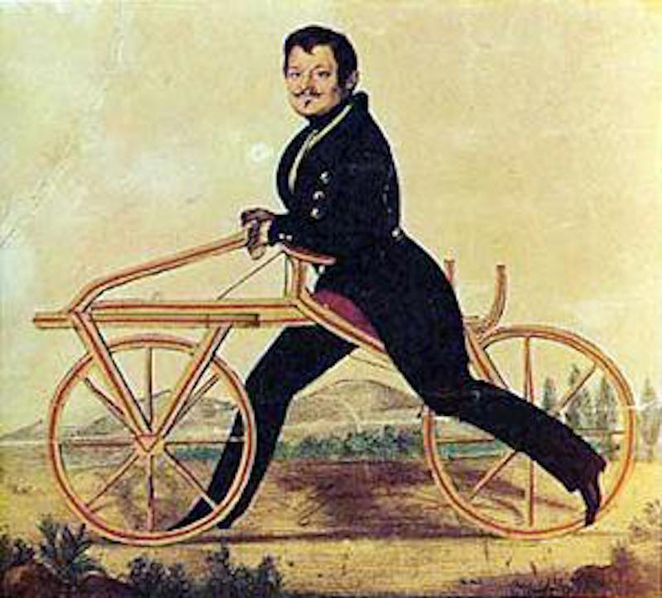
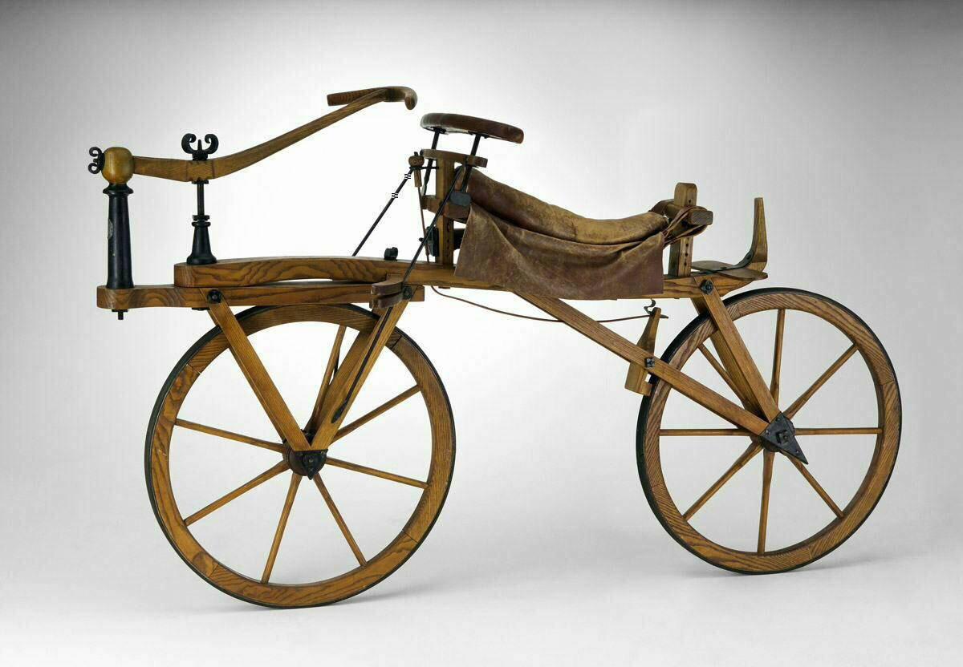
Bike as a means of transport
How we said before, bike is one of the best eco-friendly means of transport,
so let’s think about it.
Who did invent the bike?
The bike was invented by a baron German man, Karl von Drais, so the bicycle has more than 200 years old! The baron chose Laufmachine (run car) as the name of his invention.
How was the first bike?
At the beginning it was built in wood, two wheels and no pedals: to move you had to push yourself with your legs. Instead, the steering was made of a lever rather than a handlebar.

Slide 4
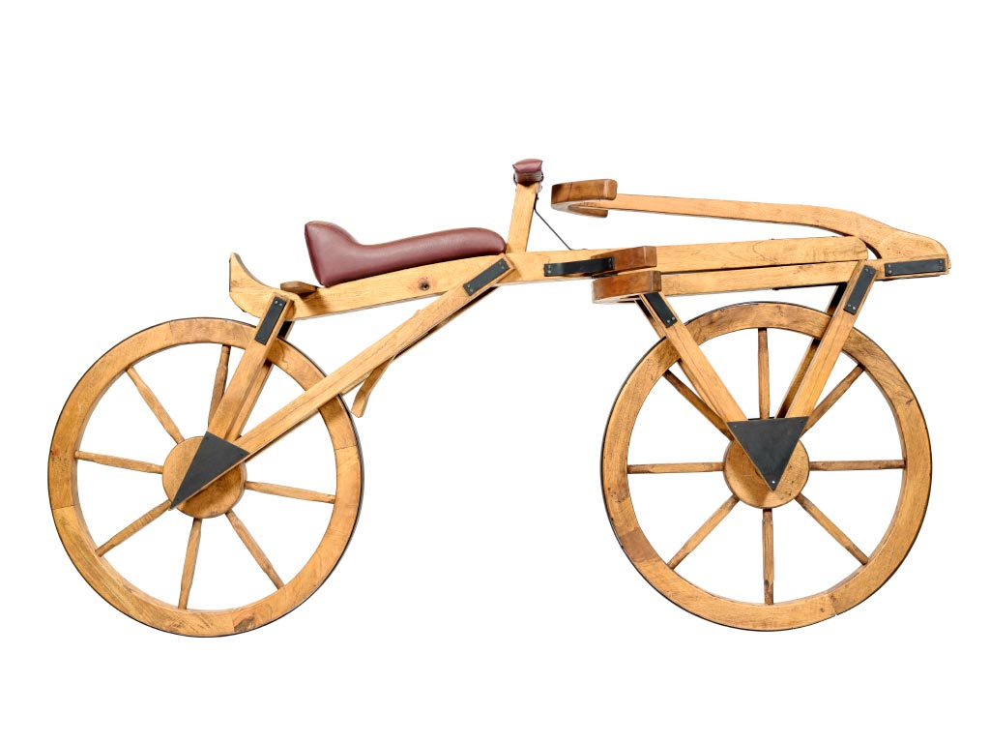
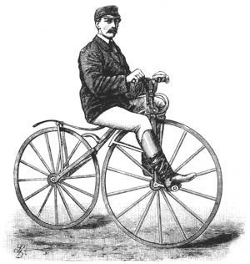
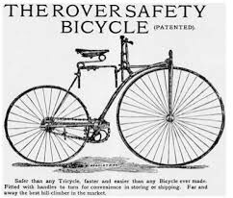
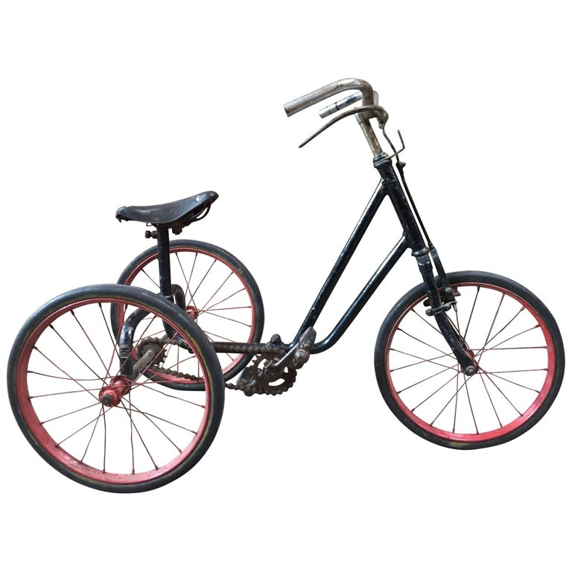
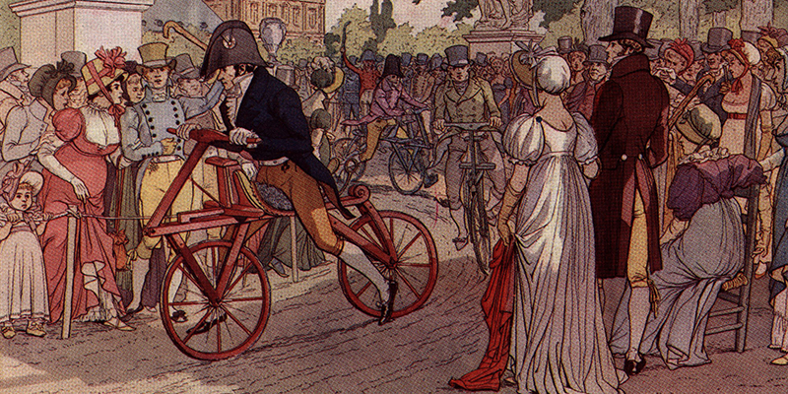
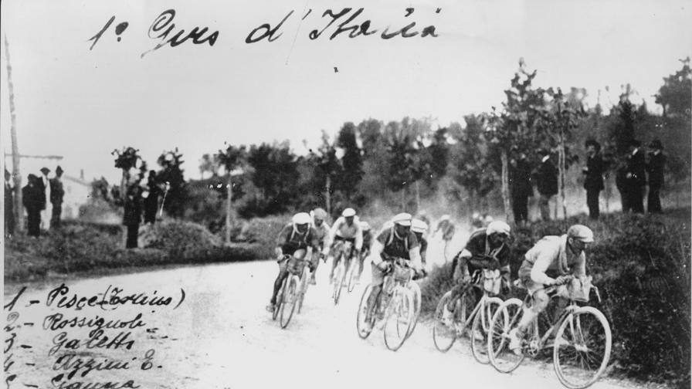
Bike as a means of transport STORY
1791
1860
1861
Ernest Michaux mounted the first pedals
1884
1888
1909
The bicycle was born
The bicycle spread in France
John K. Starley created the safety bicycle called "Rover"
Dunlop mounted a tricycle
There was the first Tour of italy

Slide 5
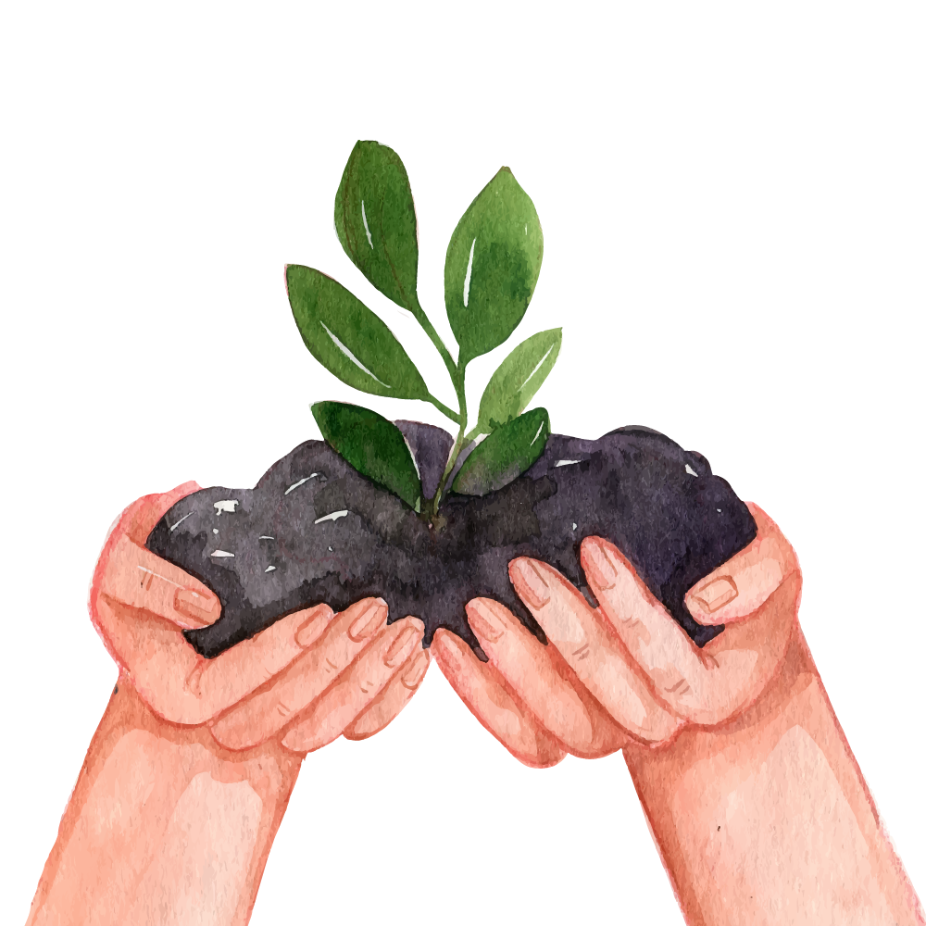
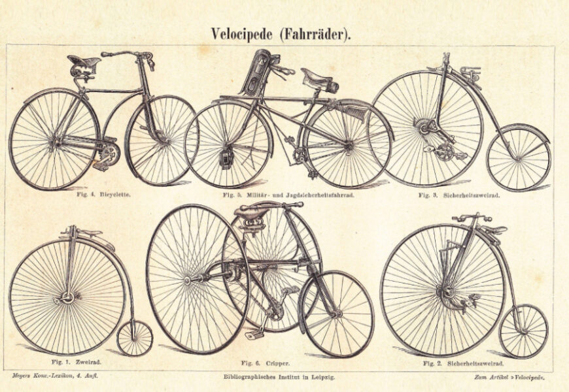
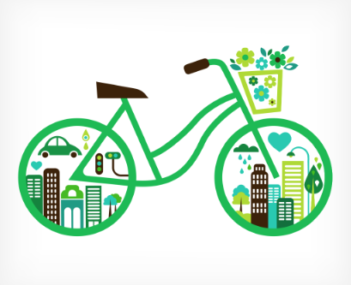
Bike as a means of transport
When did bikes spread to the population?
The bike was extended in 1817 by a man named Karl Drais, he was German.
Is it the bike an ecological mode of transport? Why?
Yes, because you can move everywhere. The bike doesn’t pollute like other transport.

Slide 6
“The bicycle is the transcription of energy in balance, the exaltation of momentum, the visible image of the wind. It tends to fly; shaves but does not touch the earth ".
—Cesare Angelini

Slide 7
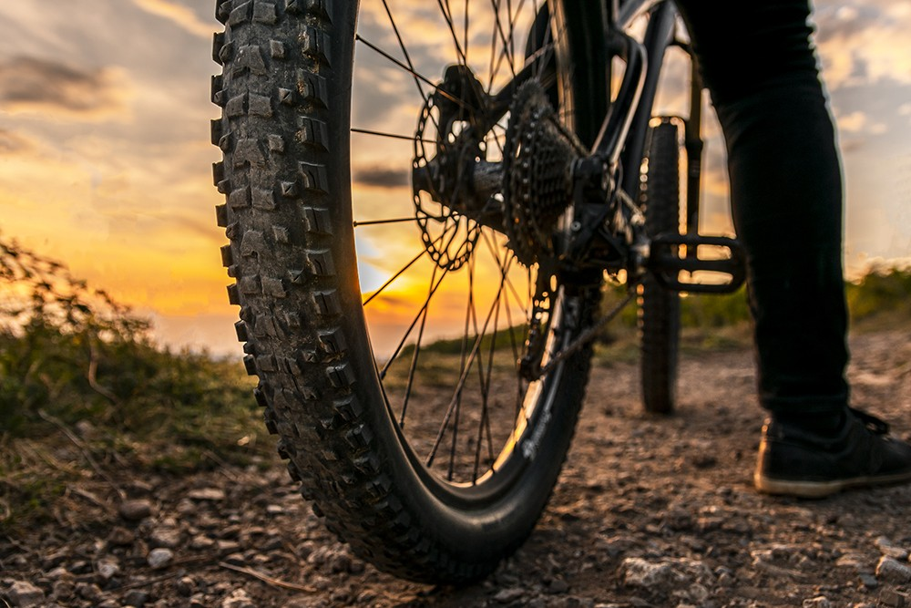
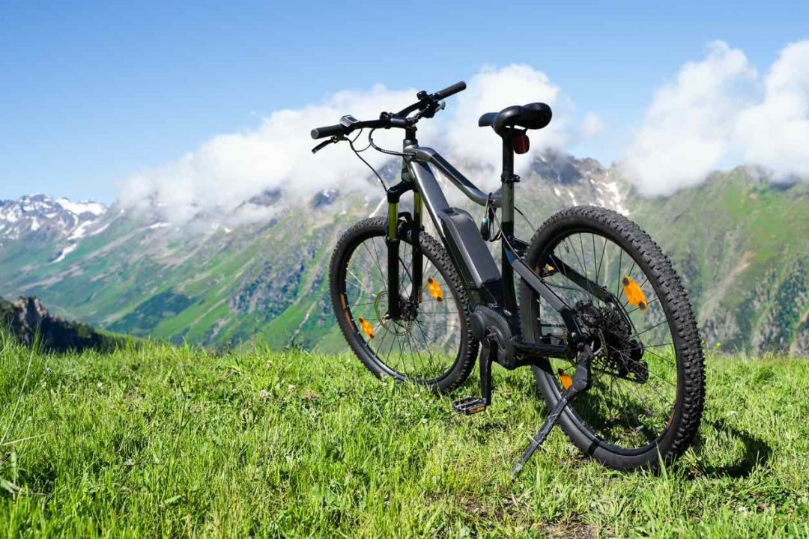
Bike as a means of transport
SOME DETAILS
COLOUR
Bikes can be in every color you like. You can buy it in the colour you want or personalise it with paint and stickers.
DIFFERENT TYPES OF BIKES
There are many types of bikes but there are 2 big categories: road bike and city bike.

Slide 8
Bike as a means of transport
SOME DETAILS
WEIGHT
There are many types of bikes distributed in two categories: city bikes ; road bikes . The weight of a bicycle depends on its category and model. Here are some weight averages.
City bikes :
-Dutch bicycles : 19kg
-Trekking bike : 12-15kg
-Folding bike : 9-18kg
-Electric bike : 20-27kg
-Cargo bike : 60-65kg
Road bike:
-Mountain bike : 16-18kg
-Racing bike : 7-10kg

Slide 9
Bike as a means of transport
SOME DETAILS
POWER
Power is the level of effort the rider puts when he pushes the pedals. It is measured in watts.
Let’s check the most important values of effort provided according to time and level:
Over one hour:
between 5.7 and 6.4 W/kg: very high level professional
between 4.7 and 5.3 W/kg: very good amateur
between 3.5 and 4.1 W/kg: average amateur
between 2.4 and 3.1 W/kg: occasional cyclist

Slide 10
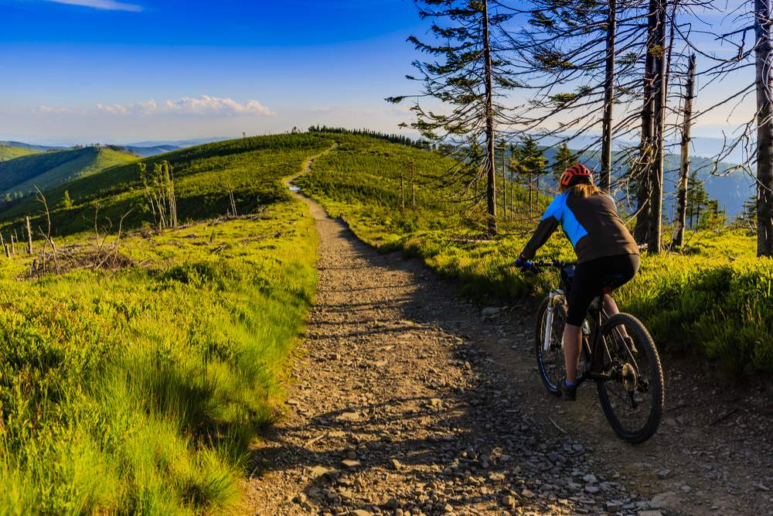
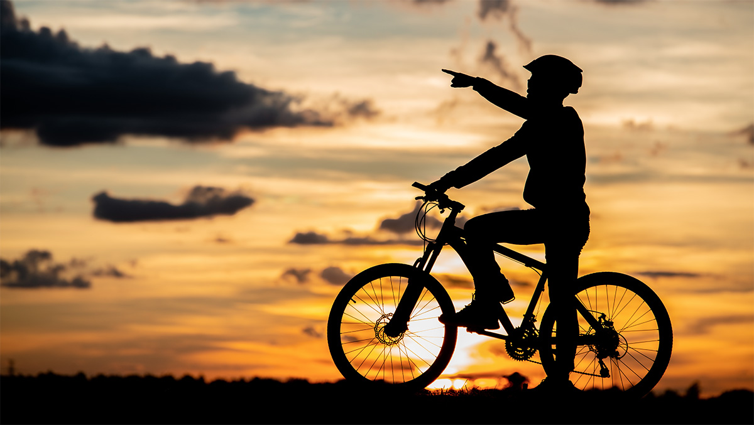
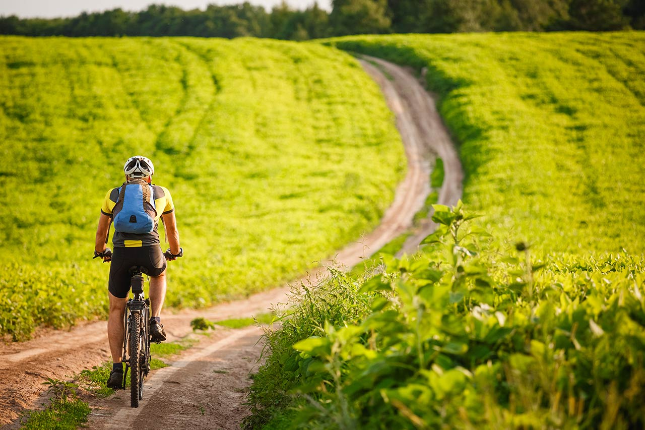
Bike as a means of transport
Why do people use bike?
When they don't feel like walking they can ride a bike. It is also really good for your health and environment.
Is it an enjoying mode of transport?
Of Course and it is easy to get and use, in addition it also excellent for the environment.
Is it useful for long or short distance?
We think that bikes are super good for both long and short distances. But on a daily basis people choose bikes for short distances.

Slide 11
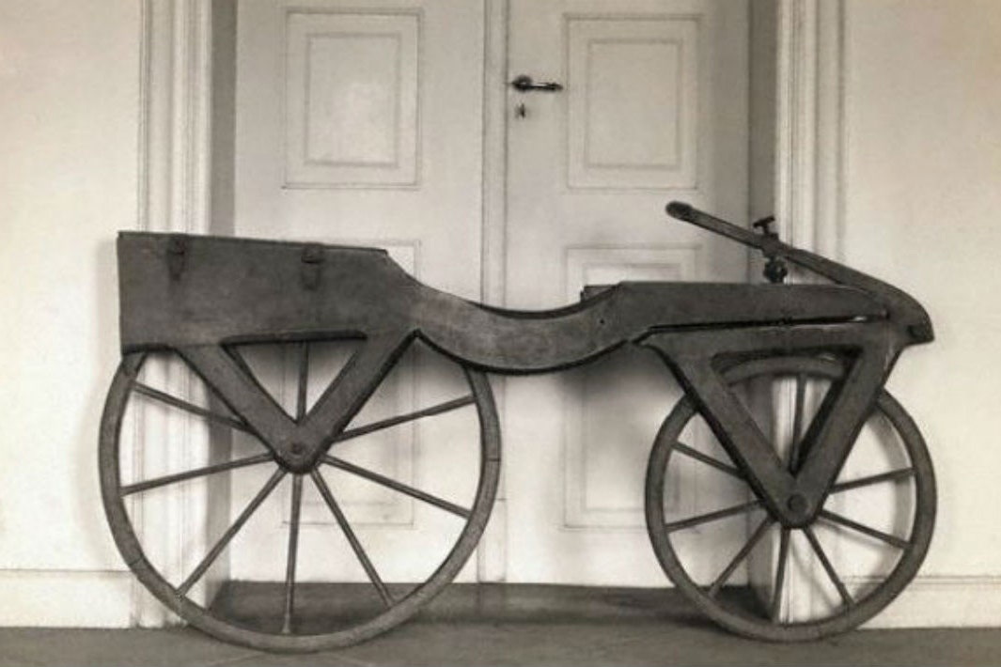
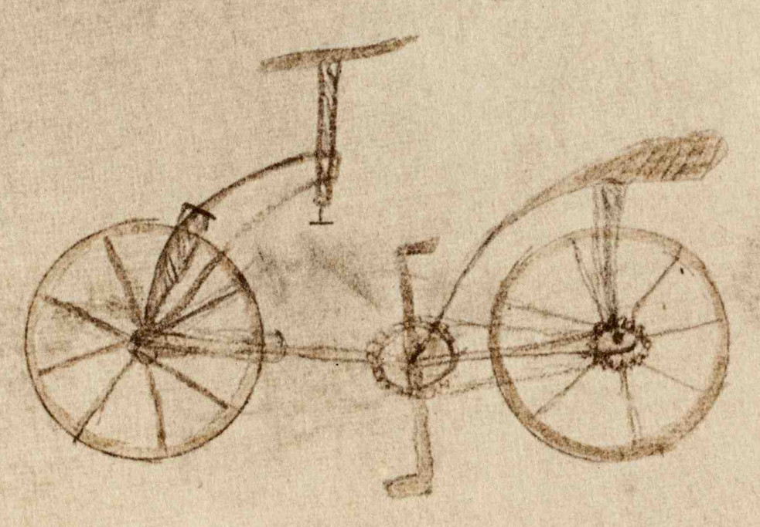
Bike as a means of transport
Curiosities
The first to have thought of the bicycle was Leonardo Da Vinci, he drew, in 1493, a "machine" with two wheels, a wooden axle that held them together, a handlebar and a kind of chain that connected the pedals to the rear wheel. This drawing is contained in the Codex Atlanticus.
The first bike had a high front wheel to remember the ride on horseback, the most popular means of transport in 1800.

Slide 12
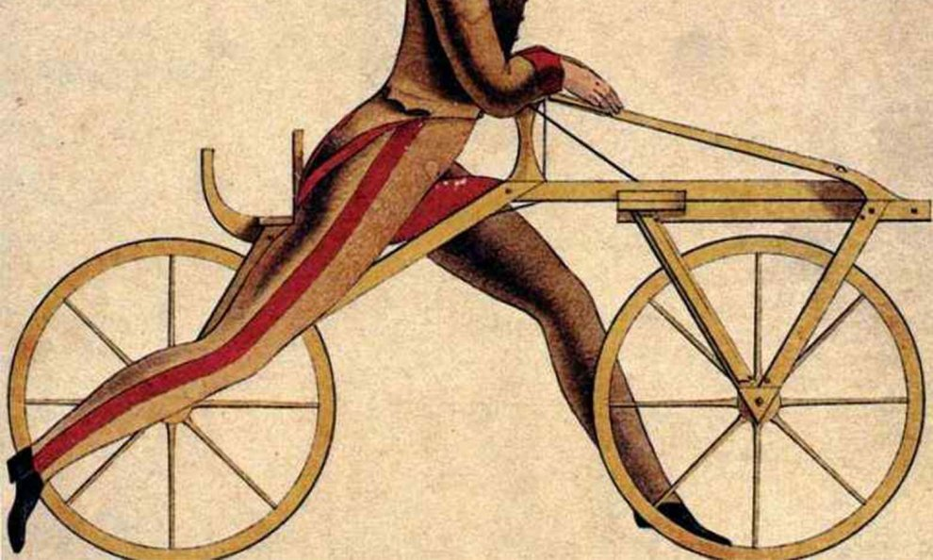
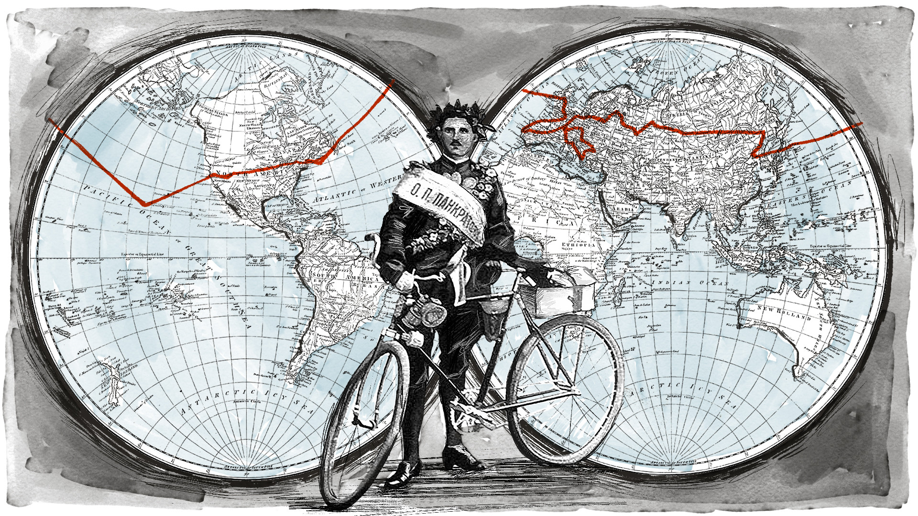
Bike as a means of transport
Curiosities
At the beginning the bike was just a means of transport for rich people
Mountain biking was invented in 1970 in America by Gary Fischer.
The first tour of the world by bike was done by Thomas Stevens who, in April 1884 left San Francisco and returned in December 1886, two and a half years and 13,500 miles later!

Slide 13
THE END

