Slide 1
E-Twinning and
From my school to your school
E-twinning offers a platform for European teachers and students to communicate, collaborate, develop projects, and to be part of the most exciting learning community in Europe.
TwinSpace is the safe platform for teachers and students. We will use it to meet and collaborate within the project with peers from France, Italy ,Lithuany and Spain
.

Slide 2
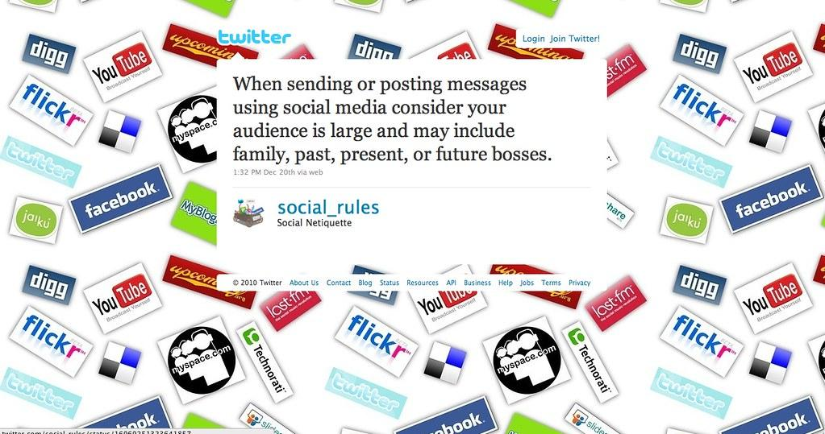
The netiquette

Slide 3
What’s netiquette?
NET|IQUETTE
« Net »
« Etiquette »
Internet
Netiquette is short for "Internet etiquette." It is a code of good behavior on the Internet. The general idea is to respect others online.
It includes several aspects of the Internet, such as email, social media, online chat, web forums, website comments, and other types of online communication.
Good netiquette benefits both you and others on the Internet. Posting a positive comment rather than a negative one just might make someone's day.

Slide 4
Before you speak
What are the rules?
THINK:
T
Is this true ?
H
Is this helpful ?
I
Is this inspiring ?
N
Is this necessary ?
K
Is this kind ?
Avoid posting inflammatory or offensive comments online (e.g flaming).
Respect others' privacy by not sharing personal information, photos, or videos that another person may not want published online.
Never spam others by sending large amounts of unsolicited emails o messages of any kind.
Don't troll people in web forums or website comments by repeatedly annoying them.

Slide 5
More rules..
THINK:
T
Is this true ?
H
Is this helpful ?
I
Is this inspiring ?
N
Is this necessary ?
Remember:
If you post offensive remarks online and the veil of anonymity is lifted, you will have to answer for the comments you made!!!
K
Is this kind ?
Stick to the topic when posting in online forums or when commenting on photos or videos or any kind of messages.
Don't swear or use offensive language.
Avoid replying to negative comments with more negative comments. Instead, break the cycle with a positive post.
Offer your help if someone asks a question and you know the answer. Thank others who help you online.

