Slide 1
The bus
Martina, Mara, Airidas, Dziugas,Aurimas, Ane, Del Salto, Urdin

Slide 2
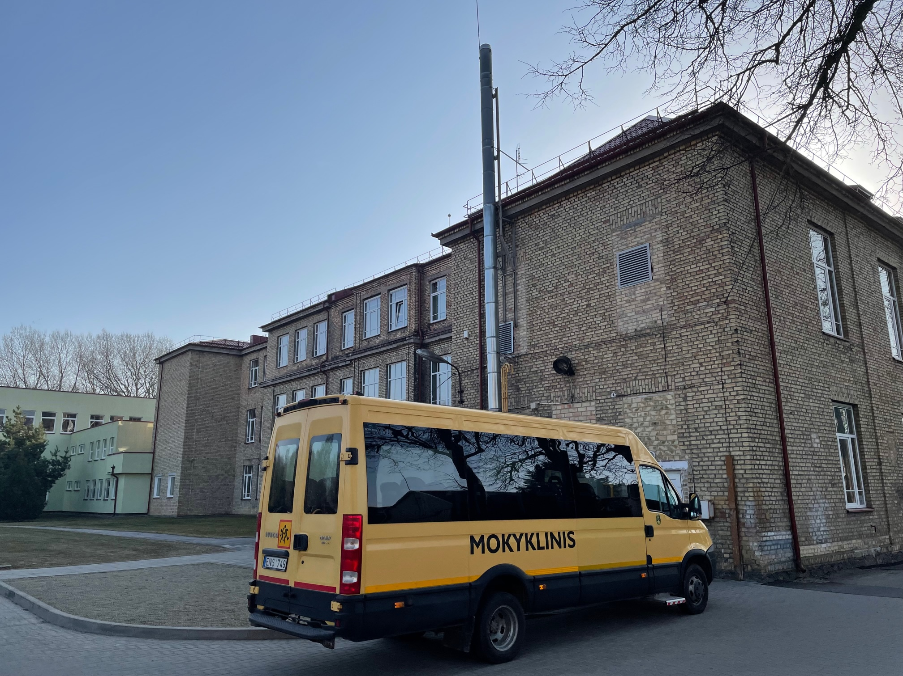
Lithuanian school bus
Bus type - Iveco Daily
Engine - 2,98cm3
Transmission - Manual
Fuel - diesel
Weight - 3200kg
Fuel consumption - 14l/100km
Power - 107kW

Slide 3
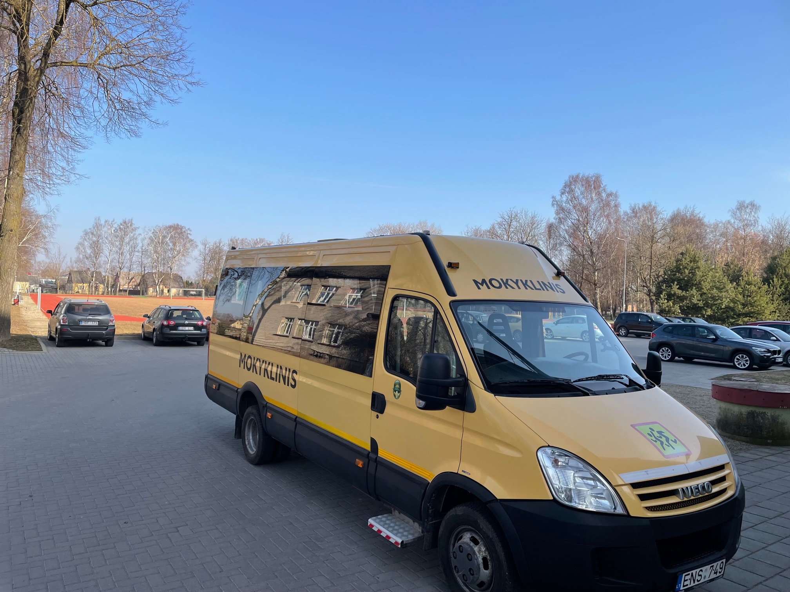
Pollution
How to calculate pollution CO₂ g/km?
For Iveco Daily producer declare formula:
CO₂ g/km = The combined litres per 100km figure x 26,3
CO₂ g/km = 14 * 26,3 = 368,2 g/km
For distance from home to school 14,6km:
14*26,3*14.6 = 5375,72 g
Formula taken from:
https://www.iveco.com/uk/contactus/pages/technical-info-vehicle-performance-faq.aspx

Slide 4
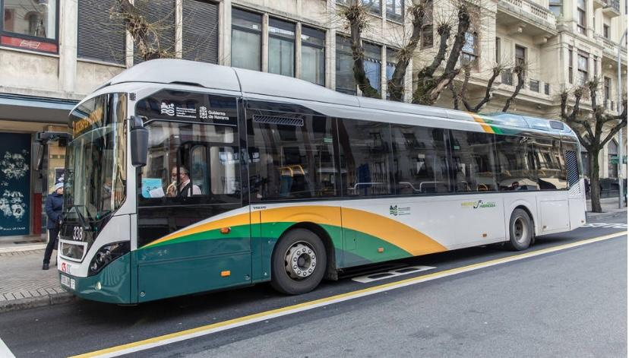
Spain bus
Bus type - urban bus.
Engine - 7700 cm3
Transmission - manual.
Fuel - diesel.
Weight - 12000 kg.
Fuel consumption - 35 l/100km.
Power - 140 kW.

Slide 5
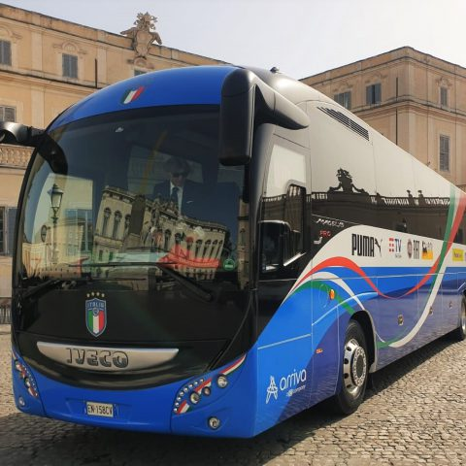
Italy bus
Speed: 82, paragraph 6: 70 km / h outside built-up areas; 80 km / h on motorways; l) work vehicles when traveling with full load: 40 km / h in built-up areas; 60 km / h outside built-up areas.
Power: In Italy, the commercial speed of buses used for local public transport is 19.4 km / h.
Consumption:
Ibrido 11 e 12 m 0,37 litri/100km*pax
Metano 11 e 12 m 0,44 kg/100km*pax
Diesel 18 m 0,40 litri/100km*pax
Energy costs: € 1,065 / liter for vehicles with a total mass at full load exceeding 7.5 tons net of VAT and partial refund of excise duties. Attached is the MIT table with the indicative reference values of the operating costs of a freight transport company on behalf of third parties.
Pollution: The urban bus pollutes a lot, 104 g / km of CO2 per passenger, while the trolleybus is much better at 46 g / km of CO2. On the other hand, scheduled buses, as well as Flixbus, Marino and other long-distance buses, emit only 27 g / km CO2 per passenger.

