Slide 1
The bike
Laurelyne, Valentin, Giada, Swami, Rugilė, Eimantė, Eneko, Edurne, Abdalah

Slide 2
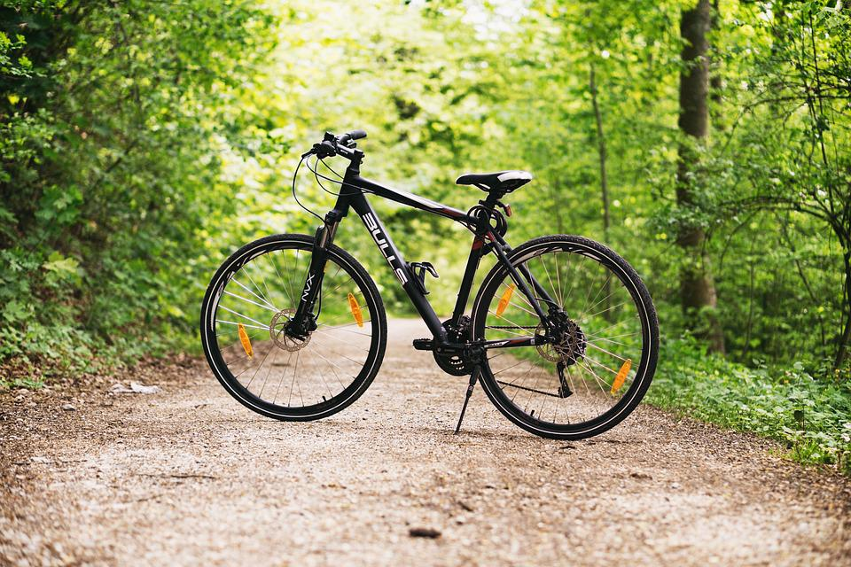
mean of transport for each country
We choose to talk about bikes, because we think it’s the best ecological means of transport.

Slide 3
selected data
We selected some datas like:
-distance
-speed
-energy spent
-pollution
-noise
-mass
-size of wheel
-brand of the bike
-model

Slide 4
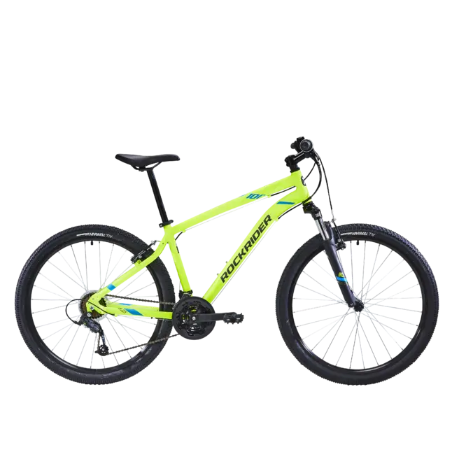
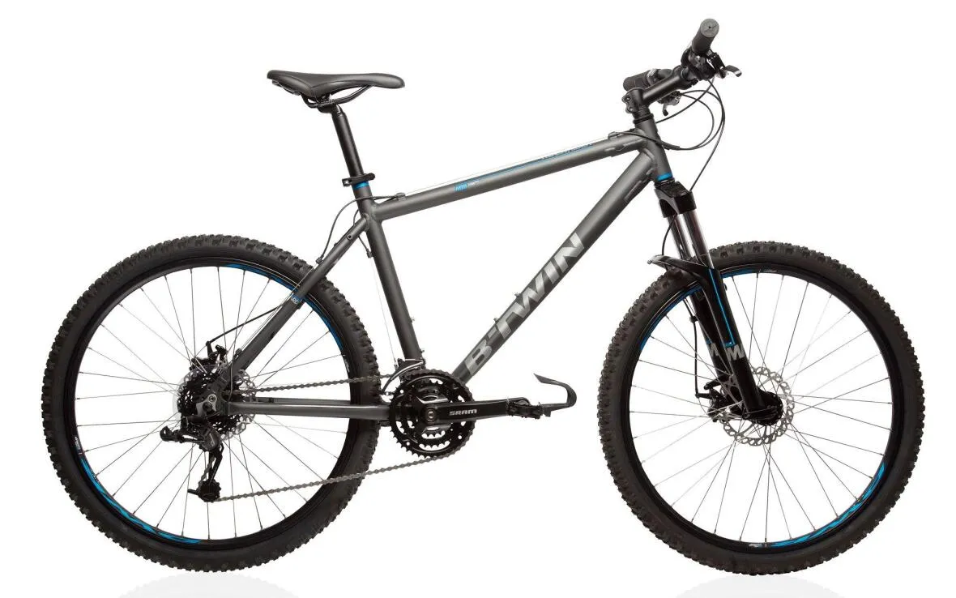
the French bikes
Valentin’s bike the rockrider ST100:
Laurelyne’s bike the rockrider 500:

Slide 5
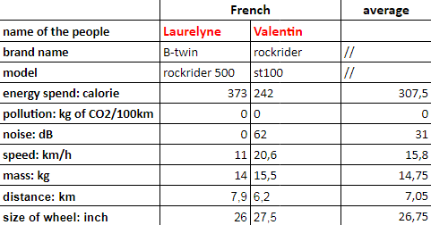
French’s datas

Slide 6
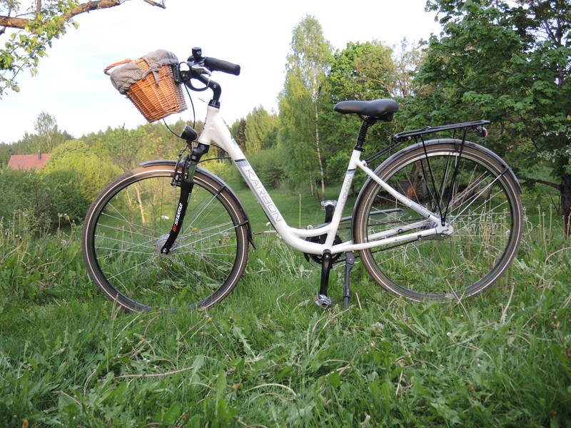
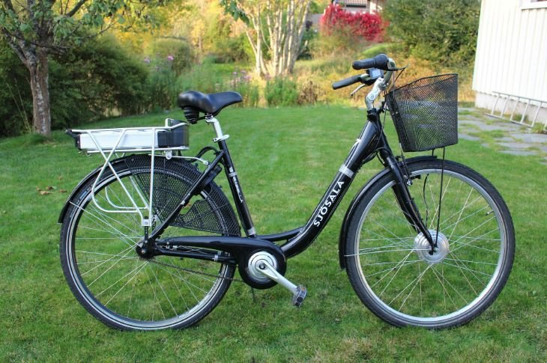
Lithuanian
Student name | Brand name | Pollution spend | Noise spend | Energy spend | Distance | Time of itinerary | Speed | Weight of the bike
Eimantė | Karbon | 0 | 0 | 189 kcal | 5 km | 30 min | 10 km/h | 13 kg
Rugilė | Sjosala | 0 | 0 | 58 kcal | 1,5 km | 10 min | 11 km/h | 13,5 kg
Size of wheel
66,3 cm
67,3 cm

Slide 7
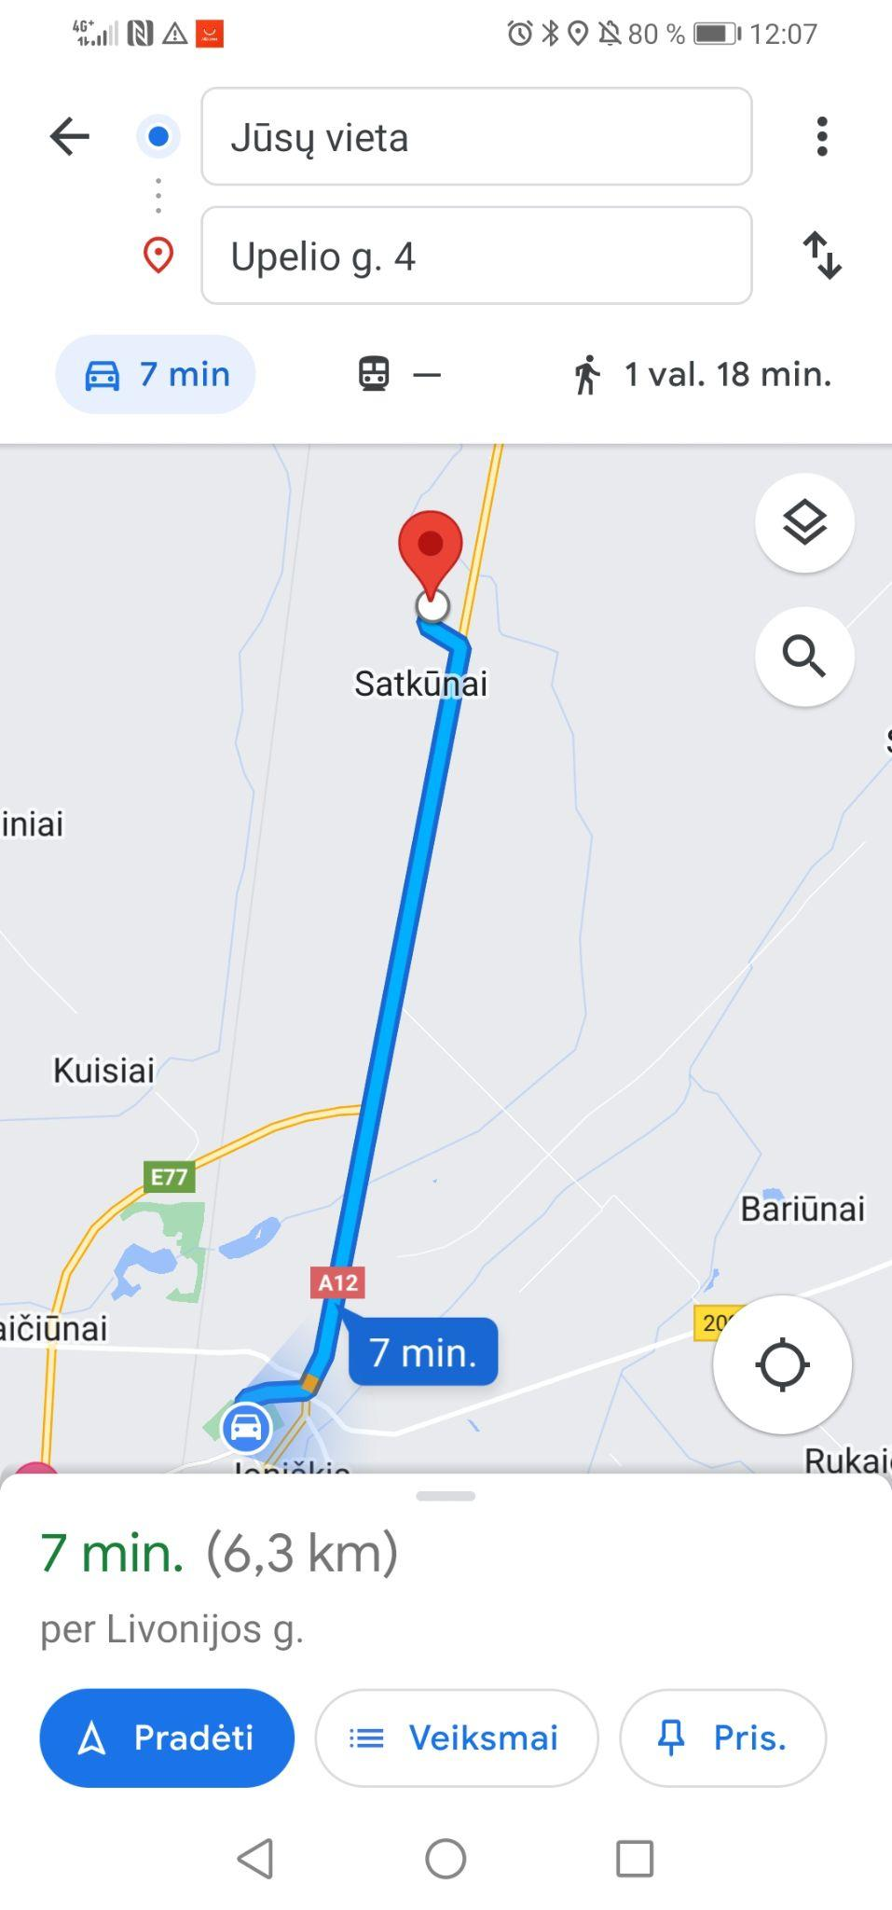

Slide 8
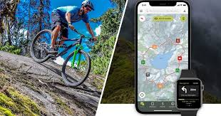
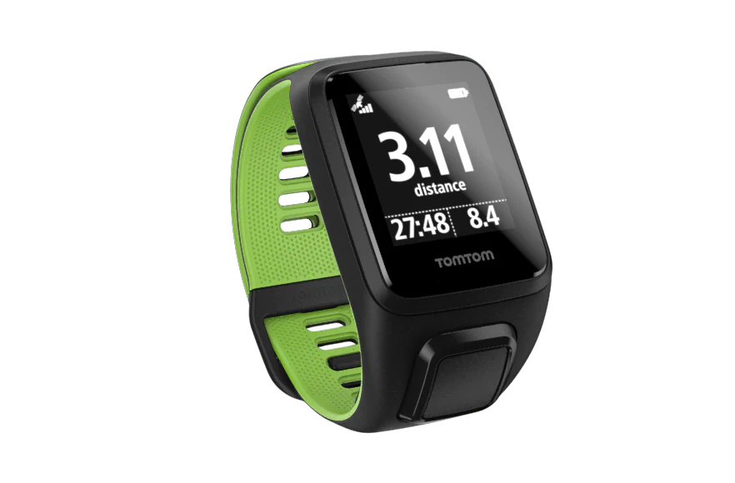
Energy spend
Valentin spend 242 calories. One liter of milk is 586 cal.So, to be able to calculate how many sugar he spend we need to divide its calorie expenditure by the calories in a liter of milk:
equivalent milk spend by Valentin : (242*1)/586 = 0.41 L
equivalent milk spend by Laurelyne :(373*1)/586 = 0.63 L
How do you get this measurement ? (picture )
This measurement was done with an app for Valentin and a watch for Laurelyne.

Slide 9
Energy spend
Energy is expressed in calories ..
what can you say about “calories” ?
Calories are an old unit of energy. One calorie is the quantity of energy needed to add one degree celsius to one gram of liquid water.
how many calories do we need per day?
A women spend 2200 cal in a day and a men 2700 cal per day.
What do we do with all these calories?
The calories we burn allow our bodies to function by making our organs work.

Slide 10
Energy spend
how many calories brings 100 cL of milk ?
100cL of milk bring 58.6 cal.
so how many liters do you need to go from home to school ? ( explain your calculation)
Laurelyne: calorie spend by 1km : 373/7.9 = 47.2 cal
distance between home and school : 0.45km
calorie spend between home to school : 0.45*47.2 =21.24
liter of milk spend: 21.24/586 = 0,036L

Slide 11
Power
which is the link between power and energy ?
how do you calculate power from energy you have measured ?
The power of a bicycle is measured in Watt, to calculate the power emitted during the ride, the following formula required is :
E(j)= P(w)*T(s)
P(w) = E(j)/T(s)
1 cal = 4.184j
1 min = 60 sec
So, the power of Laurelyne during her ride is :
P= (373*4.184)/ (43*60)
P= 0.605 W

Slide 12
Pollution
what kind of pollution do you create ?
Bike don’t create pollution during the use. The only one moment it create pollution is during the production. The production of one bike create 100kg of carbon dioxyde.
can you calculate it ?
I can’t calculate it, I find the information on Internet.
compare your result with a man who only walk??
A man who only walk don’t pollue. But it’s less polluting because there are not carbon dioxyde of the production.

Slide 13
Consumption
what do you need as a gas to drive a bike ?
we need O2 and C6H12O6 to ride a bike fore the organisme who create a chemical reaction who produce CO2 and H2O with this equation :
which volume do you need ?
The medium frequency of breath is about 30 breathing per minute during exertionand the volume of the breath is about 0.5 L so:
0.5*30=15
we need 15L of O2 and C6H12O6 in 1 minute.
compare with someone who only walk …

Slide 14
wheel….
which is the perimeter of you wheel ? (explain your calculation)
A wheel is a circle. The perimeter of a circle is 2*pi*R.
So, the wheel of Laurelyne :
2*pi*R
= 2*pi*33
= 207.3 cm
= 2.073 m

Slide 15
Wheel…
how many times do your wheel turn to travel one km ?
1km= 1000m
So, to travel 1km, Laurelyne wheel turn :
1000/2.073= 482.4 times
any differences between the front and the rear wheel?
The rear wheel need to be more rigid because it is the drive wheel, so it receives a lot of power compared to the front wheel.

Slide 16
Energy and Carbohydrates
To talk about energy that we spend when we ride means to know how much carbohydrates we consume. According to a study published byHarvard Health Publications, a 60kg personcycling at around 20km / h burns around 240calories every 30 minutes. In addition, to keepfit it's necessary to ride two or three times aweek, for 45 or 50 minutes.keep fit

Slide 17
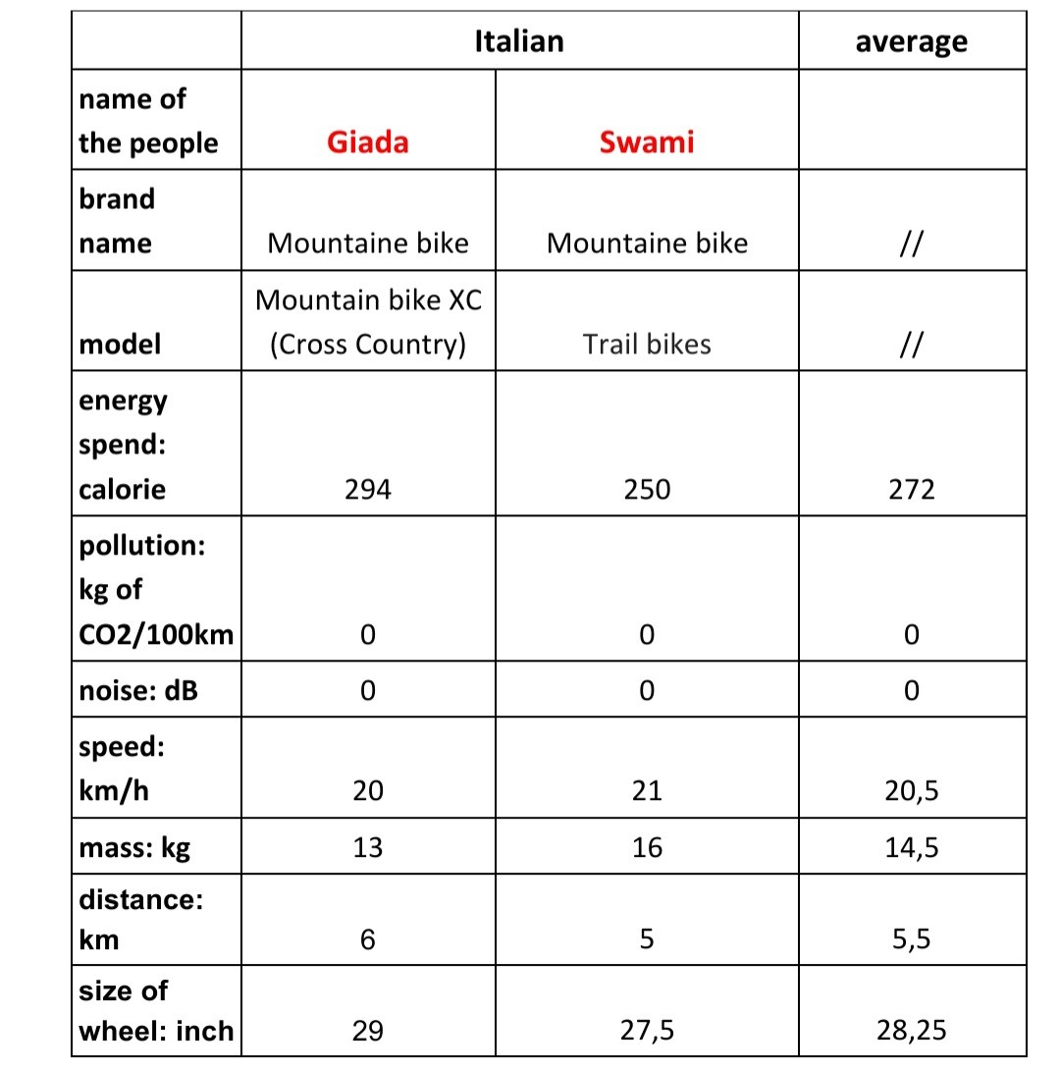
Italian’s datas

Slide 18
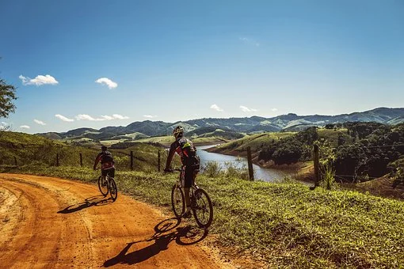
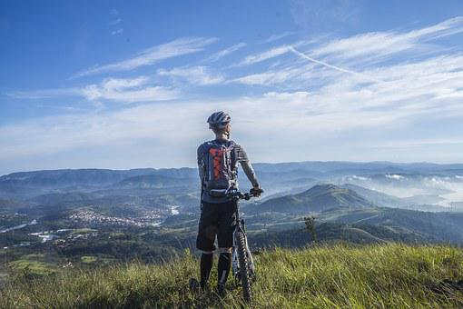
Energy and Carbohydrates….
… about Giada and Swami
Giada
Energy spend: 294
Swami
Energy spend: 250

Slide 19
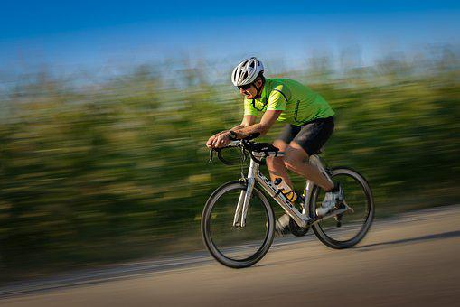
Speed….
… of Giada and Swami
Swami
speed: 21 km/h
Giada
speed: 20 km/h

Slide 20
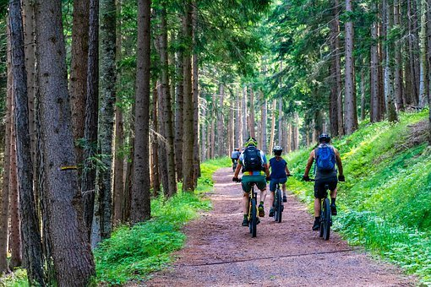
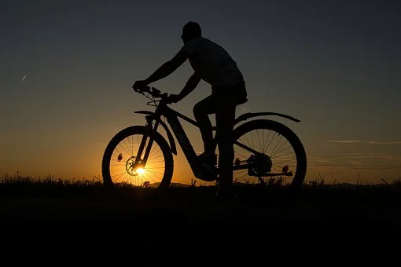
Mass and size of wheel….
… of Giada and Swami’s bikes
Swami
Mass: 15 kg
Size of wheels: 27,5 inch
Giada
Mass: 13 kg
Size of wheel: 29 inch

Slide 21
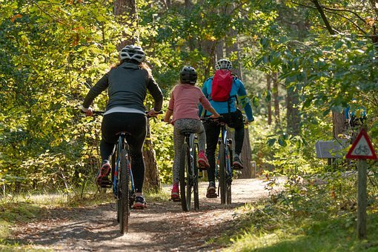
Distance traveled….
… of Giada and Swami
Swami
Distance: 5 km
Giada
Distance: 6 km

Slide 22
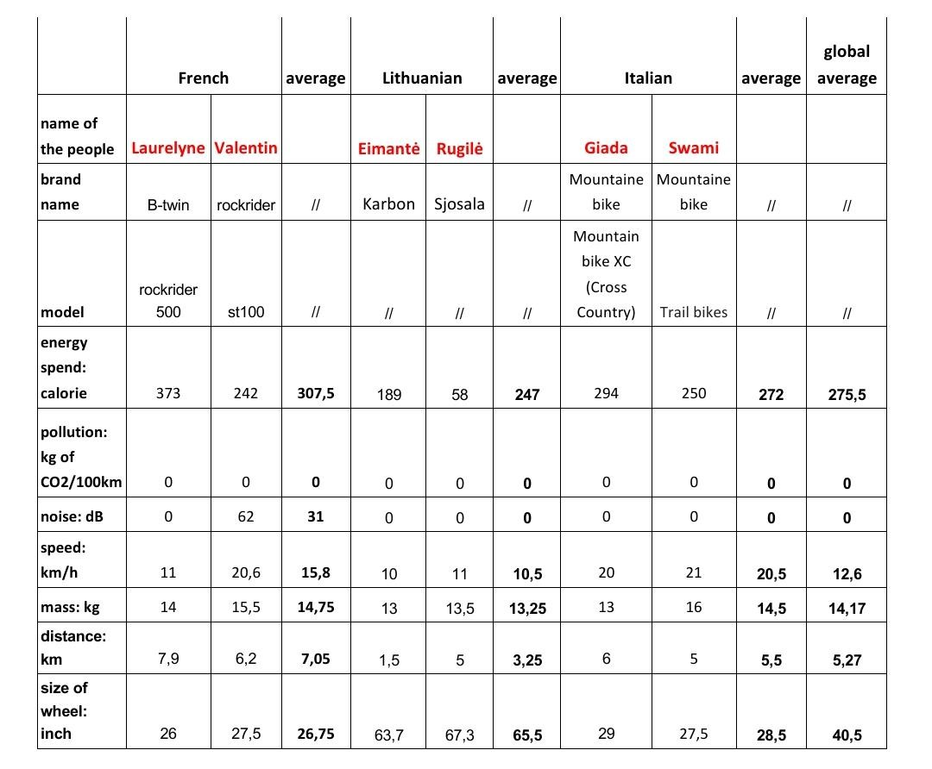
average of data and how we calculate it

Slide 23
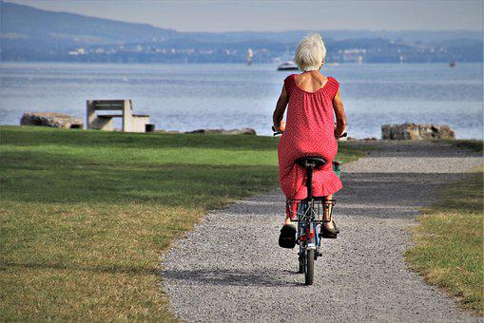
which is the beast mean of transport to go to school?
The bike is a perfect means of transport if you want move from a place to another without polluting the environment; so it’s perfect to go to school !!

Slide 24
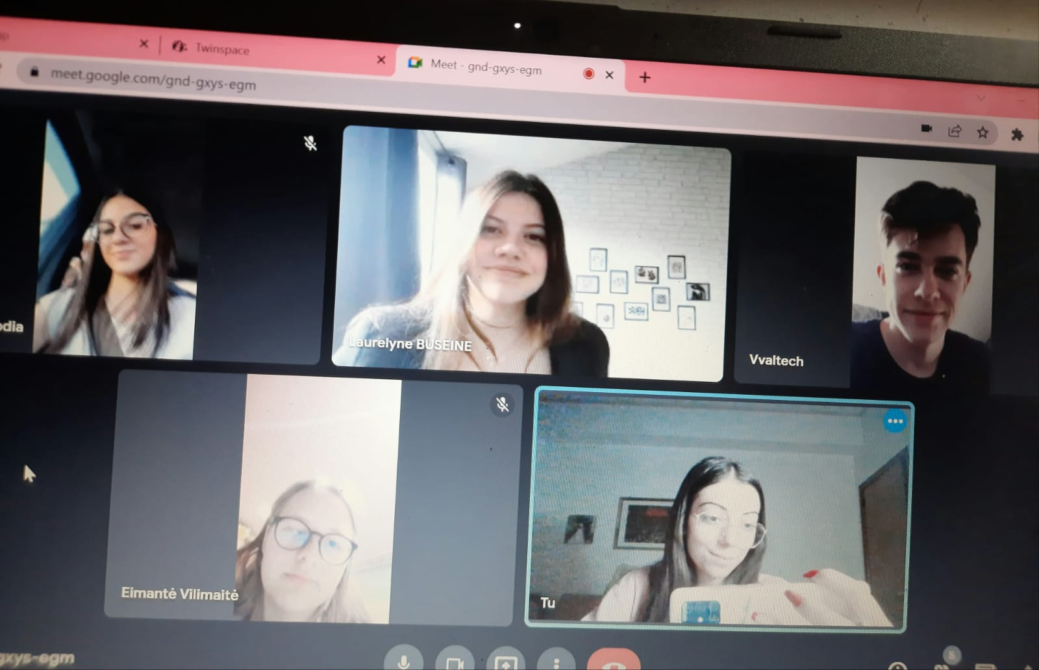
picture of a meeting
21/05/2022

Slide 25
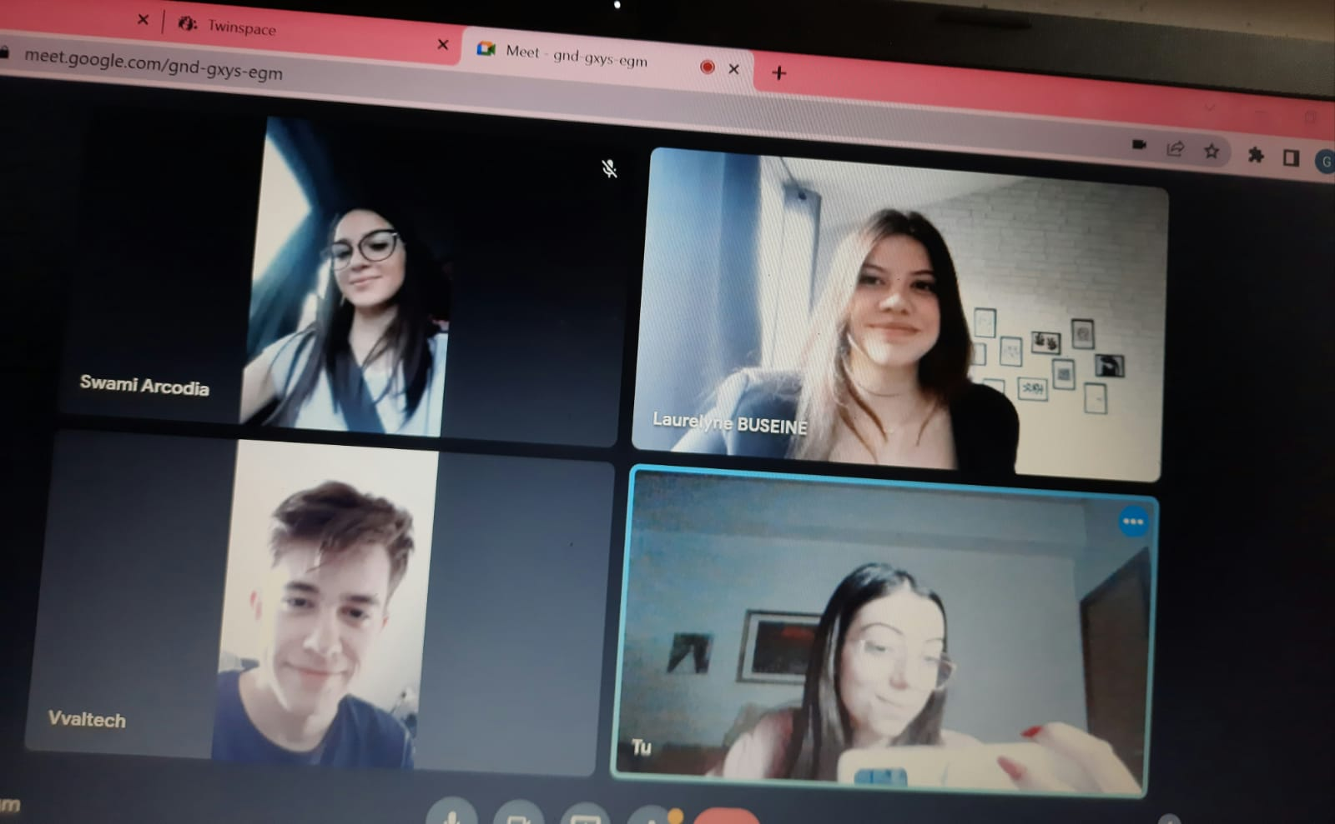
picture of a meeting
21/05/2022

Slide 26
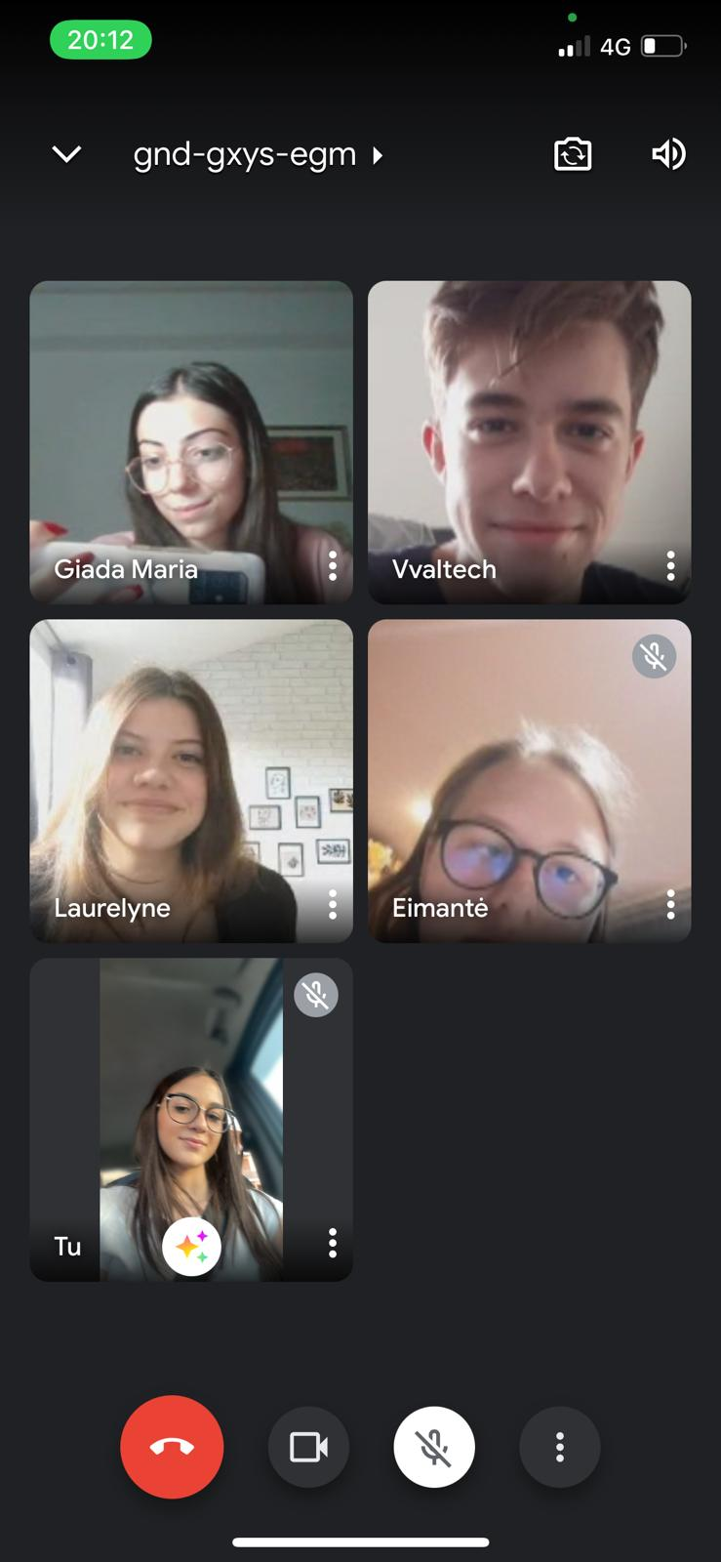
picture of a meeting
21/05/2022

