Slide 1
Cities in Latvia

Slide 2
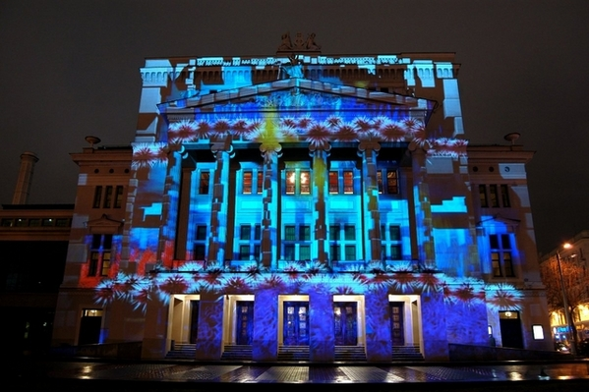
Riga

Slide 3
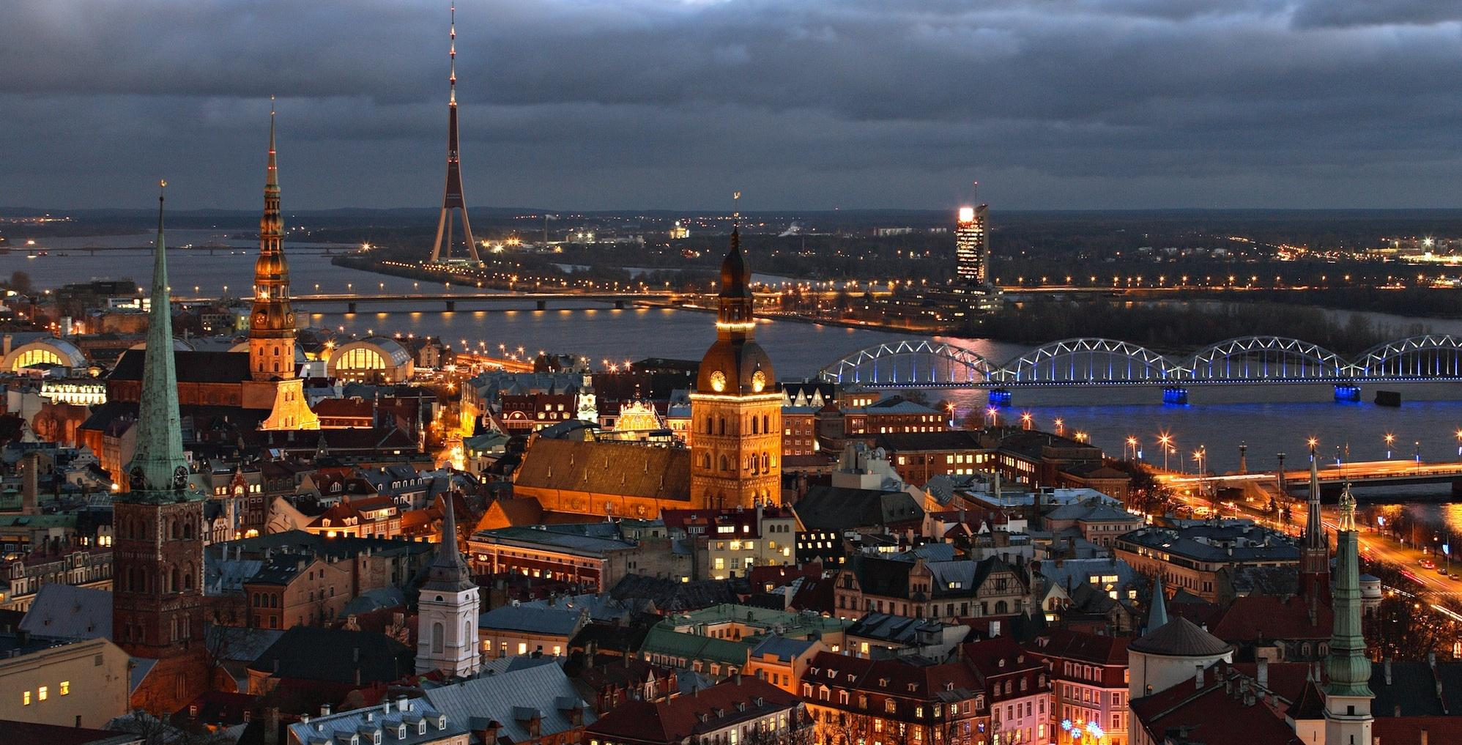

Slide 4
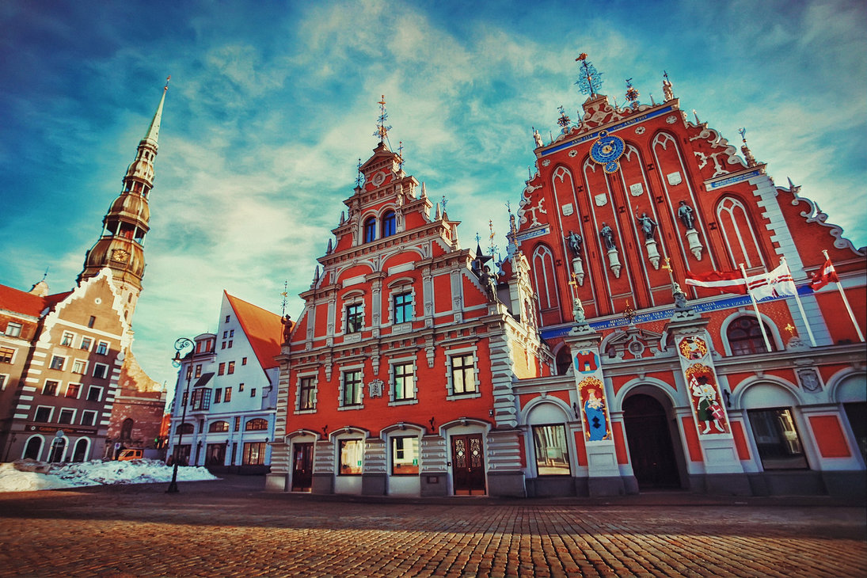

Slide 5
Facts about Riga
Riga is the capital and largest city in Latvia.
In 2015 , there lived 696,593 people.
Riga was founded in 1201.
Riga’s historical center is a UNESCO World Heritage Site.
Riga has the largest airport in the Baltic states.

Slide 6
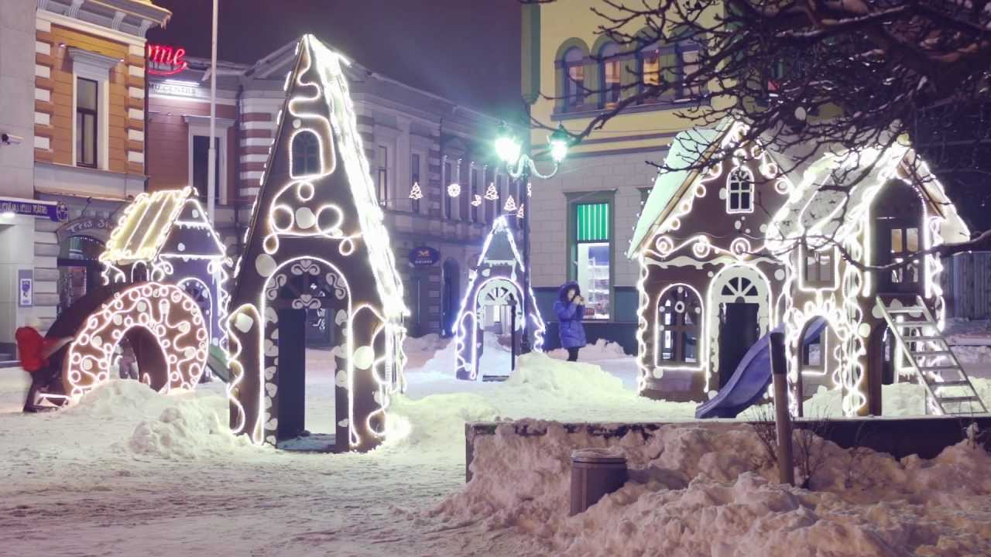
Liepaja

Slide 7
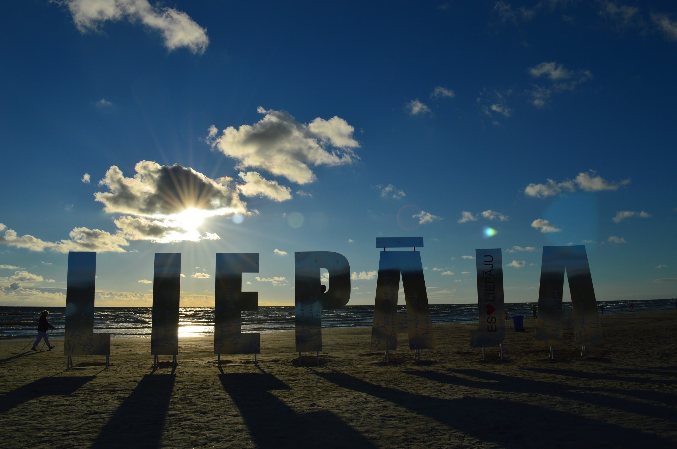

Slide 8
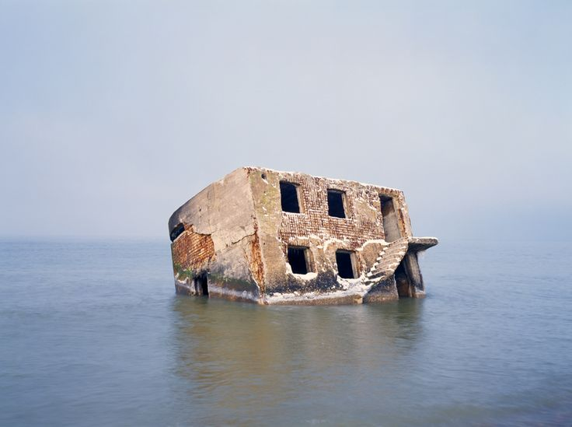

Slide 9
Facts about Liepaja
Is a city located Baltic sea.
It is a largest city of Kurzeme region.
Liepaja is known throughout Latvia as “ City where the wind is born “
With the population of 82,386 people.

Slide 10
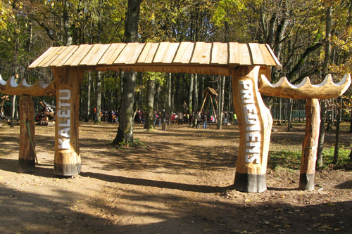
Kalēti

Slide 11
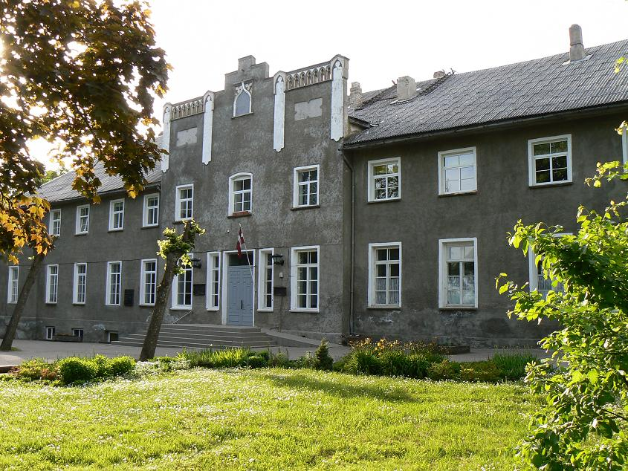

Slide 12
Facts about Klaēti
Kalēti was founded in 1264.
The next year our school will celebrate 135 years.
Kalēti primary school is the largest school in our, Priekules district.
In our schools left wing is located music and art school.

