Slide 1
Slow Food
Living euorpe, encoutaging the regions

Slide 2
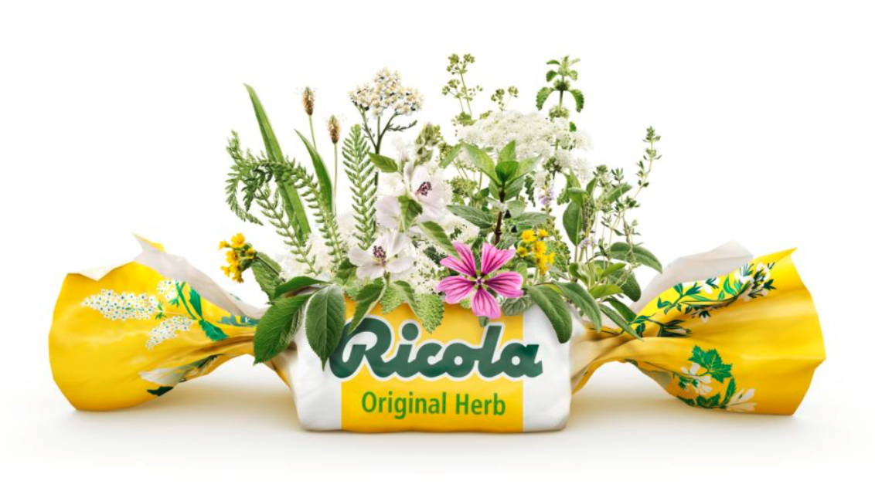
Ricola
Teacher: Mrs. Tauber Subject: project management
Anna Hufnagel, 14FA1, 20.04.2021

Slide 3
Structure
General
History
Herbs
Baseline
Production/Cultivation
Products
Video
Sources

Slide 4
General
Swiss family business
Founded in 1940
Make herbal specialities
More than 100 companies work for Ricola
Dried, washed, cut, mixed and stored 1.4 million tonnes of fresh herbs per year

Slide 5
History
Company founder: Emil Richterich was master baker Interested in herbs for a long time
He starts experimenting
--> with so much herbal power, something has to be done "
1940 (founding year): First mixture for the now world-famous Ricola herbal sugar

Slide 6
Herbs
Mixtures of 13 medicinal herbs
Elder | Burnet
Horehound | Yarrow
Mallow | Sumpfmalve
Peppermint | Women's coat
Sage | Speedwell
Thyme | Veronica
Cowslip

Slide 7
Baseline
Love for nature & protection of nature
Only natural ingredients
Organic cultivation - no use of pesticides or chemical fertilisers
Low environmental impact from herb centre

Slide 8
Production/Cultivation
Cultivation of herbs in the Schweitzer Mountains
Pay attention to individual needs of herbs
Climate, location and soil condition
Growing areas far away from industry & transport - Protection of herbs
Caring for farmers
Years of contracts – long-term protection of their work
Handicraft by farmers - Promoting biodiversity
Regular field changes → increases the fertility of the soil

Slide 9
Products
Sweets in 12 different flavors
5 varieties of soluble and instant tea
New range of functional candies introduced since 2019
Feeling of freedom of the respiratory tract

Slide 10
Video
https://www.youtube.com/watch?v=yguTH_kOw1M

Slide 11
Sources
https://terramadresalonedelgusto.com/en/scheda_espositore/ricola/

