Slide 1
LAS LORAS GEOPARK CULTURAL HERITAGE
Notes:
Today we are going to make a presentation about the culture in Las Loras. Before starting, we would like to say that we are all really happy because now we can actually say “Las Loras” geopark. It was only last May that our territory, Las Loras, was declared a geopark, which was really good news for us.

Slide 2
LAS LORAS GEOPARK
ORIGIN OF LAS LORAS GEOPARK
POPULATION
A LITTLE BIT OF HISTORY
STORIES
TIME OUT IN LAS LORAS
Notes:
We are going to divide the presentation in different parts: the origin of the geopark, its population, we will tell you a little bit of history related to art in this territory, we will tell you a story about Las Loras and we will also show you what you can do in our geopark. We will talk about tourism, food, music and traditions.

Slide 3
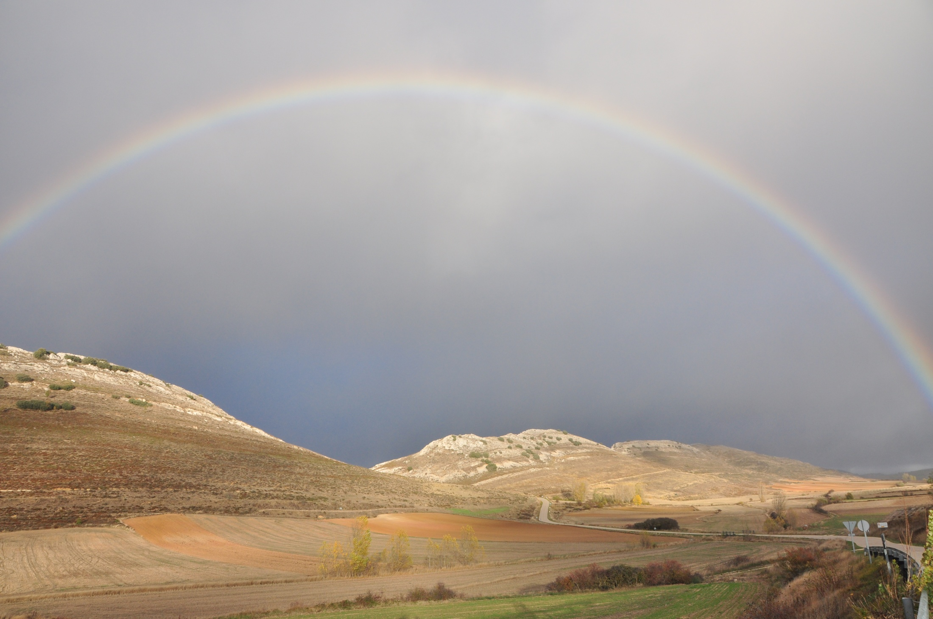
The origin of
LAS LORAS GEOPARK
Notes:
Hello! I am Arturo and I am going to talk to you about the origin of Las Loras Geopark

Slide 4
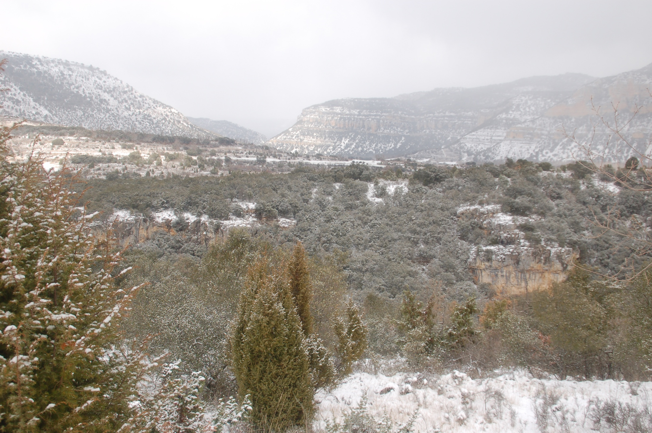
How did this project start?
It started thanks to two asociations and a local council of 3 municipalities
Supported by the Local Action Group Romanesque Country

Slide 5
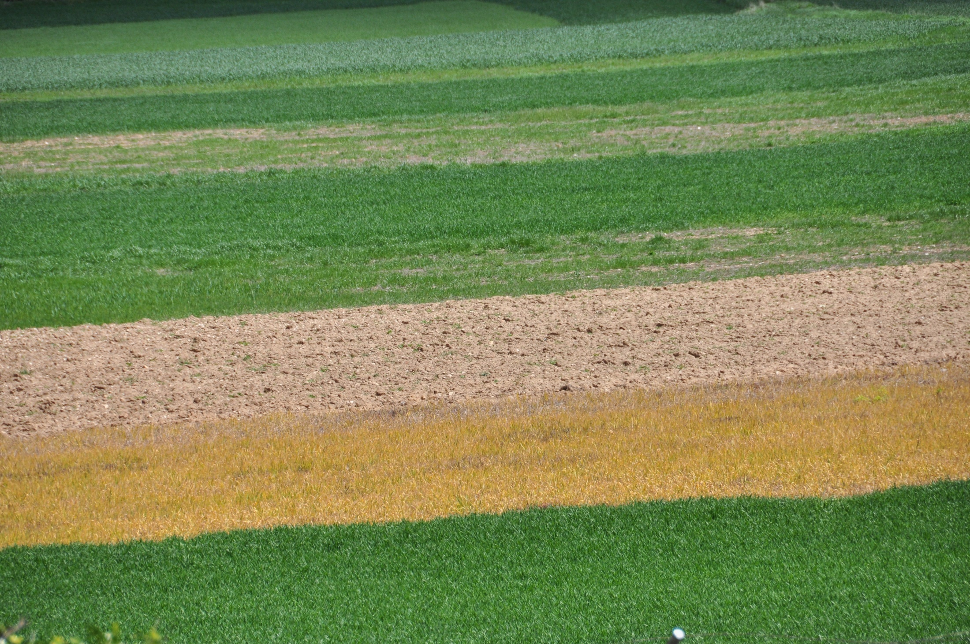
This is a special project
The inhabitants of the villages
UNESCO

Slide 6
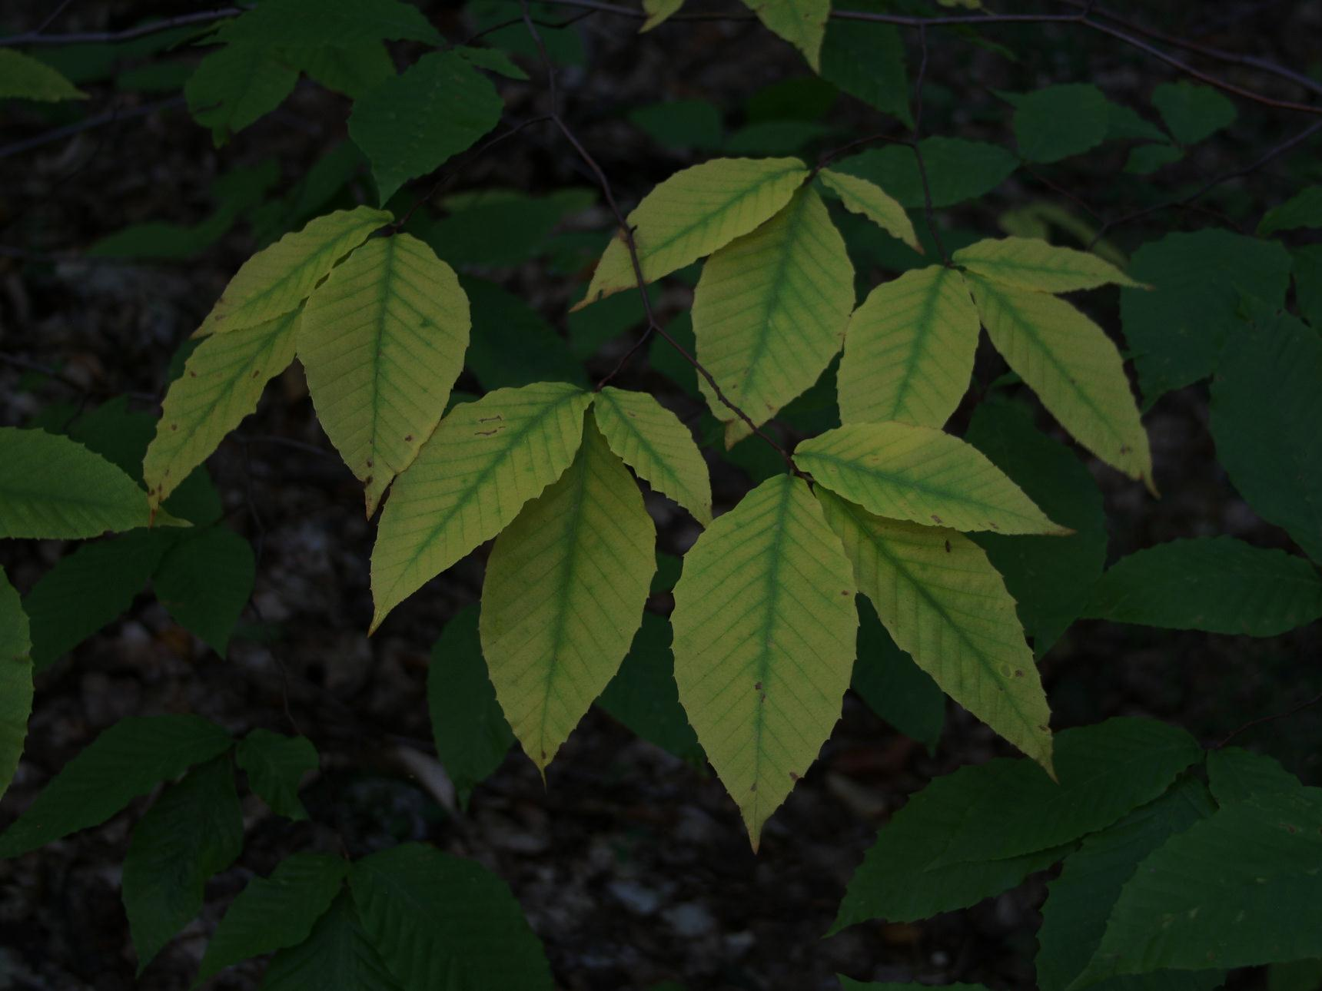
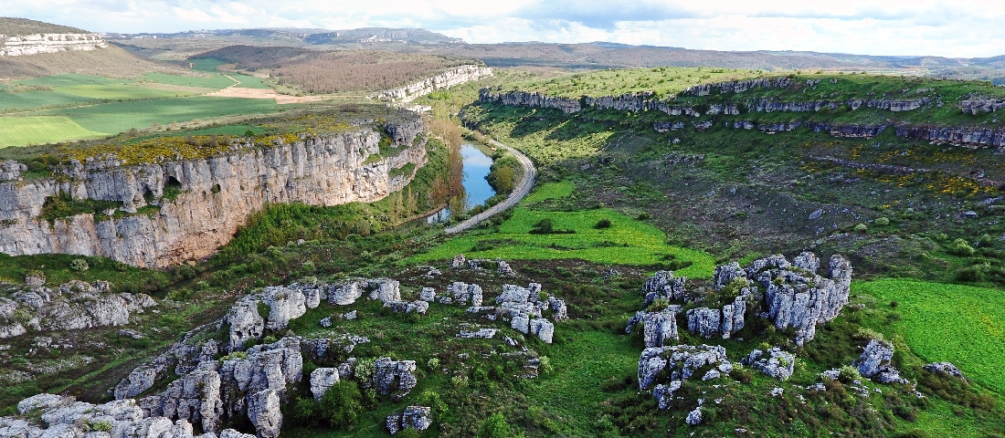
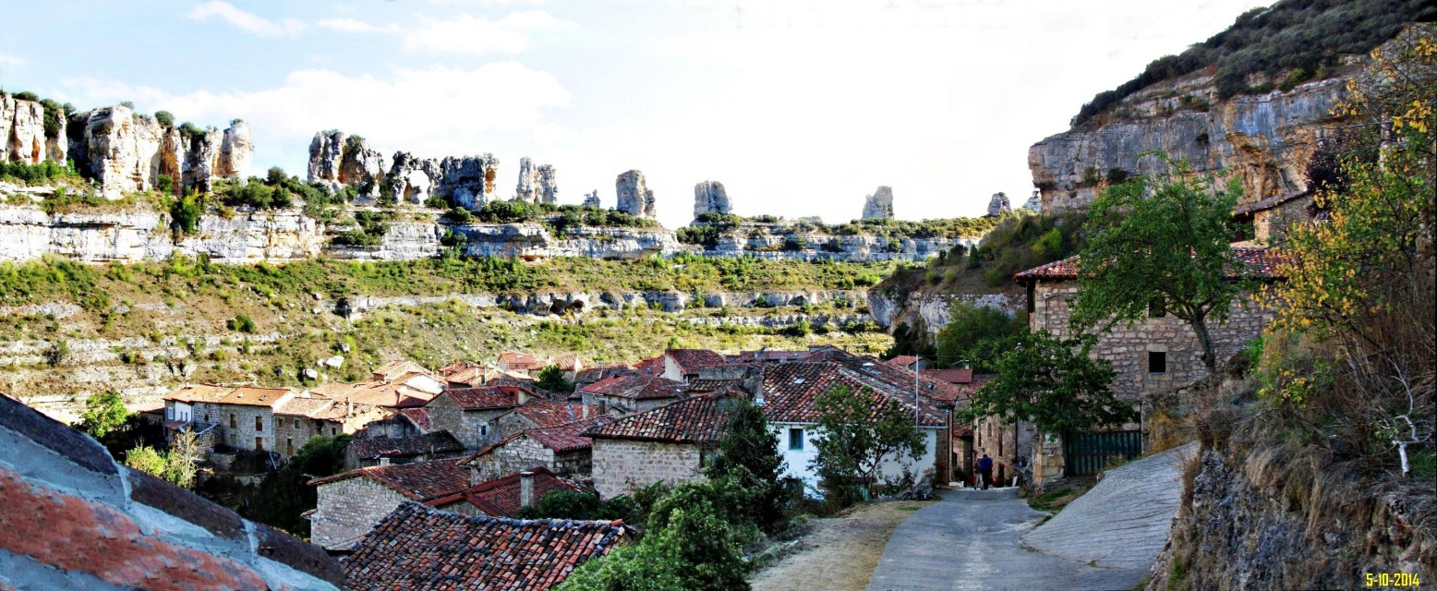
The main aim:
Preserve the area of “Las Loras”
Without harming the life of its inhabitants

Slide 7
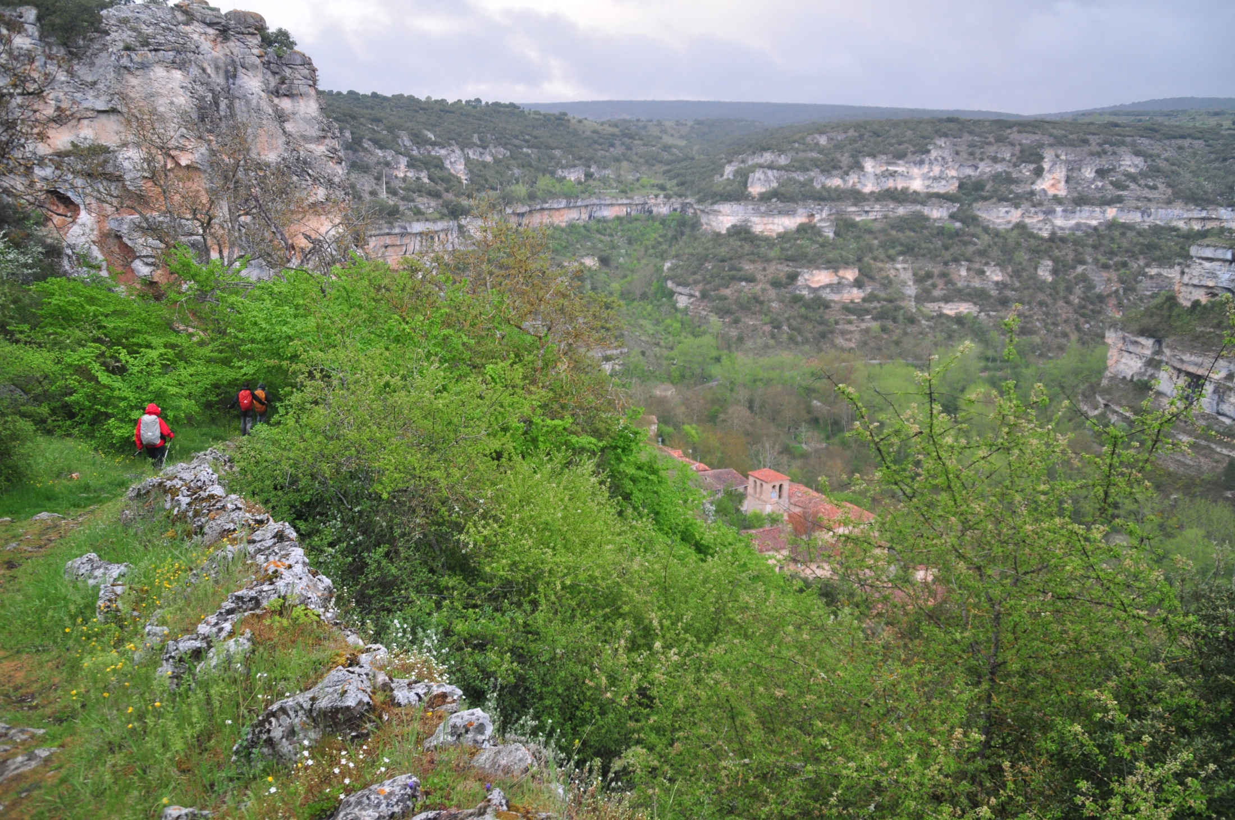
2006
ARGEOL
Asociación para la Reserva Geológica de Las Loras
Association for the Geological Reserve of Las Loras
Gives legal and leadership support to this project.

Slide 8
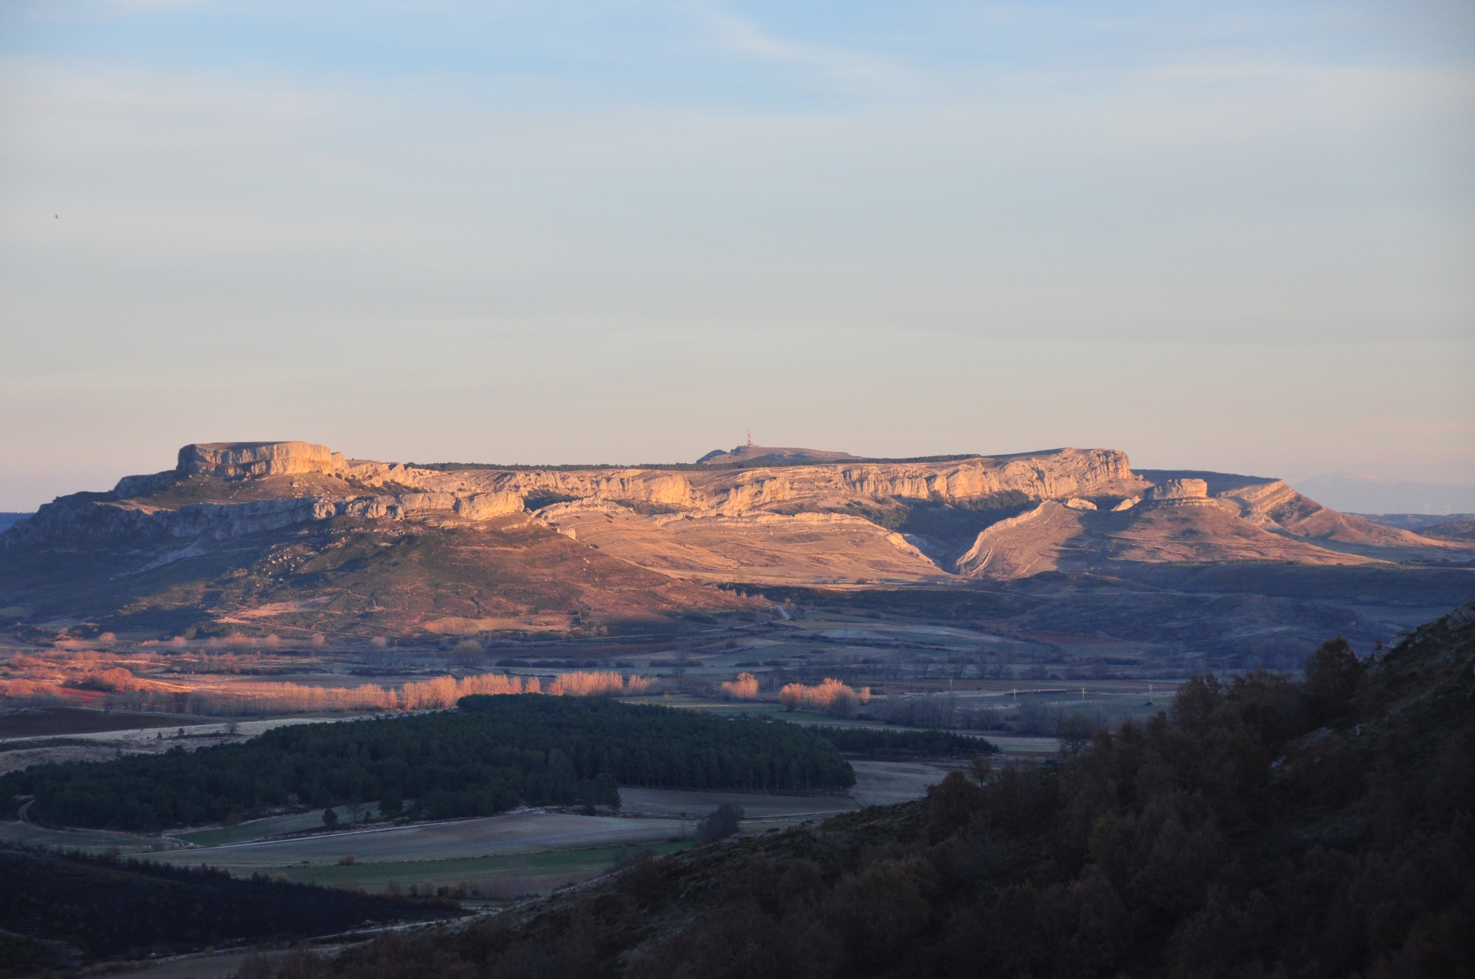
WORKING TOGETHER
Local Action Groups
Provincial Councils of Burgos and Palencia
Universities of Valladolid and Burgos.
Creation of the Scientific Committee
Collaboration with local companies and associations
Notes:
To improve the stability of the project, they have signed treaties and created groups to popularize the geopark:

Slide 9
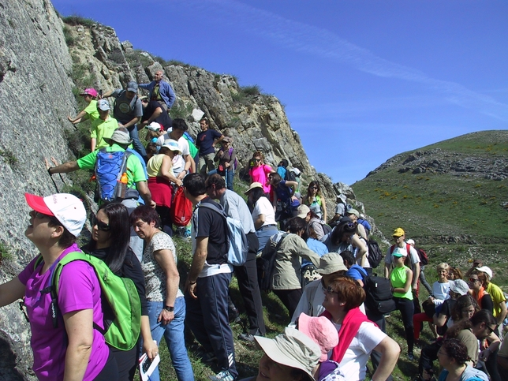
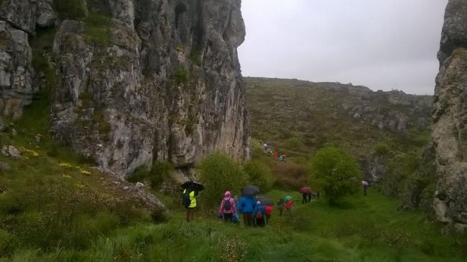
ACTIVITIES
Different activities like: volunteer days, environmental education programmes, geological week, lectures, landscape workshops…
The creation of the volunteers group -“Amigos del Proyecto Geoparque Las Loras”

Slide 10
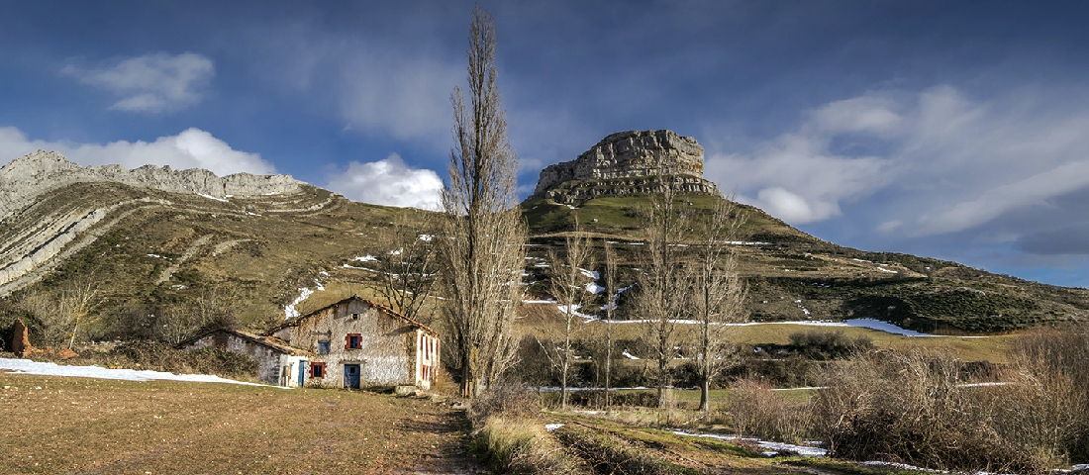
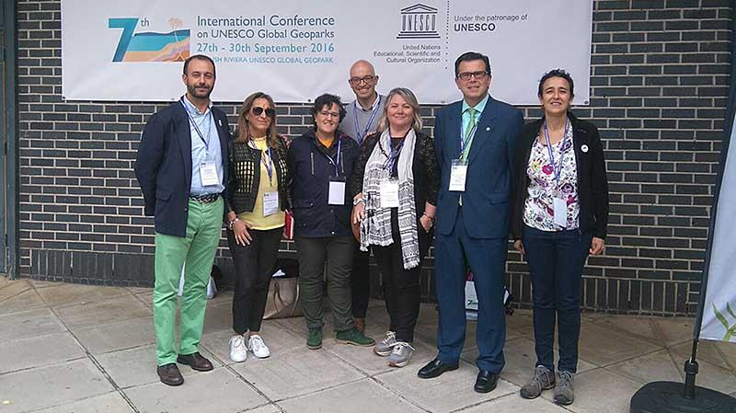
2017: Las Loras Geopark becomes a reality

Slide 11
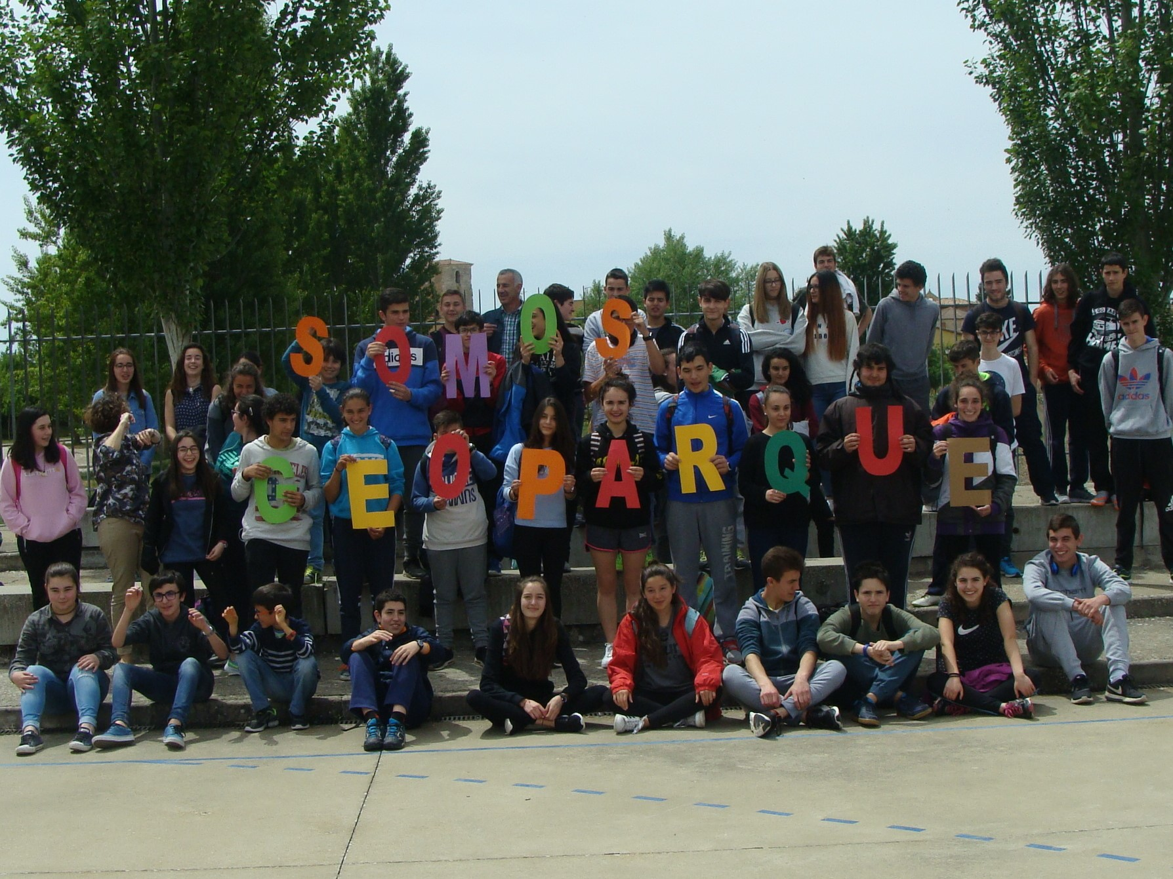
Campos de Amaya Secondary School celebrating the declaration of Las Loras as a geopark

