Slide 1
TIPS & ADVICES FOR SOCIAL MEDIAS:

Slide 2
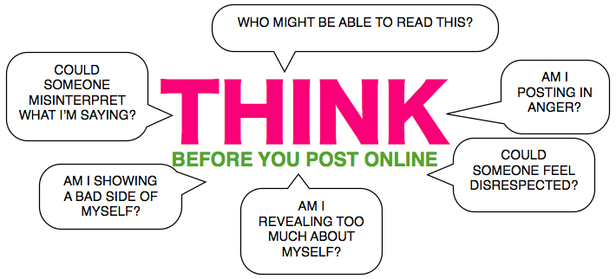
BE CAREFUL ABOUT WHAT YOU ARE POSTING
Maybe, you’ll hurt other peoples feelings, even though you didn’t mean to!

Slide 3
DON`T WRITE SOMETHING TO SOMEONE IF YOU CANT SAY IT FACE TO FACE
Bullying is way much easier on social media, than doing it face to face!

Slide 4
DON`T BE FRIENDS WITH PEOPLE YOU DON`T KNOW
You’re never sure who’s behind the screen!

Slide 5
BE CAREFUL WITH NAKED PHOTOS
Sharing nudes of other people are illegal!

Slide 6
DON`T SHARE PASSWORDS
People can use it for the bad – even though it’s your friend!

Slide 7
BE NICE & KIND
Then you won’t hurt anyones feelings, and you’ll make other people happy!

Slide 8
IF SOMETHING BAD HAPPENS, TELL SOMEONE ABOUT IT
When telling someone what is wrong, you do something about it – also if it didn’t happen to you, but a friend!

Slide 9
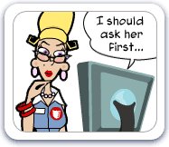
ASK BEFORE POSTING PICTURES OF OTHERS
It’s illegal to post pictures without their permission – asking before posting dosn’t take much time;)!

