Slide 1
My village Dzimierz
Ola from Pstrążna

Slide 2
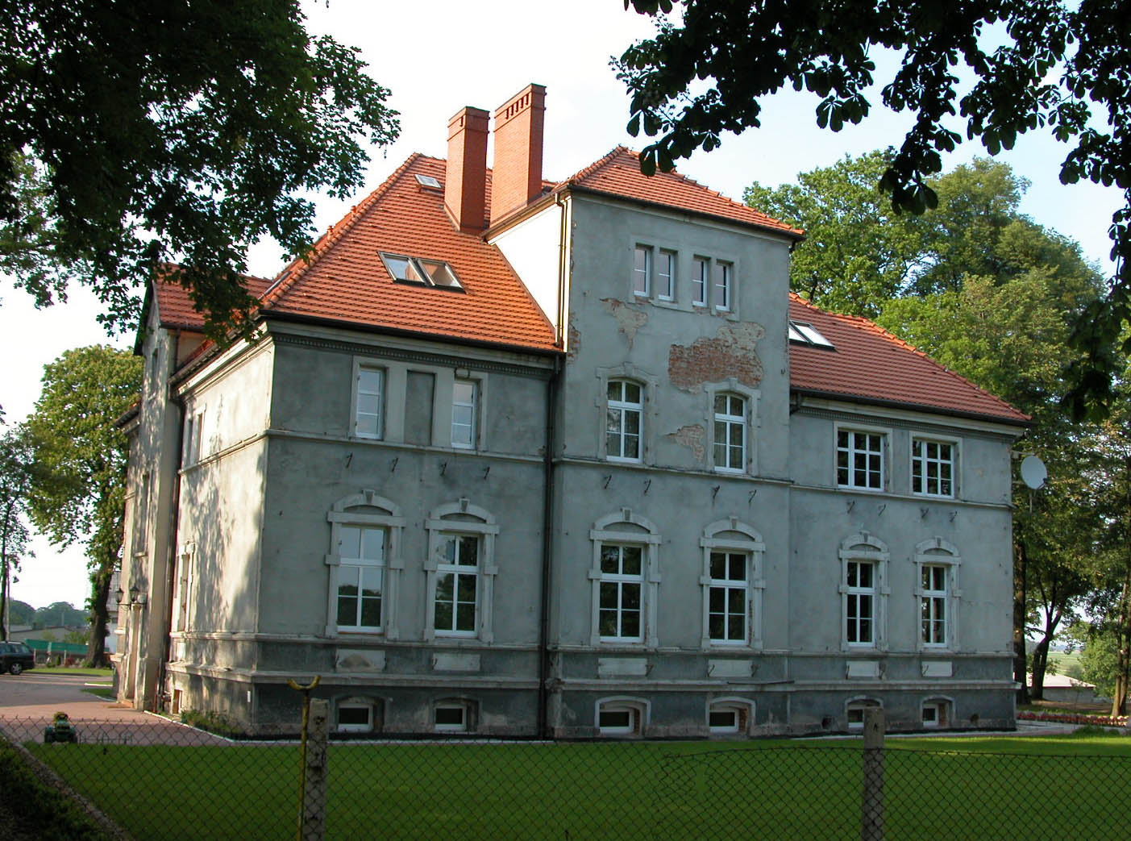
Our palace in Dzimierz

Slide 3
Our crest

Slide 4
My favourite shop in Dzimierz

Slide 5
Our chapel in Dzimierz

Slide 6
Our playing field

Slide 7
THE END

