Slide 1
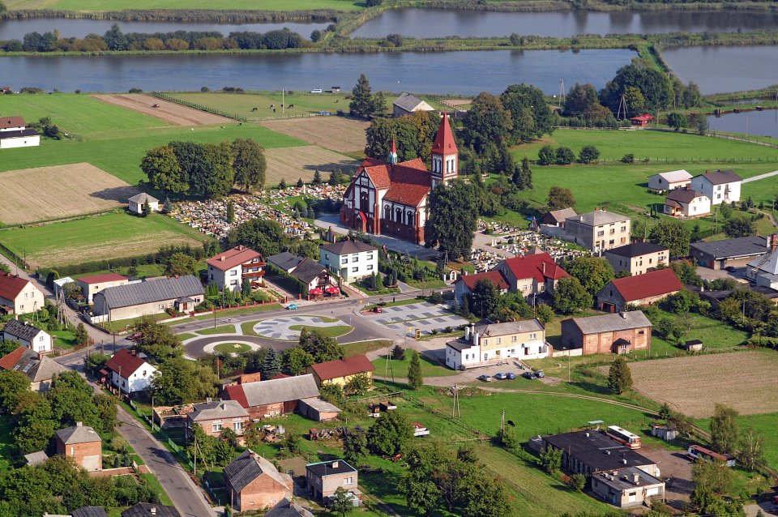
Pstrążna
Anna Waliczek

Slide 2
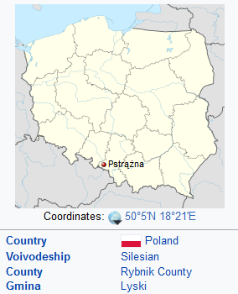
Pstrążna – is a small village in Poland.

Slide 3
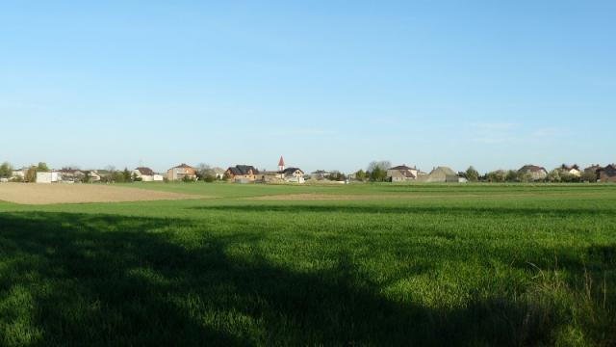
Pstrążna is located near Dzimierz

Slide 4
The name Pstrążna means the place of trout in the Suminka River

Slide 5
Our herb presents a fisherman on a blue background, carrying two buckets

Slide 6
Saint Nicholas’ Church

Slide 7
Near the church there is a fish farm

Slide 8
There is also a primary school and our kindergarten there.

Slide 9
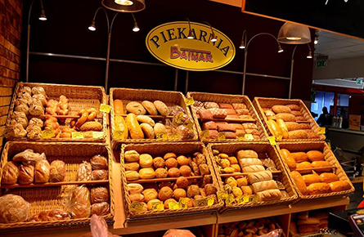
In Pstrążna there are two grocery stores and our bakery

Slide 10
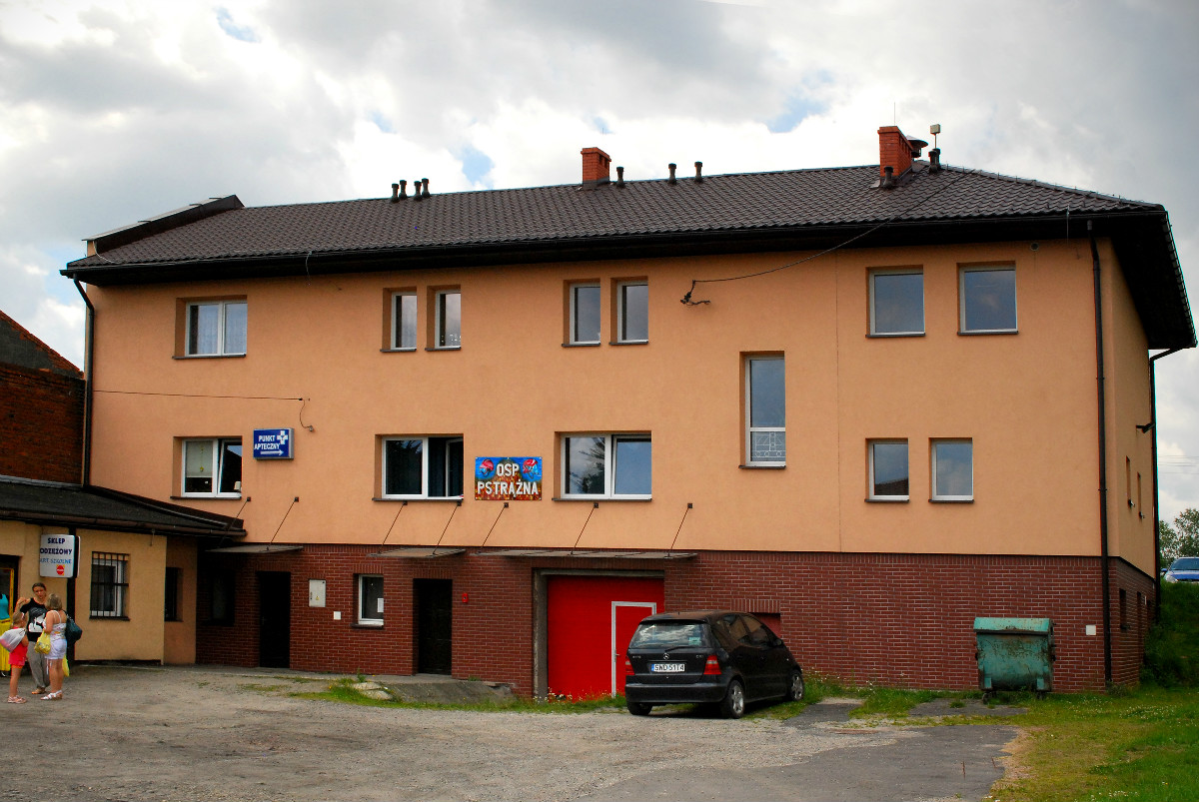
Near the church there is a fire station

Slide 11
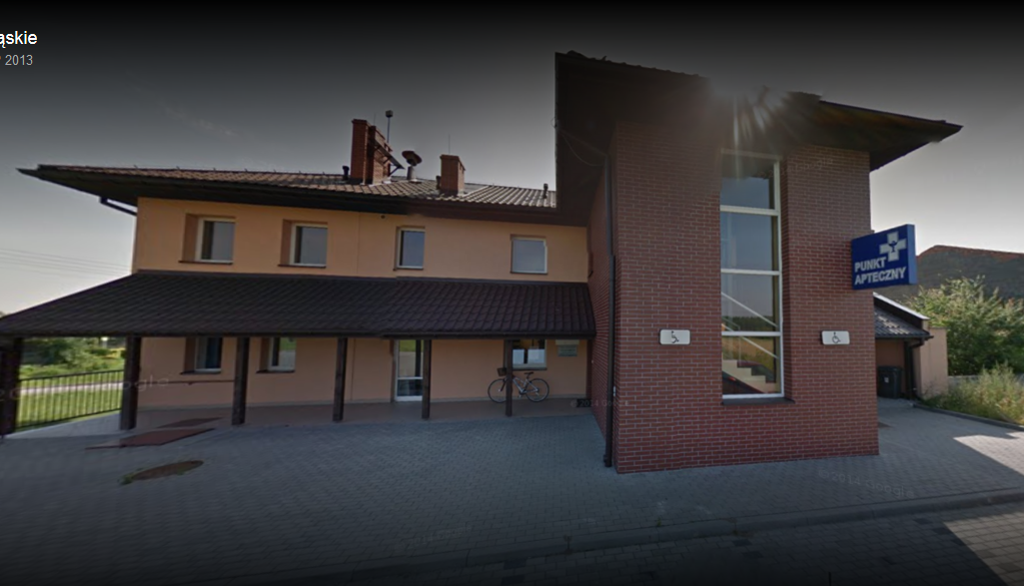
Next to the fire station our health centre is located

Slide 12
There are a lot of woods where you can spend your leisure time walking

Slide 13
In front of the forest there is a restaurant, where food is delicious

Slide 14
The End

