Slide 1
My favourite days are Saturday and Monday.
My day
Ola

Slide 2
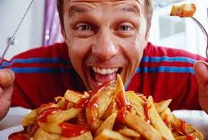
I get up at seven o’clock in the morning.

Slide 3
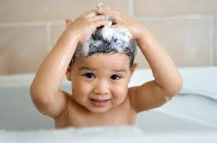
I have a shower.

Slide 4
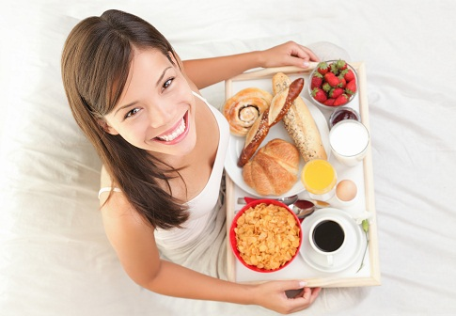
I have breakfast at five past seven.

Slide 5
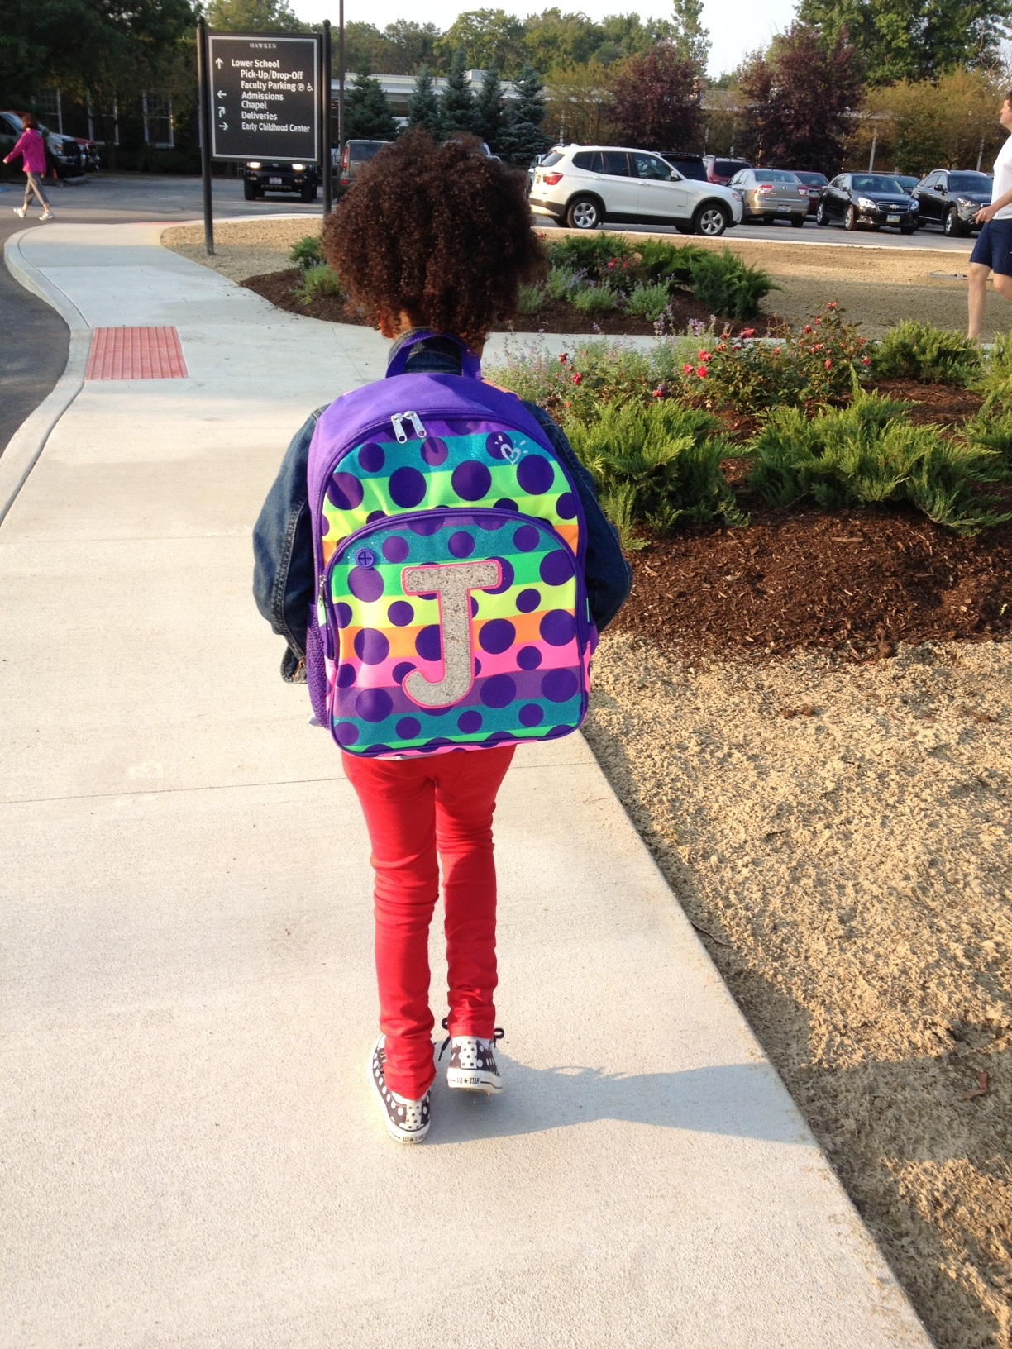
I go to school at seven thirty.

Slide 6
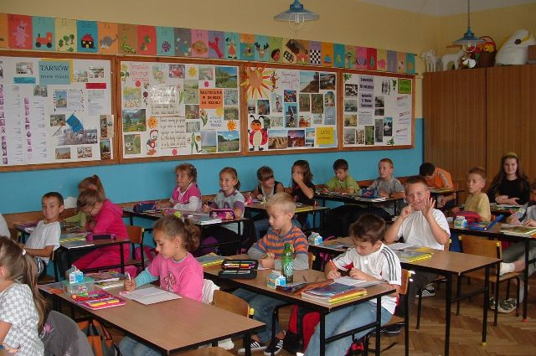
My lessons start at 8 o’clock.

Slide 7
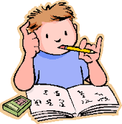
I study hard.

Slide 8
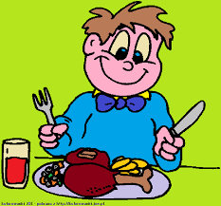
I have lunch at 12 o’clock.

Slide 9
My lessons finish at twelve twenty- five.

Slide 10
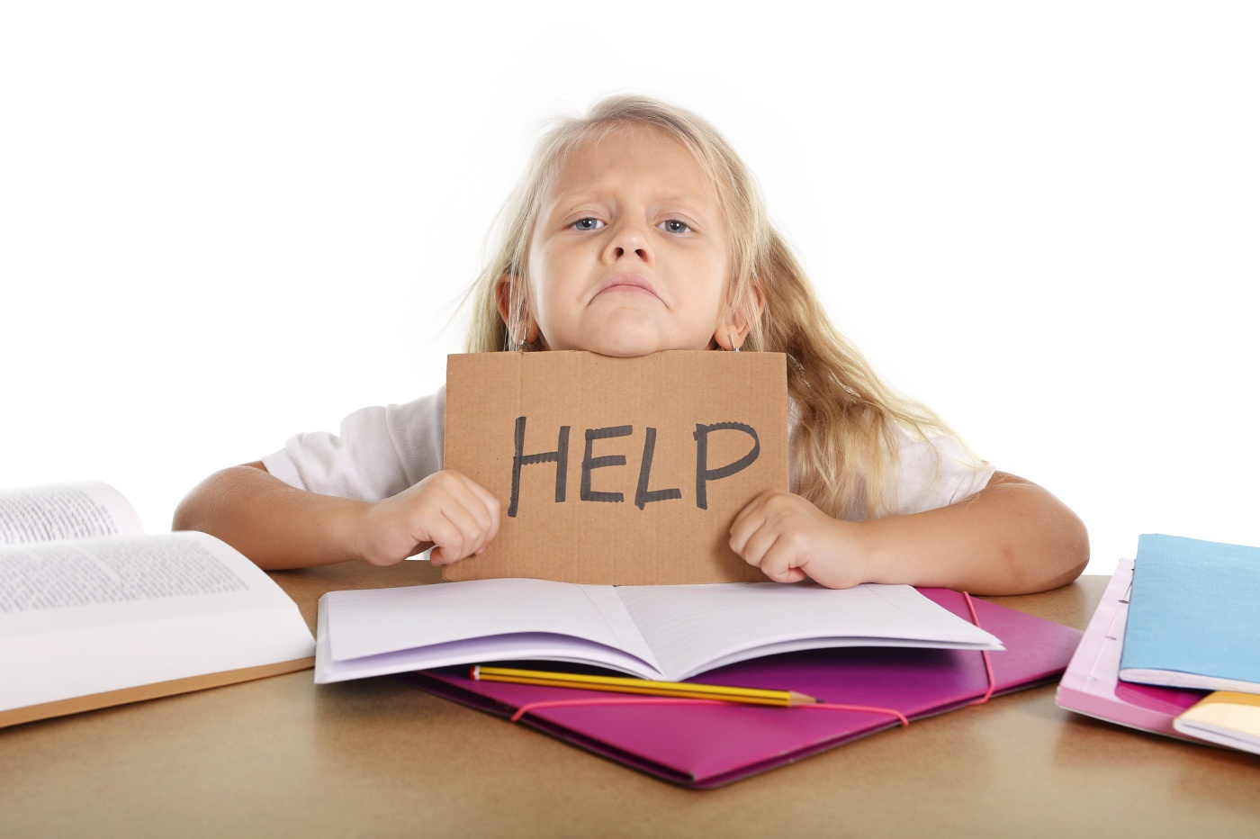
I do my homework.

Slide 11
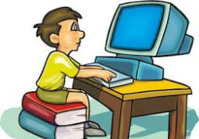
In the afternoon I play computer games, meet my friends, go to the fitness club or watch TV.

Slide 12
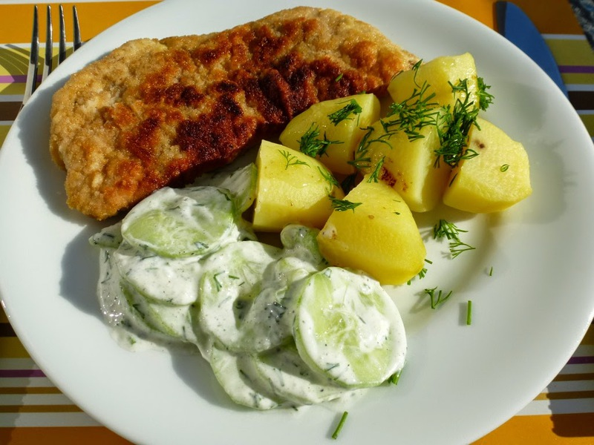
I have dinner at six p.m.

Slide 13
I go to bed at nine p.m.

Slide 14
THE END

