Slide 1

My Daily Programme
Calin Cirlea
Scoala Gimnaziala „Constantin Brancoveanu”

Slide 2
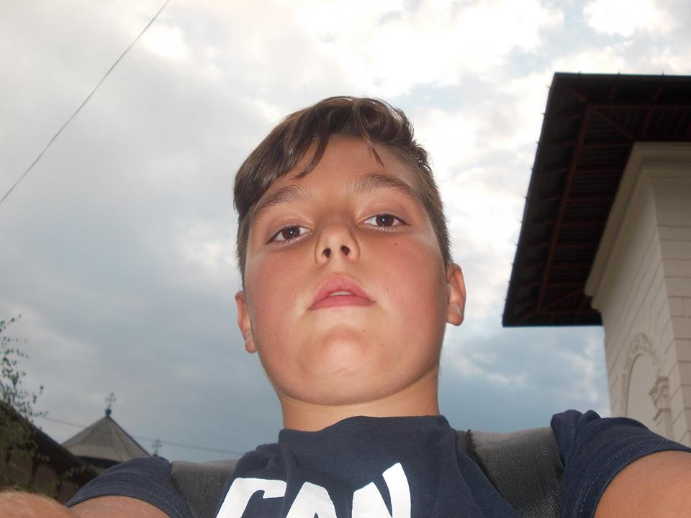
Hi! This is me and I will show you my daily programme! ☺

Slide 3
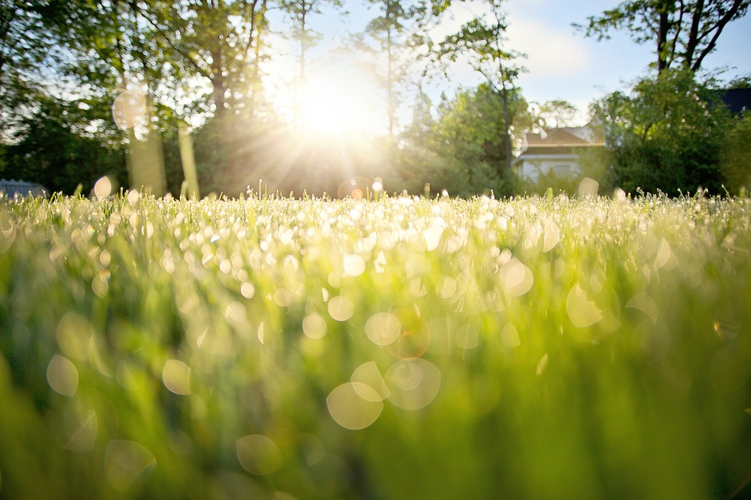
I wake up early in the morning because I like to start the day when sun is up!

Slide 4
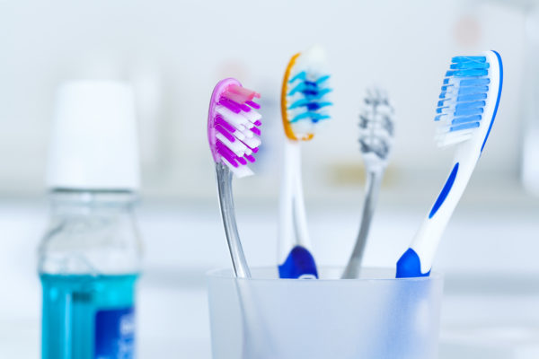
Then, I brush my teeth. It’s a very important thing! ☺

Slide 5
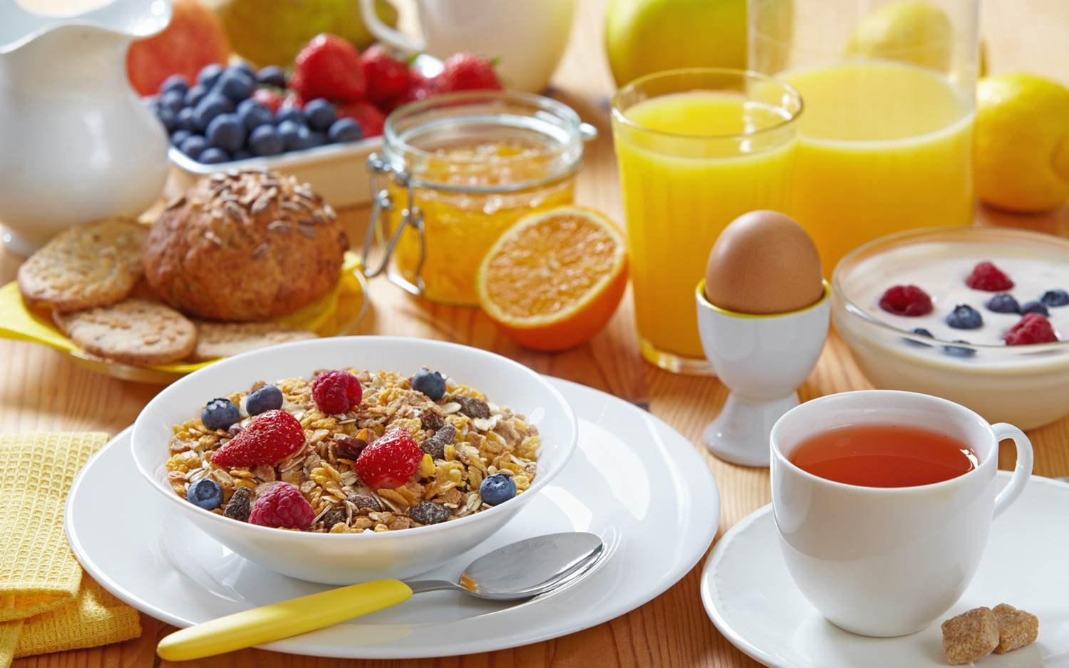
Afterwards, I have my breakfast: the most important meal of the day!☺

Slide 6
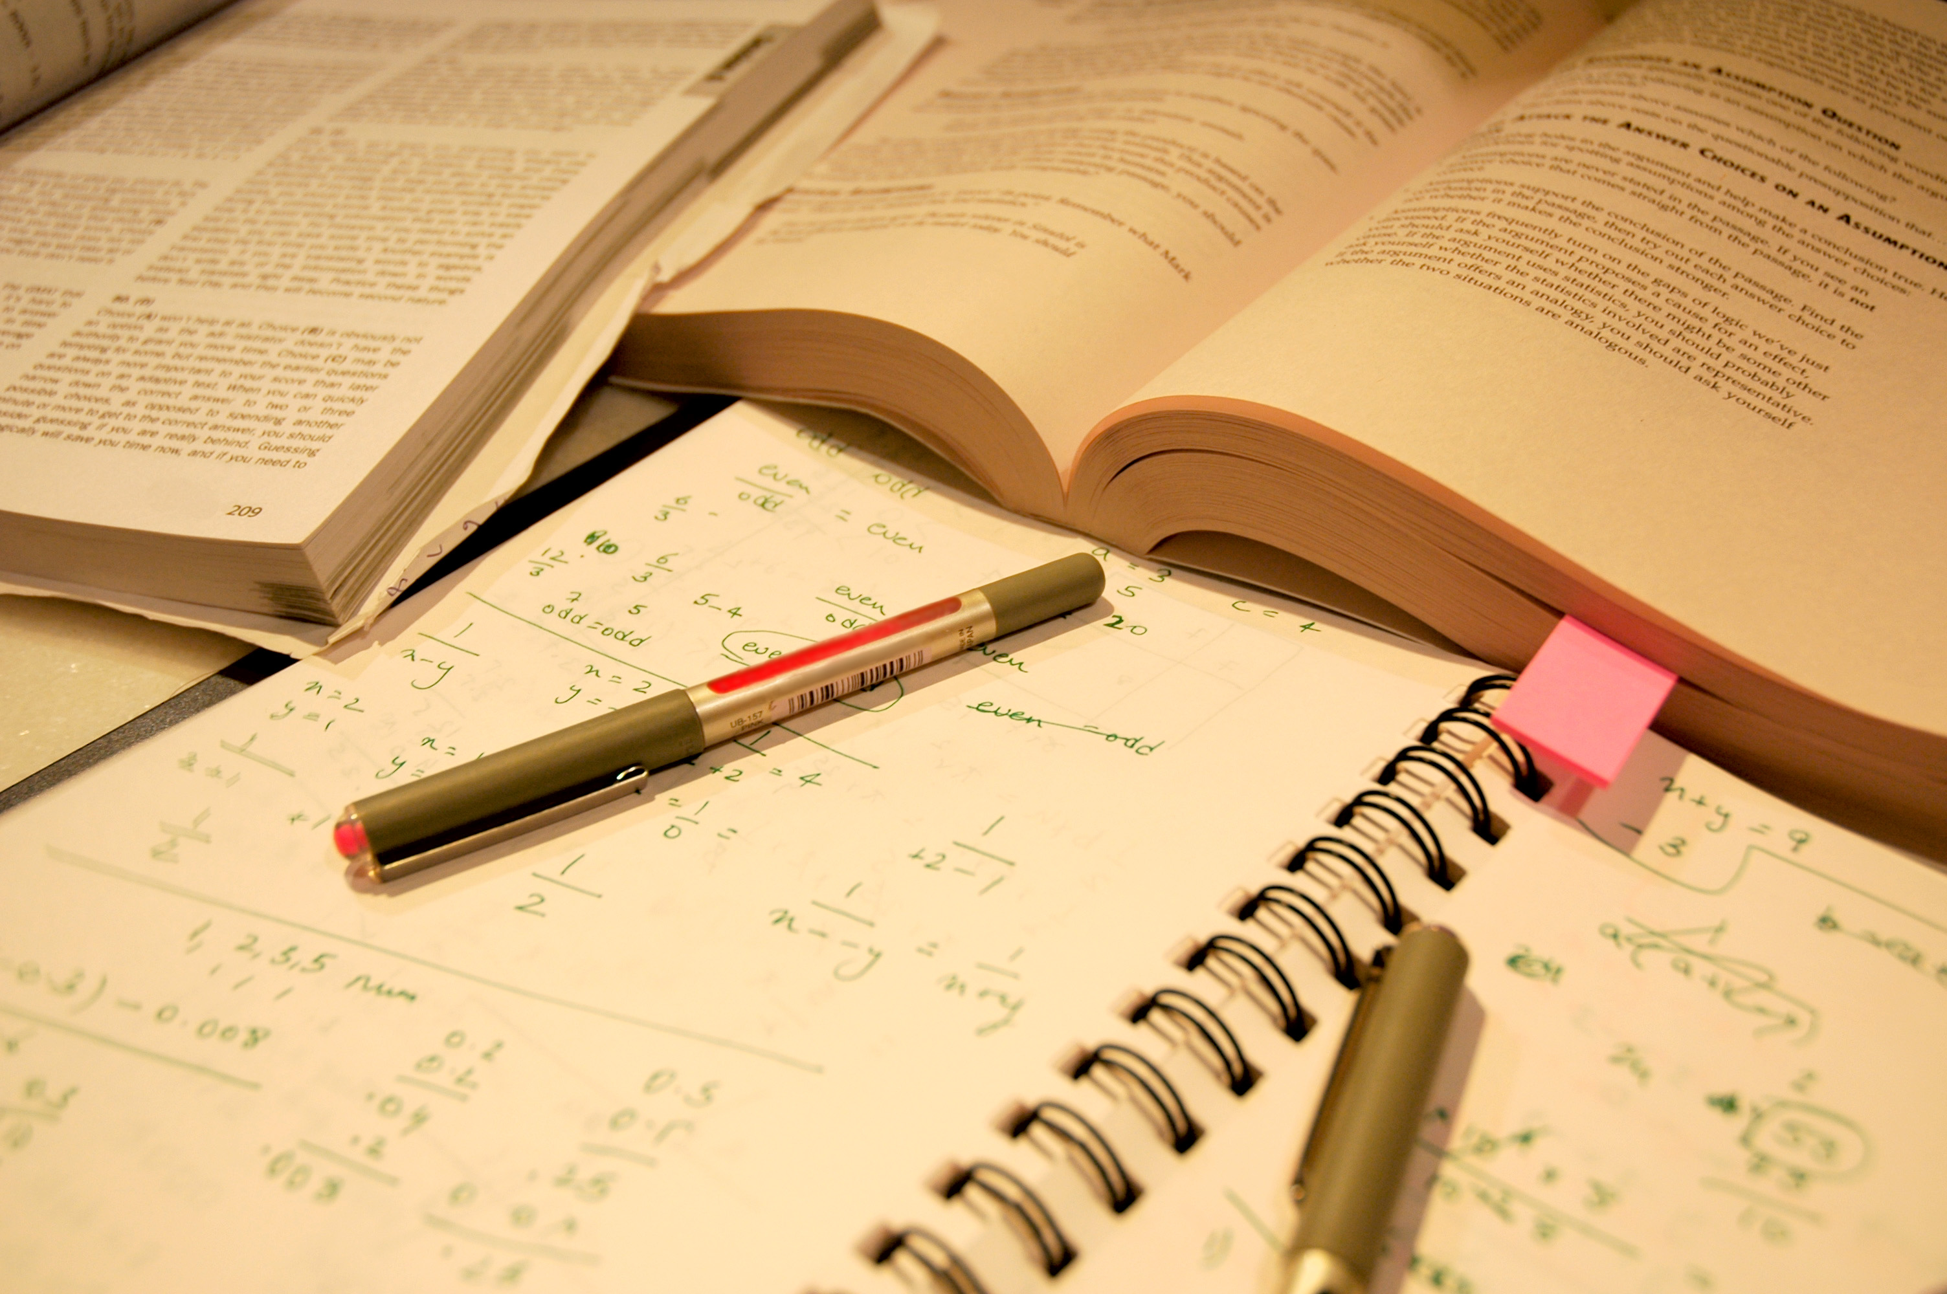
Then I spend some time studying since I go to school in the afternoon.

Slide 7
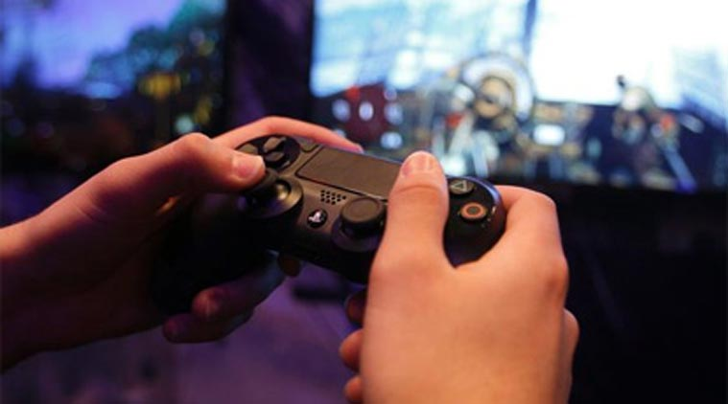
When I finish studying, I usually play some video games until I go to school.

Slide 8
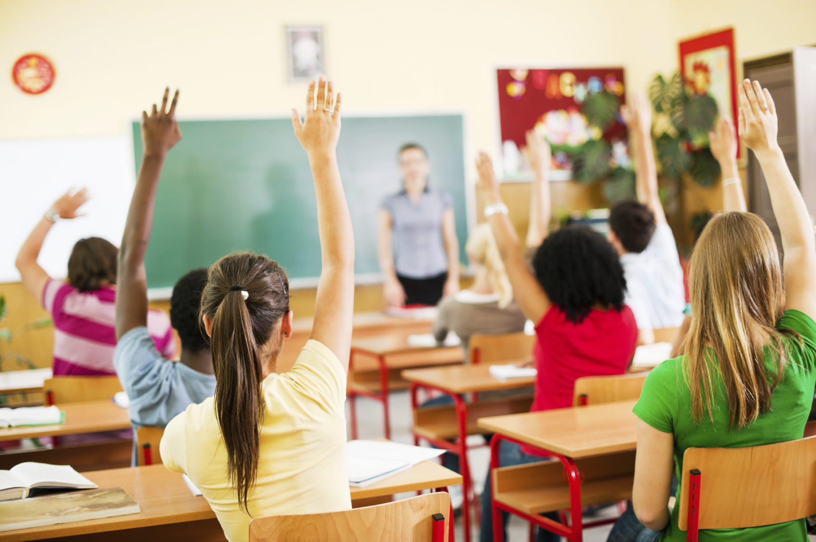
Then I go to school where I study and learn new things day by day

Slide 9
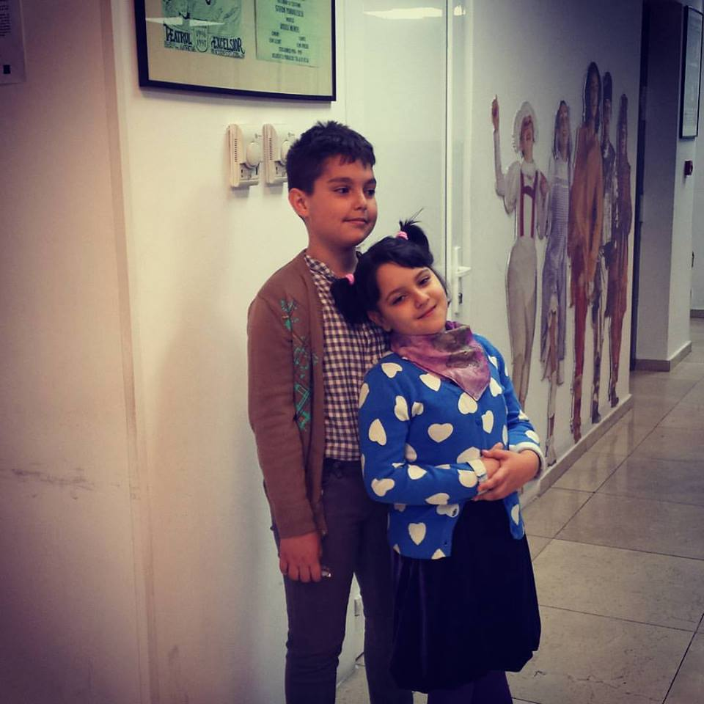
Then, I get back home where I meet my little sister and play video games together. Isn’t she gorgeous? ☺

Slide 10
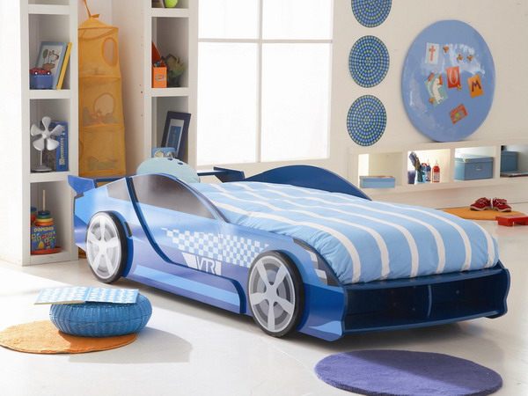
In the evening I go to sleep because tomorrow is another day! ☺

