Slide 1
Şcoala Gimnazială “Constantin Brâncoveanu” Enache Ştefan
MY DAILY PROGRAMME

Slide 2
I get up at seven o’clock.

Slide 3
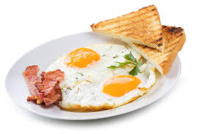
I have breakfast at seven thirty.

Slide 4
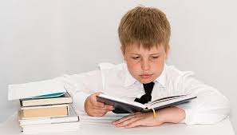
I do my homework from nine to eleven.

Slide 5
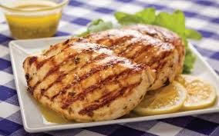
I have a lunch at twelve o’clock.

Slide 6
I start school at one o’clock.

Slide 7
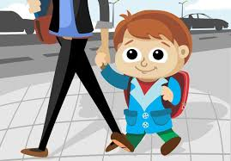
I go home from school at seven o’clock.

Slide 8
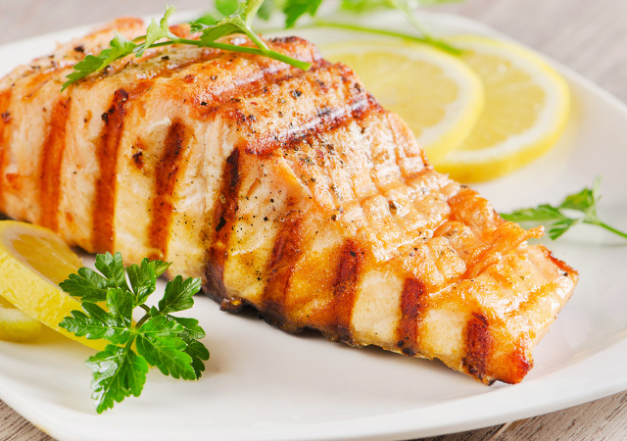
I have dinner at seven thirty.

Slide 9
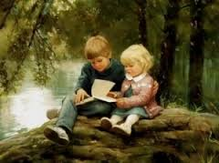
After dinner I read or I watch TV.

Slide 10
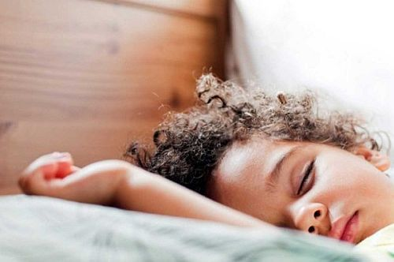
I go to bed at ten o’clock.

