Slide 1
ŞCOALA GIMAZIALĂ “CONSTANTIN BRÂNCOVEANU”
ENACHE ANDREI
MY DAILY PROGRAM

Slide 2
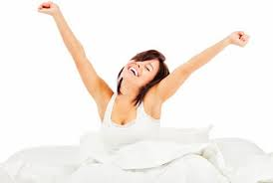
I get up at seven o’clock.

Slide 3
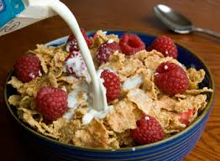
I have breakfast at eight o’clock.

Slide 4
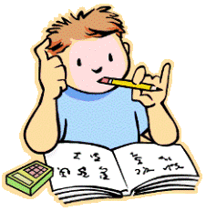
I do my homework from nine thirty to eleven.

Slide 5
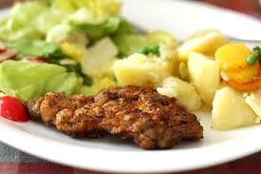
I have lunch at twelve o’clock.

Slide 6

I start school at one o’clock.

Slide 7
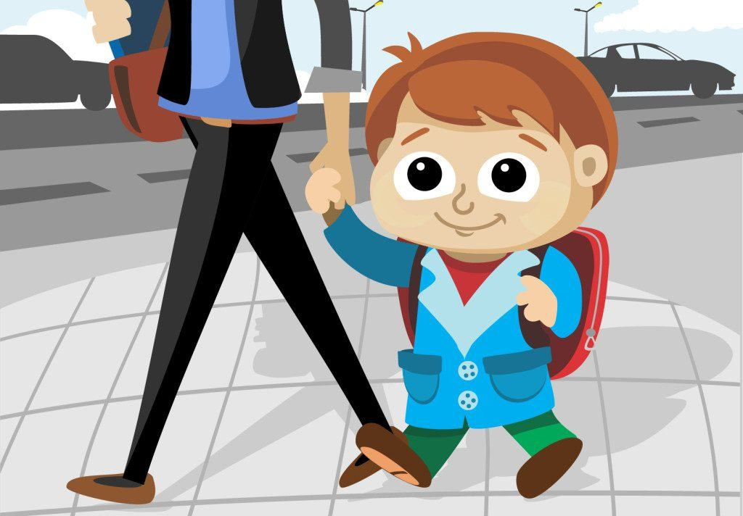
I go home from school at seven o’clock.

Slide 8
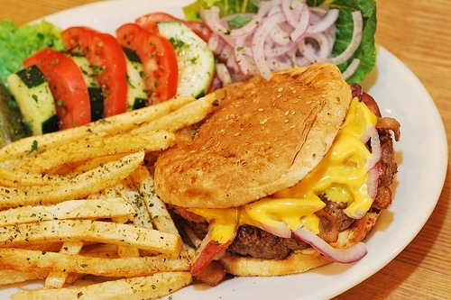
I have dinner at seven thirty.

Slide 9
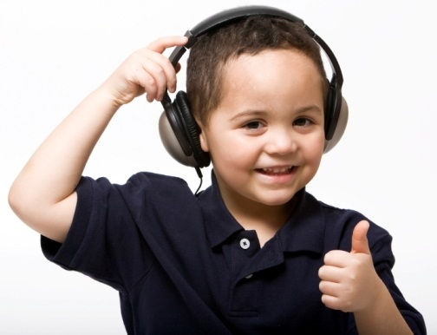
After dinner, I listen to music.

Slide 10
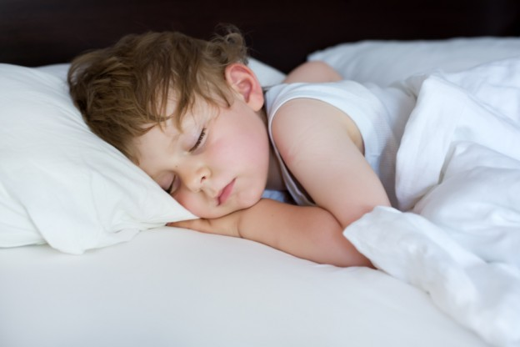
I go to sleep at ten o’clock.

