Slide 1
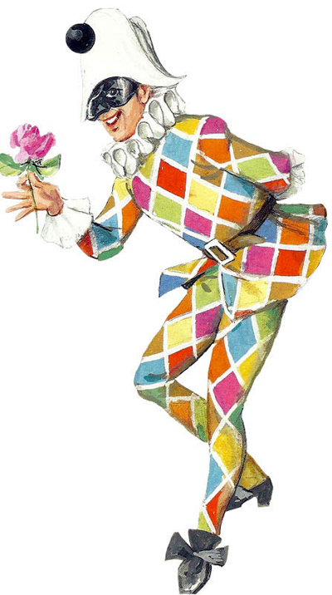
ARLECCHINO
Hi peasants, I’m Arlecchino and I’m the most important comic servant of the world. My outfit is the fashionest, a suit with patches and rags! I’m hungry again… but I can’t let my master know that I have eaten all sweets of the pantry. But they would never be as sweet as my beloved, the amazing Colombina! I should go to entertain my master now, hoped you enjoyed my company. Sciao!

Slide 2
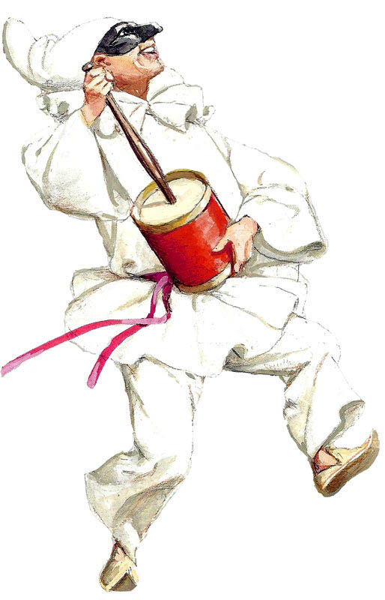
PULCINELLA
Hi my name is Pulcinella. I’m from Naples. My dress is all white and i wear a black mask. I’m a character who face up to every problems with a smile!

Slide 3
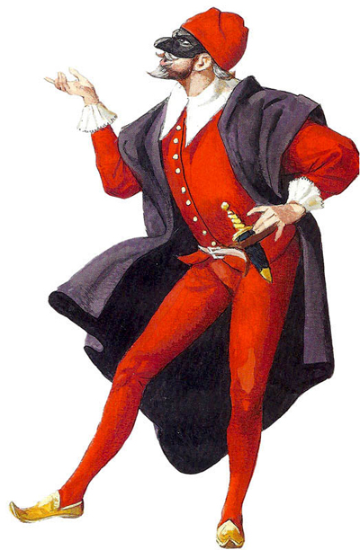
PANTALONE
Hello, I’m Pantalone! I’m a rich venetian merchant, grouchy and miserly. Money and riches are the only concerns and I always interfere myself in quarrels that don’t concern me. I have a wife and a daughter who is called Rosaura and a servant named Colombina.

Slide 4
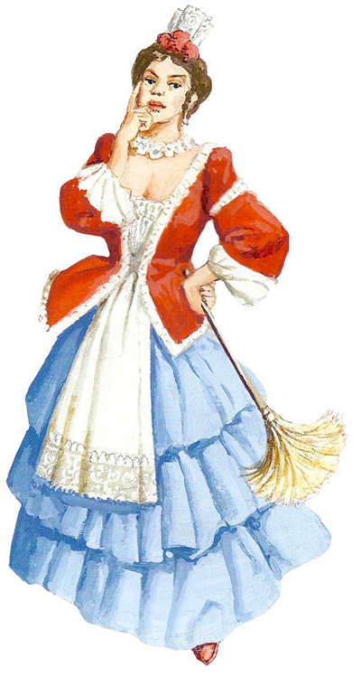
COLOMBINA
Hi! I’m Colombina and I come from Venice.
I’m a typical venetian mask and my master is Pantalone.
Sometimes he gives me attention, but I stay true to my dear Arlecchino, even if he’s jealous.

Slide 5
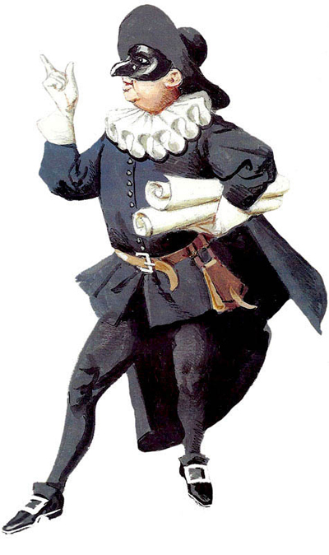
BALANZONE
I come from Bologna. I always wear black clothes. I have a little mask that covers the eyebrowns .
I brag of my titles and, most important, I give useful teachings.

Slide 6
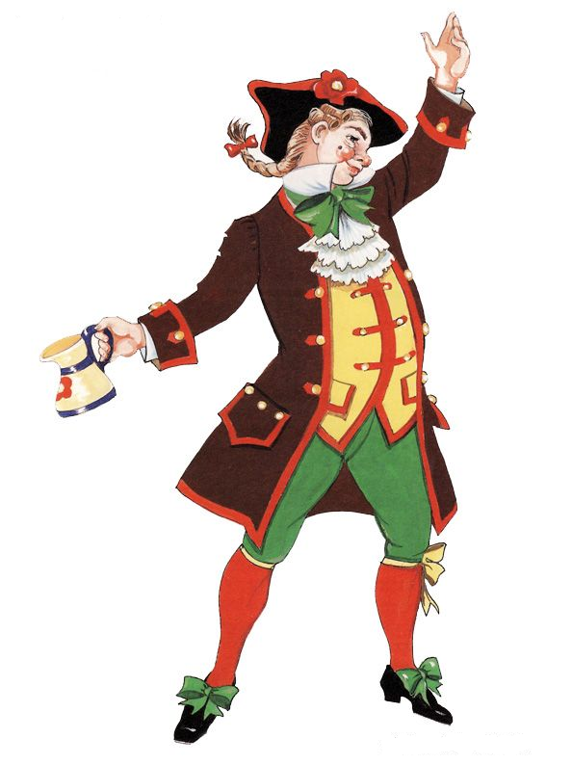
GIANDUJA
I’m a 18th Century Turinese mask with origins from the Italian city of Asti. Modestly, my name comes from GIOANN DA DOJA (Giovanni dei Boccali), that everyone knows. My personal motto is: «stay jolly and positive», even though sometimes I get lost in thoughts, and my wife Giacometta has to take me back to reality.

Slide 7
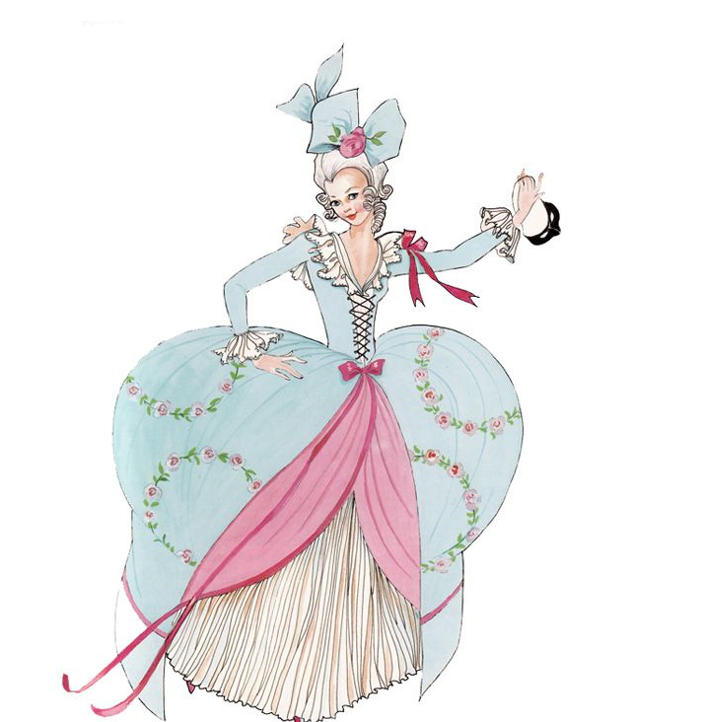
ROSAURA
Hi, I’m Rosaura, I’m from Milan. I’m Pantalone’s daughter; I really like talking with my maid. I wear a long gown with bows and nastri, I don’t wear a mask. I’ve got long blond hair, my lucky charm is a fan.

