Slide 1
Anna lewandowska

Slide 2
Who is Anna Lewandowska?
Anna Lewandowska is a Polish sportswoman, karate contestant of KK Pruszków and Polish representative in traditional karate. She is also a nutrition specialist, trainer, motivator, multiple medalist in the World, European and Polish Championships.

Slide 3
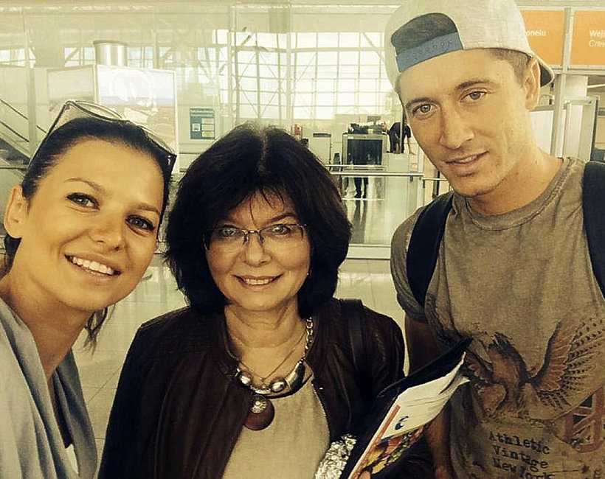
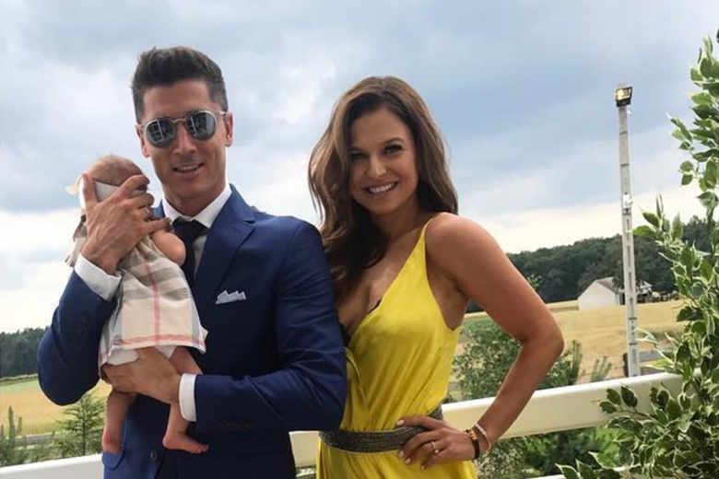
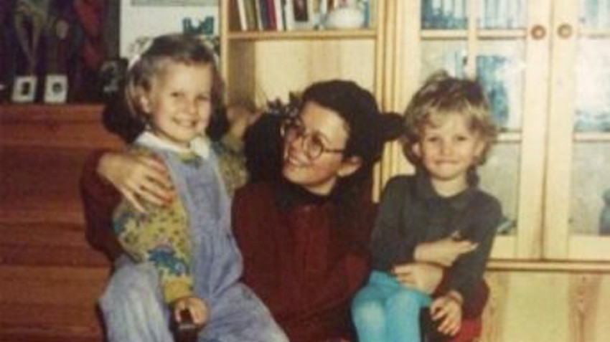
Anna's family
She was born in Łódź to Bogdan Stachurski and his wife Maria. On 22 June 2013 she married Robert Lewandowski, a Polish footballer, in Serock. In December 2016, Robert Lewandowski announced that Anna is expecting their child. She gave birth to their daughter Klara Lewandowska on 4 May 2017.

Slide 4
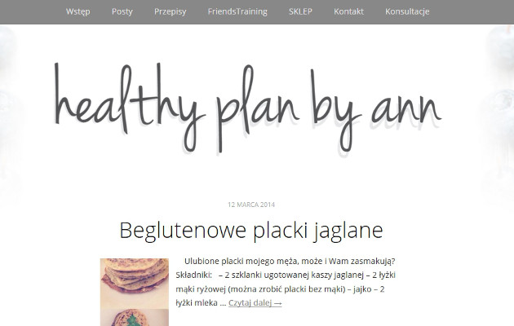
Healthy Plan by Ann
Since 2013 he has been running the blog Healthy Plan by Ann, in which she gives nutritional and sports advice with his team.

Slide 5
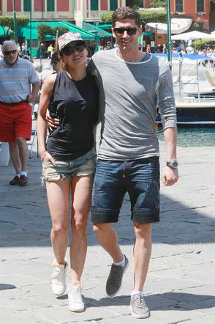
She currently lives in Germany with her family.

Slide 6
THE END
Prepared: Zuzanna Wańkowicz VII C.

