Slide 1
STEM DISCOVERY WEEK 2018
Cornelia Melcu, școala gimnazială nr. 9 „nicolae orghidan” brașov, românia
From 26th and 30th of March an event dedicated to STEM education was organized for young students – aged 10.
For five days, the students visited companies, met engineers, doctors or scientists, made experiments discovered on Scientix Resources and created posters.

Slide 2
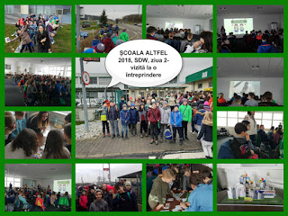
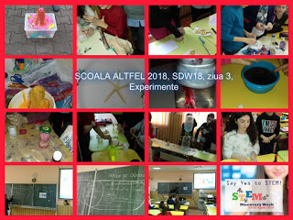
The winning activity

Slide 3
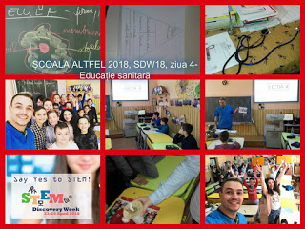
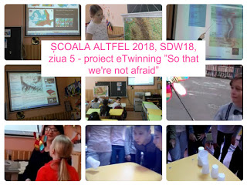
More info: http://sdw-blog.eun.org/2018/04/12/stem-discovery-week-2018-in-our-school/
https://twinspace.etwinning.net/64002/home
http://clasanoastrasc9bv.blogspot.com/2015/11/httpswww.html

