Slide 1
CAREER MANAGEMENT SKILLS Workshop

Slide 2
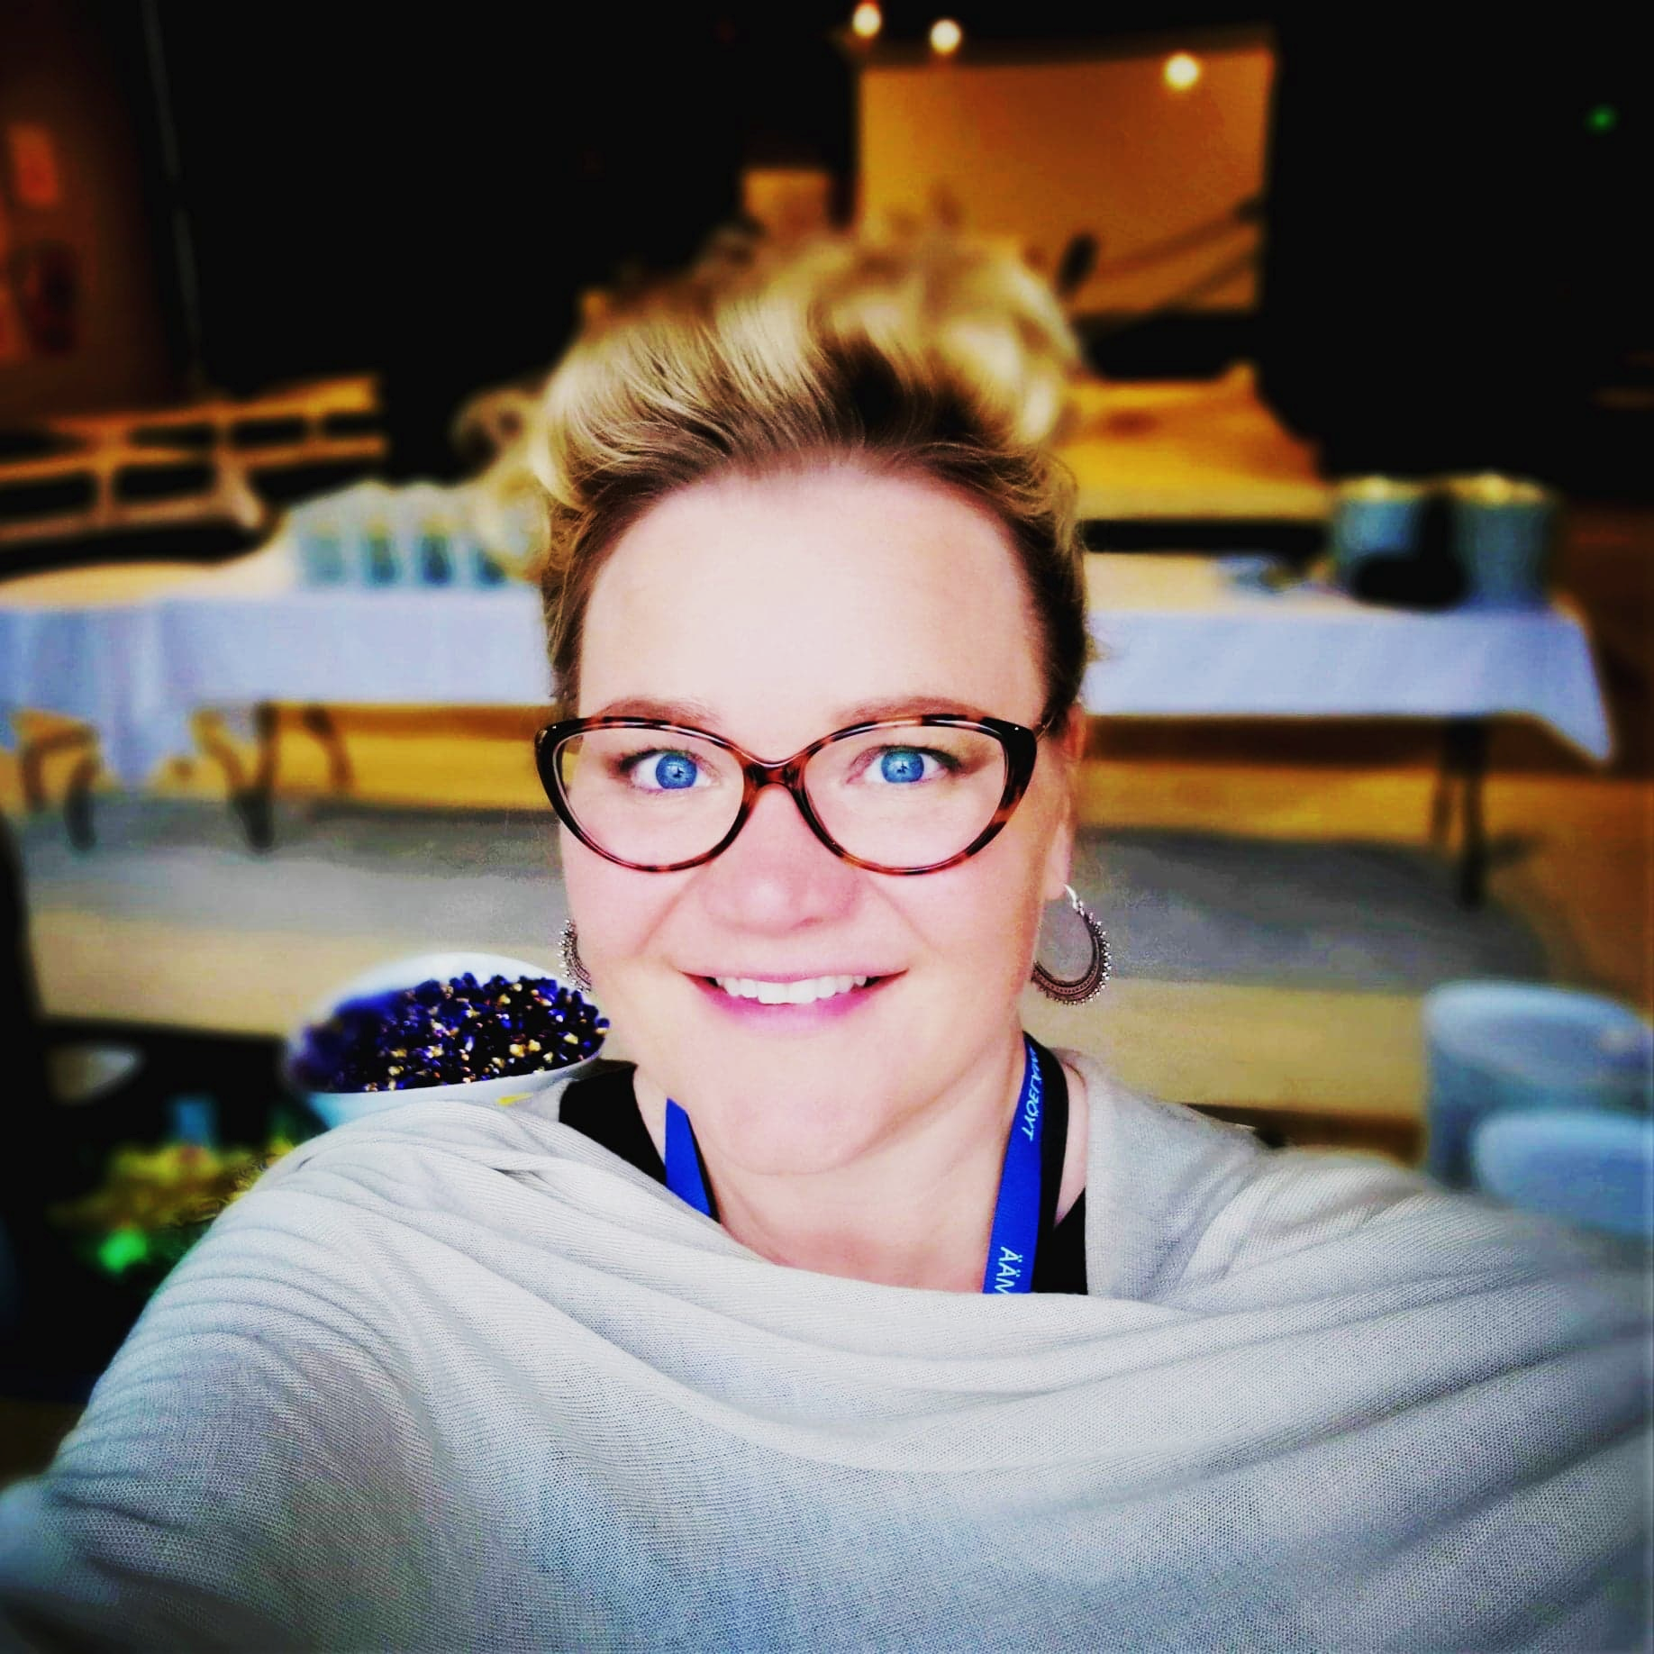
Hello!
I am Teea Oja
Master of Education (Educational psychology)
Career counsellor & Study counsellor
Working on my PhD in career counselling
Working for the last 18 years with individuals and groups, who have some kind of transition phase in their life and need for career advice and counselling
Notes:
After this, participants: ”

Slide 3
What is a career? Say anything, that comes in your mind!
1
Notes:
Career Definition 1: A Synonym for "Occupation"
We often use the word "career" as a synonym for occupation, trade, profession, or vocation. This definition refers to what a person does to earn a living. There are thousands of careers. They range from those that require extensive education and training to others for which you need hardly any preparation. Examples of careers are engineer, carpenter, doctor, ​​veterinary assistant, cashier, teacher, and hairstylist.
Career Definition 2: A Series of Jobs or a Career Path
The second meaning is much more complicated. It concerns an individuals progression through a series of jobs over his or her lifetime and includes that person's education and unpaid work experiences, such as internships and volunteer opportunities. When it is defined in this context, it covers everything related to career development including career choice and advancement. Your career can take a variety of paths.

Slide 4
(A career is…) the period that spans all the working years of our life. A career can go through many changes but we only get one. Everything we experience while we work takes place under the umbrella of our career.
live these years
Notes:
Not just ”while we work” but ”while we live these years”: study, stay home with children, engage ourselves in voluntary work etc.

Slide 5
What is career management and career planning?

Slide 6
Career management is the combination of structured planning and the active management choice of one's own professional career. The outcome of successful career management should include personal fulfillment, work/life balance, goal achievement and financial security.

Slide 7
Career planning is the ongoing process where you: Explore your interests and abilities; Strategically plan your career goals; and Create your future work success by designing learning and action plans to help you achieve your goals.
Notes:
Career planning is a subset of career management. Career planning applies the concepts of strategic planning and marketing to taking charge of one's professional future. A career is an ongoing process and so it needs to be assessed on continuous basis.
This process of re-assessing individual learning and development over a period of time is called Career Planning.
Career planning is not something that you do once and then forget. Considering that research has found that the average worker will change careers – not jobs but careers – five to seven times in their lifetime, career planning is an activity you should do at least once a year.
Succeeding in a constantly changing workplace/ working life requires a career management plan.
The goal of career management and planning is to produce the desired results for our careers that impact our lives in a positive way. Career management allows us to prepare and maintain a degree of control over the expected outcomes.
Career management means that you are the one who decides what you want to do in your professional life.
You control where you work, and what -- and how far -- you need to advance. You have the power with a good career management firm.
In our professional lives, career management is a necessary tool to assist us in achieving both personal and professional goals. With good career management, we can make the proper and timely decisions along the way with confidence.

Slide 8
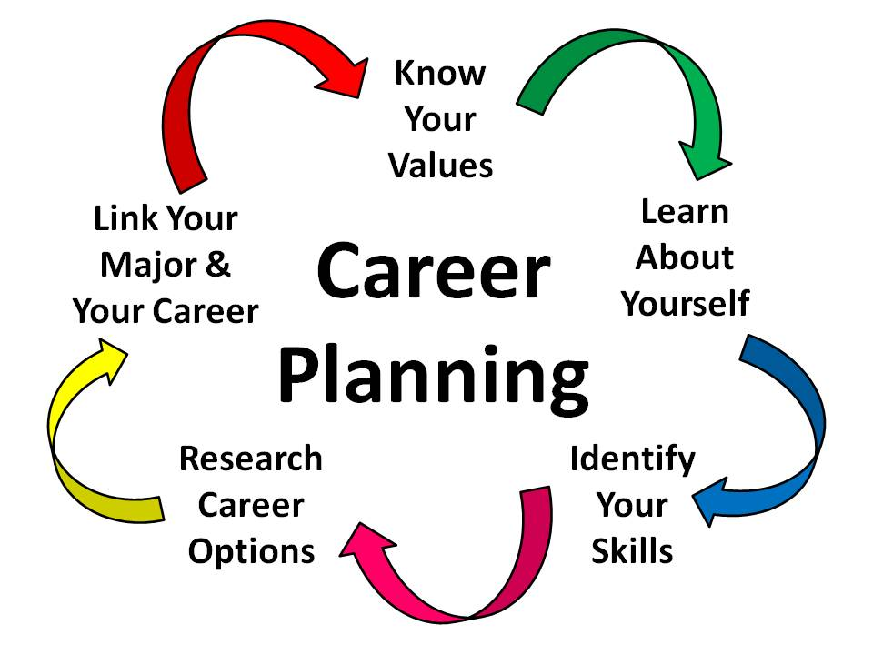
Notes:
SOME THINGS TO KEEP IN MIND
There is no one, perfect career for anyone. There may be a number of career fields which will fit you and which you will find satisfying.
In any job, there will be aspects of the work that you like and some aspects that you don’t like. No job is perfect.
People can shape their own careers. Think not only about what careers might fit who you are, but how you can mold your job or work environment to fit your personal style and utilize your particular skills and strengths most productively.
Career planning is a lifelong process. Most people change careers a number of times throughout their lives. Therefore, it is important to learn what is involved in an effective career planning process. You may find yourself using this process again and again throughout your lifetime.
Career planning is part "happenstance". Planning will get you started and keep you going, but unplanned events and other life experiences will also play a role in the direction your career path takes. Be prepared to take advantage of opportunities as they arise. Remember, opportunities are sometimes disguised as setbacks. Keep a positive attitude; Make the most of unexpected events; keep your career options open; make mistakes and learn from them; and continue to learn and build your skills as long as you live.

Slide 9
CAREER MANAGEMENT SKILLS
Career management skills (CMS) are competencies which help individuals to identify their existing skills, develop career learning goals and take action to enhance their careers.

Slide 10
EU:
“There is a growing need to equip individuals with career management skills in order to facilitate orientation in complex education landscapes and labour markets of the 21st century: the ability of an individual to identify own interests and strengths, to relate these to education pathways and the world of work, to collect relevant information, make structured educational and occupational decisions and to implement these.
Notes:
There is = based on research findings! Lifelong learning is the most important in Europe, and so we need career management skills and thus we need to do career planning.

Slide 11
1. Personal effectiveness
I know who I am and what I am good at.
I’m able to reflect on my strengths and address my weaknesses.
I make effective decisions relating to my life, learning and work.
I remain positive when facing setbacks and I stay positive for the future.
I make use of technologies to develop my career
I am able to set myself career goals
I generate ideas that help me to achieve my goals
I I can review my skills in relation to what employers are looking for

Slide 12
2. Managing relationships 3. Finding work and accessing learning 4. Managing life and career 5. Understanding the world (Find all CMS:s here)

Slide 13
Today we…
Take a look in our career management skills…
by identifying our strenghts and preparing ourselves for the future!

Slide 14
Get up and go to see the cards with pictures. Find a picture that says something about your future. This is a metaphor! Is it a plan you already have, is it a hope, or is it a feeling you have?

Slide 15
Turn the card around and find a colour. Go sit to a group with people that have the same colour! Then divide the group in two, so that you have only 4 people in your smaller group. Keep the card with you.

Slide 16
Say hello to your small group members!
Introduce yourself and say a few things about your card, why you chose that one. Everyone!

Slide 17
Turn the card around a find a Finnish word.
That is a personal STRENGHT. If there is someone speaking Finnish in your group, he/she will help you translate the word. Or just use your phone’s translator! Share the transaltions with each other.
Notes:
Huom! All strenghts are as important. They are in our personality, or something we have learned.

Slide 18
Now talk about these strenghts in your group, one at a time.
Is that your strenght, in your card?
If yes: How do you know it is? When have you needed it in your life? In what kind of situations you realise it in yourself, in your actions?
If not: why do you feel it isn’t? Is someone in the group holding a strenght, that fits you better?
If yes: talk about that strenght: How do you know it is yours? When have you seen it in yourself in your life, in what kind of situations?
If not: what IS your strenght? Name one and talk about it following instructions above!

Slide 19
Take a piece of paper, a pen and your card in your hand. Stand up and start walking and meeting people.
Stop and say hi! Tell your chatting partner about the strenght in your card. If his/her strenght is yours, write it down in your paper.
Continue, until you have 5-7 strenghts in your paper!
Go back to your small group.

Slide 20
In your small group, take a look at the strenghts you have written in your paper.
One at the time, tell others
your strenghts (in your paper)
which of these strenghts you think you will need in the working life
what strenght you think you should develop in yourself, something you don’t have yet?

Slide 21
Why is it important to know your strenghts?
Notes:
Discuss this in your small group for a while!

Slide 22
For example:
You know yourself better.
You value yourself, when you find good, positive thing in yourself.
When you know your strenghts, you can utilize them.
You can talk about yourself plausibly.
Makes it easier to apply for a job.
Remember to tell your friends about their strenghts – we need help in mapping our skills and strenghts!

Slide 23
Skills needed in the working life
2

Slide 24
Survival on the moon

Slide 25
Skills needed in the future working life
2

Slide 26
What do we know about the future? How can we know, what we need?

Slide 27
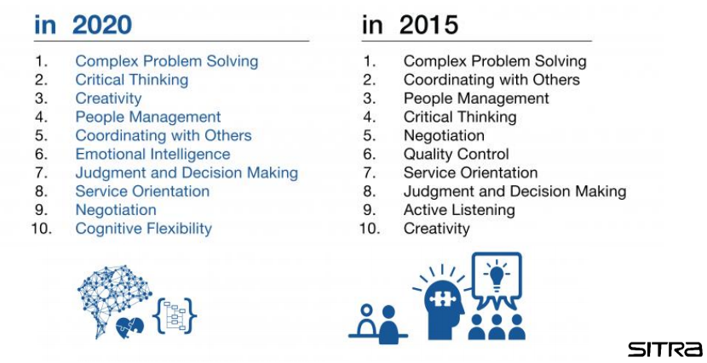

Slide 28
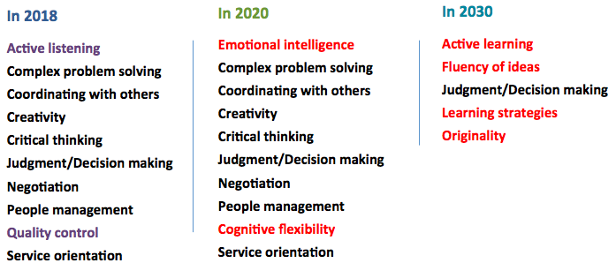

Slide 29
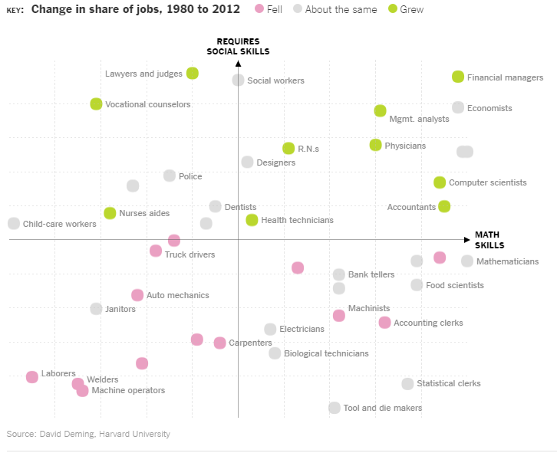
Notes:
New skills for new economies
https://www.weforum.org/agenda/2016/09/jobs-of-future-and-skills-you-need?utm_content=bufferee974&utm_medium=social&utm_source=twitter.com&utm_campaign=buffer
So what skills should workers be acquiring to make sure they have value as the Fourth Industrial Revolution gathers pace? Some may be surprised to learn that skills we develop in pre-school will be valued highly.
David Deming, associate professor of education and economics at Harvard University, argues that soft skills like sharing and negotiating will be crucial. He says the modern workplace, where people move between different roles and projects, closely resembles pre-school classrooms, where we learn social skills such as empathy and cooperation.
Deming has mapped the changing needs of employers and identified key skills that will be required to thrive in the job market of the near future. Along with those soft skills, mathematical ability will be enormously beneficial.
Single-skillset jobs in decline
Deming shows that in recent years, many jobs requiring only mathematical skills have been automated. Bank tellers and statistical clerks have suffered. Roles which require predominantly social skills (childcare workers, for example) tend to be poorly paid as the supply of potential workers is very large.
The study shows that workers who successfully combine mathematical and interpersonal skills in the knowledge-based economies of the future should find many rewarding and lucrative opportunities.
Refocusing skills education
The challenge now, says Deming, is for educators to complement their teaching of technical skills like mathematics and computer science, with a focus on making sure the workers of the future have the soft skills to compete in the new jobs market.

Slide 30
SITRA MEGATREND CARDS These cards contain various trends which SITRA believes are already affecting our lives and society– and thus also our future. Cards are not to predict the future. Cards enable us to make our own thoughts nimbler and to stretch them further. Create new ideas and visions about the possible future!
Notes:
Sitra was a present given by Parliament to Finland on the country’s 50th anniversary. The independent fund has been commissioned with the task of probing the future and promoting qualitative and quantitative economic growth.
The secret to Sitra’s independence
Sitra’s operations are funded by returns from an endowment originally granted by the Finnish Parliament. According to law, the funds must be invested securely and in a profitable manner.
Although the return from Sitra’s endowment fluctuates, it averages approximately 30 million euros a year. The amount is not very large in terms of the overall state budget, but if wisely allocated it does give Finland an opportunity to play a pioneering role, increase well-being and generate new business. Sitra is an investment of 30 million euros in the future, every year.
Another important facet of Sitra’s independence is the fact that it reports directly to the Finnish Parliament. We are not answerable to the government in power at any one time, nor to a certain party or a trend, but to the parliament.
The profits accrued from our diverse investments secure the long-term future-oriented work carried out by Sitra’s staff, based on their expertise and vision.
Ketterä agile nimble

Slide 31
Stand up, hold your original colour card in your hand. Start walking! Form a group of 6 people, where everyone has a different colour.

Slide 32
SITRA MEGATREND CARDS
Take 1 card.
One at a time: read you card. Then the whole group tries to understand toghether, what it means. Discuss about the meaning.
What skills, attitudes and strenghts would you need in that kind of future?
Write down on a big paper the headline of the card and the skills needed!

Slide 33
Let’s share! There are two other groups with different cards. Visit them and discuss the skills they’ve written down. Pick one skill you already master! And pick one skill you don’t have yet, but wish to develop.

Slide 34
Go back to your group of 6 people. Tell others the skill you already have. Then tell about the skill you wish to develop, and how exactly you will develop it. Group members will help you by generating ideas how you can develop this skill.

Slide 35
LIFELONG LEARNING …will be a necessity! Lifelong learning should become a new basic feature of life, since life spans will continue to increase in the future. In more and more people live to around 100, it is quite likely that the education acquired in the early stages of life will not support people throughout their working lives.

Slide 36
And remember: Future is not done yet. It depends on our decisions and actions. YOU make the future! Be bold, follow your values and act. Happy future!

Slide 37
Thanks!
Any questions?
You can find me at:
Twitter @TeeaOjaELY
LinkedIn Teea Oja
Teea.oja@gmail.com

