Slide 1
E portfolio
express thyself

Slide 2
An electronic portfolio (also known as an e portfolio, e-portfolio, digital portfolio, or online portfolio) is a collection of electronic evidence assembled and managed by a user, usually on the Web. Such electronic evidence may include
input text,
electronic files,
images,
multimedia,
blog entries, and
hyperlinks.
E-portfolios are both
demonstrations of the user's abilities and
platforms for self-expression.

Slide 3
If they are online, users can maintain them dynamically over time.
One can regard an e-portfolio as a type of learning record that provides actual evidence of achievement.
E-portfolios, like traditional portfolios, can facilitate students' reflection on their own learning, leading to more awareness of learning strategies and needs. Comparative research between paper-based portfolios and electronic portfolios in the same setting, tentatively suggests that use of an electronic portfolio may lead to better learning outcomes.

Slide 4
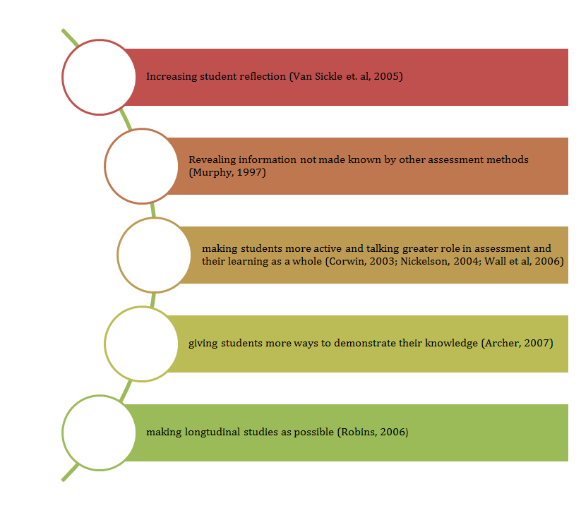

Slide 5
A wide range of materials evidencing your work (media, images, video, etc.)
Demonstrations of required competencies
Work samples across a very broad spectrum of creative fields
Project work, essential job requirement examples of targeted skills
Top quality creative work and performance materials
Specific examples of required experience and skills in context with a position
Why an e portfolio?

Slide 6
What competencies are promoted in an e portfolio?

Slide 9
How do we do it?
Open the 1.10.jar file located on your desktop.
You are now in the executable application.
Start filling information on the relevant tags.
Once you finish each text input save your work. Even if you forget, the program will remind you.
If you wish to add extra files to a certain tag, press the green button. The dialogue box will ask you what file you want to add, and where this file is. Fill in the information and press add. Save your work once you finish.
When you have filled in all tags and have added all files you wish to have in your e portfolio, you must press the top left button “extract html”. The dialogue box will ask you which language you want to have it extracted. Choose English .

Slide 10
The application will ask you where you want to extract your file. Choose “Desktop”.
From there, you can copy your e portfolio to a usb flash or send to a future employer via email.
BUT BE CAREFUL!!!!
You should compress your e portfolio file if you wish to send it to someone.

Slide 11
lets make an e portfolio then!!!!!

