Slide 1
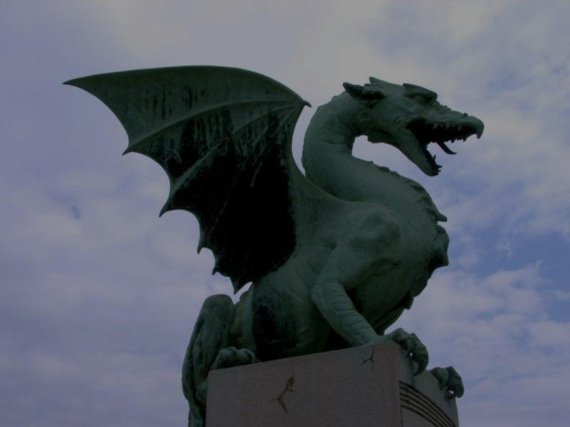
Slovenian souvenirs
made by the blue team

Slide 2
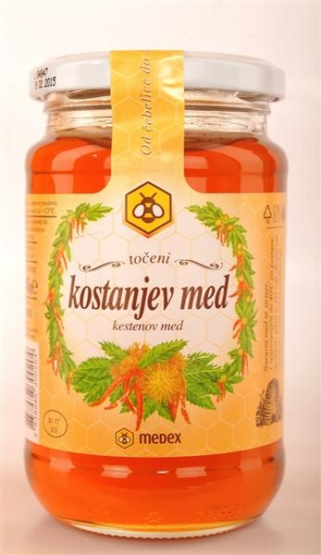
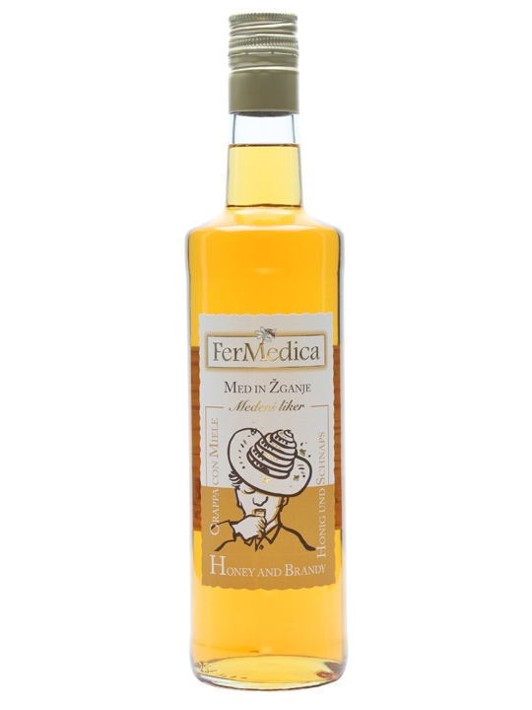
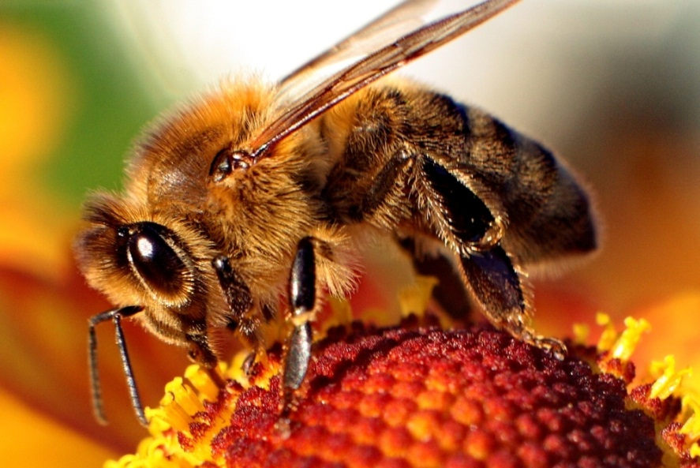
Slovenian honey
highest quality honey made by excellent beekeepers
it is filled in traditional jars
honey liqueur

Slide 3
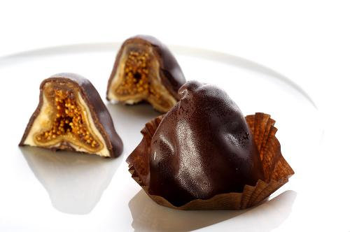
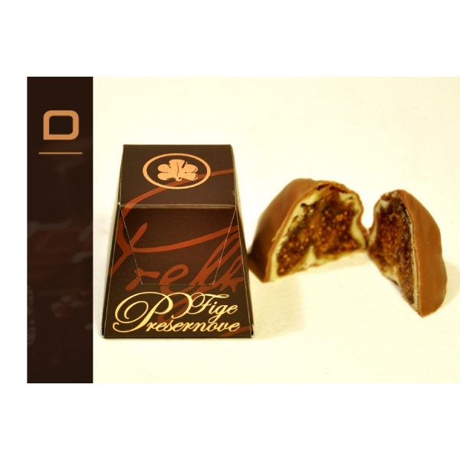
Prešeren figs
inspired by France Prešeren
top quality product
as the poet said he carried dried figs in his pocket and the people would call him „Doctor figs, figs“

Slide 4
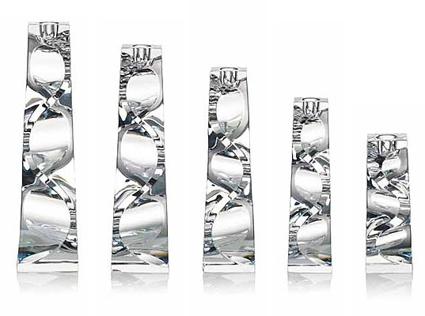
Rogaska crystal
it has a 350 years old tradition
crystal made into goblets, plates, home decor
it makes all wine taste better

Slide 5
Wishing bell from Bled
Bled is in a touristic town, in Gorenjska
visitors ring the small copy of the original bell, so their wishes come true

Slide 6
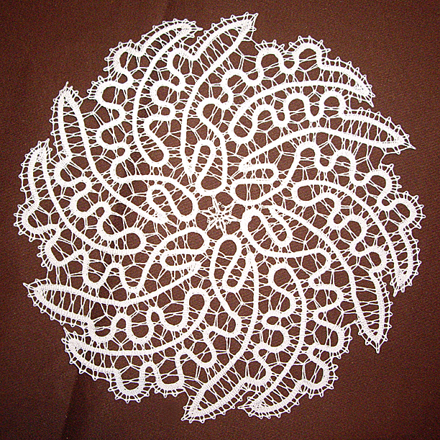
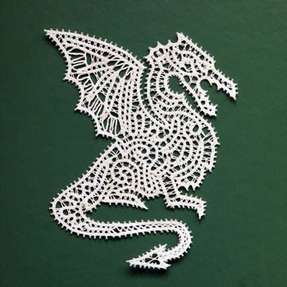
Idrija lace
Idrija is known for 2 things: mercury, lace
it is made some of the highest quality lace
products: gloves, earrings, necklaces

Slide 7
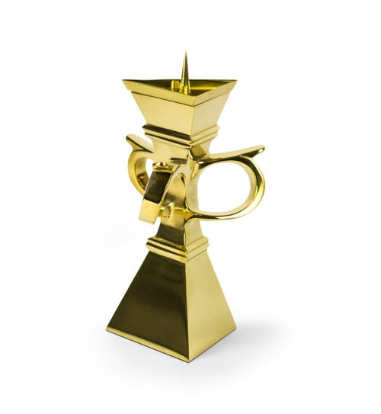
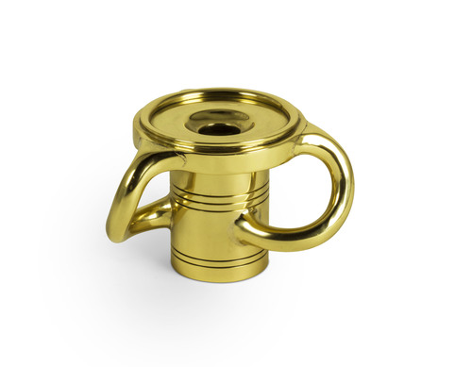
Plecnik candleholder
originally made by Jozek Plecnik in Kropa

Slide 8
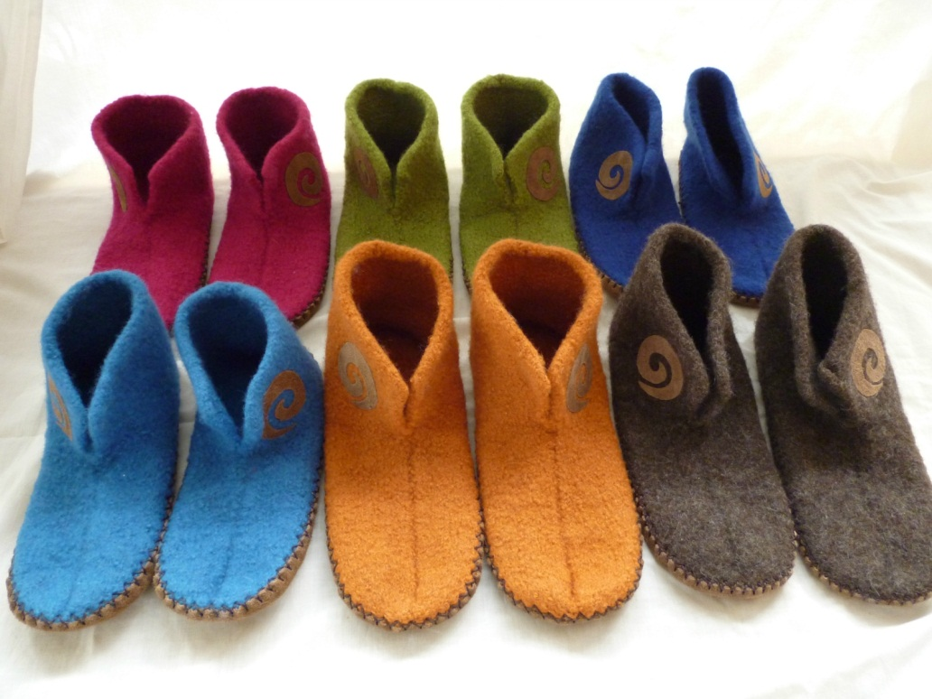
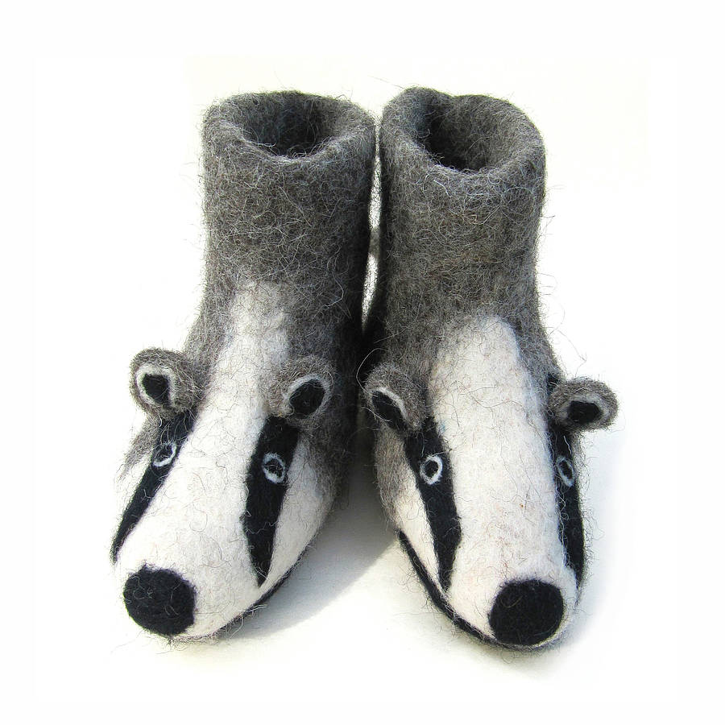
Felt slippers
indigenous Jezersko-Solcava sheep breed
shoechanging in Slovenian homes

Slide 9
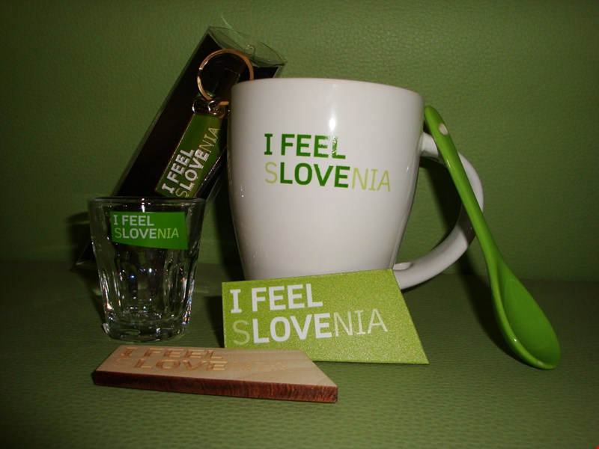
Feel Slovenia logo
great marketing catch
modern offer of quality souvenirs

Slide 10
Thank you for your attention!

