Slide 1
Guide of Ljubljana
Autors: Yellow team

Slide 2
Content
Prešeren Square
Triple bridge
Dragon bridge
Butcher‘s bridge and the market
Cathedral St. Nicholas
Library
Town hall
Sources
End

Slide 3
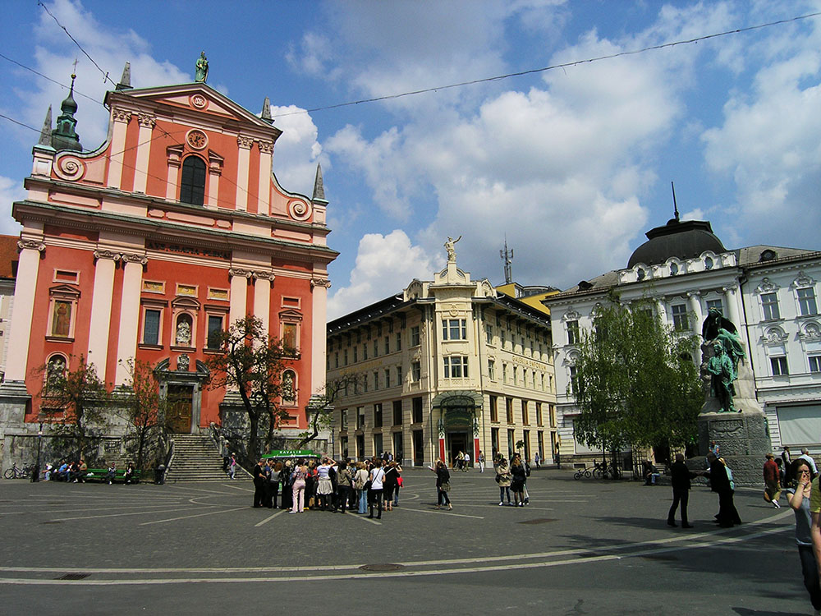
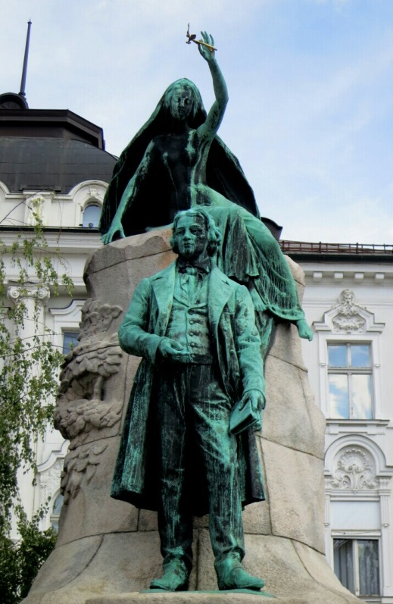
Prešeren Square
France Prešeren was a 19th century Slovene poet
The government had problems with the church
His inspiration was a naked woman

Slide 4
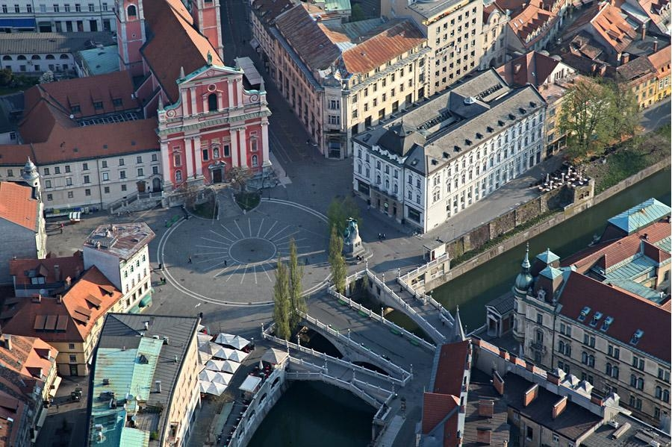
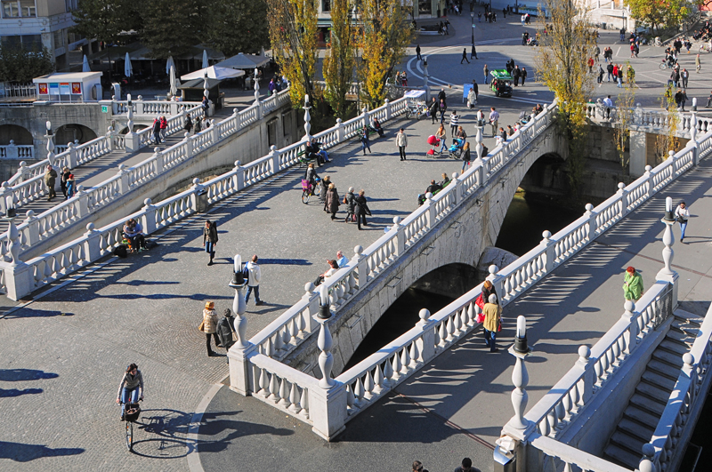
Triple bridge
A group of three bridges across the Ljubljanica river
The central bridge is partly built from Glinica limestone, other parts are built from concrete

Slide 5
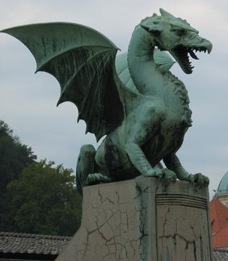
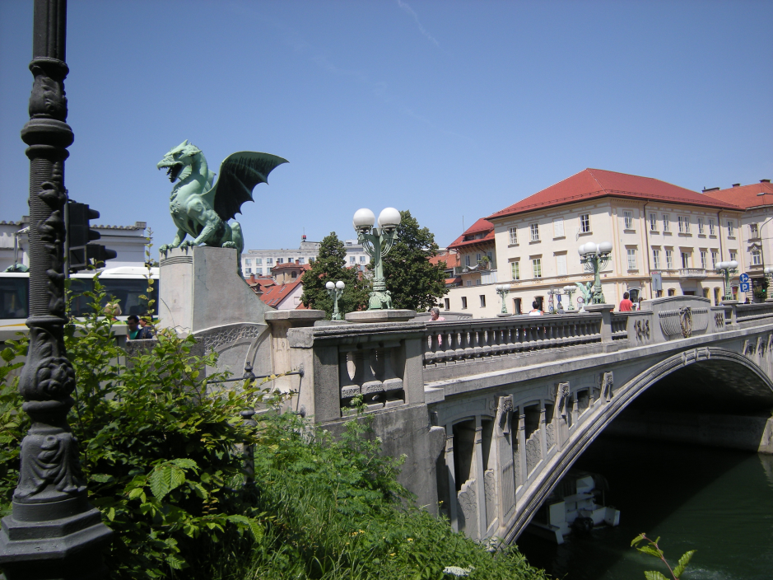
Dragon bridge
Built in the beginning of the 20th century
Between Kopitar street and Ressel street
By the locals it is called a „Mother-in-law“
The legend

Slide 6
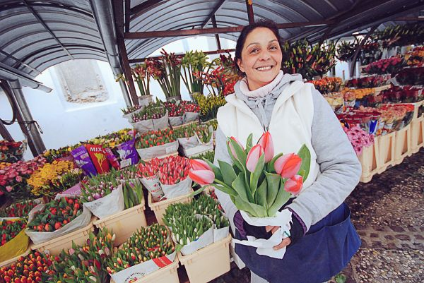
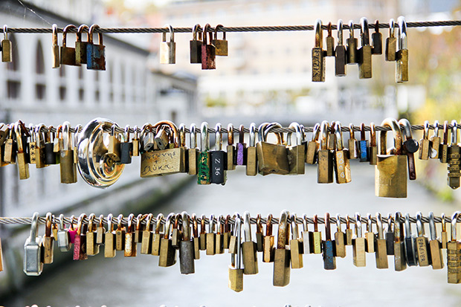
Butcher‘s bridge and the market
Ljubljana‘s central market is more than just a place to shop
It has many events and it is opened daily except Sundays
The bridge connects the Ljubljana central market and Petkovšek Embankment
Nowadays the bridge is called the Lovers brigde

Slide 7
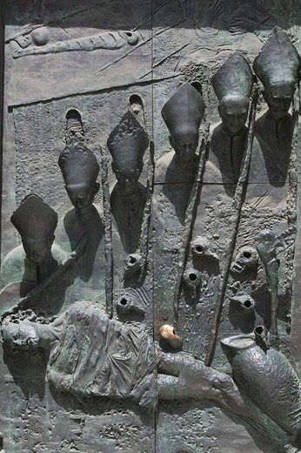
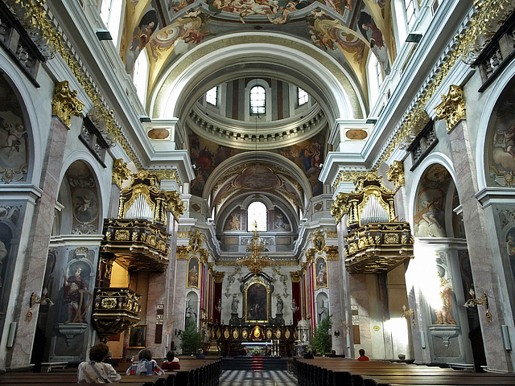
Cathedral St. Nicholas
In Ljubljana near the Ljubljana central market and the Town hall
Originally it was a gothic church
In the early 18th century it was replaced by a baroque building

Slide 8
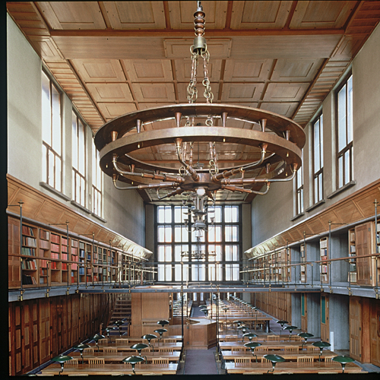
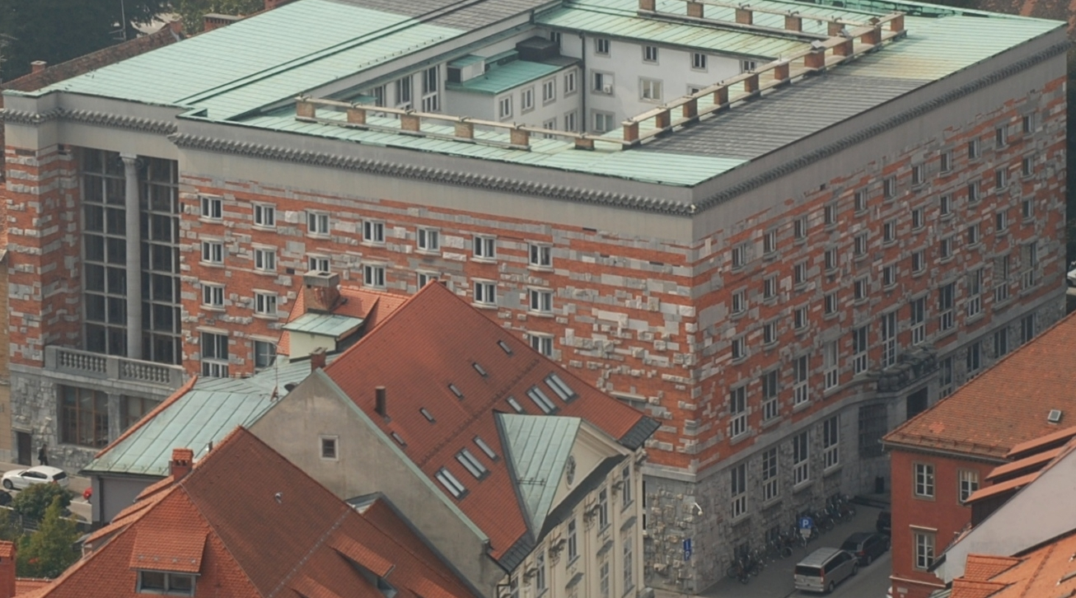
Library
Established in 1774
One of the most important national, educational and cultural institutions of Slovenia
It was designed by Jože Plečnik in the years from 1930-1931
In 2011 the library kept about 1 307 000 books

Slide 9
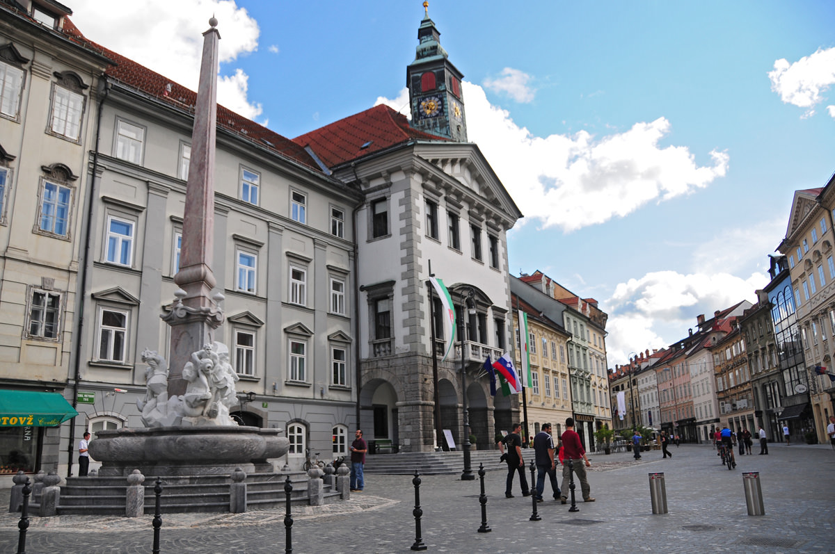
Town hall
It is the seat of the city manicipality of Ljubljana
It is located in the townsquare in the city centre
It was built in the gothic style in 1484 by Peter Bezlaj

Slide 10
Sources
http://www.parkiraj.si/uploads/images/Presernov_trg.jpg
http://www.visitljubljana.com/file/439352/d.-wedam-tromostovje-2010-.jpg
https://allajohn.files.wordpress.com/2012/10/tromostovje02.jpg
http://www.culturaldiplomacy.de/mediacenter/content/images/2c916267c9b6f0e6021026f854fd2047.jpg
http://upload.spottedbylocals.com/Ljubljana/normal/ljubljana-central-market-ljubljana-(by-mankica-kranjec).jpg
http://cdn.ipernity.com/118/02/14/10560214.61f69cd7.640.jpg?r2

Slide 11
End
Thank you for your attention!

