Slide 1
Business competition
Monika Rak
Eva Molnárová
Timeea David Ariana Carmina
Sara Kheribi
Tereza Langová
Kalina Pekova

Slide 2
What is the competition about?
International English competition (7 countries)
Countries : Austria, Bulgaria, Czech Republic, Hungary, Romania, Slovakia, Slovenia
Date: 26.03.2015
Place: Secondary school of Economics in Pápa

Slide 3
How was the competition structured?
Firstly, the students had to write a Business English Grammar Test where they showed their English skills and their knowledge. For the test the contestants were given 50 points and for the poster that they have made at home they could get 10 points.
Secondly, each team had a presentation regarding a company from their hometown (40 points). The presentation had to have at least 15 slides and the students had to talk about their project at least for 5 minutes. As the rules clearly stated, the teams were not allowed to have more than 3 members.

Slide 4
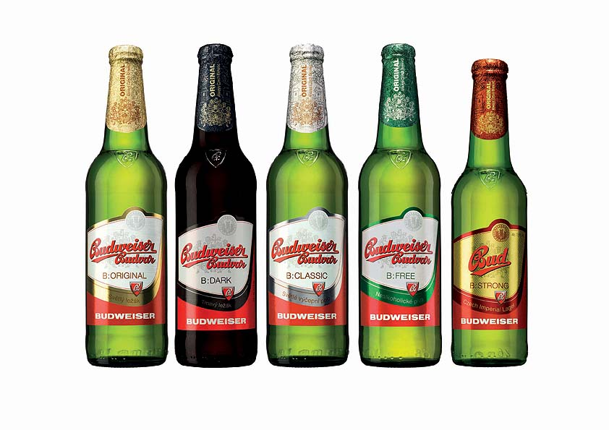
Czech team
SLOVAK TEAM
TEAM FROM VESZPÉM

Slide 5
Slovenian team
Austrian team

Slide 6
BULGARIAN TEAM
TEAM FROM PÁPÁ

Slide 7
Thank you for
your attention

