Slide 1
Carpathian Biosphere Reserve
eTwin team
Ukraine

Slide 2
General information
Carpathian Biosphere Reserve
established as a nature reserve in 1968 and became part of the World Network of Biosphere Reserves of UNESCO in 1992;
consists of six separate massifs, two botanic preserves (Chorna Hora and Yulivska Hora) and regional landscape park Stuzhytsia;
covered by virgin forests, located in four districts of Zakarpatska Oblast.

Slide 3
Location

Slide 4
Protected areas
Chornohirskyi protected massif
located on the southern slope of the Chornohora, the highest mountain belt in the Eastern Beskids and the Ukrainian Carpathians.
Its total area is 16,375 hectares (40,460 acres)

Slide 5
Protected areas
Marmoroskyi protected massif
located on the northern slope of the Rakhiv Mountains and
covers a territory of 8,990 hectares (22,200 acres) at the altitude of 750–1940 m.a.s.l.

Slide 6
Protected areas
Kuziyskyi protected massif
located on the southern branches of the Svydovets mountain range.
total area of 4925 ha.
located in the forest area.

Slide 7
Protected areas
Uholsko-shyrokoluzhanskyi protected massif
located on the southern slopes of the Krasna and the Menchil mountains grasslands;
The total area of the protected territory is 15580 ha.

Slide 8
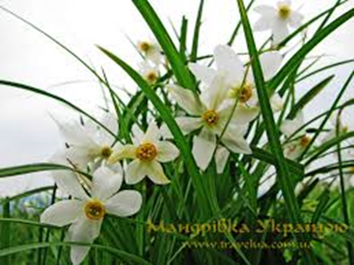
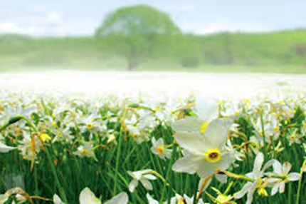
Protected areas
Valley of Narcissi protected massif
located at an altitude of 180–200 m.a.s.l. in the western part of Khustsko-Solotvynska Valley and lies in a flatland of the Khustets river flood plain.

Slide 9
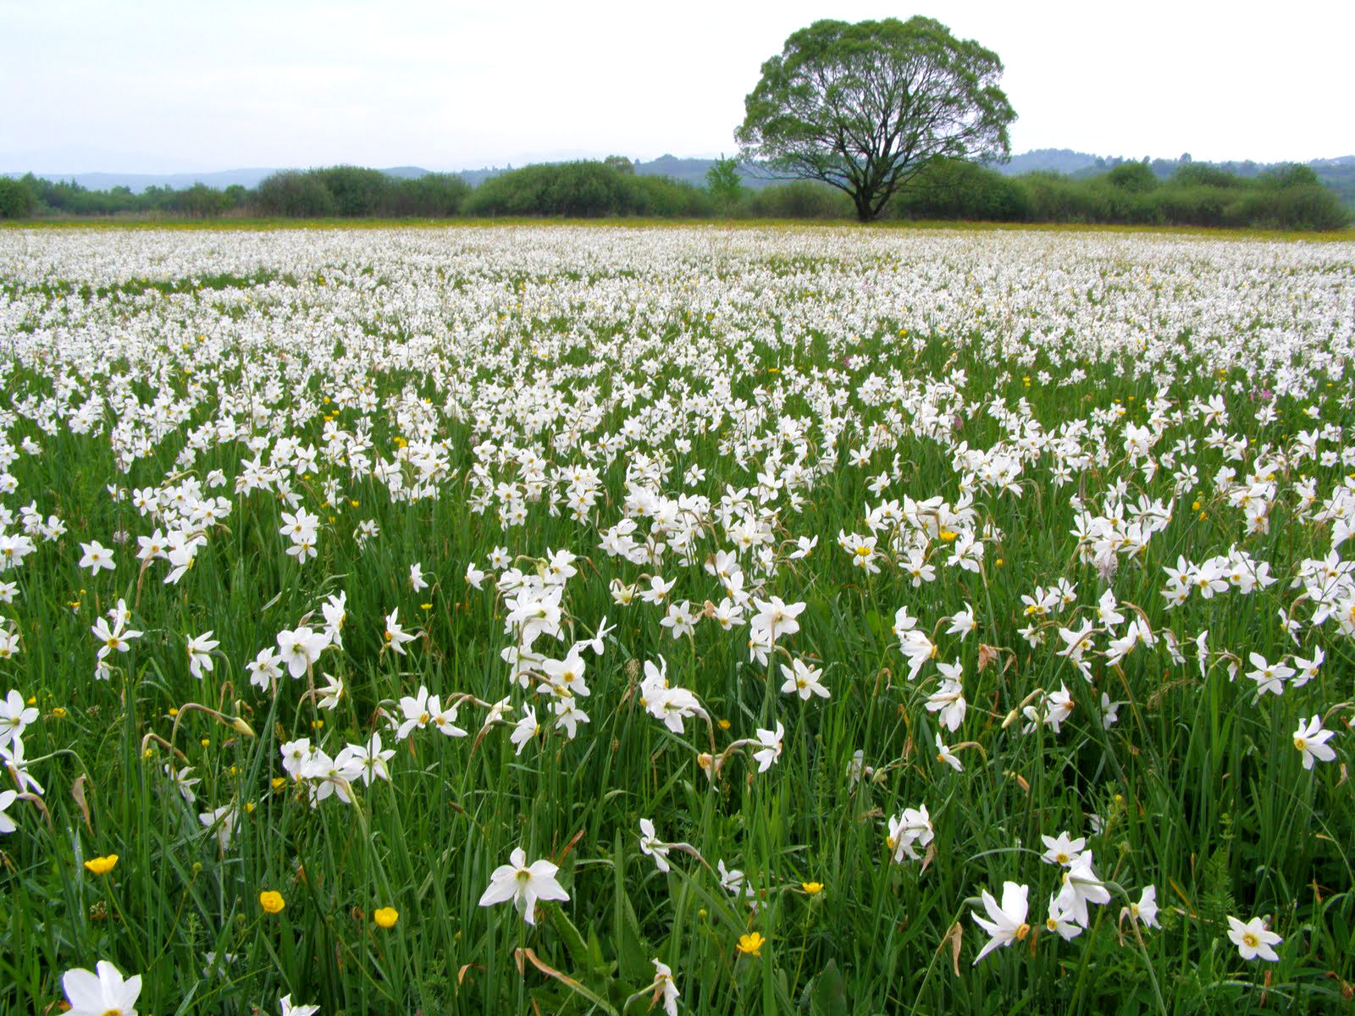

Slide 10
Protected areas
Svydovetskyi protected massif
the area of 6,580 hectares (16,300 acres) and is located at an altitude of 600–1883 m.a.s.l;
the highest region of the Svydovets mountains.

Slide 11
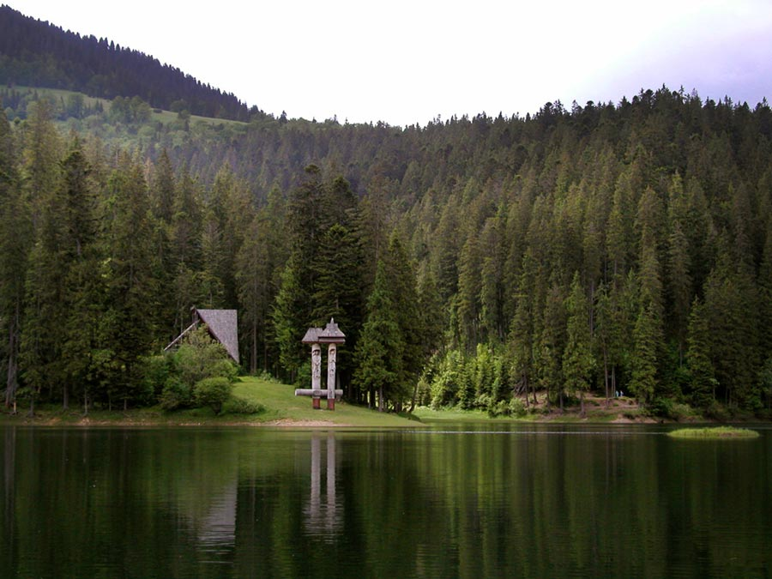
The most prominent sights
National Park "Synevyr”
Located in Mizhgirsky region.
Established in 1989;
The park area – 40 400 ha;
In the center of the park "Sea Eye" -lake Synevyr is located

Slide 12
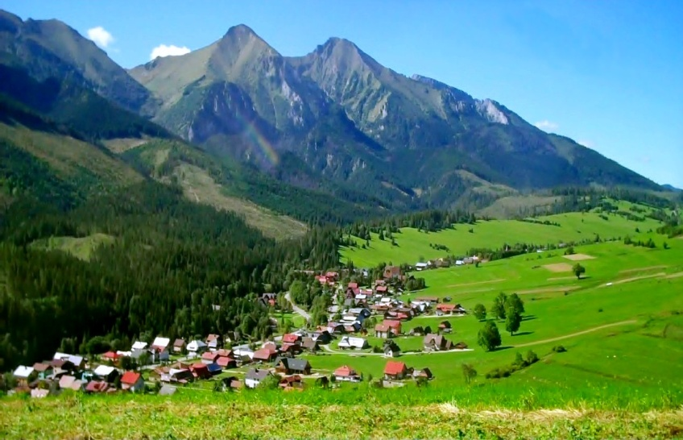
The most prominent sights
Hoverla mount
The hichest pick of UkraineTop 2061 mnpm. - Ukraine's highest peak.
Located in the Chornohora strip, in Eastern Beskyd. A frequent target for tourist's trips.

Slide 13
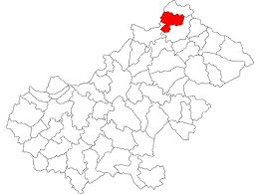
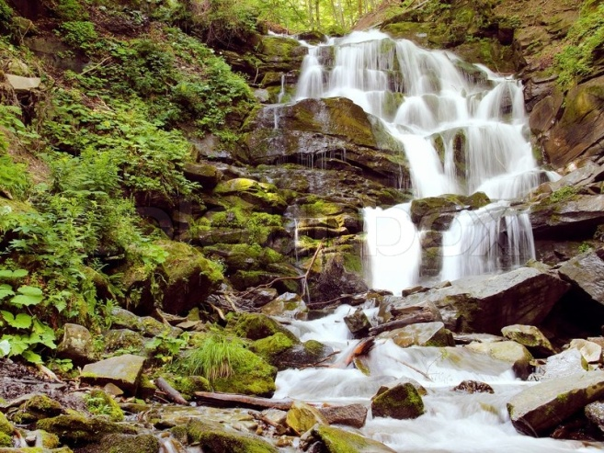
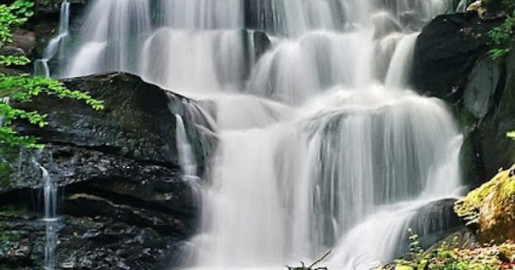
The most prominent sights
Waterfall Shypit
located on the Pylypets River, about 6 kilometres from the village of Pylypets, Mizhhiria Region,
14 metres high and 1km long

Slide 14
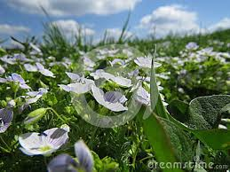
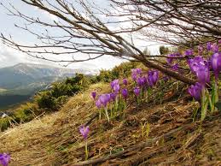
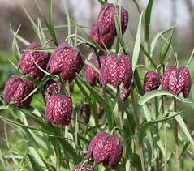
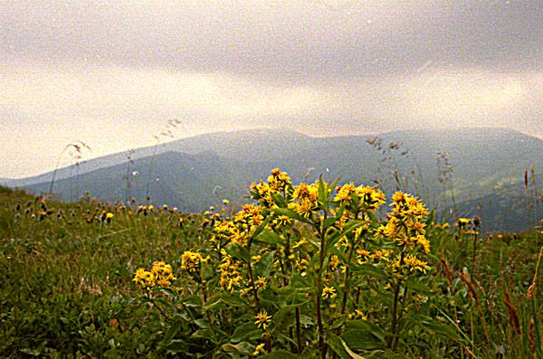
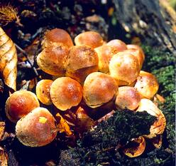
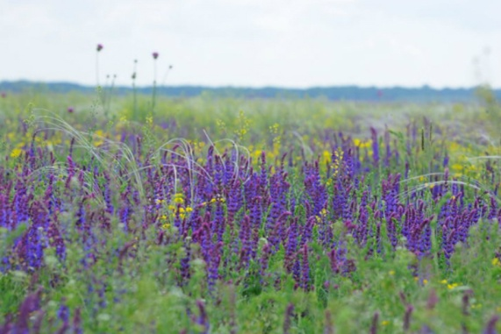
Flora of the Carpathians
262 fungi species, 392 species of lichens, 440 species of mosses and 1062 species of vascular plants.
The algal flora includes 465 species.
64 of plants species represented in this reserve are listed in the Ukrainian Red Data Book as well as in IUCN and the European Red Lists.

Slide 15
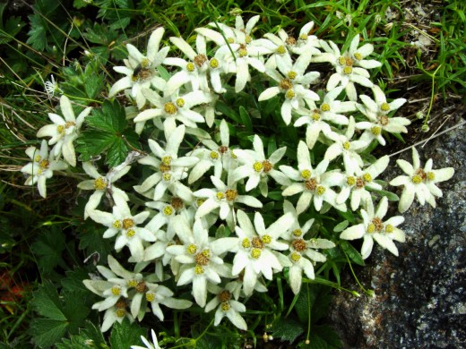
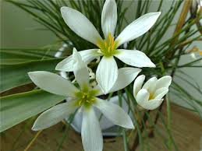
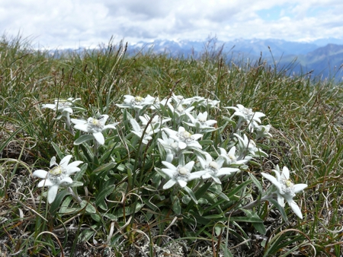
Flora of the Carpathians
Leontopodium alpinum (edelweiss)
a well-known mountain flower,
prefers rocky limestone places at about 1800–3000 m altitude.
non toxic, and has been used traditionally in folk medicine
found in remote mountain areas,
a symbol of alpinism, of
beauty and purity
giving this flower as a gift to a loved one is a promise of dedication.

Slide 16
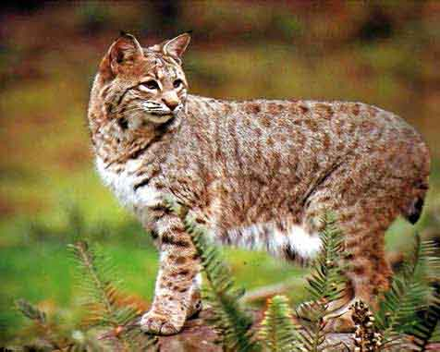
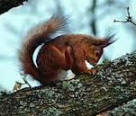
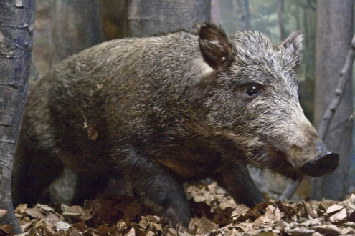
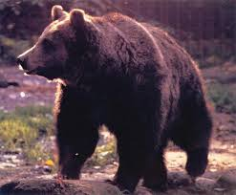
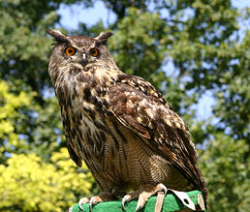
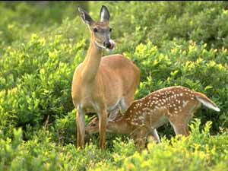
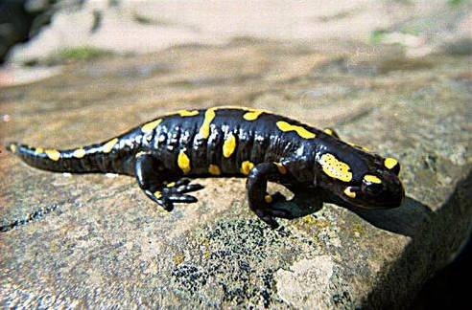
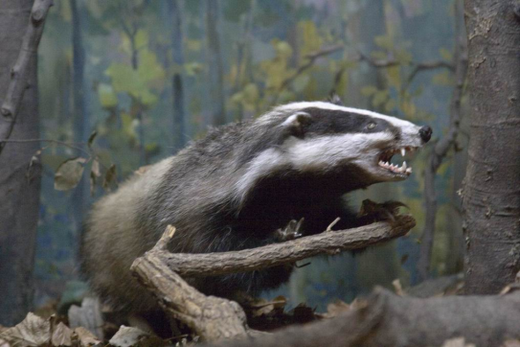
Fauna of the Carpathians
64 mammal species,
173 birds,
9 reptiles,
3 amphibians,
23 fish and more than 10,000 invertebrate species.
72 species are listed in the Ukrainian Red Book and in IUCN and the European Red Lists.

Slide 17
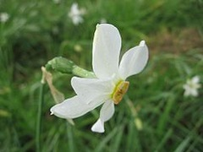
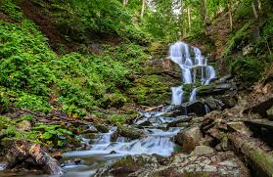
Welcome to the Carpathians!
eTwin team from Ukraine

