Slide 1
Visit to City Hall
ORANGE TEAM

Slide 2
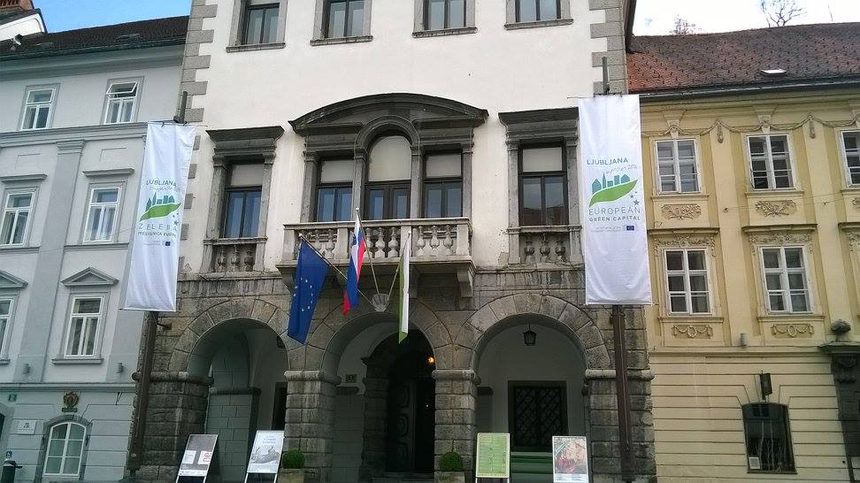
Ljubljana Town Hall is the town hall in Ljubljana, the capital of Slovenia, is the seat of the City Municipality of Ljubljana. It is located at Town Square in the city centre close to Ljubljana Cathedral.The monument, designed by the architect Jože Plečnik, was removed and destroyed by the Fascist Italian occupation authorities of the Province of Ljubljana in April 1941.

Slide 3
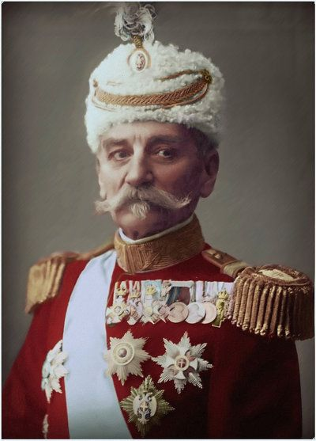
The original building was built in a Gothic style in 1484, probably according to plans by the Carniolan builder Peter Bezlaj.Between 1717 and 1719, the building underwent a Baroque renovation with a Venetian inspiration by the builder Gregor Maček, Sr., who built based on plans by the Italian architect Carlo Martinuzzi and on his own plans. In the mid-1920s, a monument to the Serbian and first Yugoslav king Peter I was erected in the entrance of Town Hall.
king Peter I

Slide 4
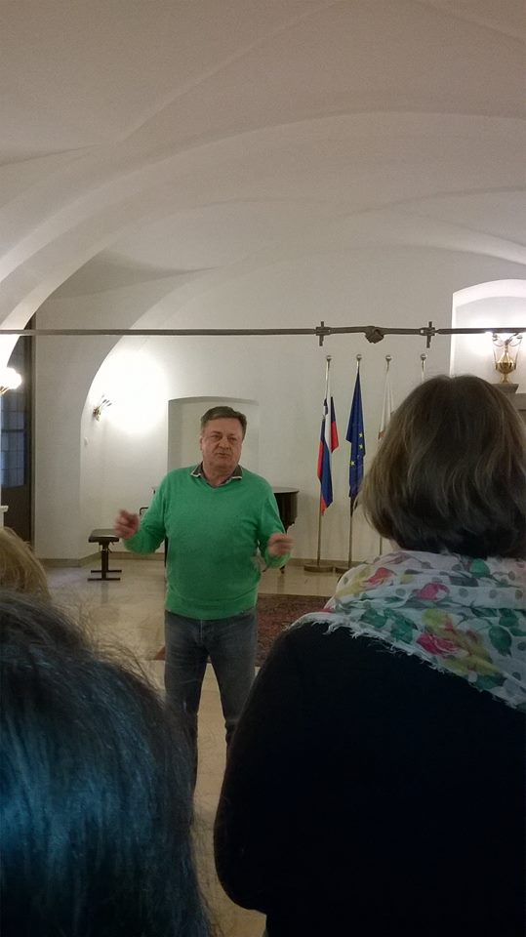
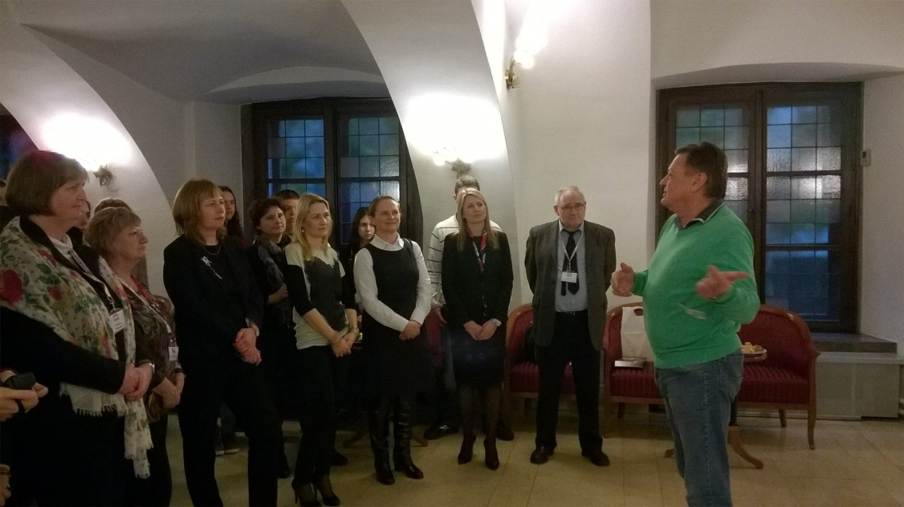
We were there on Monday. The mayor’s name of Ljubljana is Zoran Janković.He is the mayor of Ljubljana since 25 of March 2012.

Slide 5
The mayor told us that Ljubljana is the Green Capital 2016.This means it’s the first and only green oasis in central and south eastern Europe.

Slide 6
THANK YOU FOR YOUR ATTENTION

