Slide 1
PÁPA AIR BASE

Slide 2
INFORMATION
Opened in 1936.
There are 3 active air bases, and the only active air base in Western-Hungary.
During the Second World War several German and Hungarian units used the Air Base.
After the Second World War a Russian fighter regiment was stationed in Pápa.

Slide 3
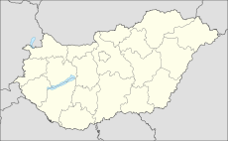
In 1961 the Hungarian People's Army's Air Force 47th Fighter Regiment became the home regiment of the air base.
PÁPA AIR BASE

Slide 4
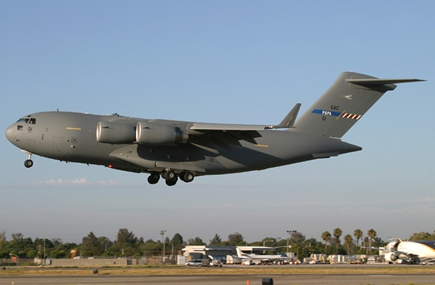

Slide 5
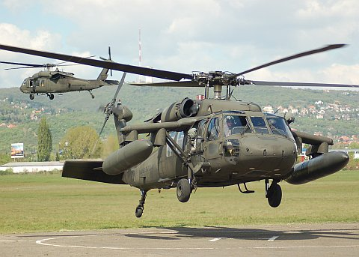

Slide 6
THANK YOU! ☺

