Slide 1
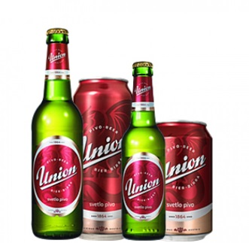
The largest joint-stock enterprises in Slovenia

Slide 2
The company produces
Sola
refreshing non-alcoholic beverages
near water ZA
water Nula
Zala spring water

Slide 3
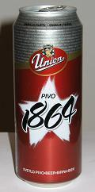
HISTORY
1864: The brewery was founded
1967: Start of Production
1909: Foundation about the shareholding brewery
1911: Incoperation of other brewerys
1923: Production of yeast and methylated spirits
1946: Nationalization of the brewery
1968: Modernization of brewery

Slide 4
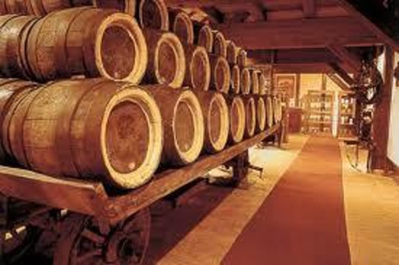
HISTORY
1971: New packaging
1982: New brewing and storage plant
1986: Brewery Museum
1990: New incorporation
1991: Transformation into a shareholding company
2008: Innovation of the union trademark
2009: 145th anniversary of the brewerys existence
2014: Renovation of union brands

Slide 5
„Our primary goal is the production and sale of quality beer, non-alcoholic beverages and spring water.“

Slide 6
Employees
employs nearly 350 people
education, skills and aptitudes
50% of workers have college-equivalent qualifications

Slide 7
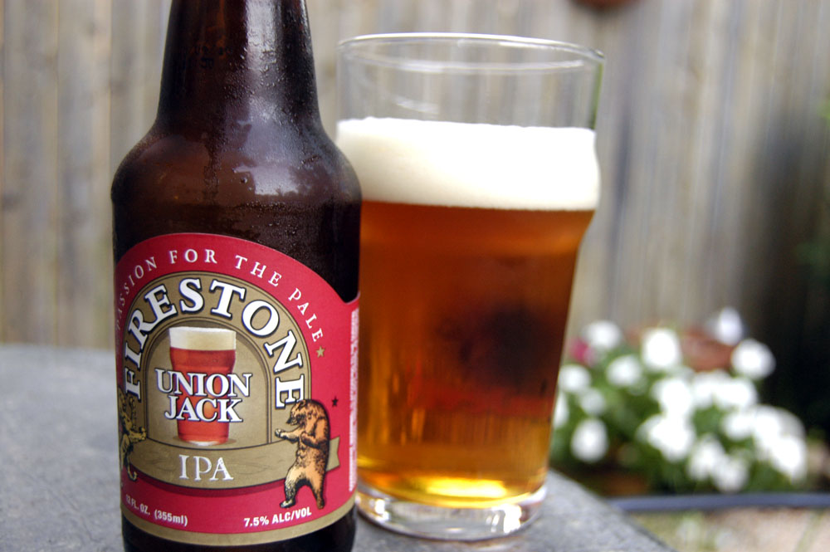
THANK YOU FOR YOUR ATTENTION

