Slide 1
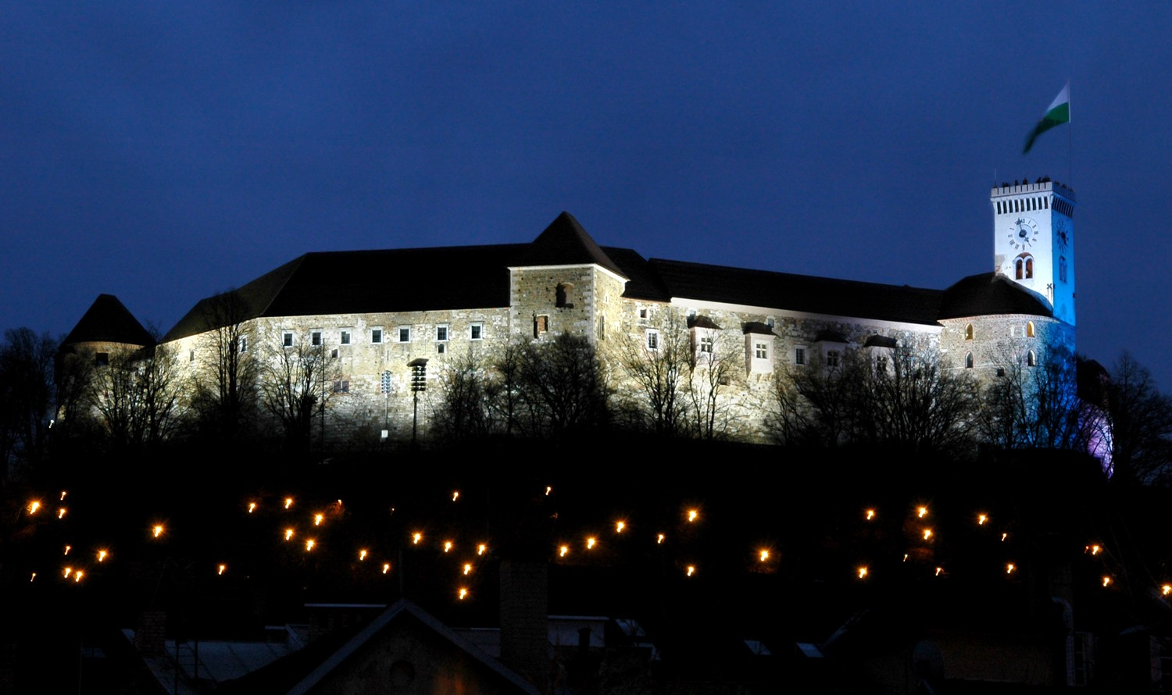
Experience of Ljubljana

Slide 2
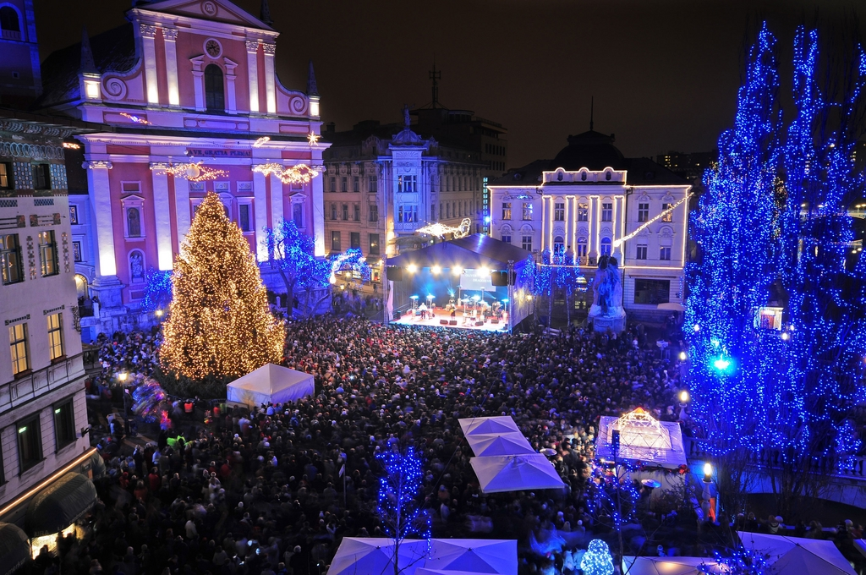
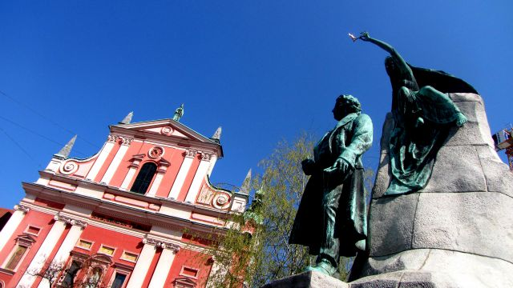
Prešeren square
Is the central square in Ljubljana, the capital of Slovenia
We saw the church and the sculpture
Prešeren is looking at hers lovers house

Slide 3
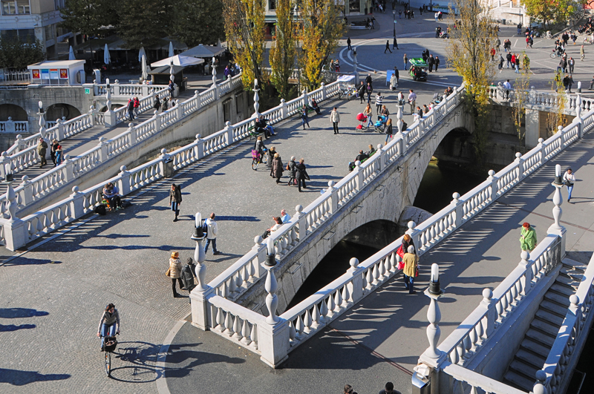
Triple bridge
Is a group of three bridges across the Ljubljanica River
It connects the Ljubljana's historical, medieval, town on one bank, and the modern city of Ljubljana on the other

Slide 4
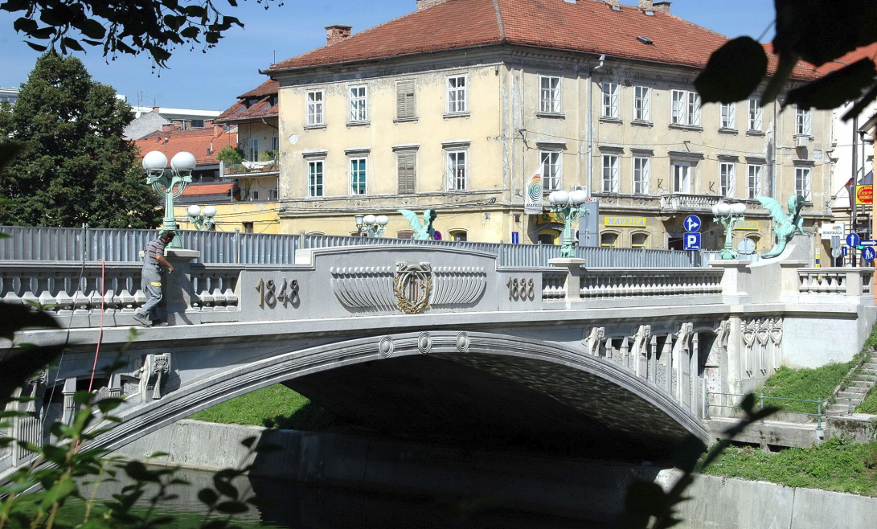
Dragon bridge
It crosses the Ljubljanica River between Kopitar Street (Kopitarjeva ulica) and Ressel Street (Resljeva cesta), to the north of the Ljubljana Central Market at Vodnik Square

Slide 5
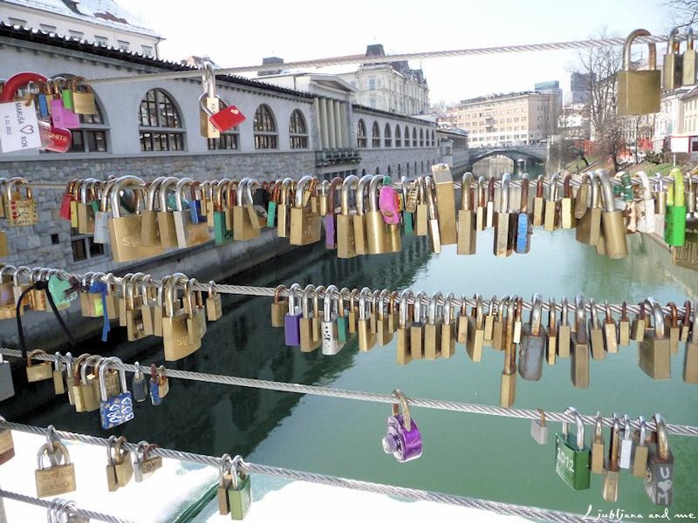
Butchers or lovers bridge
is a footbridge crossing the river Ljubljanica in Ljubljana
It connects the Ljubljana Central Market and the Petkovšek Embankment (Petkovškovo nabrežje)
It was expressed by an architect Jože Plečnik

Slide 6
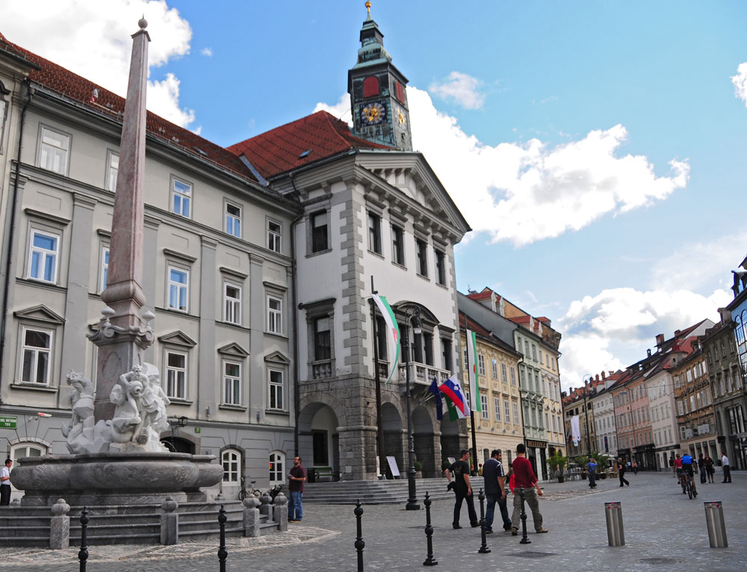
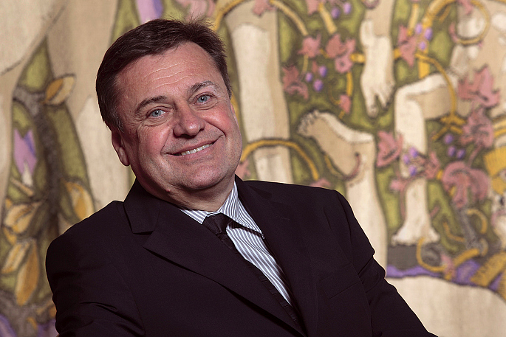
Zoran Janković
Mayor of the City of Ljubljana
He wore green because Ljubljana is a green capital of Europe and it resembles it
He welcomed us and talked about his job

Slide 7
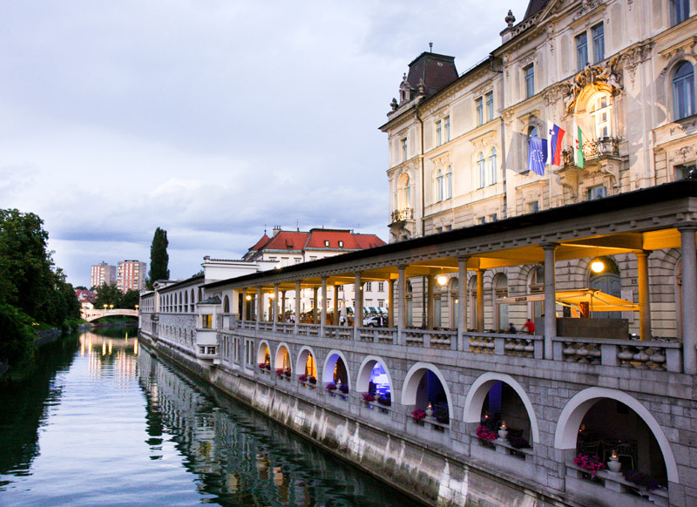
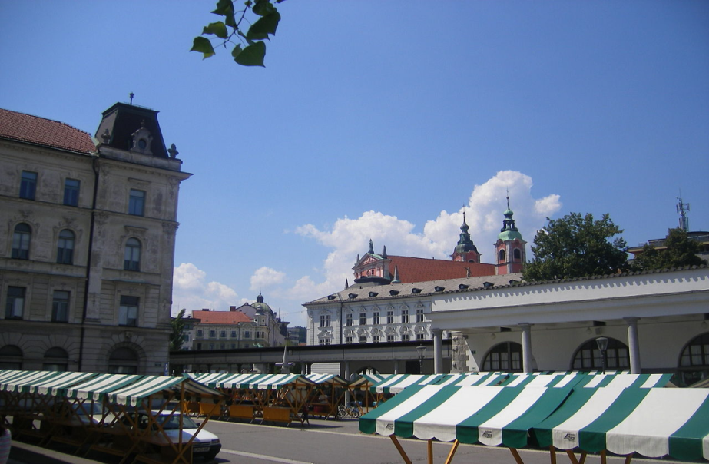
Ljubljana Central Market
It was designed after an earthquake by Jože Plečnik
Good position because the river is close
Slovakians say that it is cheap

Slide 8
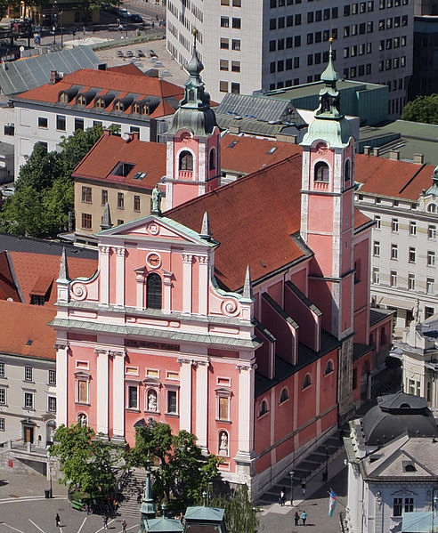
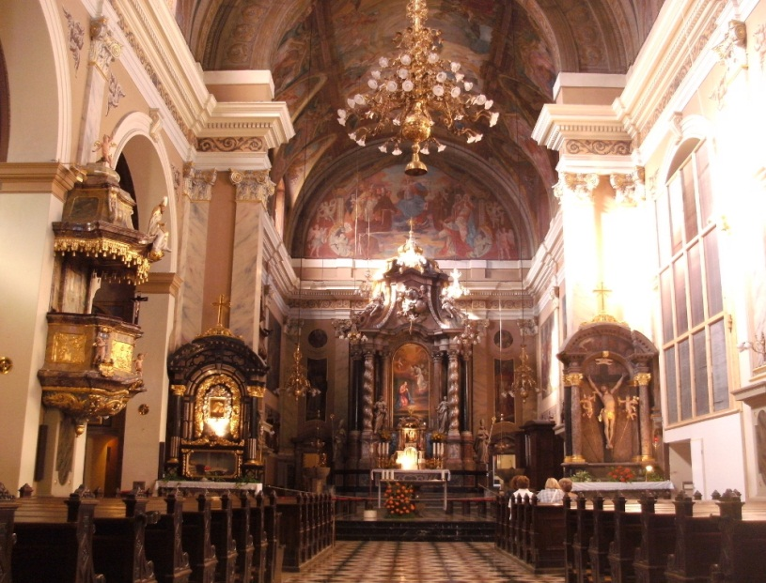
Franciscan Church of the Annunciation
is a Franciscan church located on Prešeren Square in Ljubljana
Since 2008, the church has been protected as a cultural monument of national significance of Slovenia

Slide 9
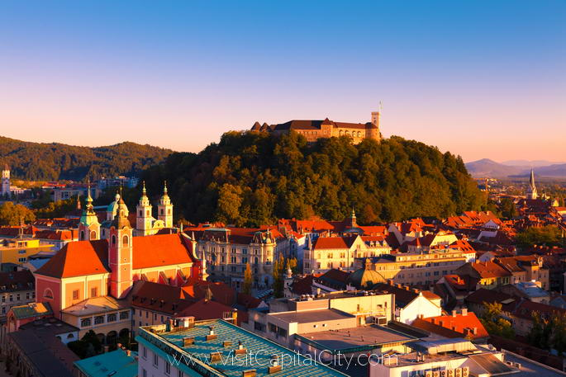
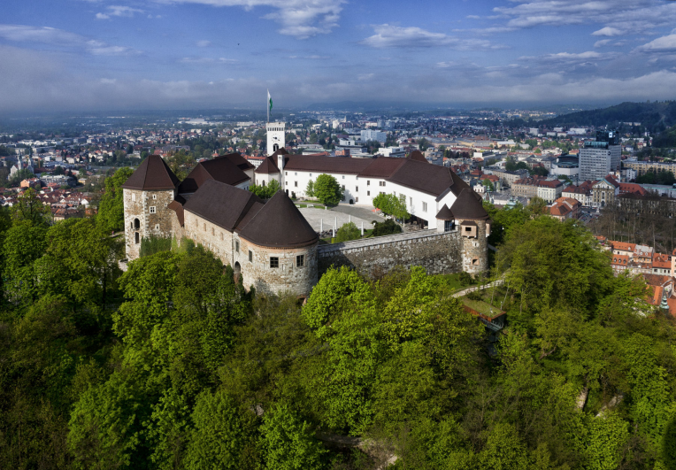
Ljubljana castle
Is a castle complex standing on Castle Hill above the downtown of Ljubljana
Originally a Medieval fortress, probably built in the 11th century and rebuilt in the 12th century
It is a key element of the Ljubljana skyline

Slide 10
Thank you for your attention!
GREEN TEAM
Csaba – Slovakia Vendulka – Czech Rp.
Sanel - Slovenia Szimona - Hungary
Daniel – Slovakia Madalina - Romania
Valentina - Bulgaria

