Slide 1
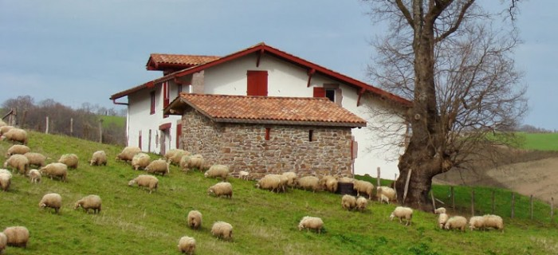
Agritourism

Slide 2
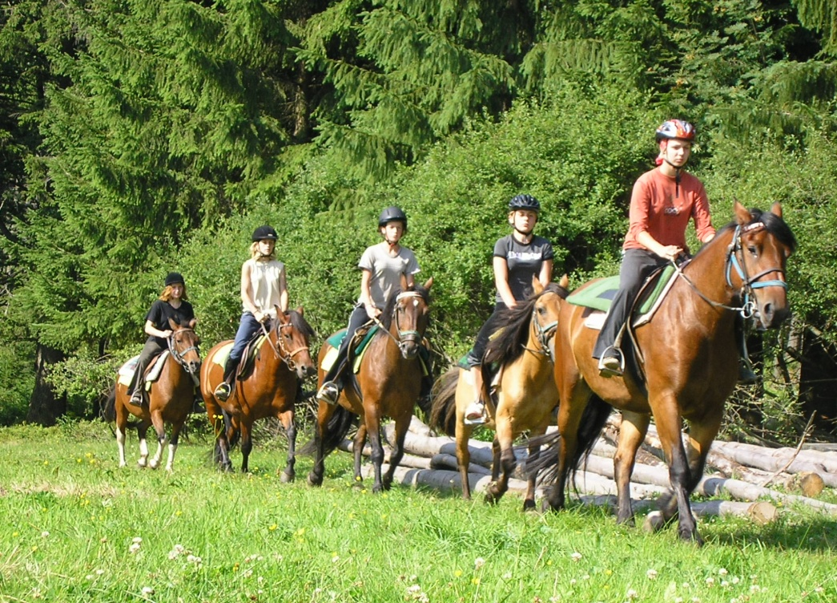
What is agritourism?
Business conducted by farmers on their
working operation for the enjoyment
and education of visitors that generates
supplemental income for the owner:
Outdoor recreation
Farm Market
Corn Maze
Pick-Your-Own-Operation
Bed and Breakfast
Winery Tasting Room
Entertainment
Educational experience

Slide 3
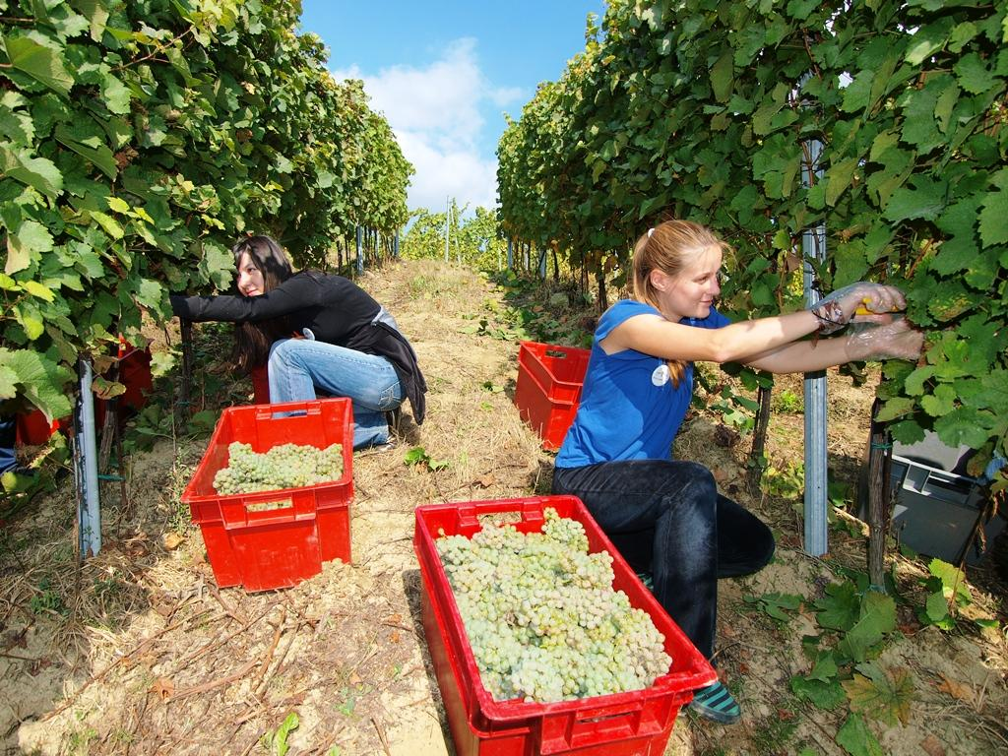
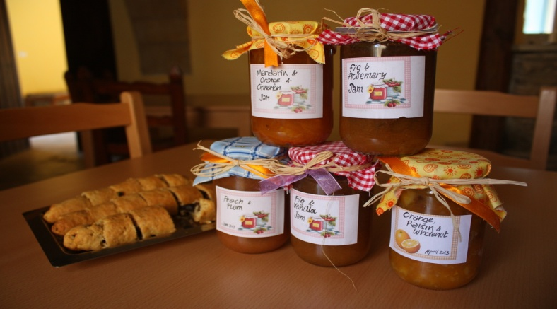
Agritourism is also...
business rooted in agriculture that is depends
upon and promotes tourism. It is a style of
vacation in which hospitality is offered on farms
Rural Life and Farm museums
Farms
Horse racing

Slide 4
Agritourism
is often practiced in wine growing regions, as in Italy, France and Spain.
In USA, Agritourism is wide-spread and includes any farm open to the public at least part of the year.
Tourists can pick fruits and vegetables, ride horses, taste honey, learn about wine, shop in gift shops and farm stands for local and regional produce or hand-crafted gifts, and much more.
Each farm generally offers a unique and memorable experience suitable for the entire family

Slide 5
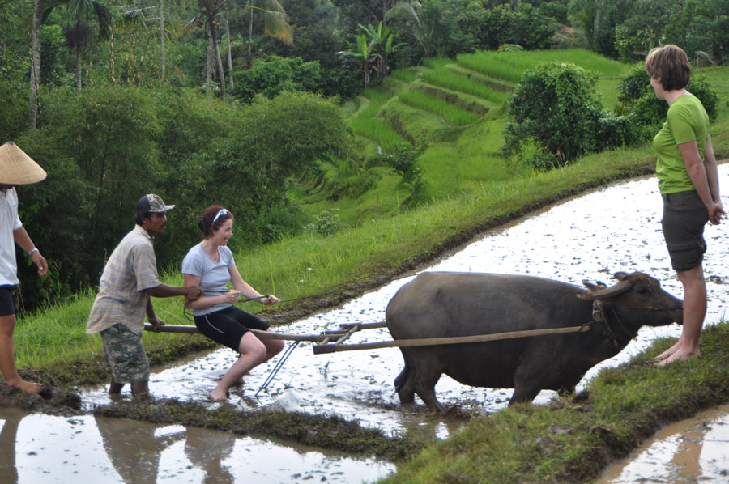
Agritourism
called „ agritourismo“ in Italy, and
„sleeping in the straw“ in Switzerland,
agritourism is well established in Europe,
New Zealand and Australia.
There is growing interest in the rural life
experience.

Slide 6
Why Agritourism ?
While agritourism is a booming industry, agriculture is not,
Only 15% inhabitants of the central Europe farm today,
Yet, agribusiness is the top industry in the Commonwealth,
Increasing farm income preserves family farms and the rural economy,

Slide 7
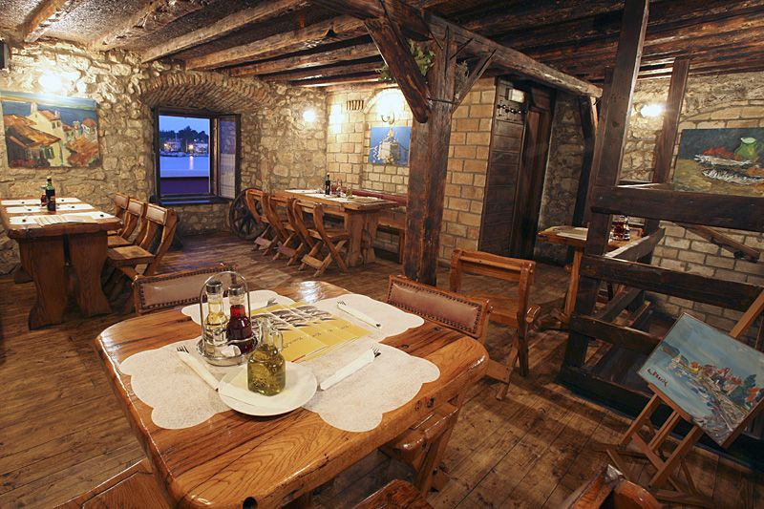
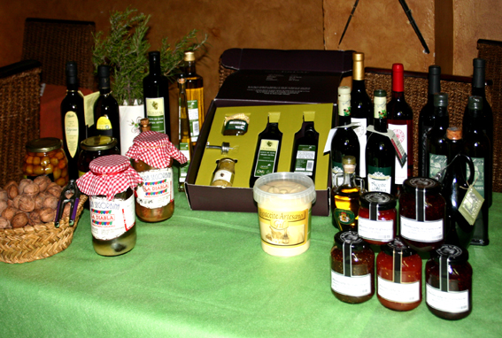
Tourism
A leading economic engine for most countries
7 million people visit fairs annually

Slide 8
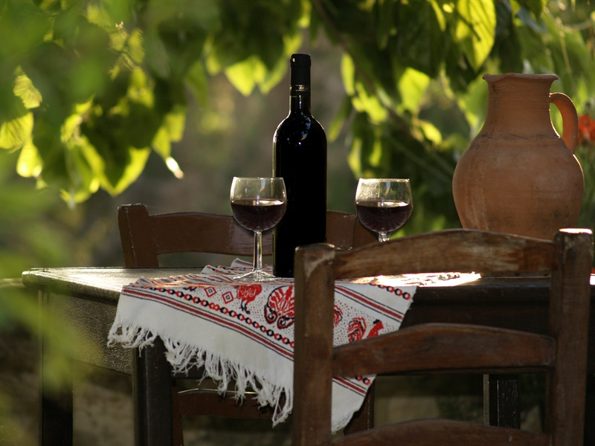
Problems
Struggling dairy farms
Insufficient cash flow
High dairy production costs
Concern over making monthly notes

Slide 9
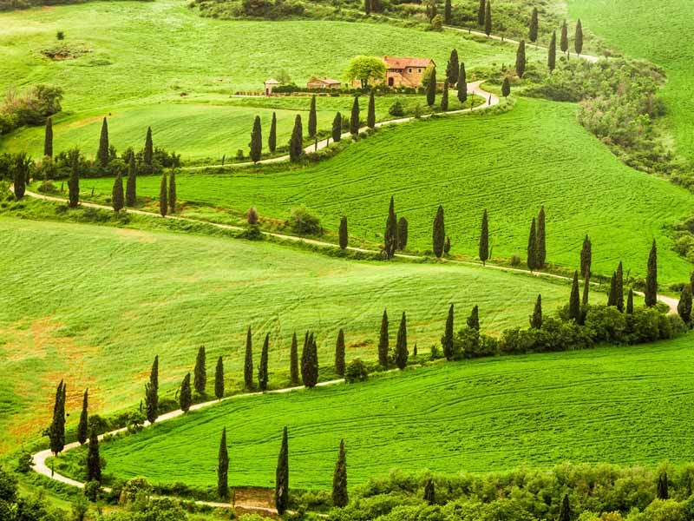
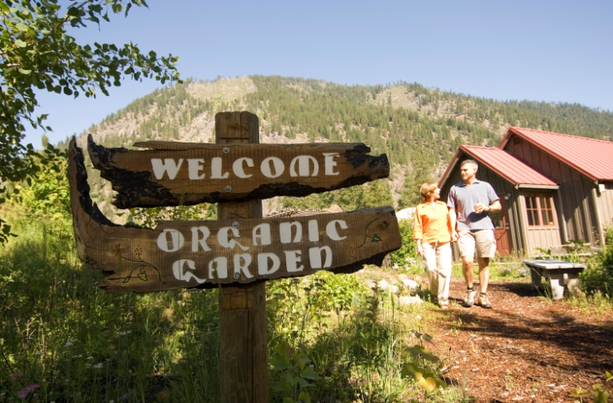
Solution
Diversify the farm
Find a niche
Surround yourself with those who care
Give a fantastic field trip
Make sure the price is right
Health, safety, security
Be hospitable!

Slide 10
Use of existing media
web site links
brochures
tourism guides
special events
stationary
radio, press, TV
word of mouth

Slide 11
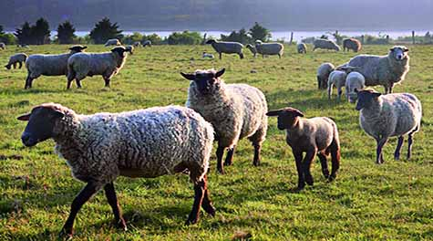
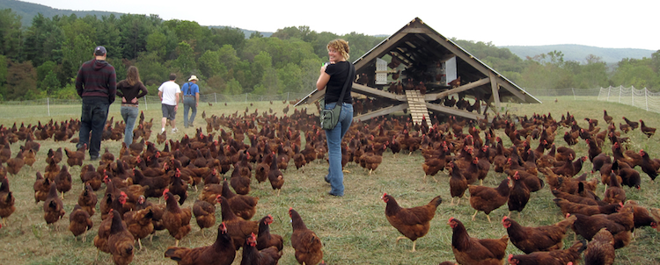
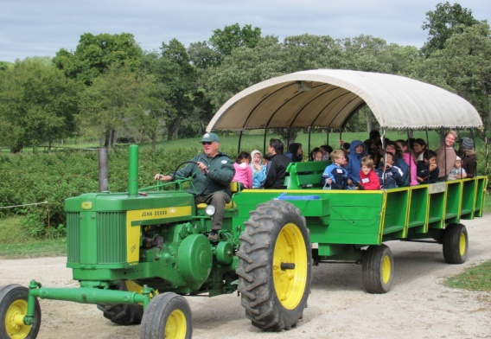
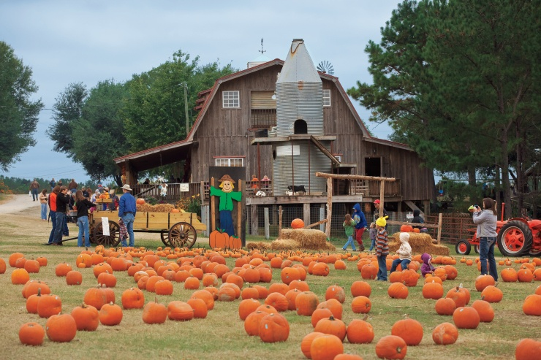
Agritourism ideas
Horseback riding
Wildlife-viewing/ photography
Fee fishing
Picnicking/camping
Fee hunting
Cross-country riding
School tours
Garden/winery tours
Agricultural exhibits
Agricultural Research stations
Exotic farm animals
Festivals/fairs
Dog trials/training
Organic gardening

Slide 12
Your task
Make up your own
Agritourism plan in your contry/region/town
Give some examples of possibilities and offer some activities, local products, places/routes and daily programmes
Follow the credo „ HEALTH,
SAFETY,
SECURITY“

