Slide 1
Light orange group
Esztergom, Bratislava

Slide 2
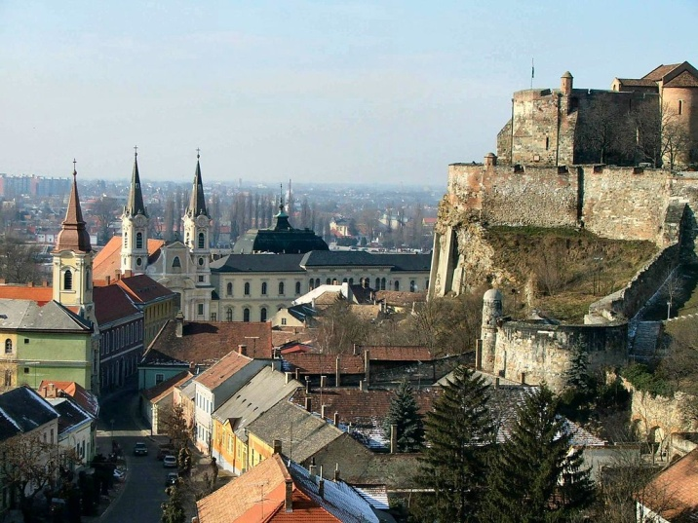
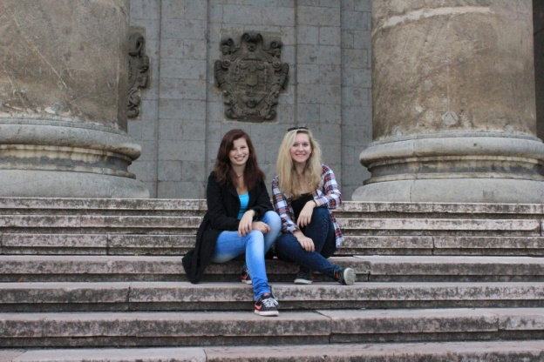
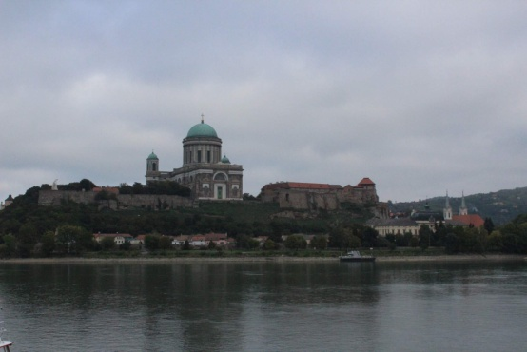
Esztergom
is a city in northern Hungary
on the right bank of the river Danube, which forms the border with Slovakia there

Slide 3
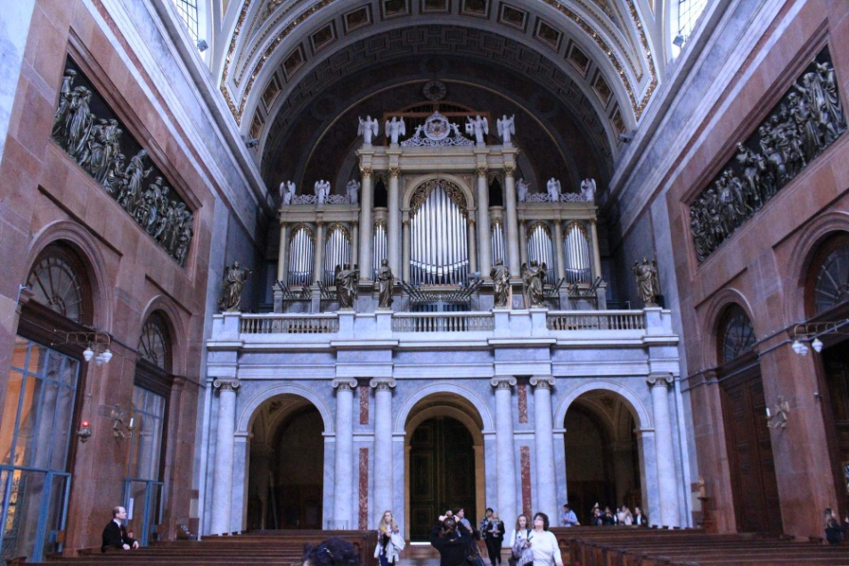
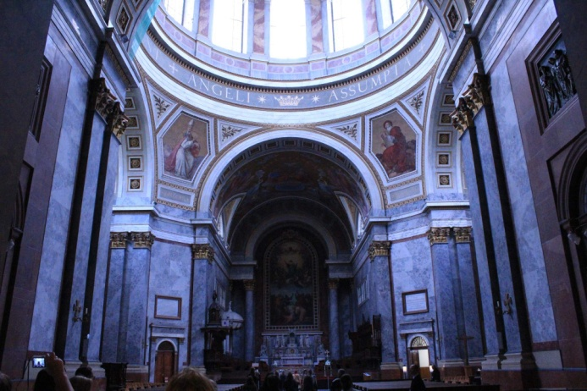
Basilica
the seat of the Catholic Church in Hungary
it is the biggest building in Hungary

Slide 4
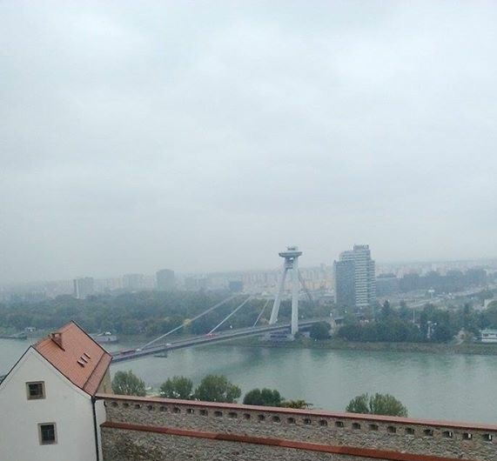
Bratislava
The capital city of Slovakia
Bratislava is the seat of national government, the presidency, and the parliament.
It has several museums, galleries and of other educational, cultural and economic institutions.

Slide 5
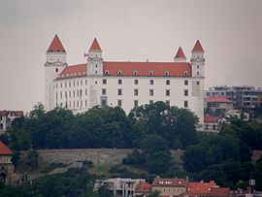
Bratislava castle
There is a small Old Town, and a castle called Bratislavský Hrad.
The Danube river goes through Bratislava.
is the main castle of Bratislava

Slide 6
Thank you for your atention!

