Slide 1
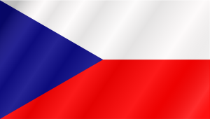
Nature in the Czech Republic
By: Klára Vaňková, Vendula Voláková, Sára Kubálková

Slide 2
Content
1. National parks in our country
2. National park Šumava
3. Protected landscape area Blanský forest
4. Protected landscape area Třeboňsko
5. Flora-protected flowers and trees
6. Fauna-protected animals
7. Nature reserves nearby Tábor

Slide 3
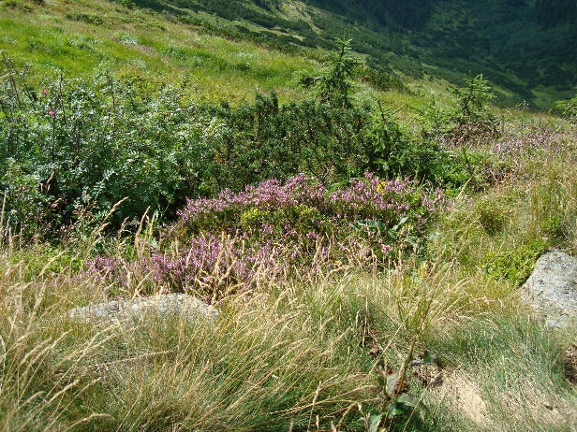
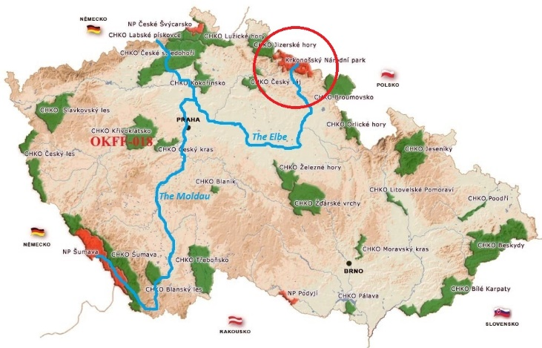
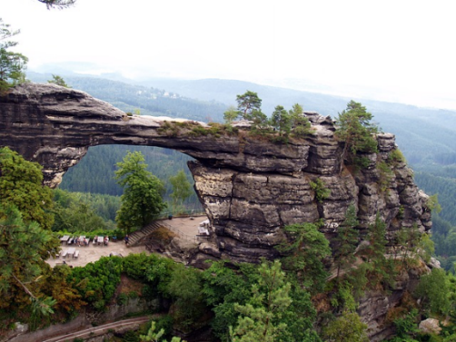
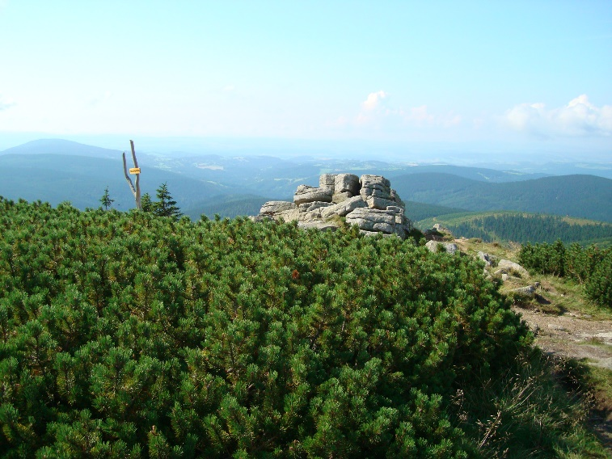
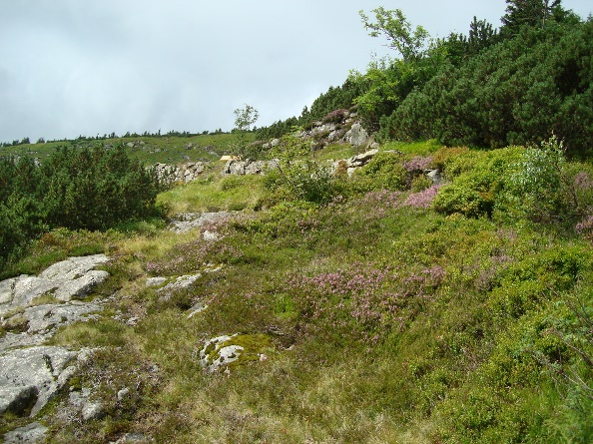
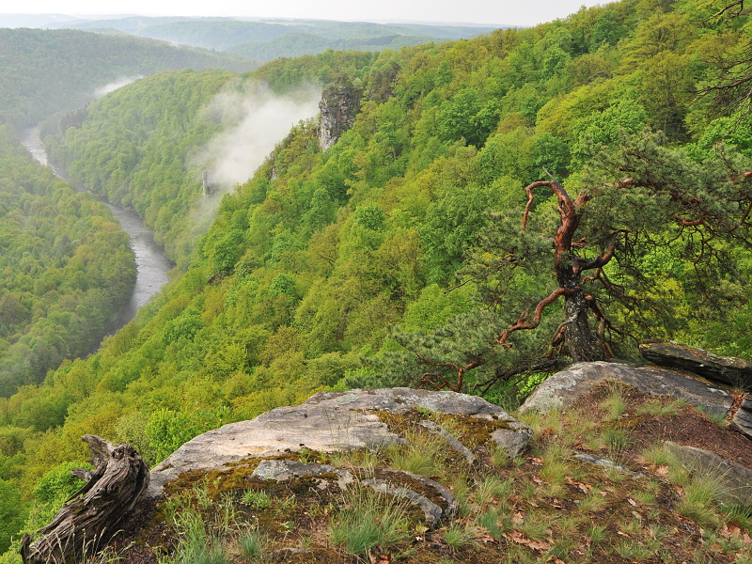
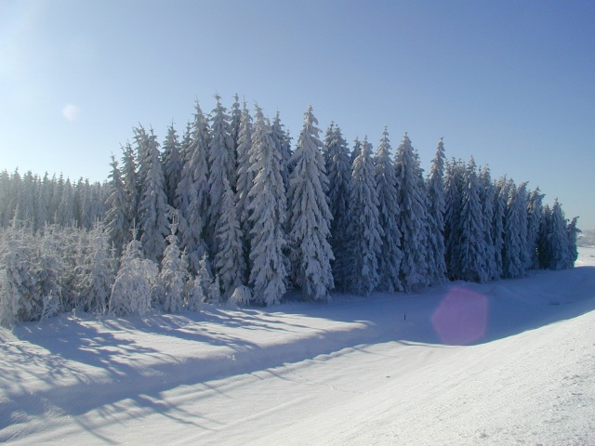
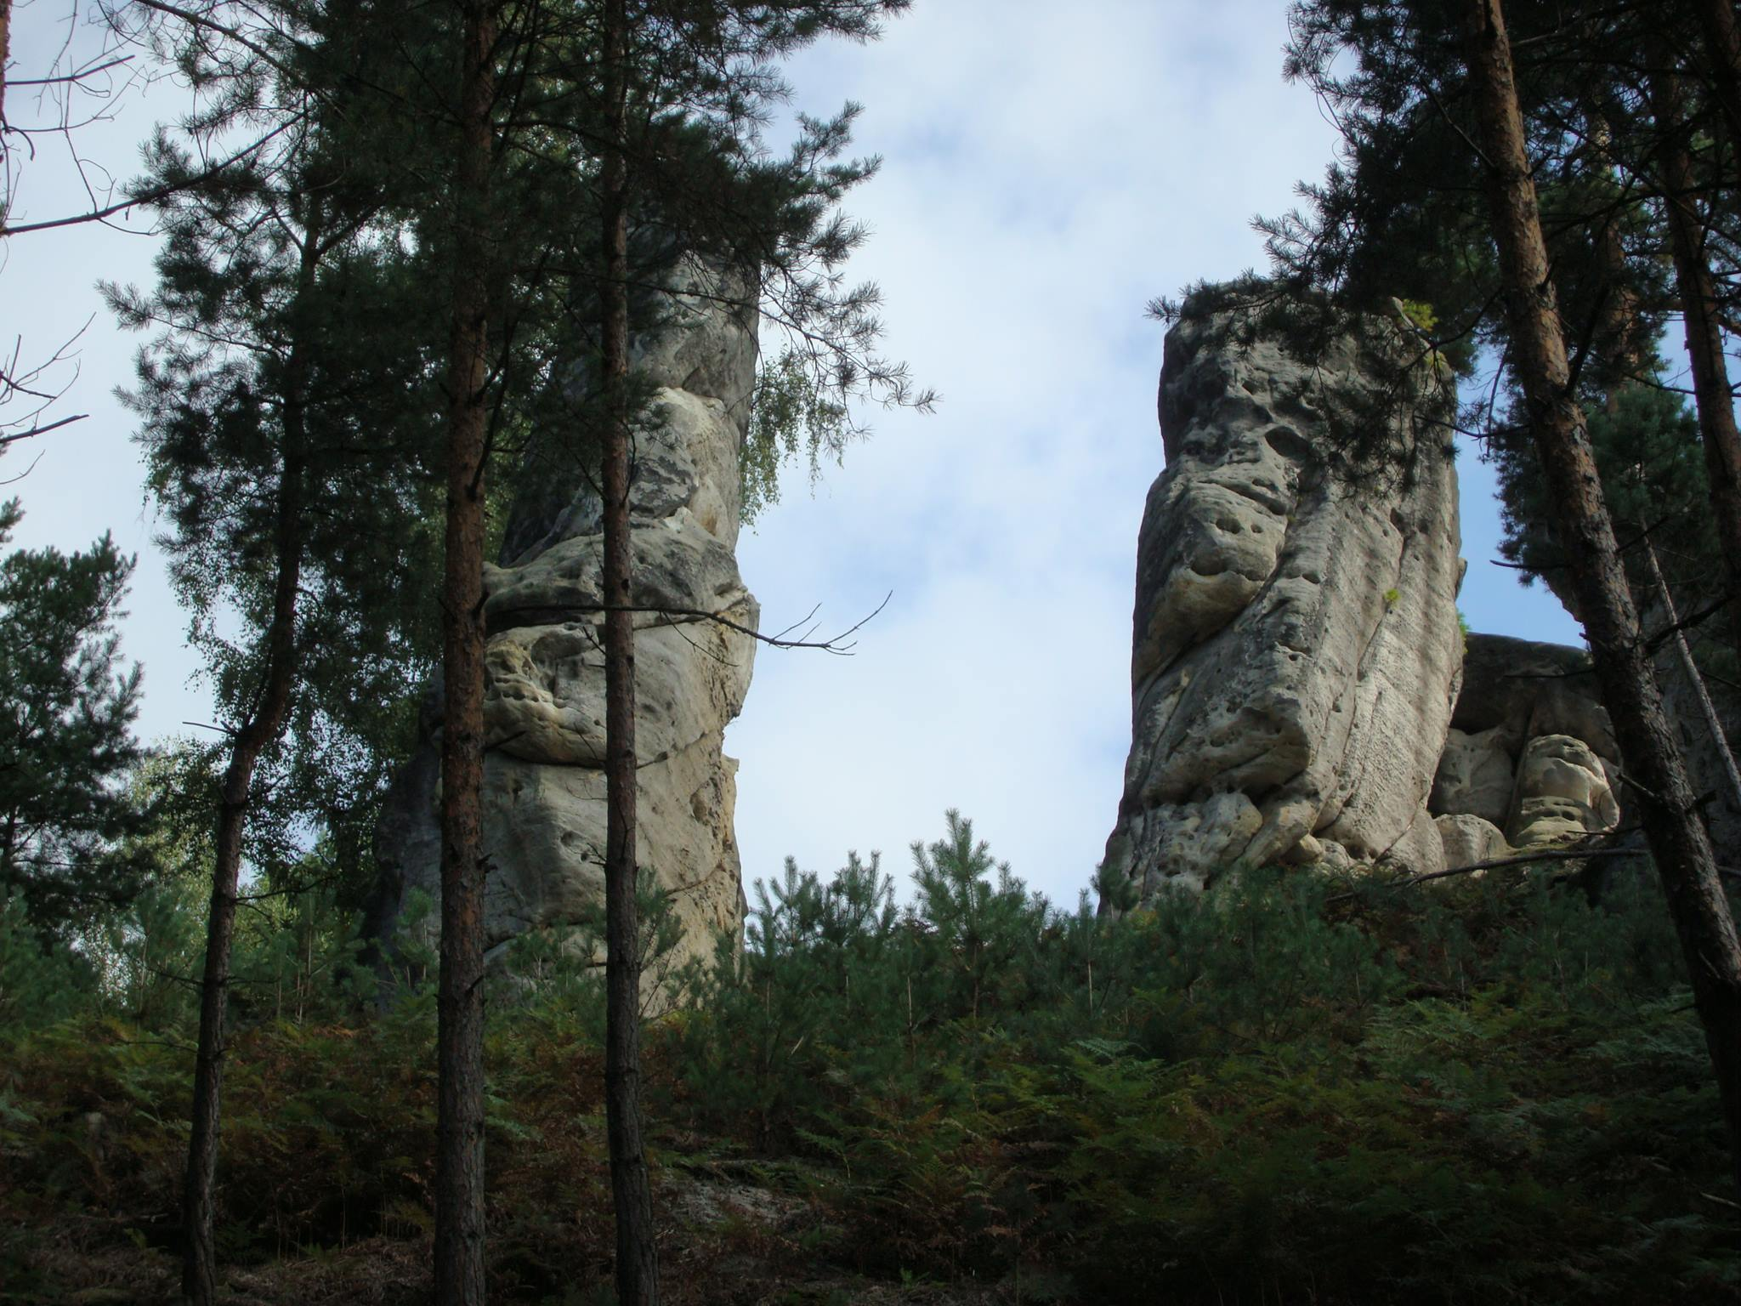
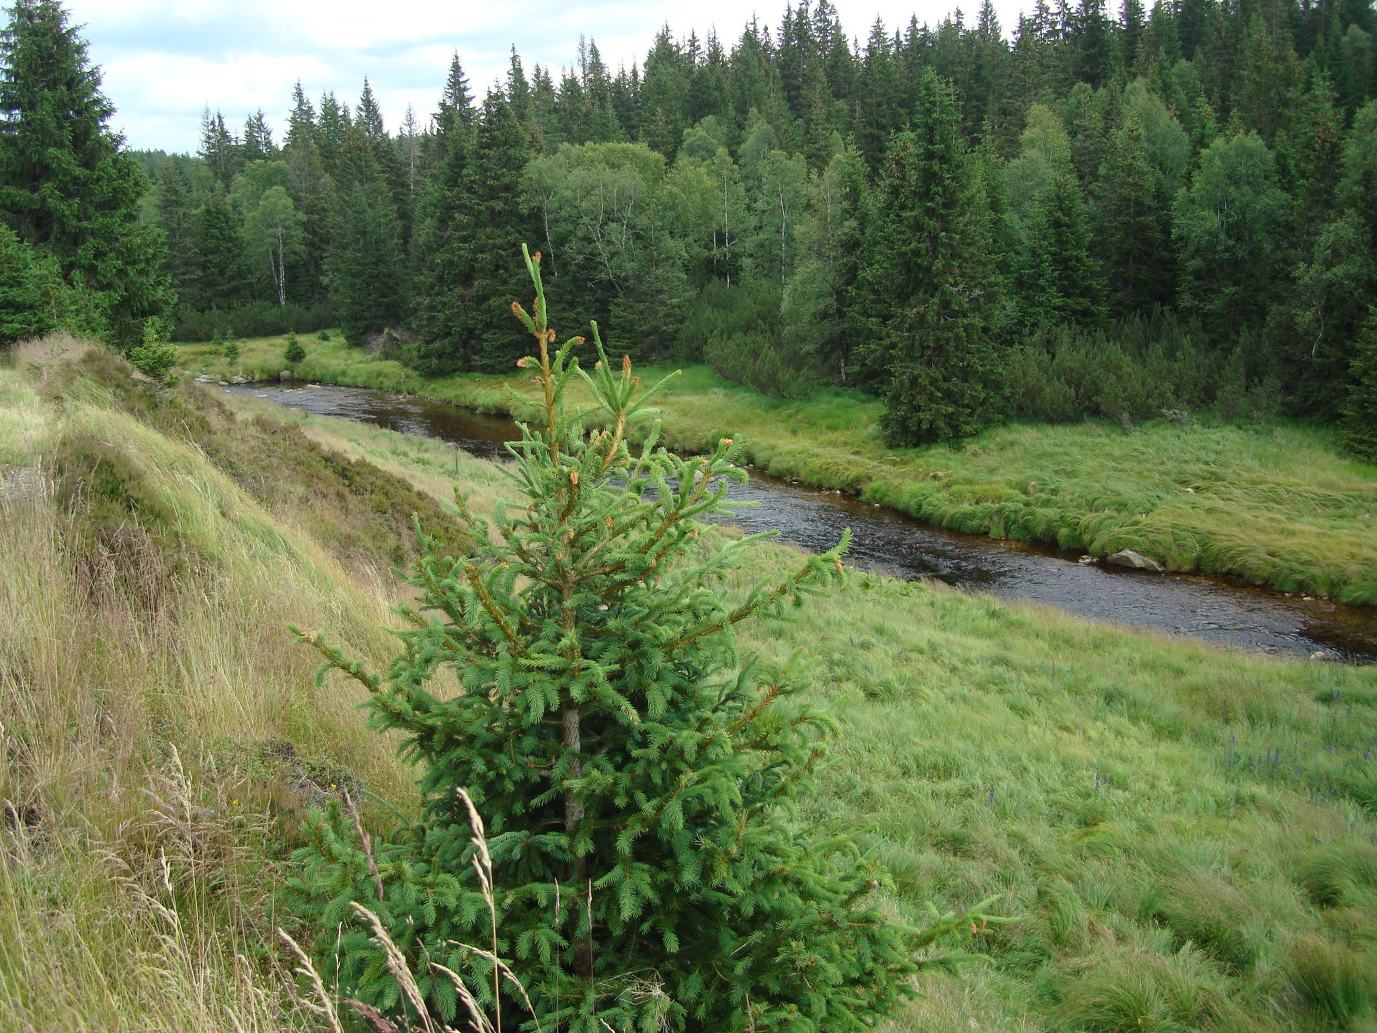
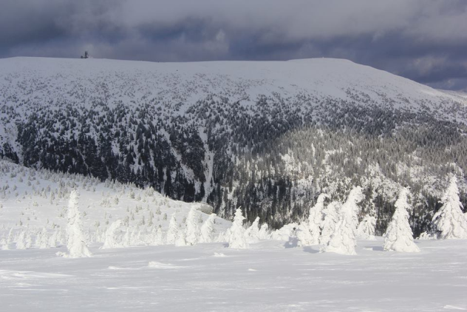
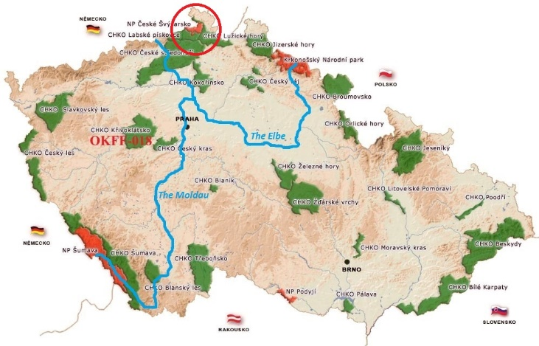
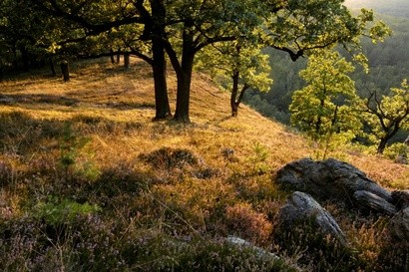
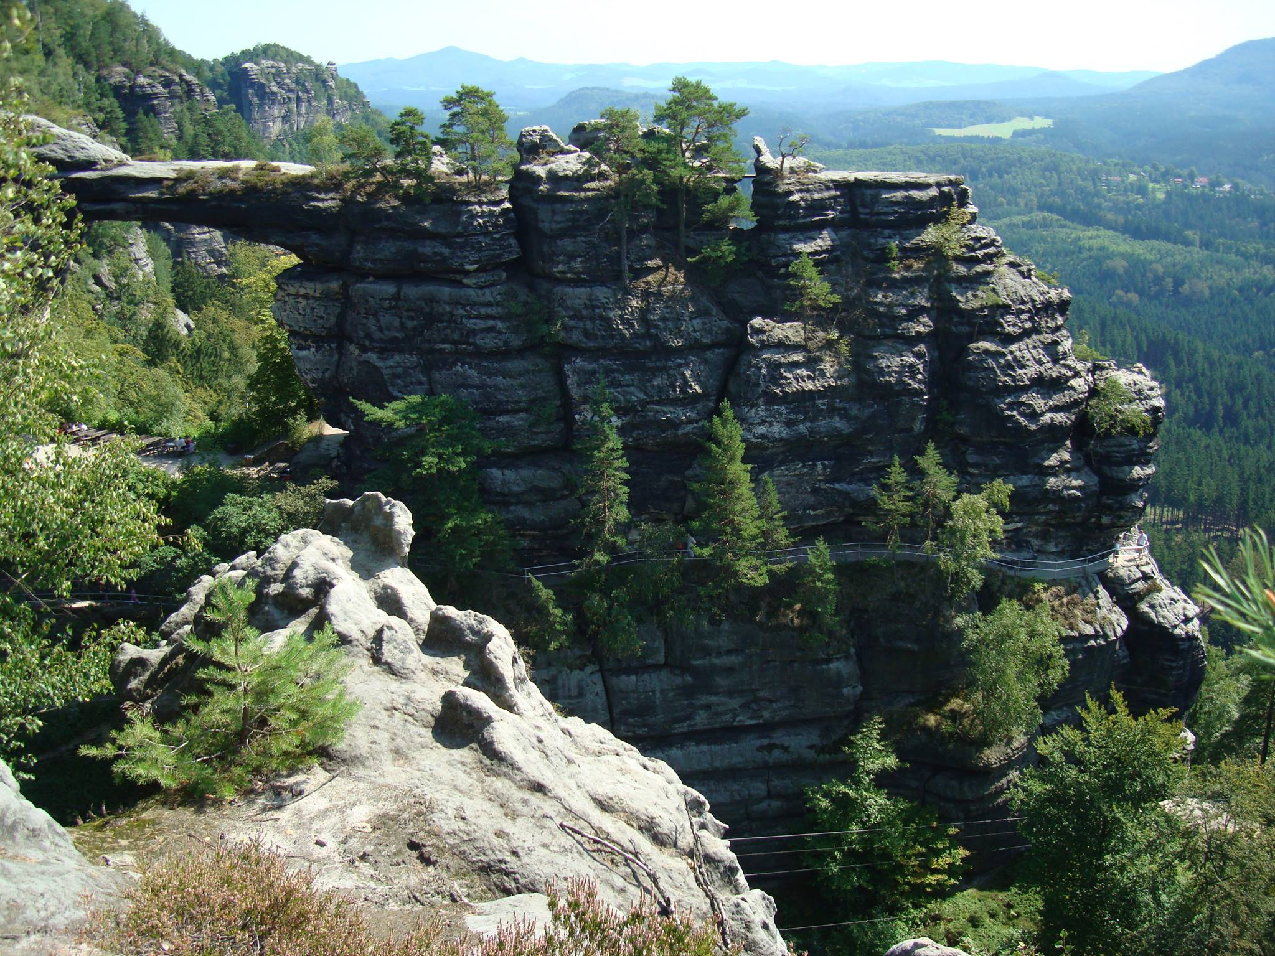
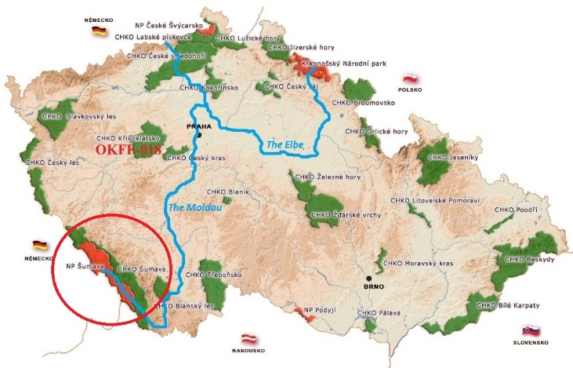
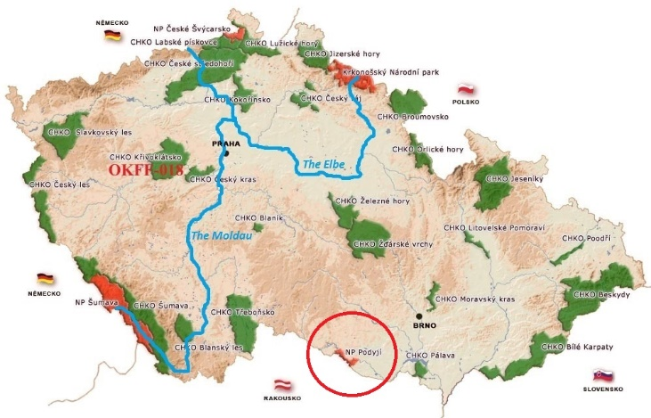
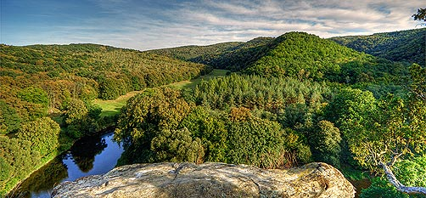
List of National Parks
1. National park of Krkonoše – 17 May 1963
2. National Park of Czech Switzerland – 1 January 2000
3. National Park of Podyjí – 20 March 1991
4. National Park of Šumava – 20 March 1991

Slide 4
National Park of Šumava
National Park in the Southern Bohemia
Length: 100 km
Width: 20 km
Area: 680 km2
Since 1990 protected Biospherical Reserve of UNESCO
The Vltava/Moldau river springs here (the longest river in the Czech Republic)
Trees not well adapted to the harsh local climate (such as strong winds) and bark beetle

Slide 5
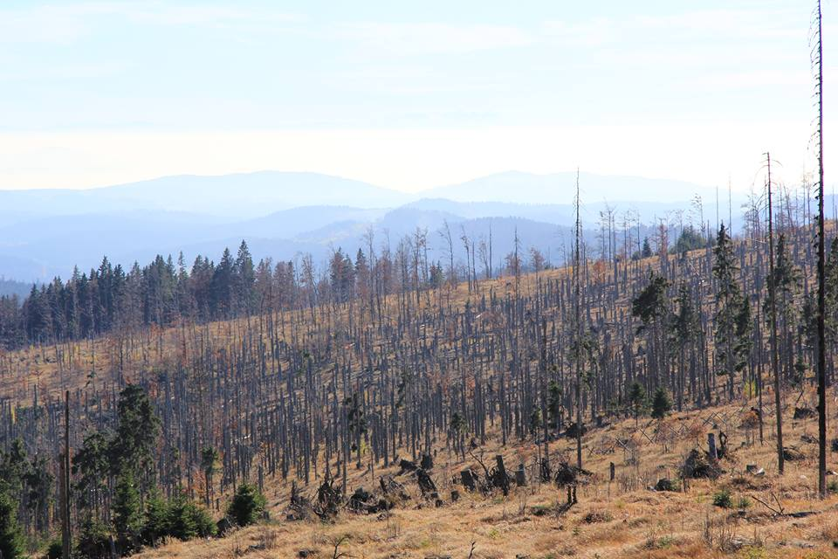
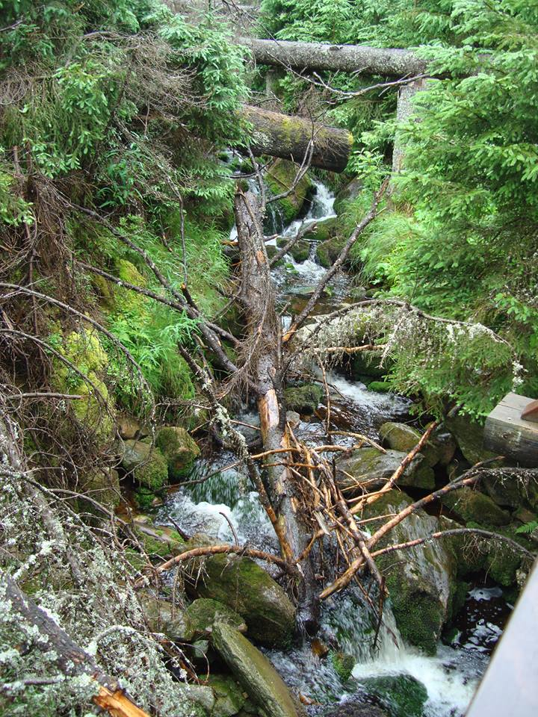
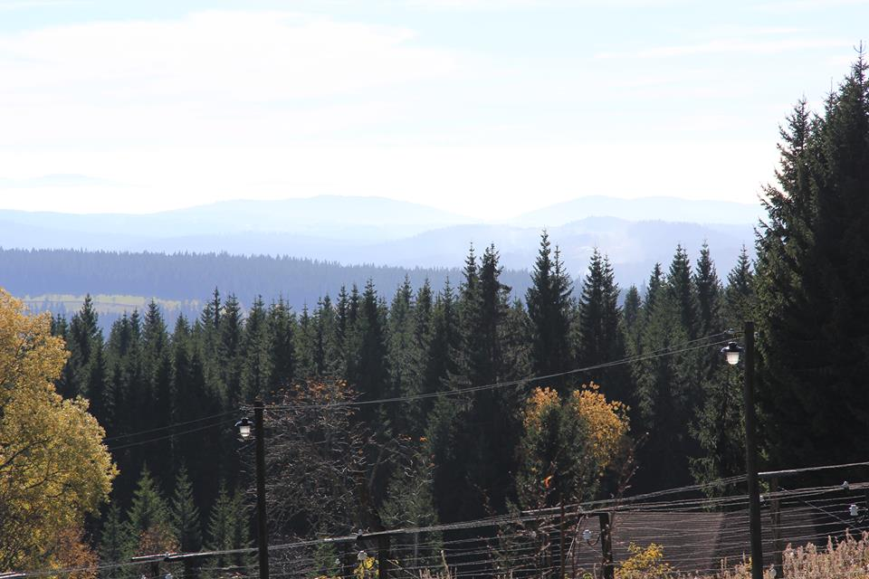
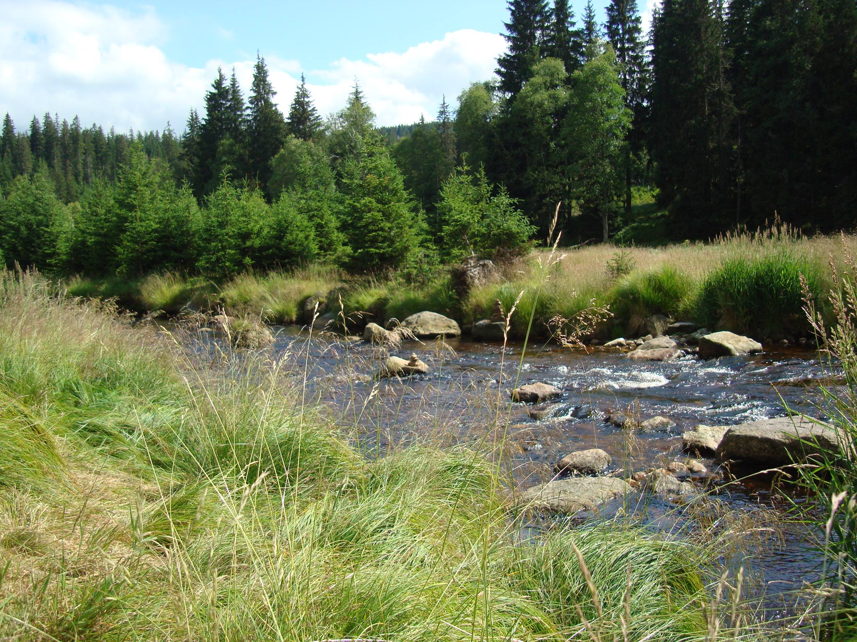
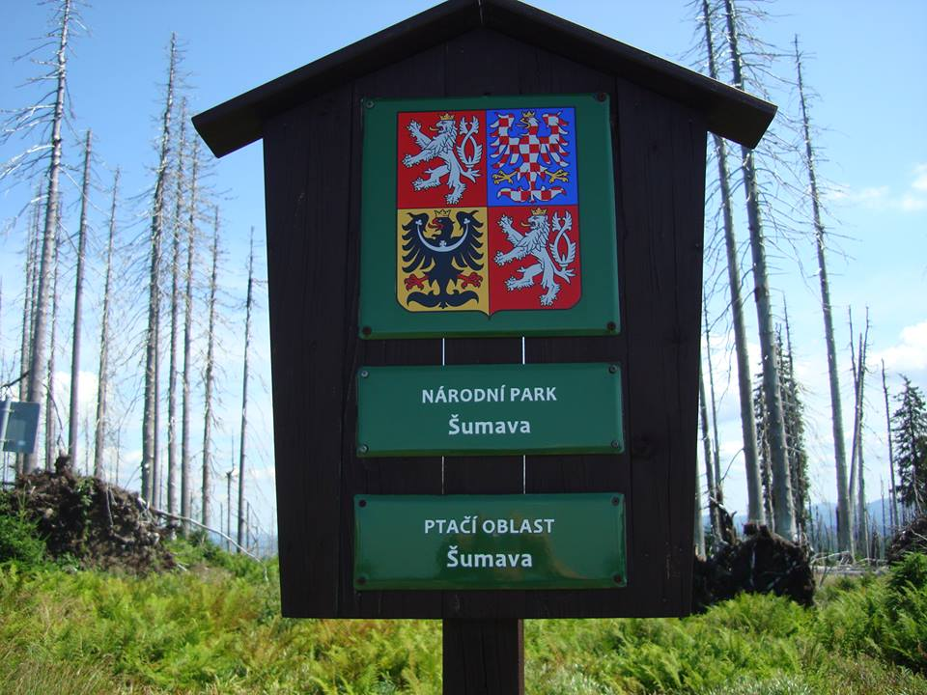
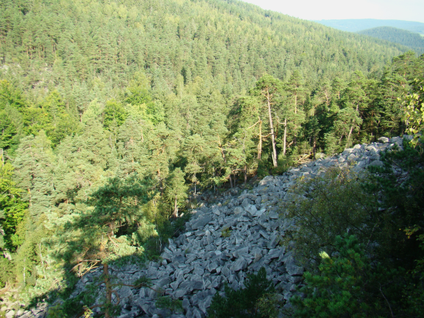
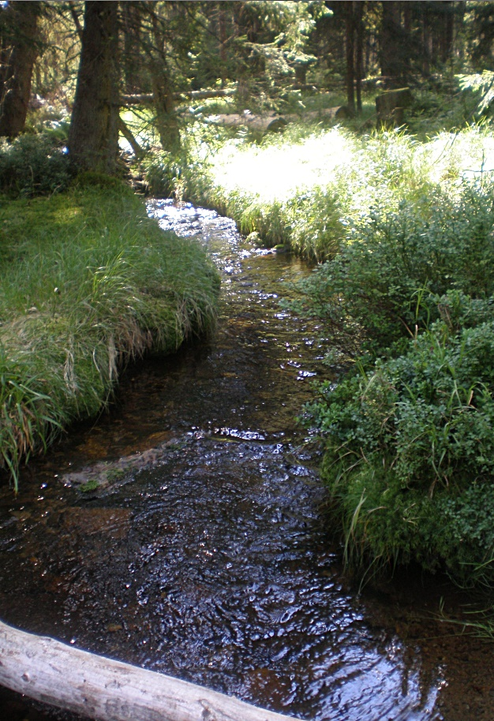
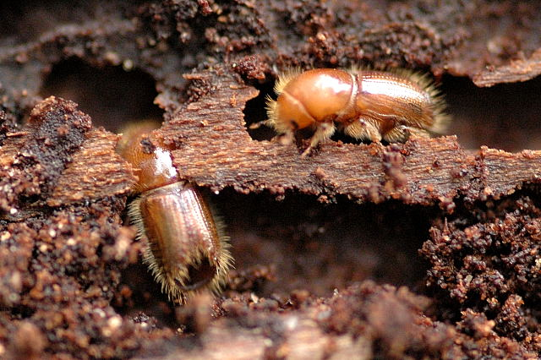

Slide 6
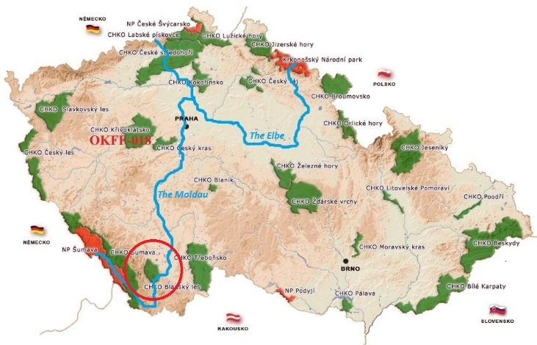
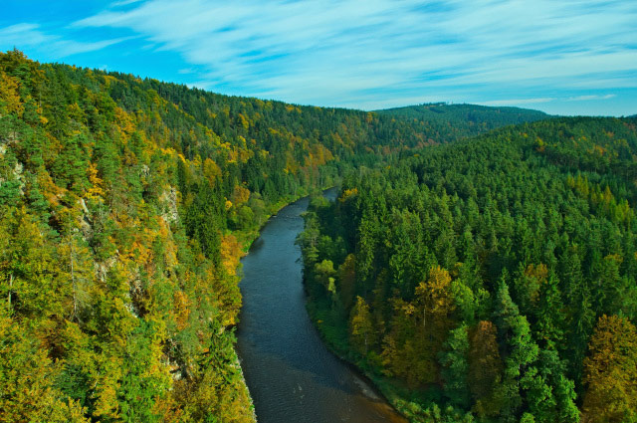
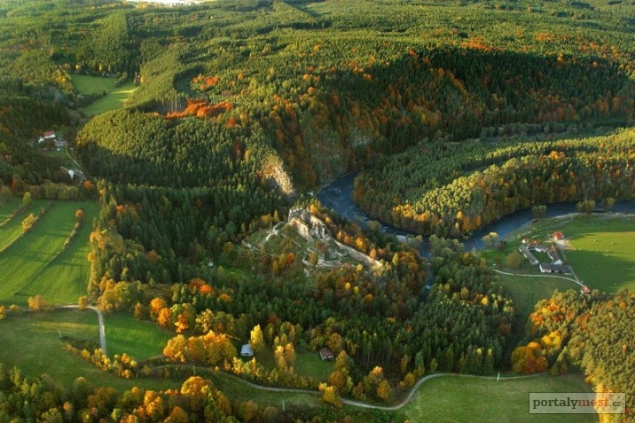
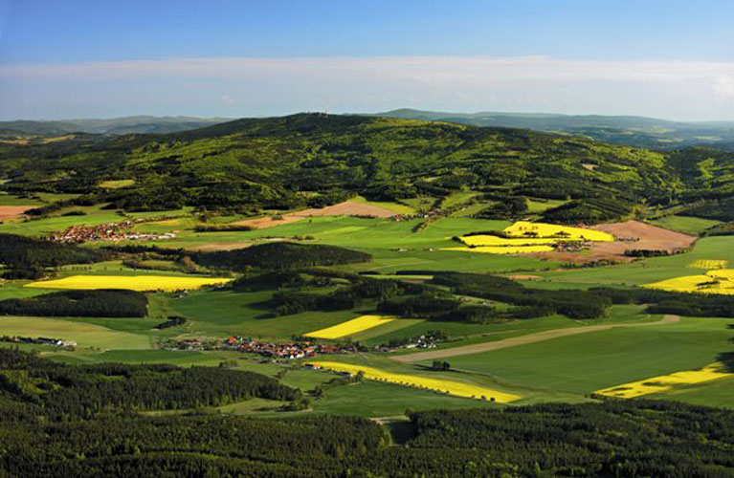
Protected landscape area Blanský Forest
Protected landscape area in Soutern Bohemia
Since 1990
Area 212,35 km²
Beautiful and preserved nature → frequented recreation area
The Vltava/Moldau river flows through

Slide 7
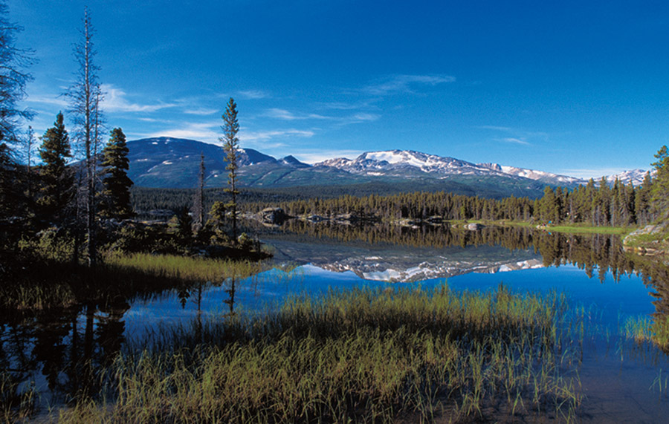
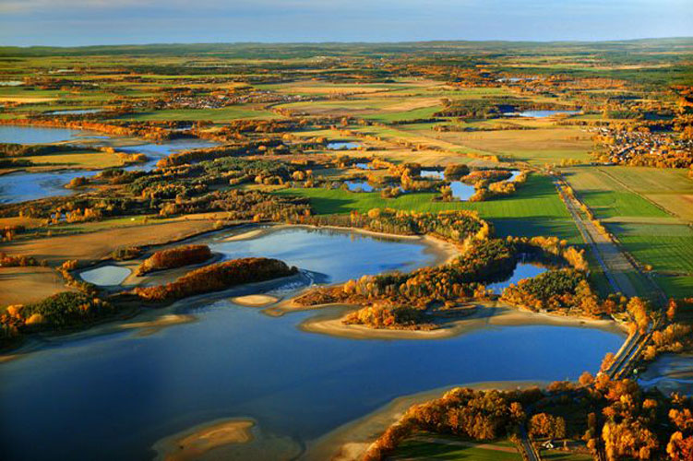
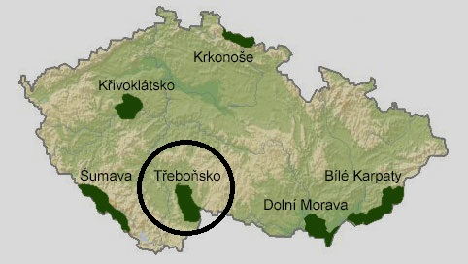
Protected landscape area Třeboňsko
One of the most popular tourist destinations in the Czech Republic
Located in Southern Bohemia region near the state borders with Austria
There are currently 460 fishponds, which are used for breeding freshwater fish, especially carp

Slide 8
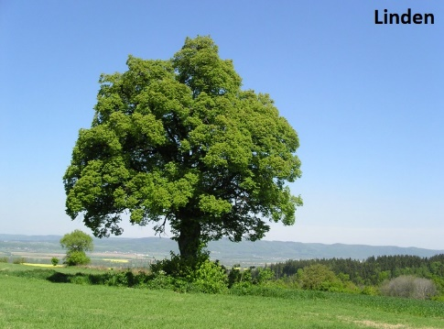
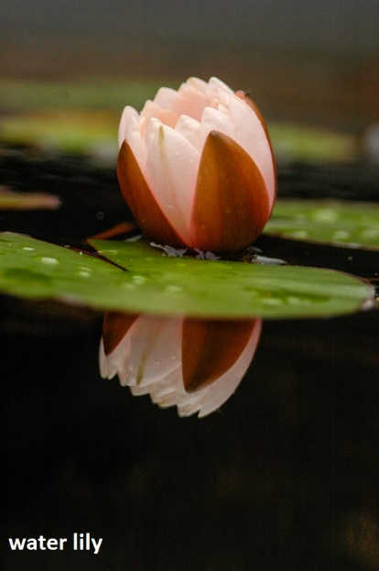
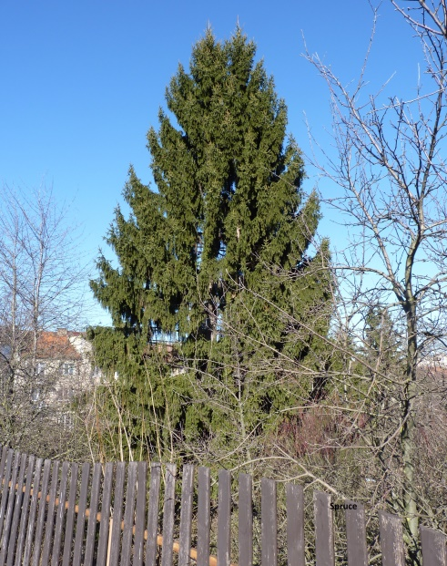
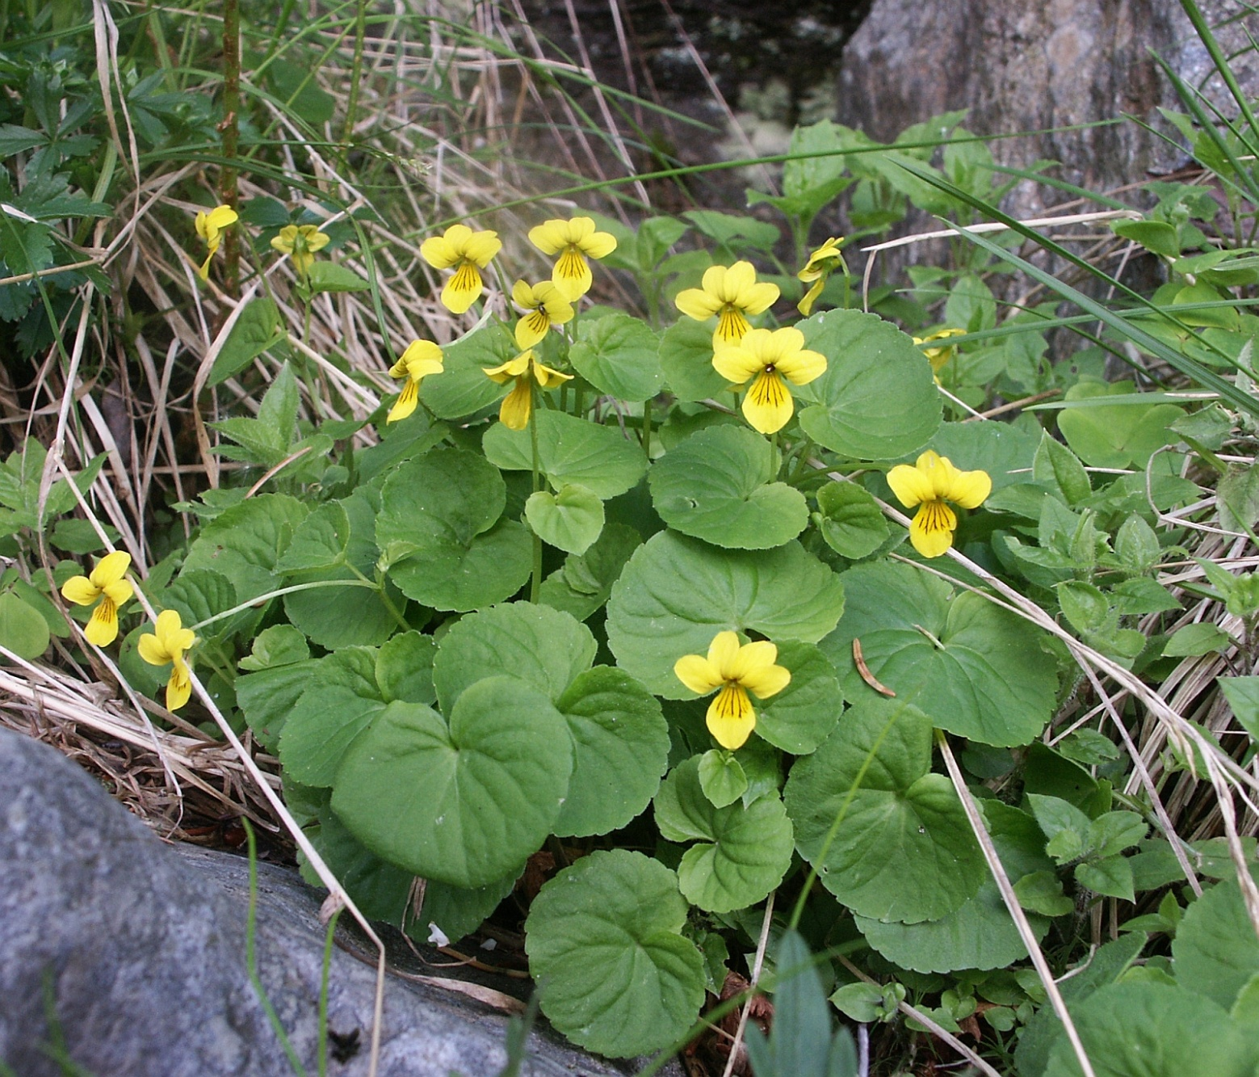
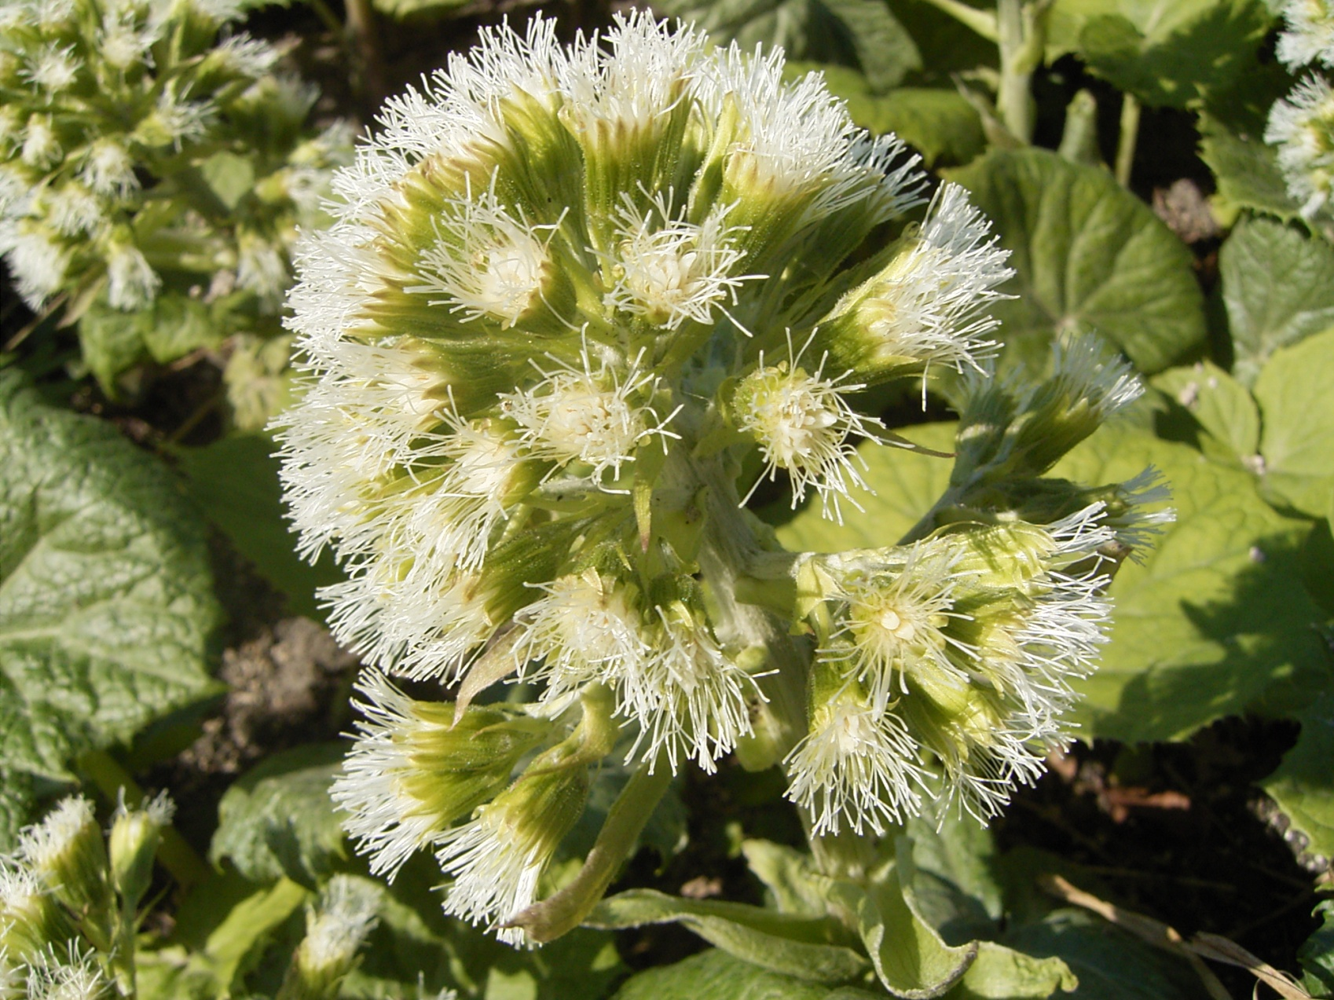
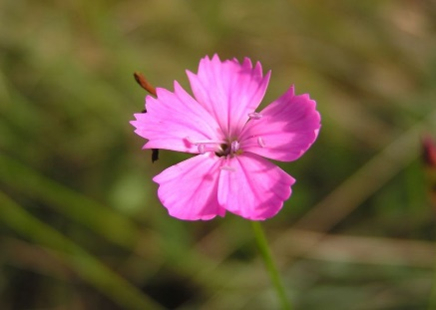
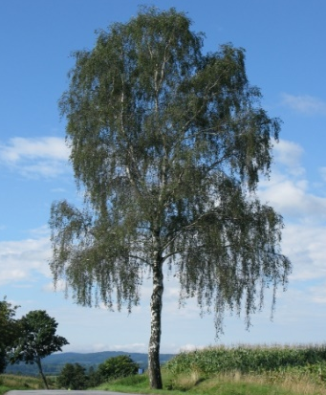
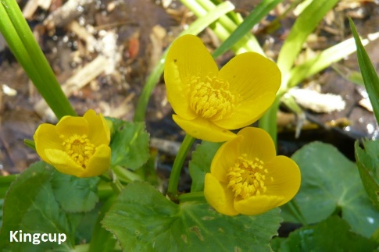
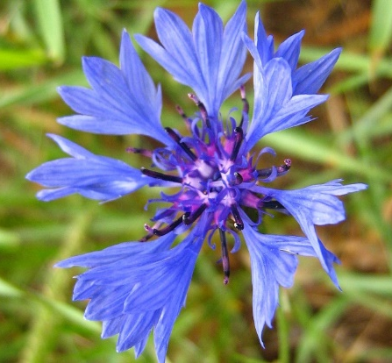
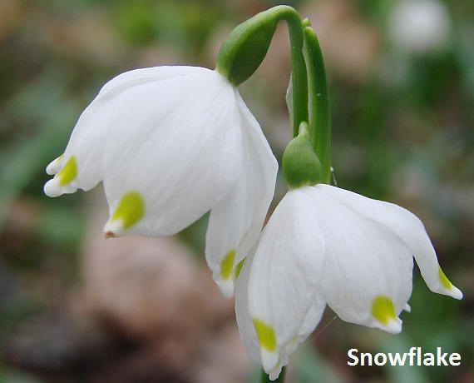
FLORA
Spruce

Slide 9
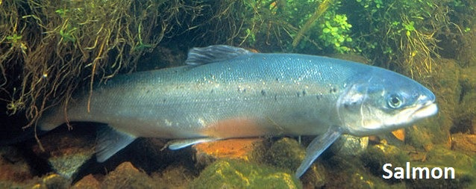
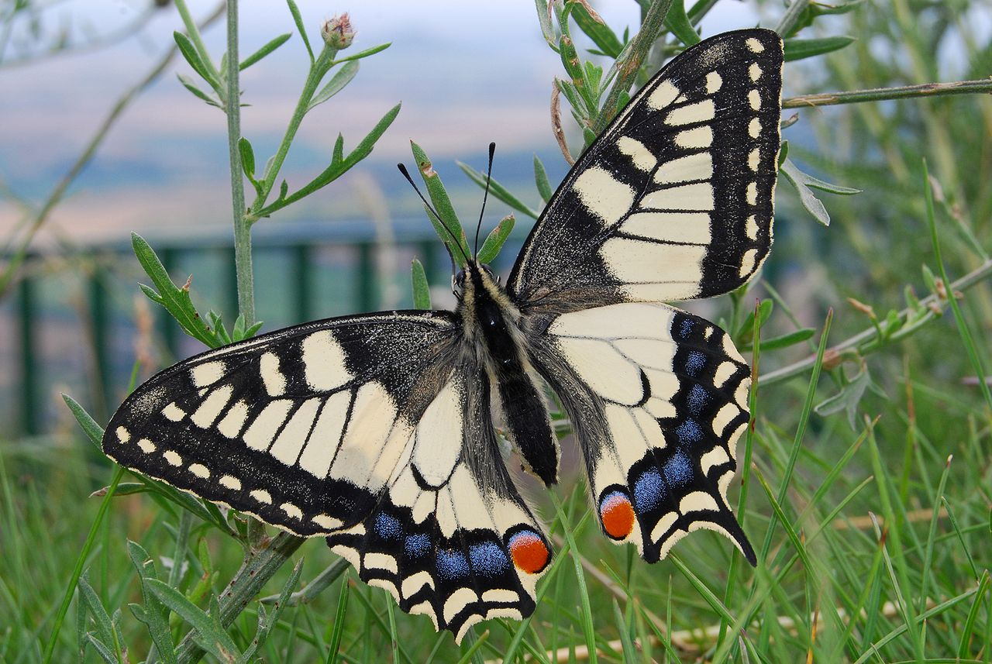
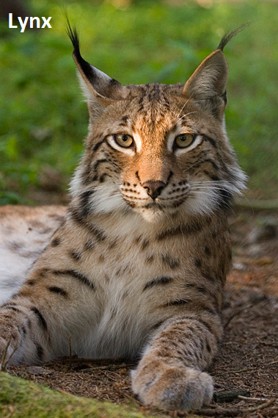
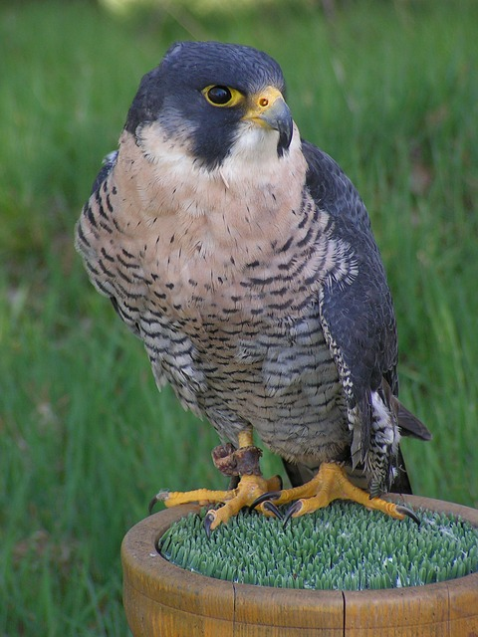
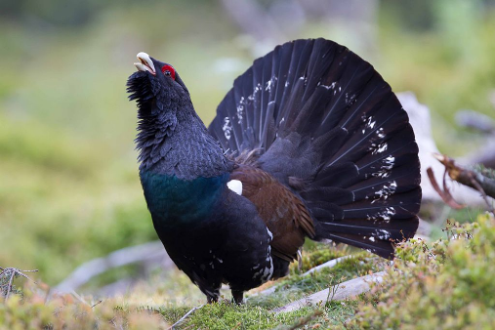
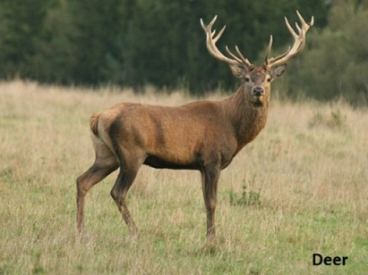
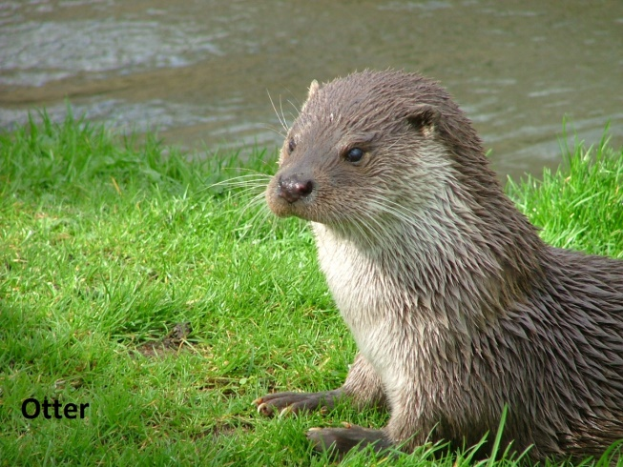
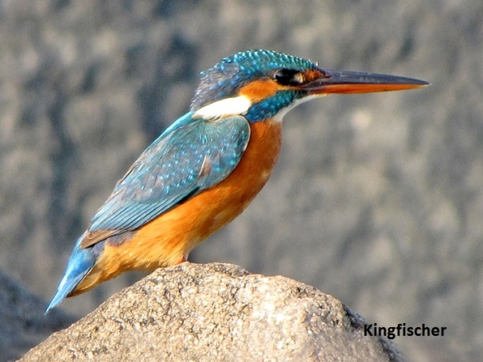
Fauna
Grouse

Slide 10
Nature reserves nearby Tábor
Borkovická blata – Peat bogs in marshland
Chýnov cave – the lowest spot – 42m underground
Choustník – rocky peak covered with forest
Pacov mountain – habitat of minerals

Slide 11
Thanks for your attention ☺

Slide 12
Resources
www.wikipedia.com
www.google.com
www.priroda.cz

