Slide 1
Bears’ Cave
Known as one of the most spectacular touristic attractions in our contry,Bears' Cave (Romanian: Peștera Urșilor) is located in the western Apuseni Mountains, northwestern Romania.

Slide 2
The name of the cave is due to the numerous bear fossils, which were found there, so it represented a favorable shelter for the animals that used to live there 15,000 years ago. Owing to the falling of a huge rock, the entrance of the cave was blocked and more than 140 bears were trapped inside. Being hungry, the bears attacked one another until they all died.

Slide 4
The cave was discovered in 1975 during the limestone exploitation by an amateur speleologists group.Until September 1975 the cave was closed and in this time the subterranean pit was artificially opened through the dynamiting of the entrance gate.The first man who went down the open pit was a miner from the same location.
The cave has three galleries and four halls: the Candles Hall, the Spaghetti Hall, Emil Racovita Hall, the Bones Hall. Being more than 1500m long, the cave presents galleries situated on two levels: the upper gallery is intended to tourists and the lower gallery is destined to the scientific research.

Slide 5
One may visit this cave starting from The Bears Gallery (called The Bones Gallery as well), where 1500 items, 140 skulls and numerous shelters for the cave bear can be seen. On the walls of the gallery, one may notice scratches left by the paws of the bears.

Slide 6
In the second gallery, called Emil Racovita, one may see a bear skeleton exposed just in the position the bear died and besides that, the fossils of other animals which disappeared hundreds of years ago: a black goat species, the cave lion and cave hyena. The distance between the walls of the cave is somewhere between 10-15 meters and 10 meters height, being decorated with numerous stalagmites, domes, water basins and stalactites.

Slide 7
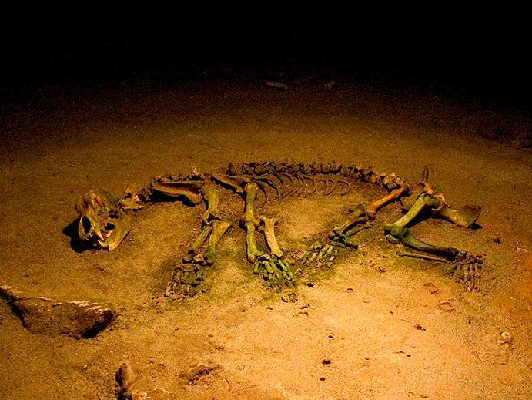

Slide 8
The last gallery, The Lights Gallery, welcomes us with its exciting stalagmites and stalactites which created some true statues that look familiar to the ones of wax, revealing a pure white that gives freedom to any visitor’s imagination.

Slide 9
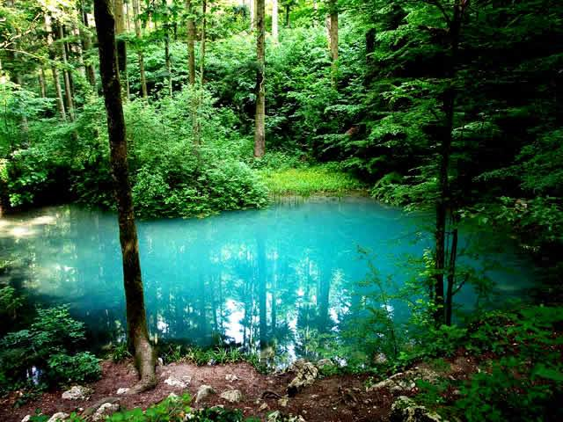
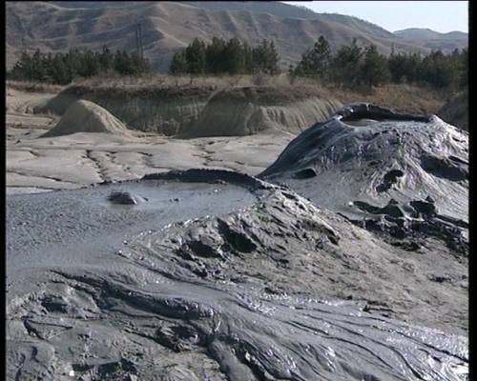
Other natural places specific for romania
Bye’s Eye
Mud Volcano

Slide 10
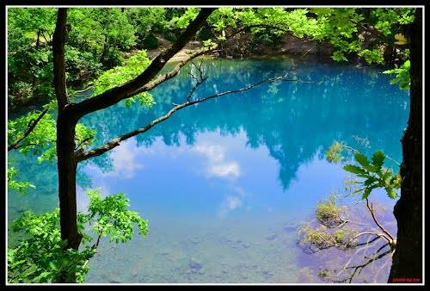
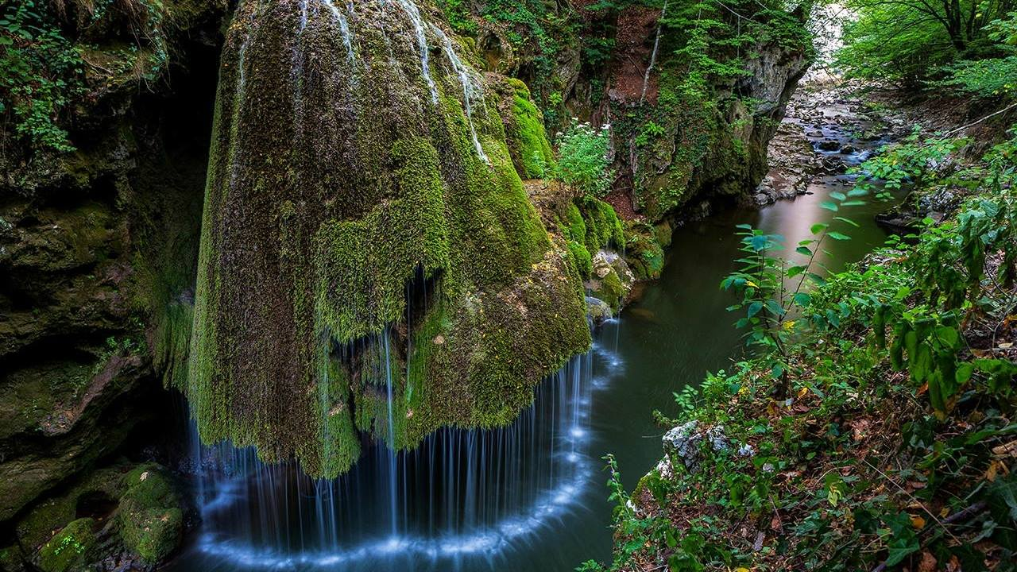
Blue Lake
Bigar Waterfall

Slide 11
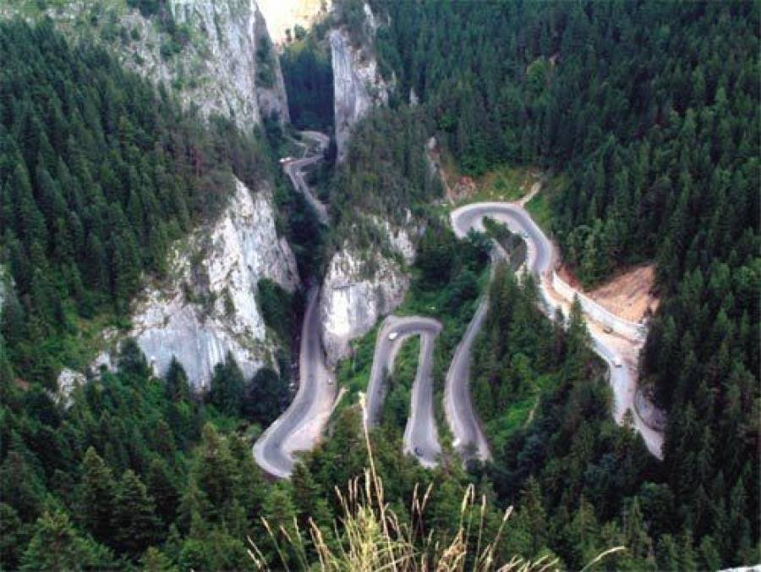
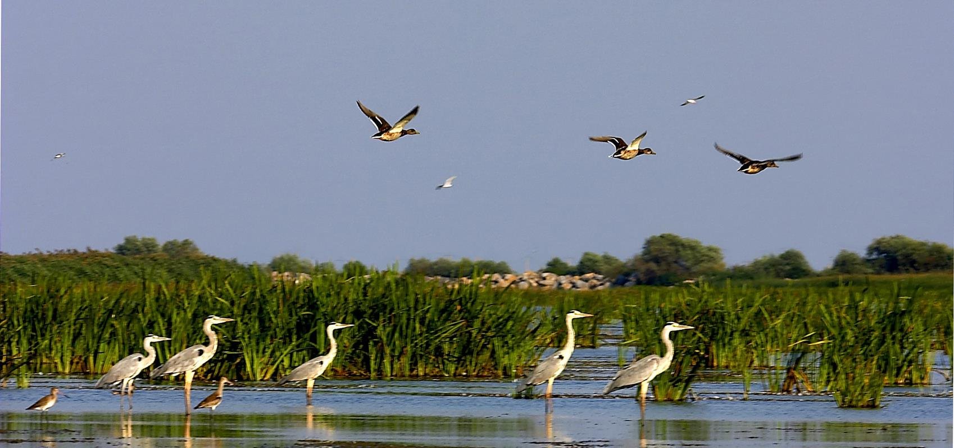
Bicaz Canyon
The Danube Delta

Slide 12
Thank you all for watching! Daju Daiandra
Dragoi Cristina
Grad Ana-Maria
Maghet Bianca

