Slide 1
Budapest
The yellow team
SIBEL, Natali, Cristina, Arju, Tereza and Dániel

Slide 2
Content
Basic information about Budapest
Most popular buildings
House of the Parliament
Széchenyi Chain Bridge
Castle of Buda
Heroes' Square
What did we see?

Slide 3
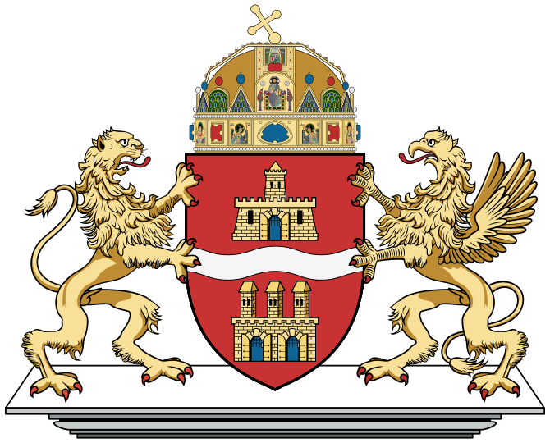
Basic information about Budapest
It is the capital of Hungary and also the biggest city.
It has approximately 2 million inhabitants.
It has two parts: Buda and Pest, which joined in 1848.
The two cities were firstly connected by the Chain Bridge.
Nowadays it has 11 bridges.
It is a great city with huge history behind it.
It was a victim of WWII bombings.

Slide 4
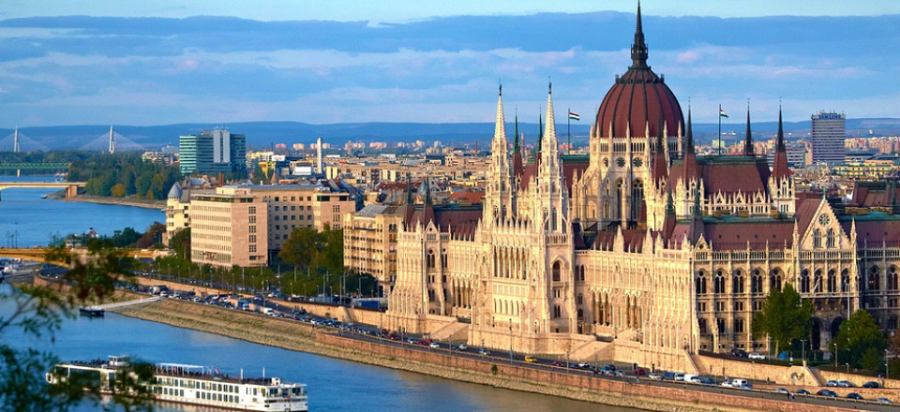
Famous buildings
House of the Parliament

Slide 5
Széchenyi Chain Bridge

Slide 6
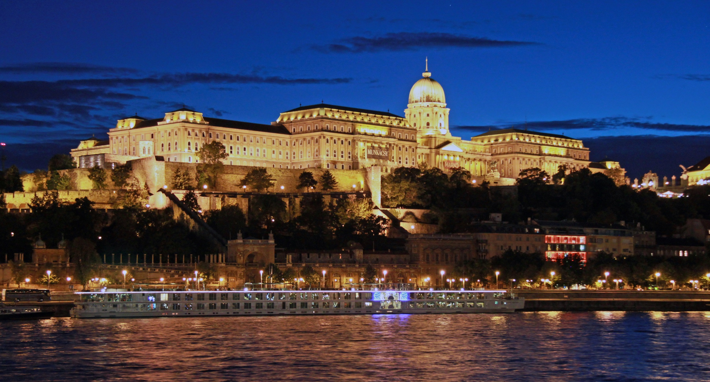
Castle of Buda

Slide 7
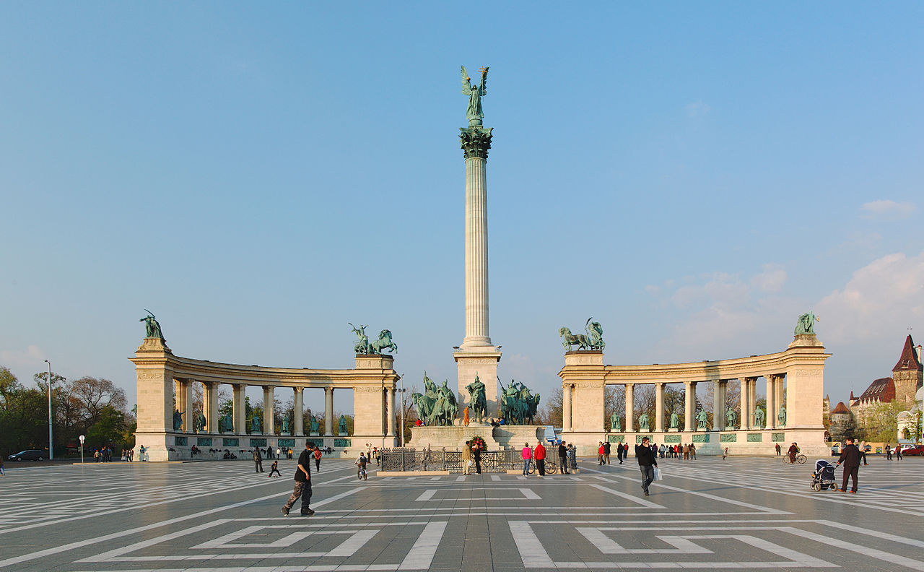
Heroes' Square

Slide 8
What did we see of it?
We had a guided tour across the city by bus.
We saw the Heroes' Square. It has the statues of the greatest Hungarian kings.
After it we went across the Andrássy Avenue, we saw Astoria Square and Oktogon Square too.
Then we went to the Castle of Buda. We travelled across the Chain Bridge, which is one of the oldest bridges in Budapest.
We saw the Church of Mathias, Sándor Palace, Fisherman's Bastion. We had a beautiful panorama over the city of Budapest and the river Danube.
After it we had some free time on Vörösmarty Square.
Our last destination in the city was the Mount of St. Gellért.

