Slide 1
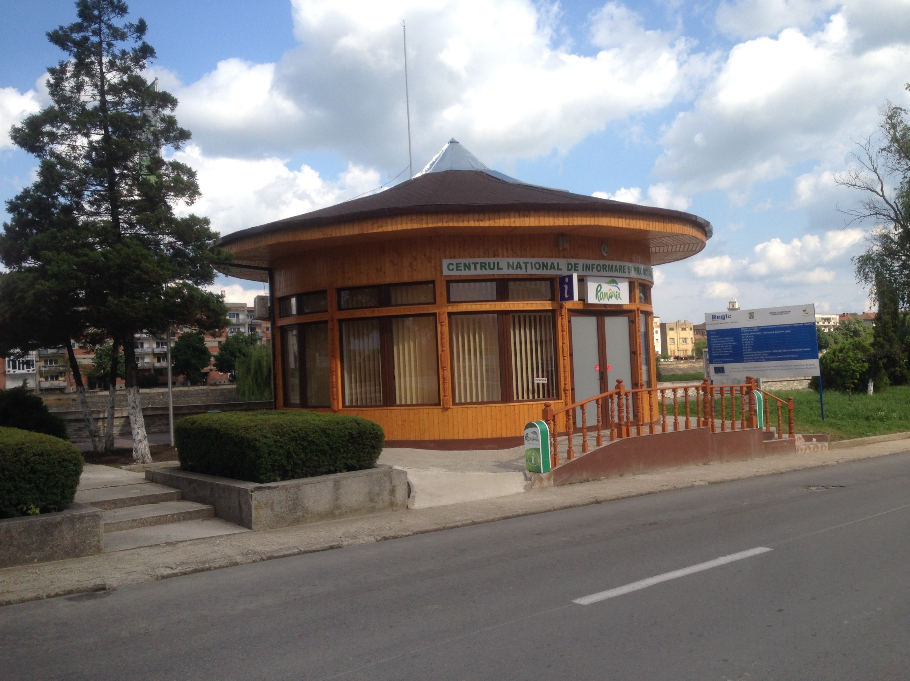
Tourist information centres
How do they work?

Slide 2
Why build a centre?
The information centre is usually used for informing outsiders about historical monuments inside and outside the city, infrastructure, tourist attractions, city history and others.
Every centre was financed from European funds for a period of five years. Once the five years pass by, it becomes town’s hall property, and the council will decide if they keep the project going or not.
Also, the centre must collect a thousand signatures from tourists and passersby in the first five years of functioning.

Slide 3
The tourist information centre in Lugoj
It became possible through the Regional Operational Programme named REGIO.
The implementation period lasted seven months, after which the construction began. It has been working for four months.
It has wireless connection, air conditioning, 2 desktops, TVs for presentations, thermal insulation and even solar panels for electricity.

Slide 4
The objective
The main objective of building an information centre was to develop the tourism in Lugoj and Lugoj’s surroundings and also to increase the number of tourists in the city.
Without knowing, it shortly became a new source of jobs for the ones specialized in geography and tourism.
They even opened a website for making it easier for others to check what Lugoj can offer and to promote the city easier.

Slide 5
Benefits
The construction of the centre brought attention over the city and its events. It made Lugoj easier to discover by tourists who wanted to have a nice time participating at concerts, festivals, stand up comedy shows or visiting nice places inside and outside the city, on specific routes.

Slide 6
Personal interaction
The members of the staff were not only knowledgeable and well informed but also very friendly, open and ready to help us with everything we needed.
We even tried to take a picture with them but they refused, stating that they weren’t wearing an appropriate outfit for a picture and instead they offered some picture of us.

Slide 7
If you ever get to Lugoj, don’t forget to pass by and visit our information centre too!

