Slide 1
Tourinform Pápa
HUNGARY

Slide 2
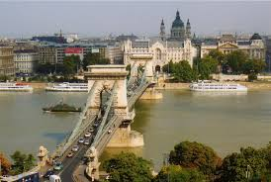
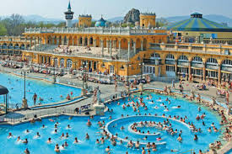
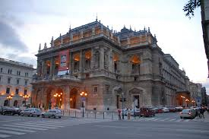
All offices
Do you like active holidays?
Do you like spending your free time in the nature?
Do you like having active programmes with your friends and relatives at the weekends?
Then here’s your chance to make your dreams come true!

Slide 3
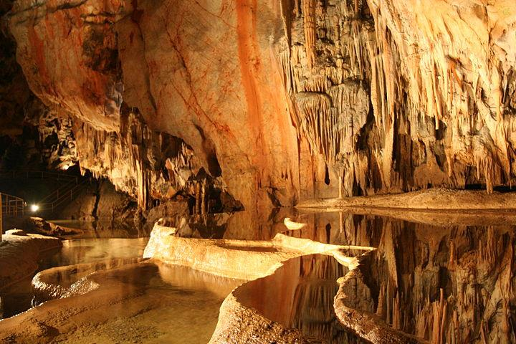
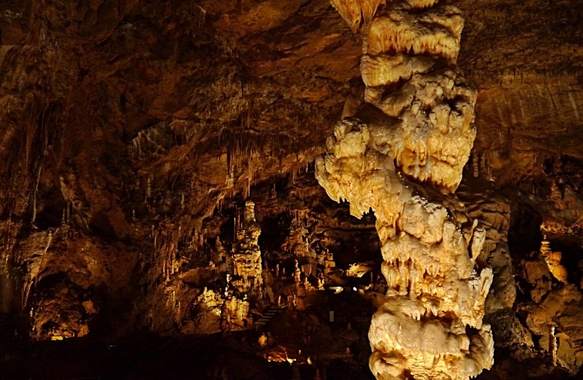
Don’t hesitate. The nearest Tourist Office offers a wide range of programmes during your holiday. Their experienced staff will help you find amazing destinations and accommodation throughout the country: in towns, villages or in a forest.

Slide 4
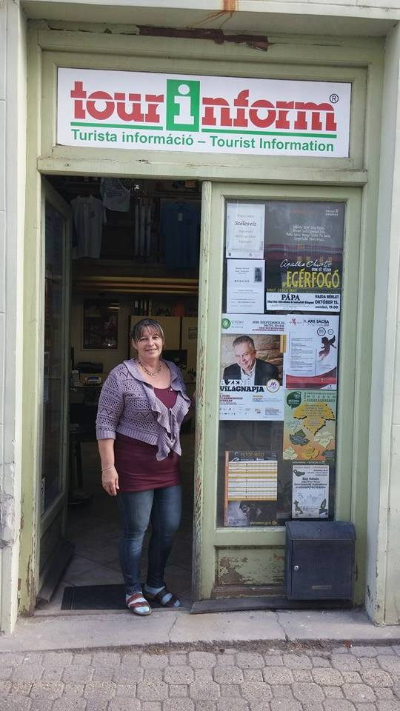
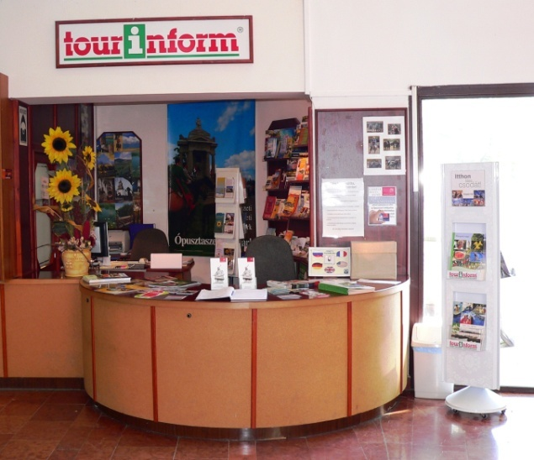
Some important information
(office in Pápa)
-Tourinform network has 137 offices all over the country.
-The Pápa office was opened in 1997. Two very friendly and helpful employees receive guest.

Slide 5
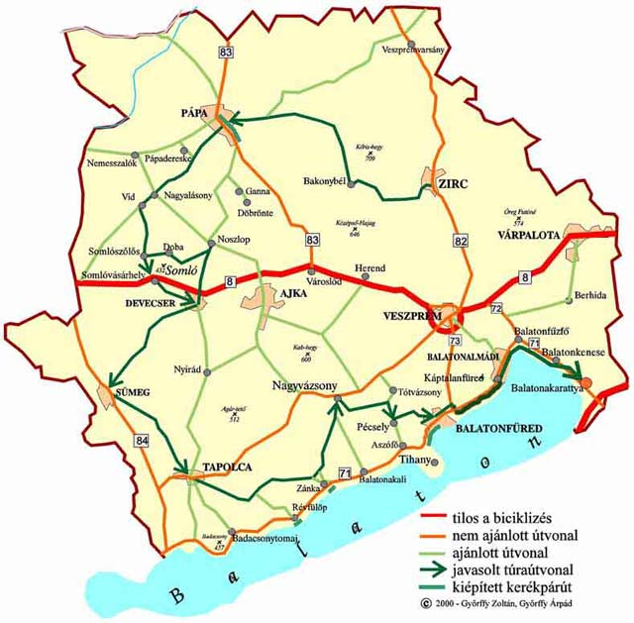
Their guests
Our office is mostly visited by tourists from Germany and Austria, because we have many bicyle roads across the country and they love to make journeys from point A to point B by bicycle. Pápa’s location is very good, because we are not far from bigger cities for example Győr, Veszprém etc. And the office is also visited by local people.

Slide 6
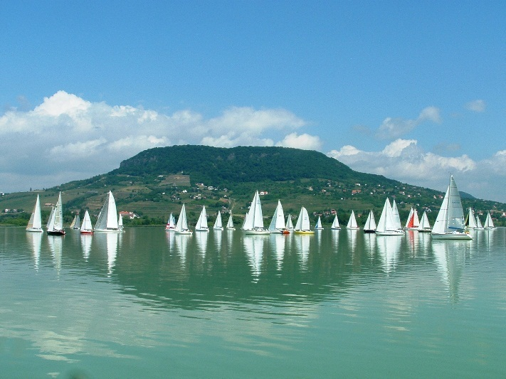
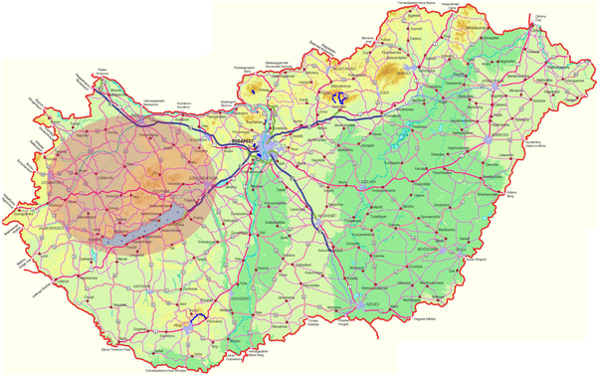
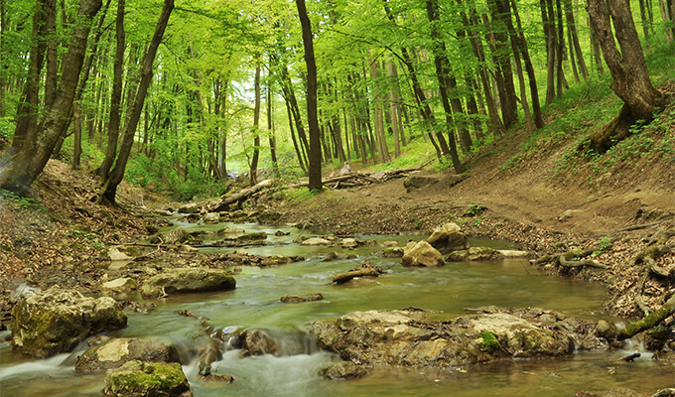
-Opening hours: Monday-Friday 9 a.m. – 17 p.m., and Saturday 9 a.m. – 12 p.m.
-Tourinform has offices in 87 towns

Slide 7
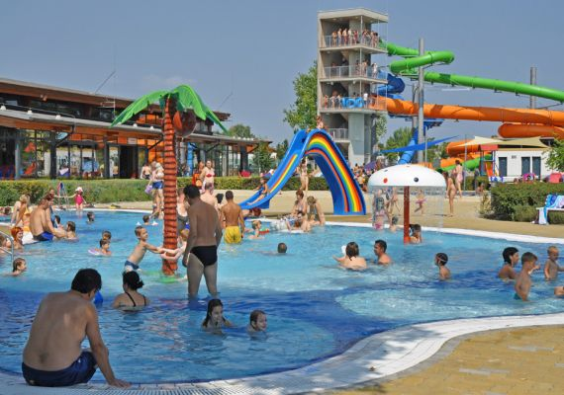
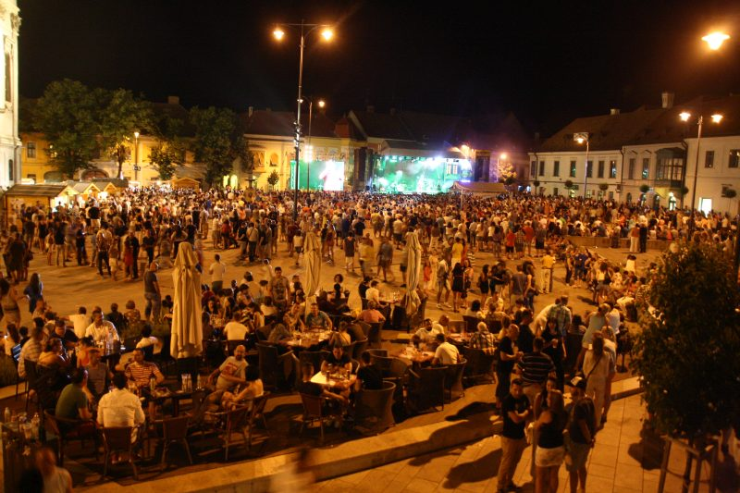
The main tasks
Their task is provide information on activities, entertainment facilities, concerts, sport events etc.

Slide 8
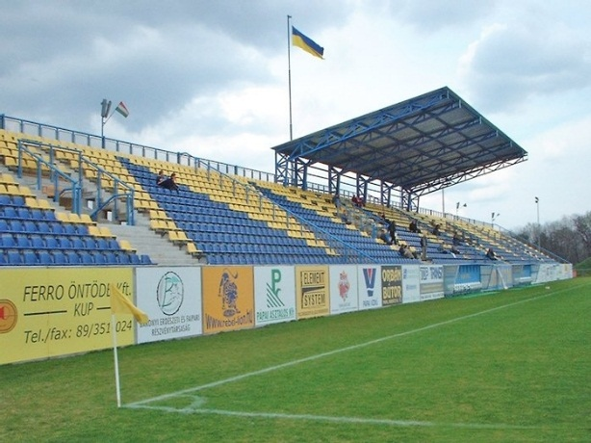
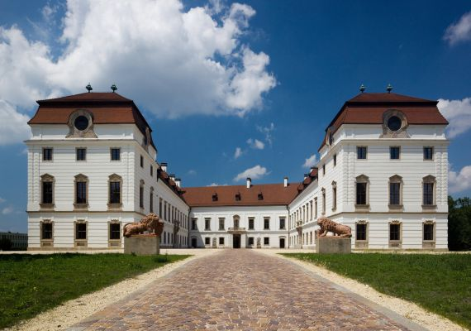
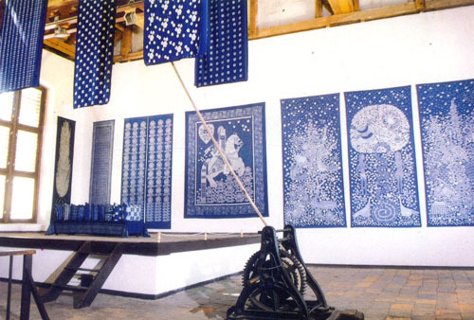
- Publishing brochures
- Work on the National Touristic Database
- Ticket sales: local theatre, football club etc.
- Insurance
- Selling gifts and souvenirs: (Blue dyeing, products Esterházy Palace gifts, postcards)
- Organising and supporting local events

Slide 9
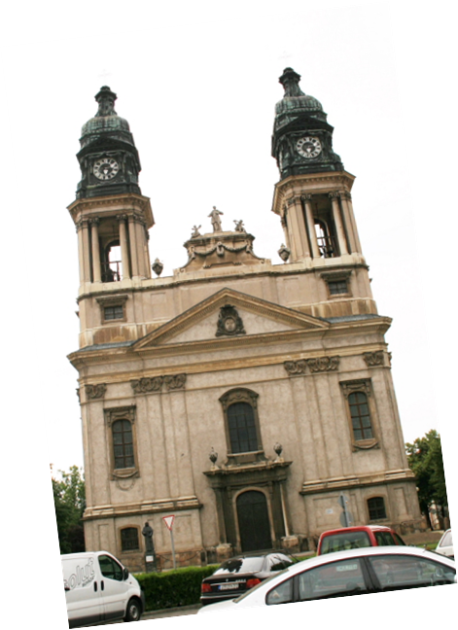
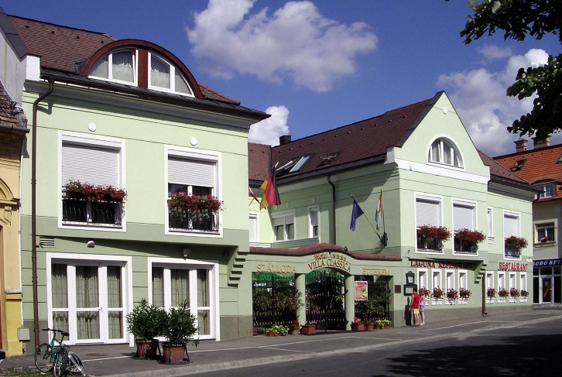
Other tasks:
- Advice on accommodation
- Map sales
- Organising tours in and around the town

Slide 10
If you want more details, visit their Facebook site.
Thank You for your attention!
https://www.facebook.com/PapaTourinform/

