Slide 1
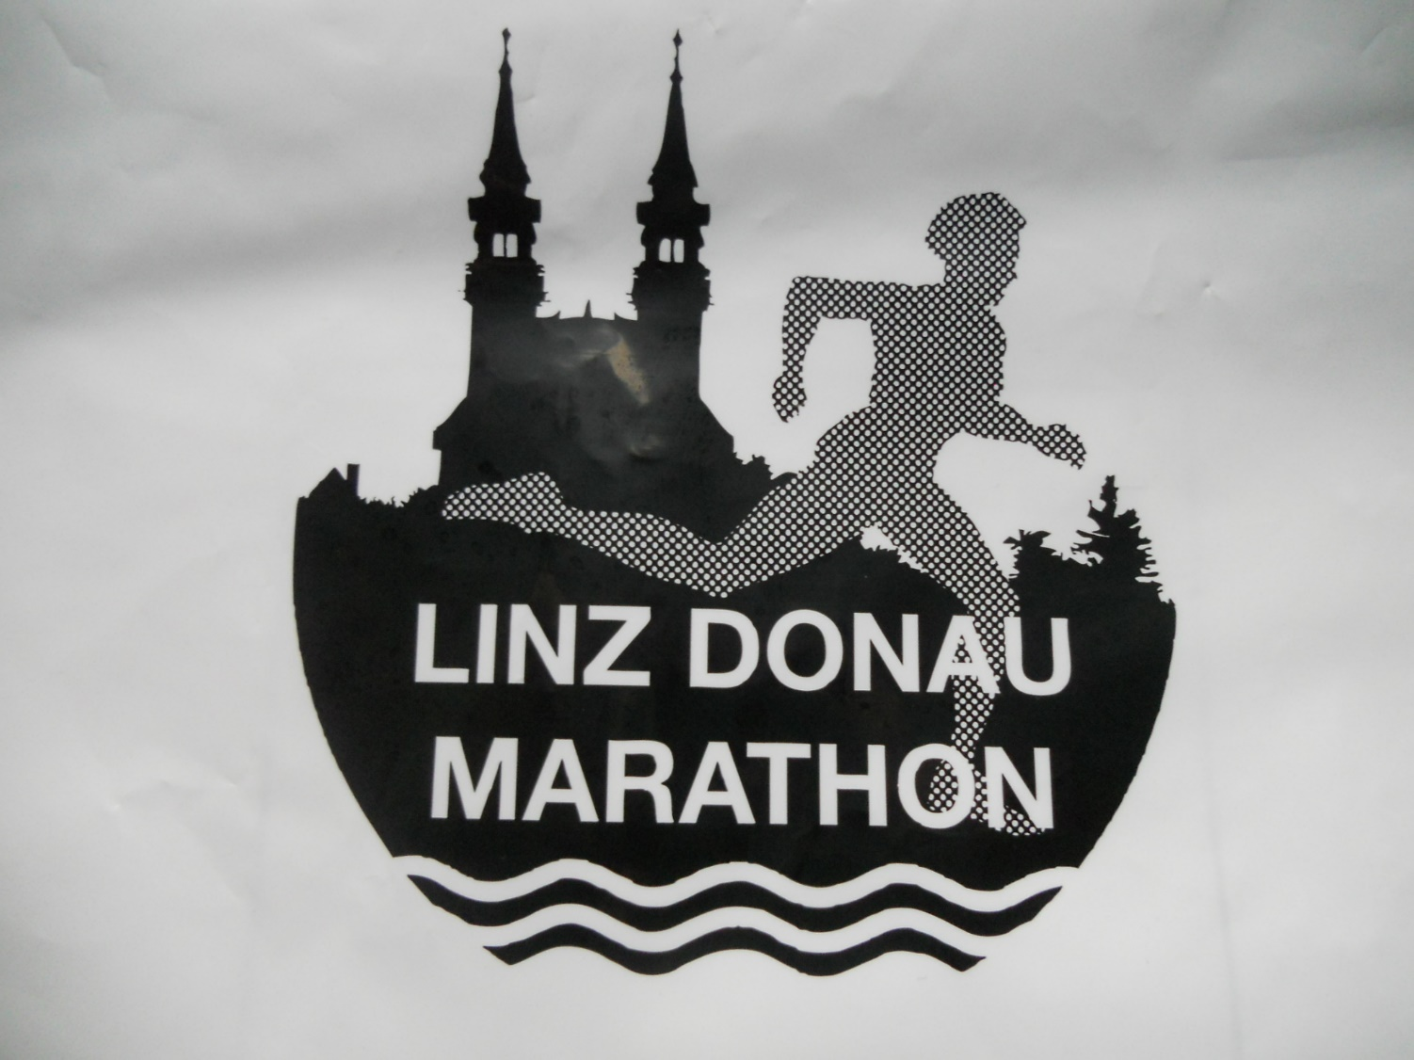

Slide 2
Borealis Linz Donau Marathon
The Borealis Linz Donau Marathon is the biggest sporting event in Linz, the capital city of Upper Austria.

Slide 3
The 14th Borealis Linz Donau Marathon
19 April 2015
More than 19,500 runners from many different countries took part in the different distances of the event.
More than 130,000 spectators watched the runners along the track.

Slide 4
Schools take part in the quarter marathon

Slide 5
Running school ----- Schule läuft
The German title „Schule läuft“ (running school) refers to the initiative to get both students and teachers active and get running.
hak oö rennt was our team, consisting of teachers and students from all Commercial colleges from Upper Austria

Slide 6
This was the participant number of one of our teachers

Slide 7
Preparations before the start

Slide 8
This is us before the beginning of the race

Slide 9
The race starts on the motorway bridge over the Danube

Slide 10
Further members of our team

Slide 11
Track along Landstrasse

Slide 12
The way is hard but the end is near

Slide 13
Only a few meters

Slide 14
Finishing line

Slide 15
Finish – the picturesque main square in Linz

Slide 16
Leaving main square after the race

Slide 17
Each particpants gets a medal

Slide 18
Keep on running
The 15th Borealis Linz Donau Marathon will take place on Sunday, 3 April 2016
Will we meet there?

Slide 19
Compiled by Robert Wagner and Markus Meindl, BHAK Linz International Business School

