Slide 1


INFOCENTRE TÁBOR
Antonín Spálenka
Anna Horká

Slide 2
Basic information
Location: the town hall building – Žižka square
branch – the train station building (June – September)
Opening hours:
    Monday – Friday: 9:30 – 11:45 and 12:50 – 17:00
    Saturday: 9:00 – 11:45 and 12:50 – 14:30

Slide 3
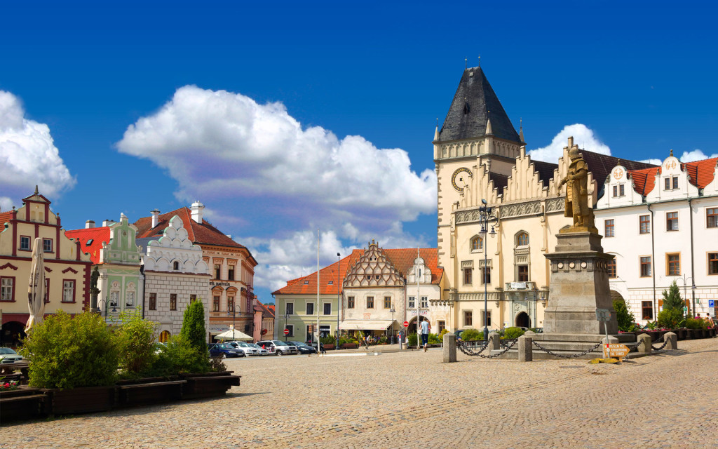
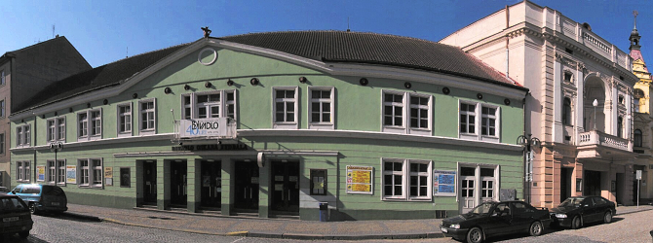
A little of history…
The infocentre was opened to help develop tourism not long after the opening of the border after the Velvet Revolution (1989)
Seasonal information centre was opened in the building of the theatre of Oskar Nedbal (1993)
Since 1994 the infocentre has been in the town hall building

Slide 4
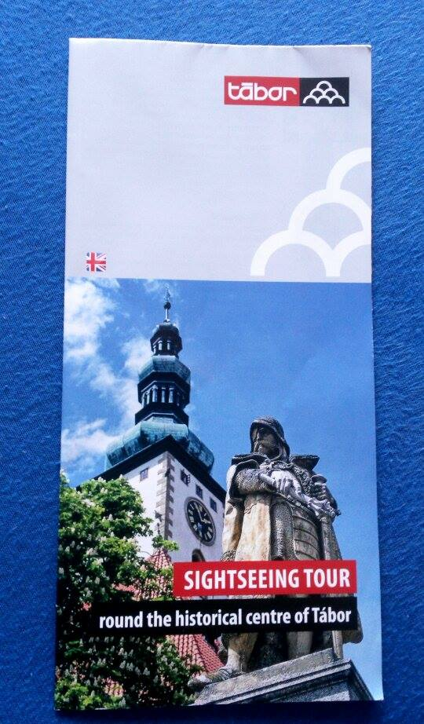
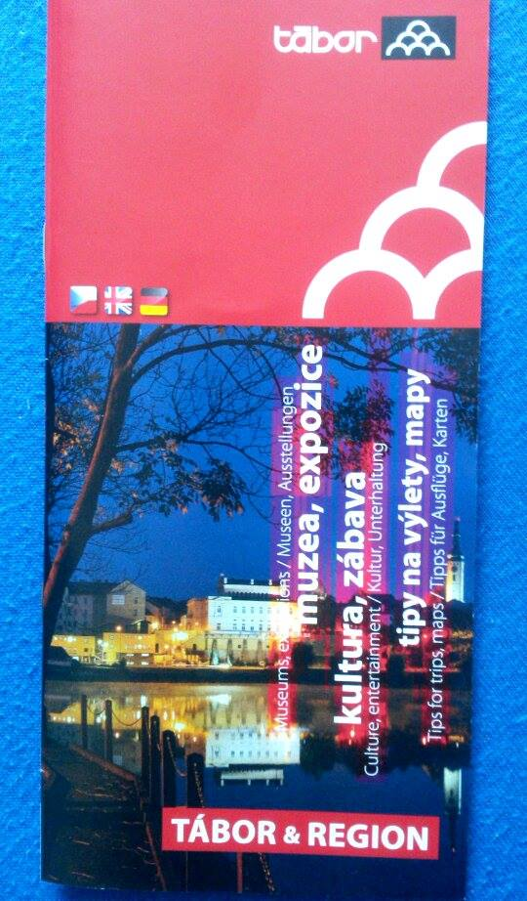
Visitors
In 2016 70,000 visitors visited information centre
Dutch, Slovaks, English, Spanish
It‘s the fourth most visited infocentre in South Bohemian region after České Budějovice, Český Krumlov and Jindřichův Hradec

Slide 5

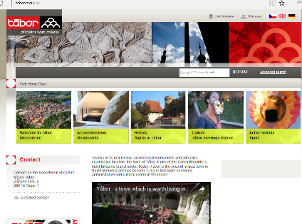
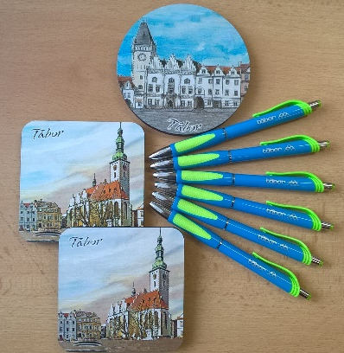
What is it good for?
Information about: the city's history,
sights, attractions, recreation
and cultural activities in the region
Provides:
information on accommodation and food services guide services in several languages
search timetables, ticket sales, maps, guidebooks and souvenirs (T-shirts, pens, mugs, posters, postcards)
bicycle storage
mobile guide for smart phones

Slide 6
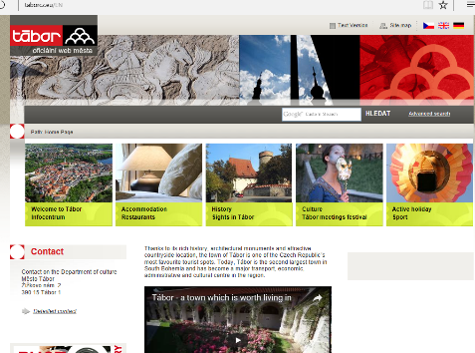
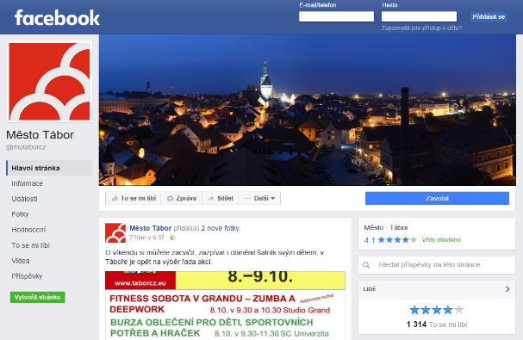
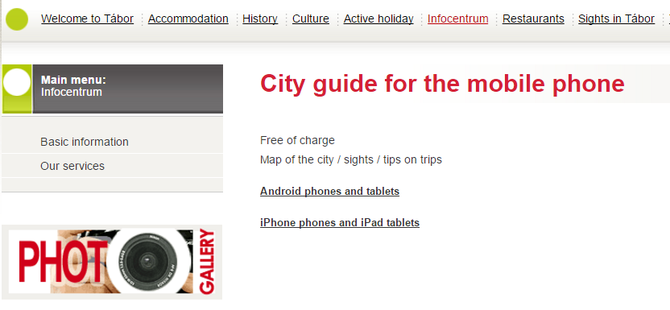
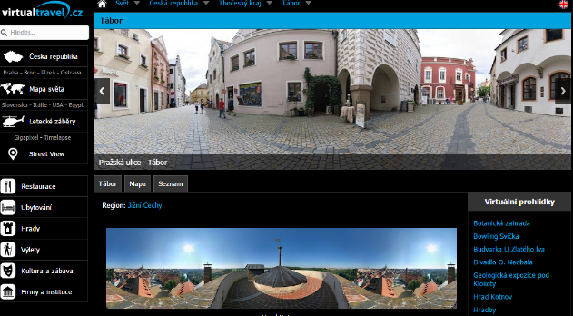
Online services
Website:
http://www.taborcz.eu/EN/
Facebook:
http://bit.ly/2dGaaU9
Mobile APPS for Android and iPhone/iPad
http://bit.ly/2dTNjCY
3D Virtual Travel:
http://www.virtualtravel.cz/tabor.html

Slide 7
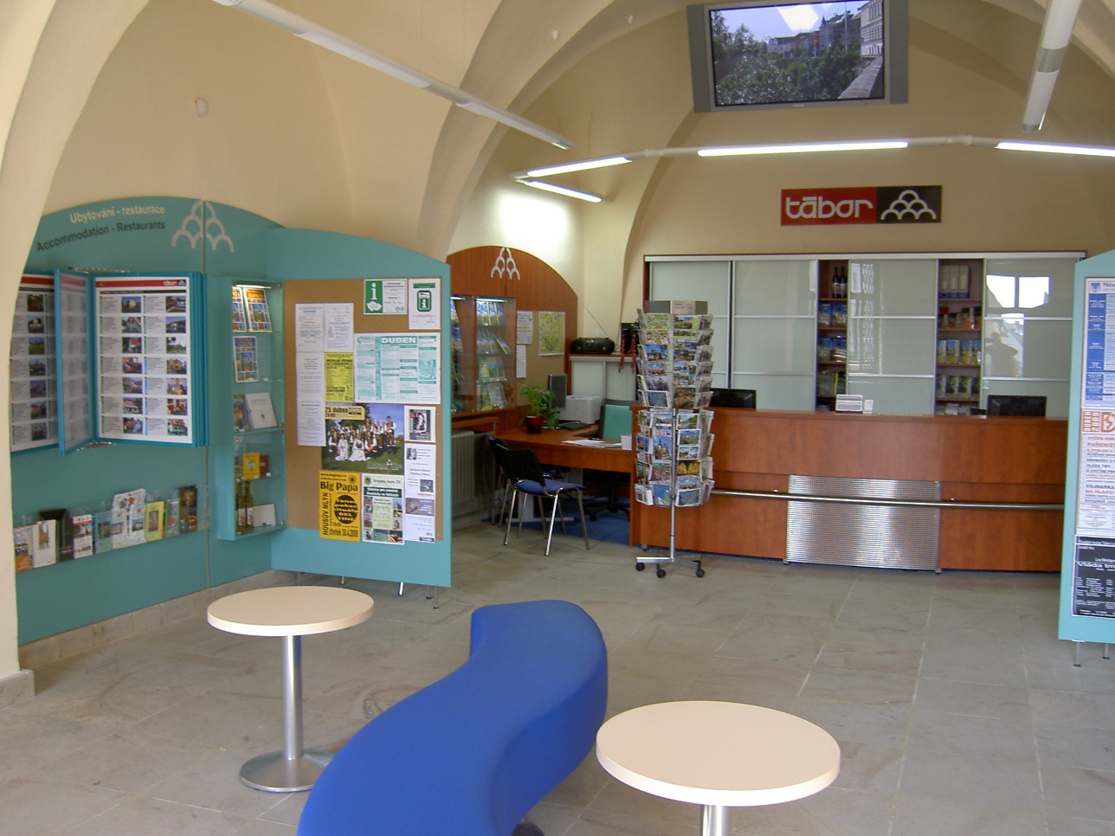
What does it look like in there?
Moreover, inside on the screen you can watch a film about the town or a video from the Tábor Meetings
https://www.youtube.com/watch?v=1ZNC7kCxx5g

Slide 8
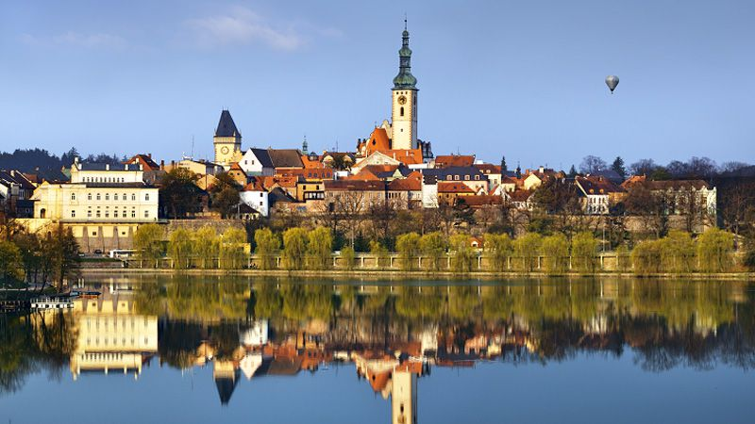
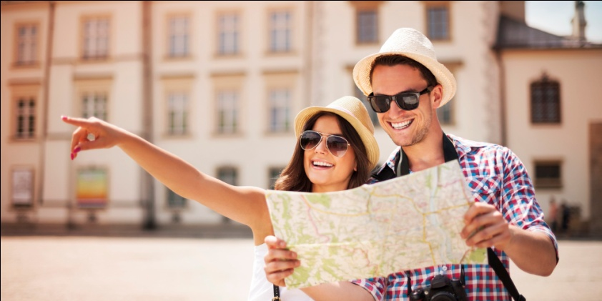
Awards
The best tourist information centre in the Czech Republic established by a municipality (1st place in a competition of the C.O.T. media publishing house “Our Region 2006“)
2nd place in the category for the Best Foreign Language promotion material in the competition “Our Region 2006“

Slide 9
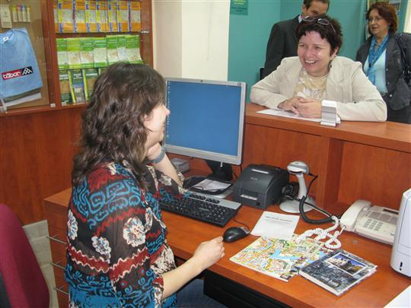
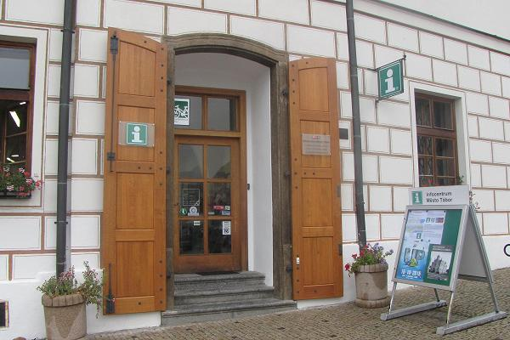
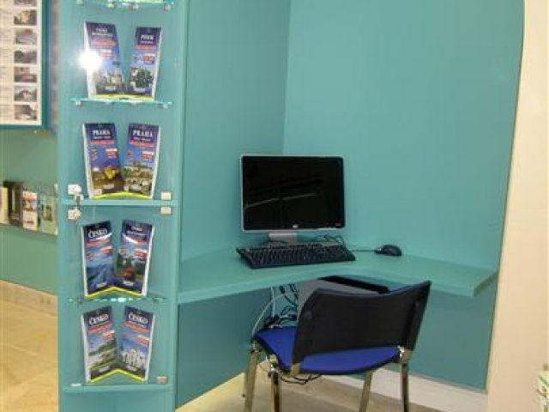

Slide 10
Thanks for your attention ☺

Slide 11
Resources
http://www.taborcz.eu/infocentrum/ms-1058

