Slide 1
Our Harbour
Štúrovo-Esztergom

Slide 2
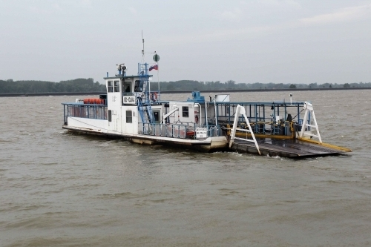
Our ferry boat from the past

Slide 3
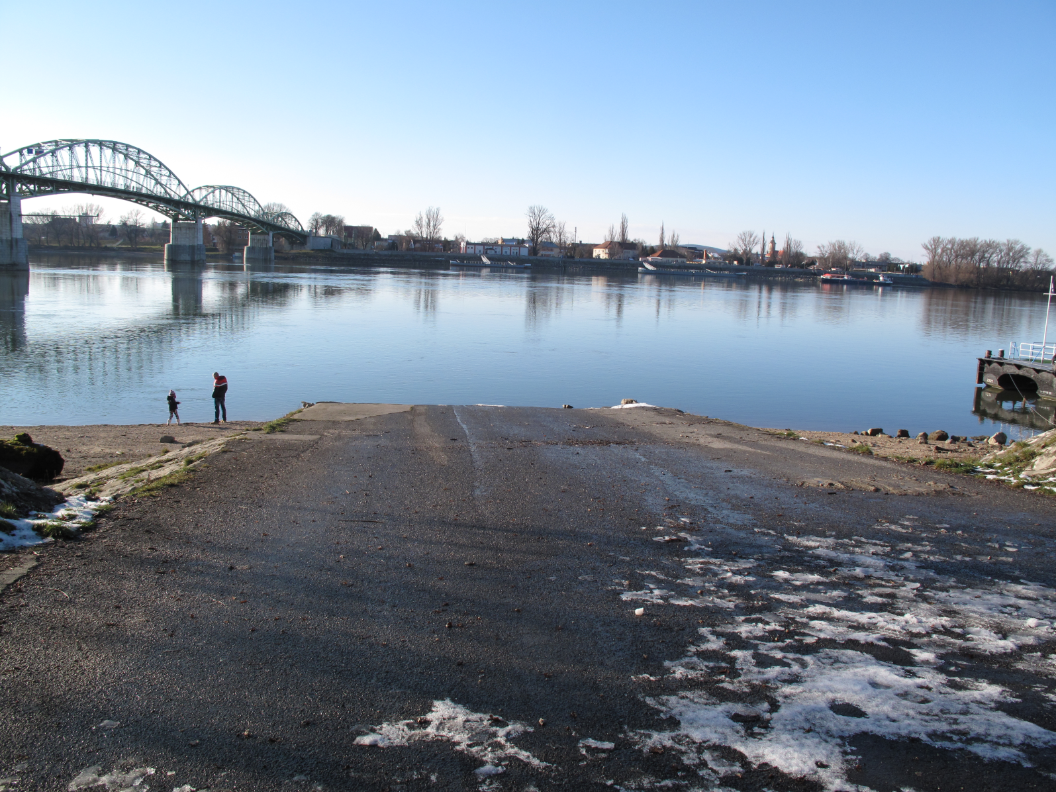
The ferry-boat station

Slide 4
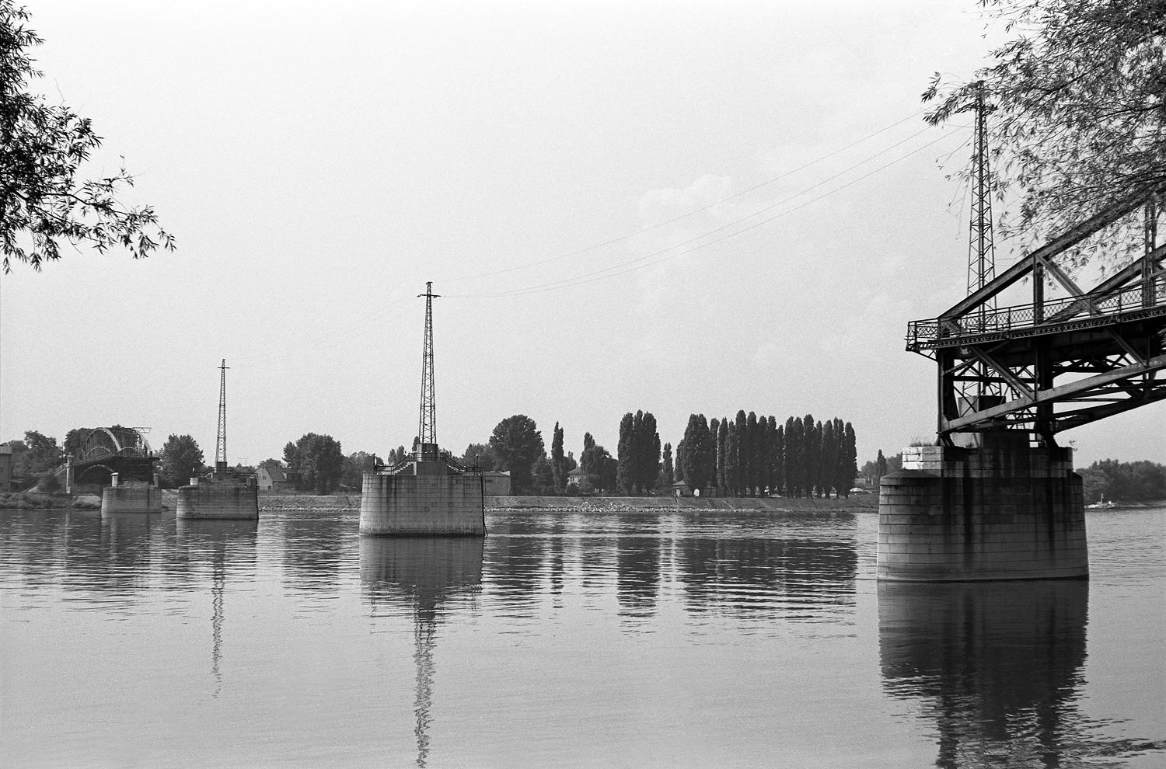
The bridge in ruins

Slide 5
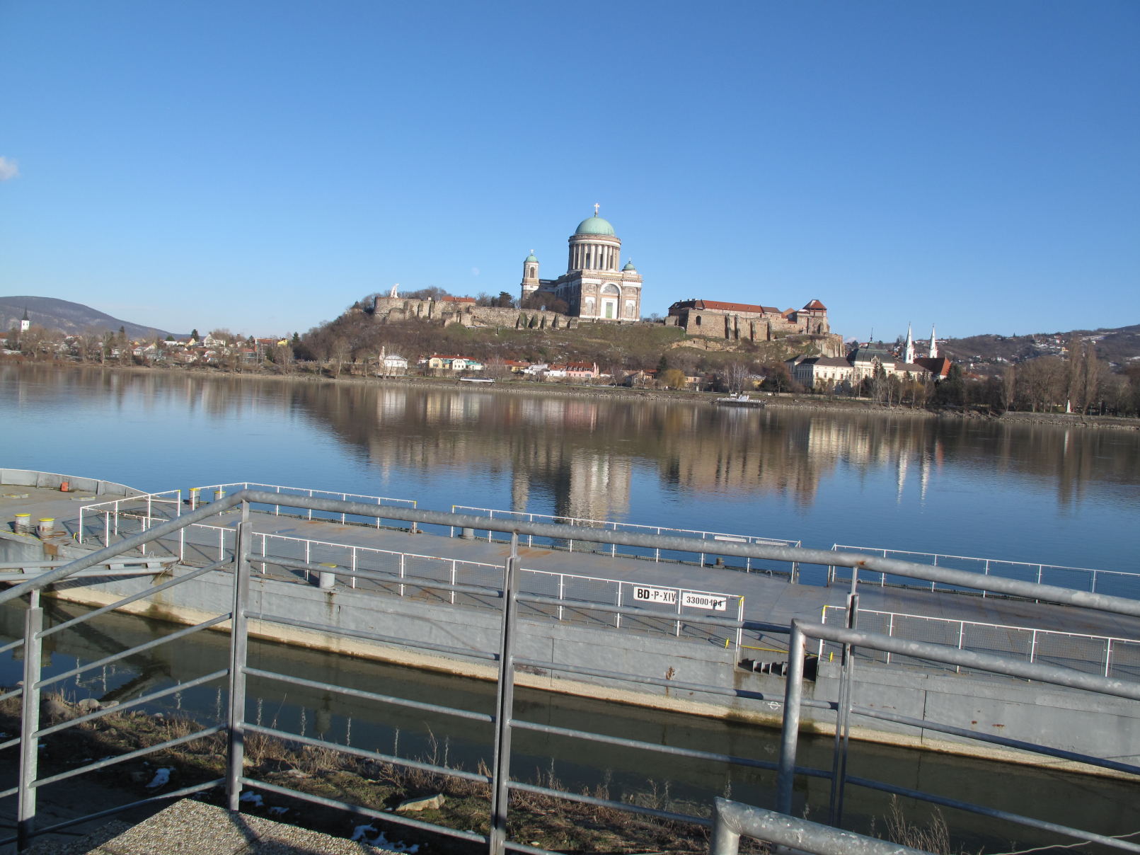
Štúrovo harbour

Slide 6
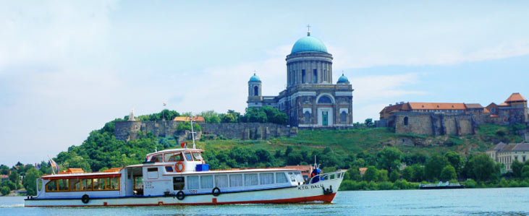
Our excursion boat for turists in summer

Slide 7
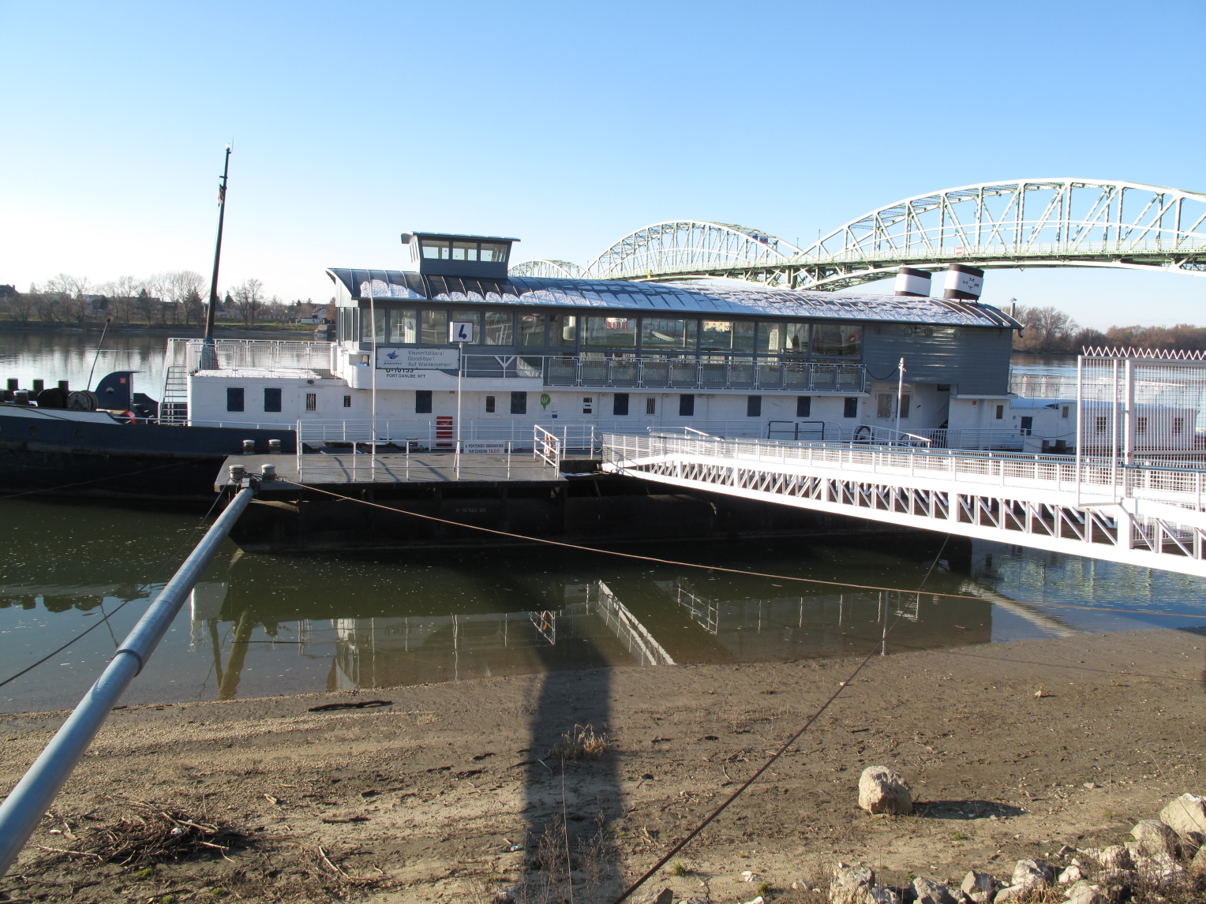
Esztergom Harbour, excursion boats travelling to Budapest

Slide 8
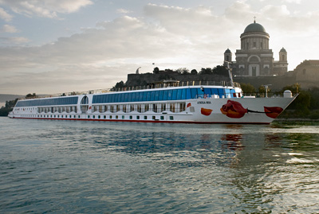
Huge excursion boats

Slide 9
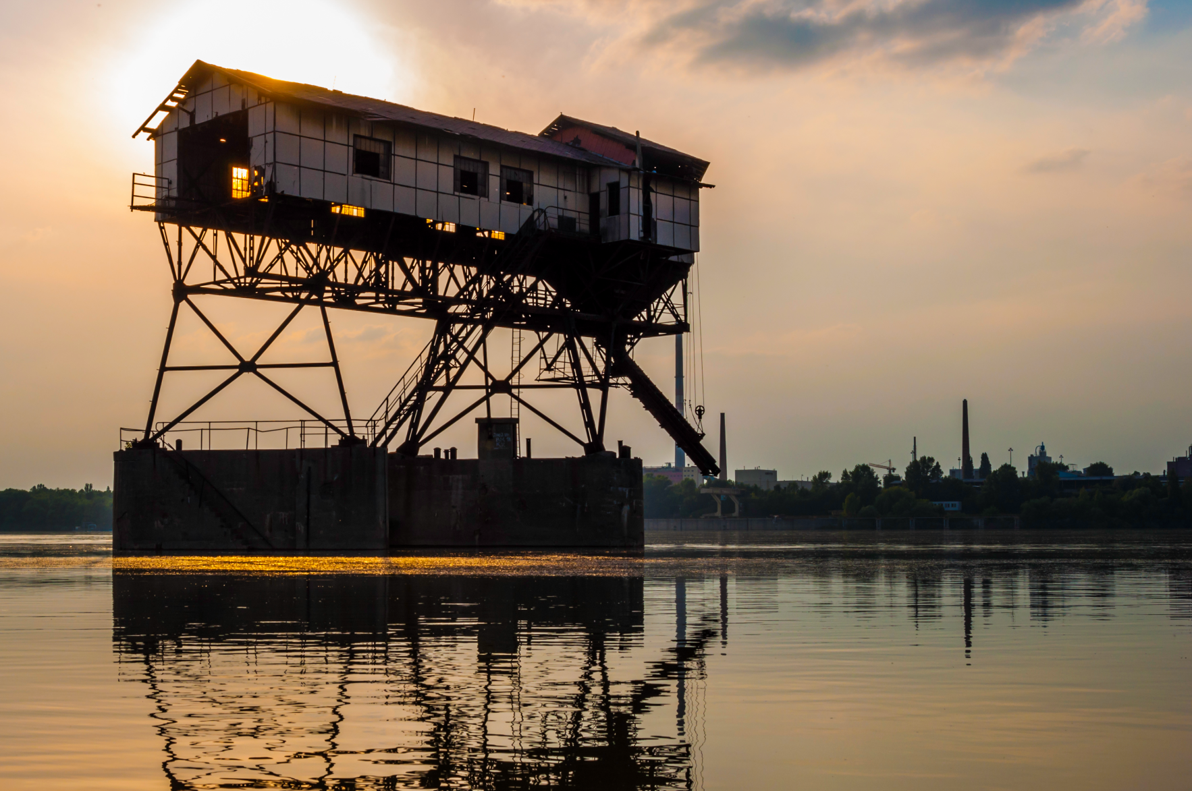
Cargo-loading place for Dorog coal-mines near Esztergom

