Slide 1
Danube
https://www.50plus.at/fluesse/donau.jpg

Slide 2
Facts
Europe's second-longest river
located in Central and Eastern Europe
length: 2,860 km
countries: Germany, Austria, Slovakia, Hungary, Croatia, Serbia, Bulgaria, Romania, Moldova, Ukraine

Slide 3
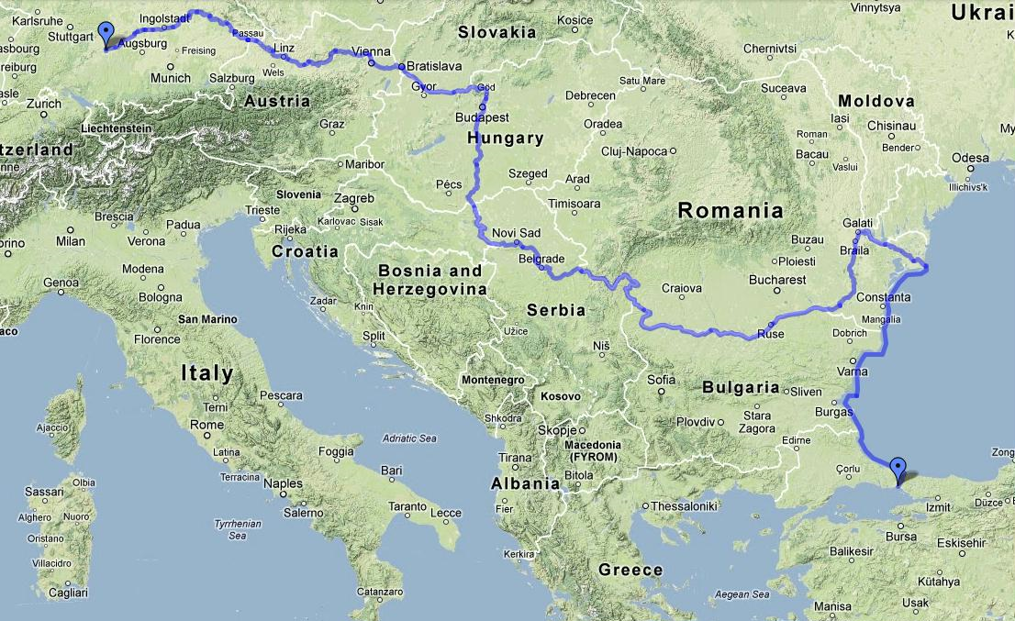
Course of the Danube
http://global.nexusmods.com/mods/4/images/4-3-1421406040.jpg

Slide 4
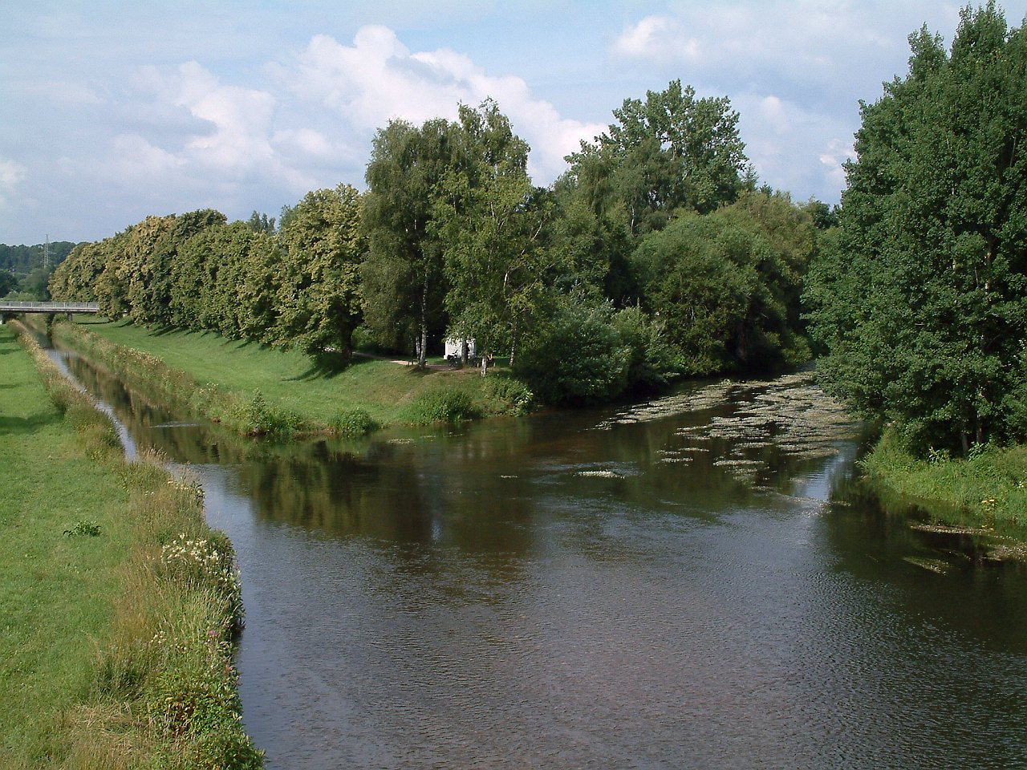
Danube confluence
http://en.wikipedia.org/wiki/Danube#/media/File:Donaueschingen_Donauzusammenfluss_20080714.jpg

Slide 5
Tourism
Important tourist and natural spots along the Danube :
Wachau Valley
Nationalpark Donau-Auen in Austria
Gemenc in Hungary
Naturpark Obere Donau in Germany
During the peak season more than 70 cruise liners are in use on the river

Slide 6
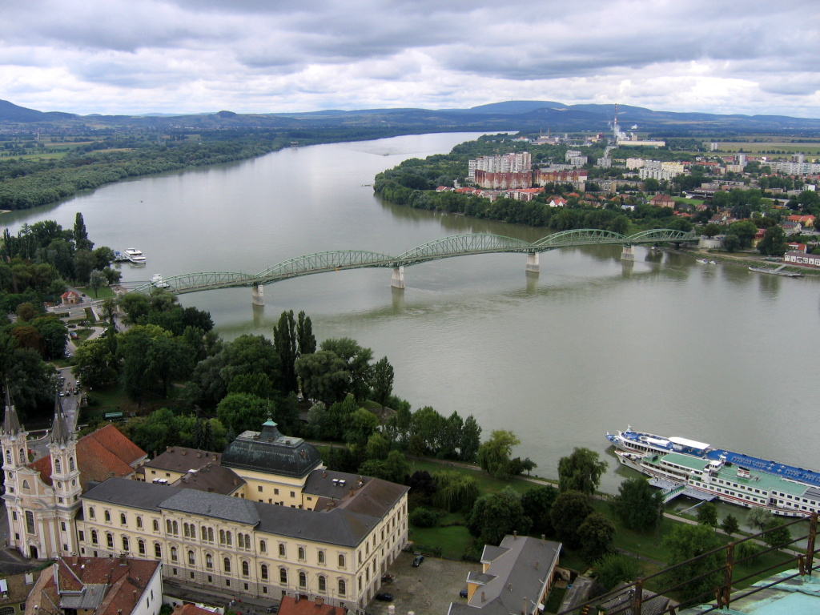
Danube in Esztergom and Štúrovo
http://en.wikipedia.org/wiki/Danube#/media/File:M%C3%A1ria_Val%C3%A9ria%C2%B4s_bridge.jpg

Slide 7
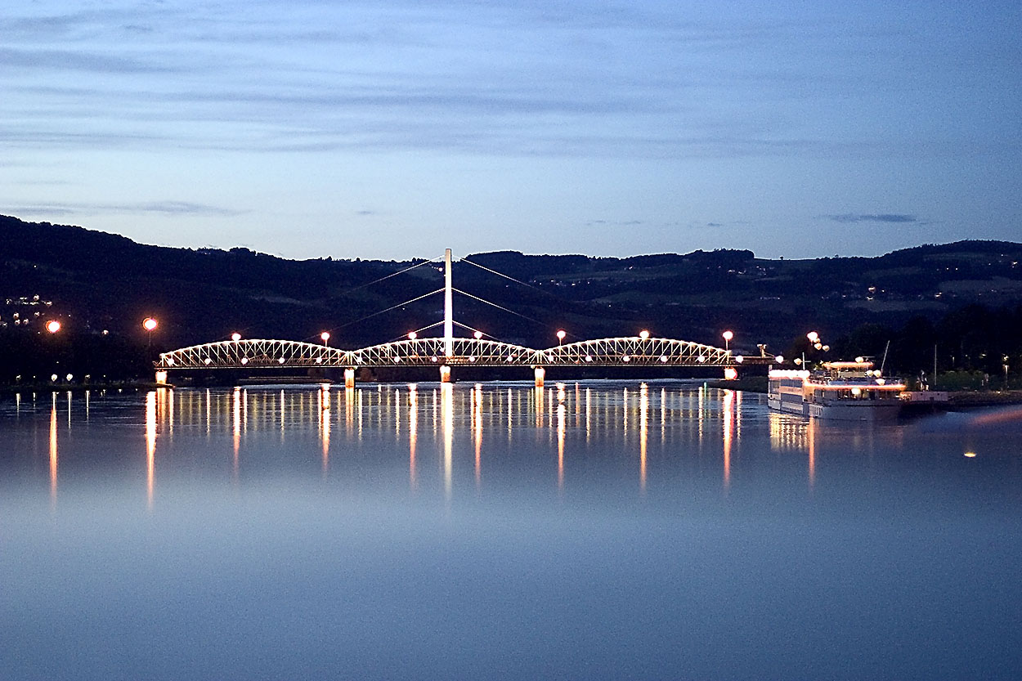
Danube in Linz
http://en.wikipedia.org/wiki/Danube#/media/File:Danube_in_Linz.jpg

Slide 8
Navigation and transport
was an important waterway in the 19th century
is an important transport route
since the opening of the Rhine–Main–Danube Canal, the river connects the Port of Rotterdam and the industrial centres of Western Europe with the Black Sea

Slide 9
Danube
source: Wikipedia

