Slide 1
Visit to Honeywell & Mondial

Slide 2
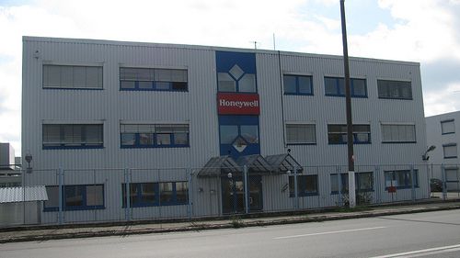
Honeywell

Slide 3
Basic information
Honeywell International is an American multinational conglomerate company that produces a variety of commercial and consumer products , engineering services and aerospace systems for a wide variety of customers, from private consumers to major corporations and governments.
Honeywell has a global workforce of approximately 130 000 of whom approximately 58 000 are employed in the United States.
Honeywell Aerospace innovates and integrates thousands of products, software and services to advance and more easily deliver safe, efficient, productive and comfortable transportation experiences worldwide.

Slide 4
Mondial

Slide 5
Basic information
Mondial is a Romanian company which produces sanitary objects
The company belongs to the German group Villeroy & Boch
The company has the capacity of producing 1.25 million sanitary objects a year
In 2004 was the greatest producer of sanitary objects in Romania

Slide 6
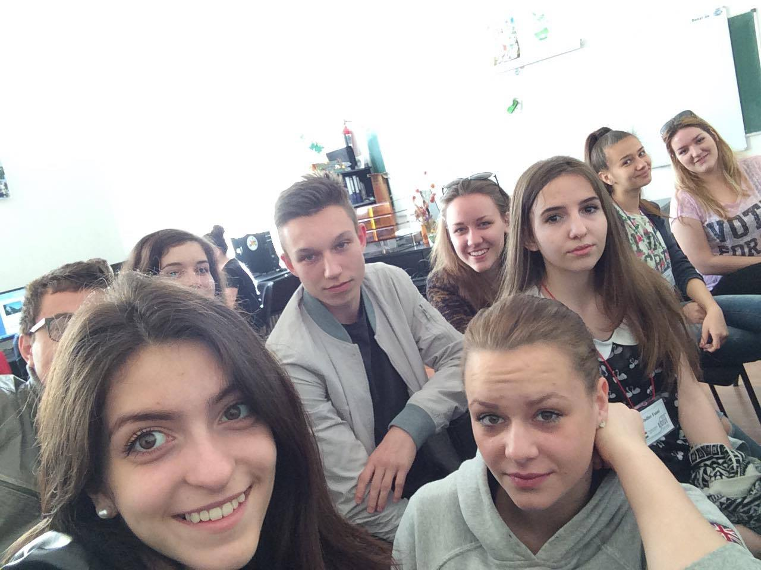
Accountants
Thank you for paying attention! ☺

