Slide 1
Sturovo
Light orange group

Slide 2
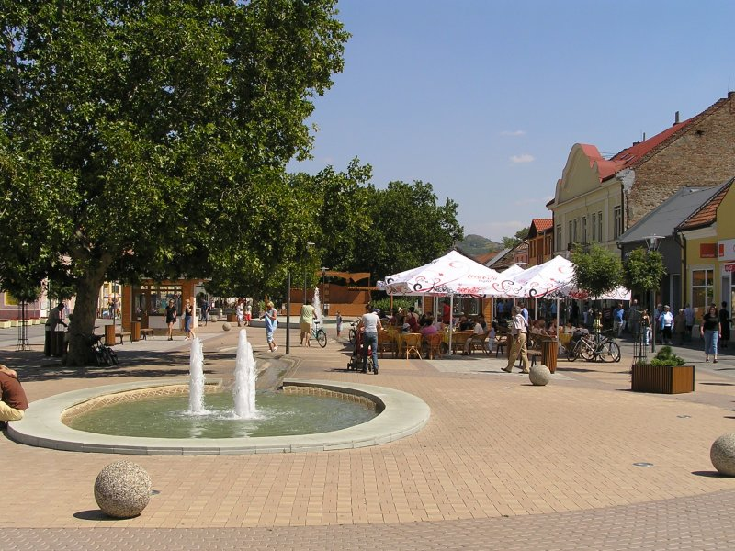
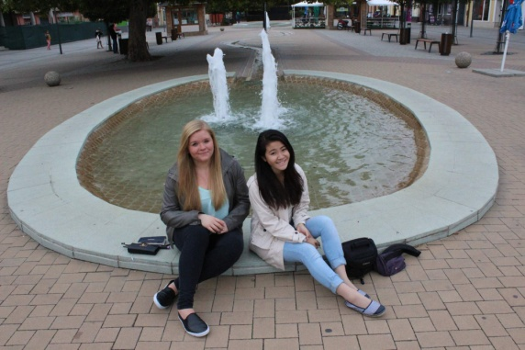
Šturovo
The southest city in Slovak Republic
It has approximately 11 000 inhabitants
It borders with Hungary
Lot of tourists visit it because of the summer attractions
The river Danube disconnets Slovakia from Hungary

Slide 3
Sightseeing
Statue of Ján Sobieski
The Church of St. Emerick
Mária Valéria Bridge
Museum
Julius Barta Gallery
Russian cementery

Slide 4
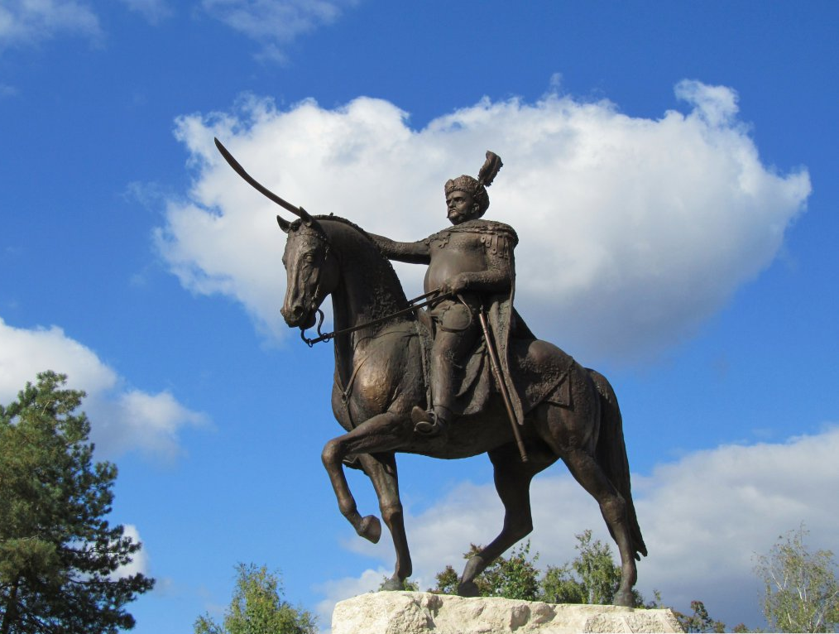
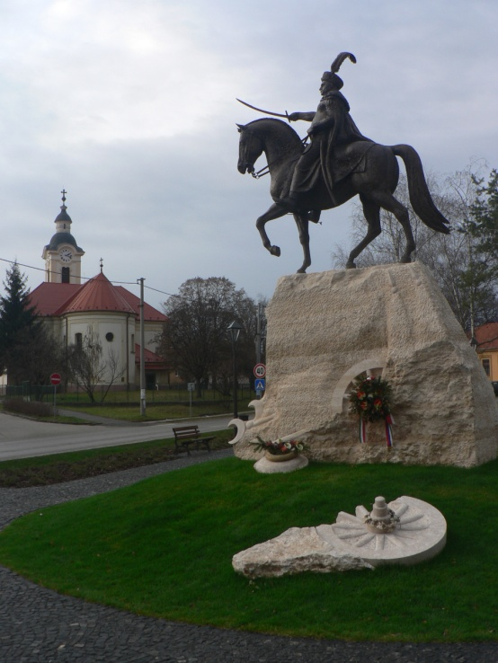
Statue of Ján Sobieski
It was made by sculpture Lajos Győrfi
Put up from the money raised in subscriptions
The statute of the king commemorates the defeat of the Turkish army

Slide 5
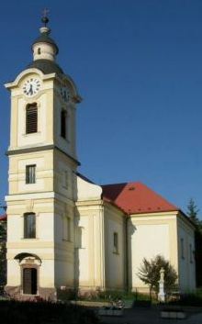
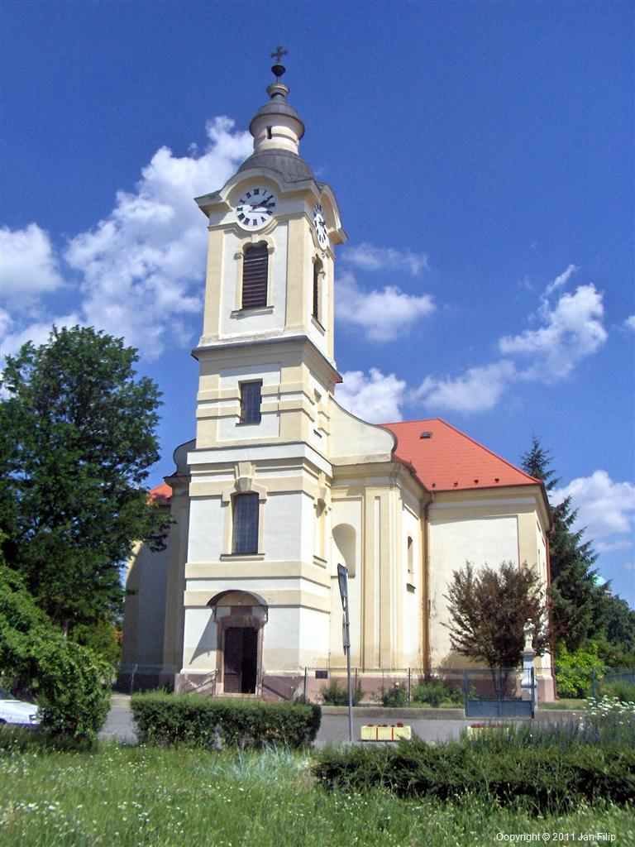
The Church of St. Emerick
The Church was built in a Baroque style
Was consecrated to honur Saint Emerich of Hungary
It was enlarged few years ago
The painting of Saint Emerick was also restored

Slide 6
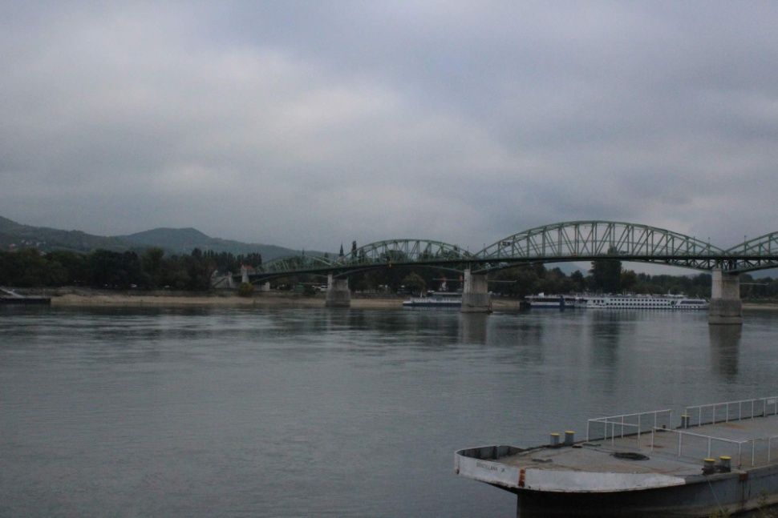
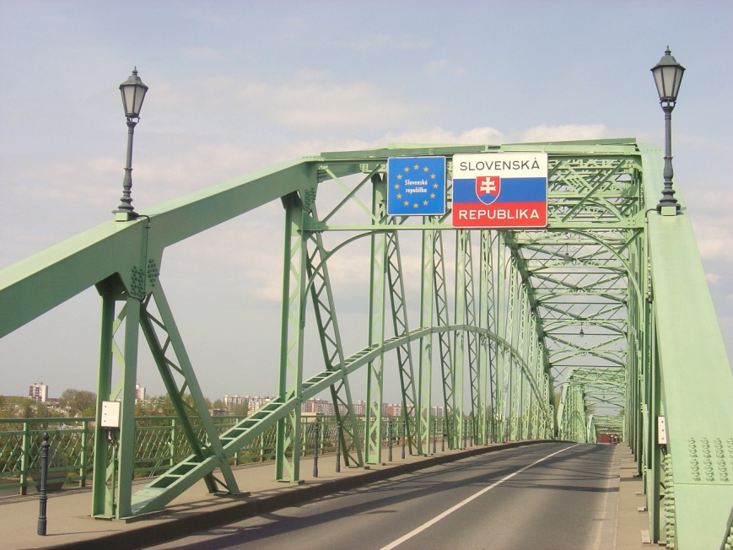
Mária Valéria Bridge
It is a very important crossing point between Hungary and Slovakia
Destroyed at I. and II. World War

Slide 7
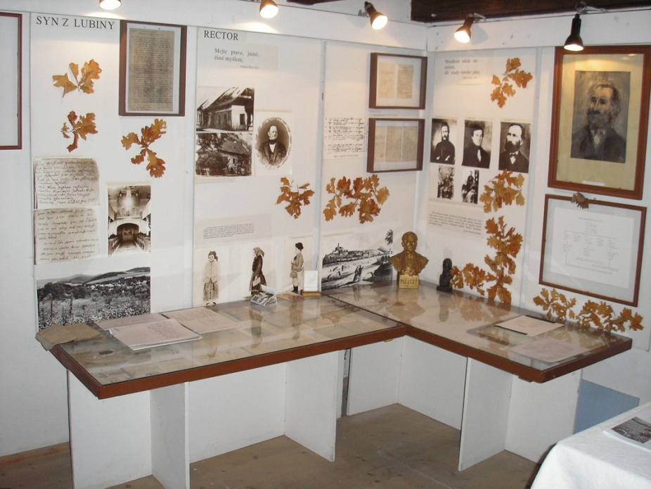
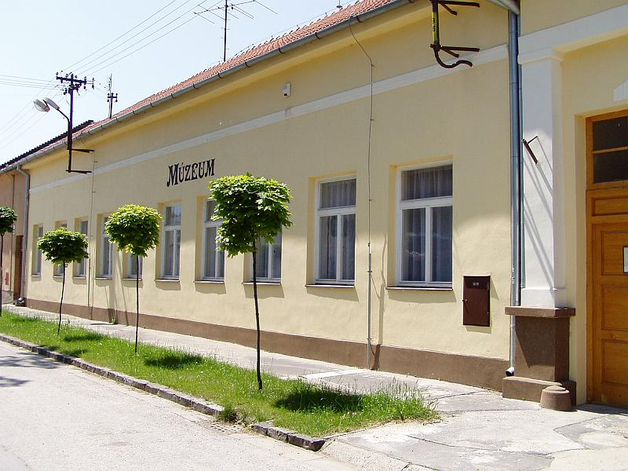
Museum
It was opened of the public in May 2004
Was registered in the Ministry of culture of the Slovak Republic in February 2004
During every summer is there a night of museums, when the museum is open during the night

Slide 8
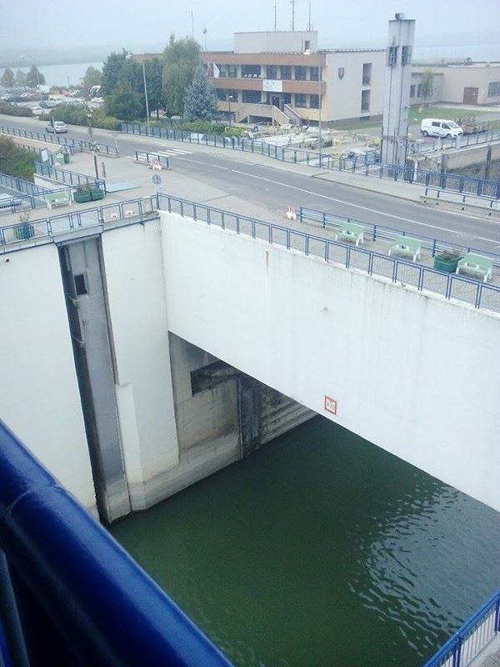
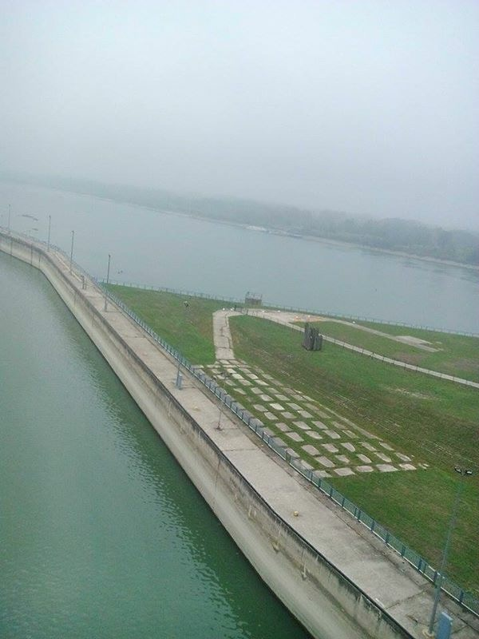
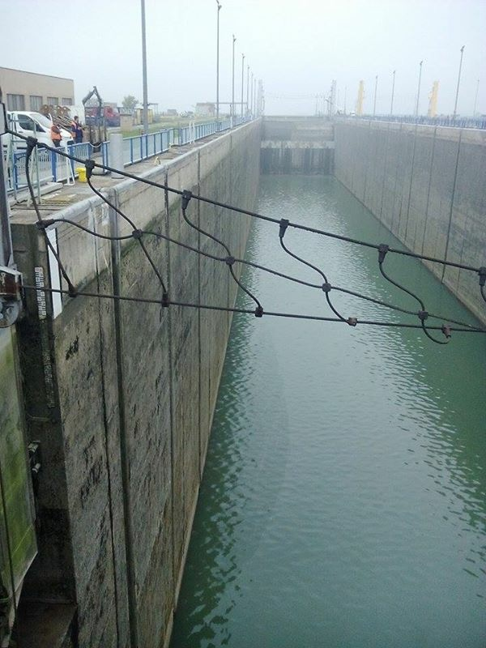
Gabčíkovo Dam
The biggest barrage project on the river Danube
It produces clean energy

Slide 9
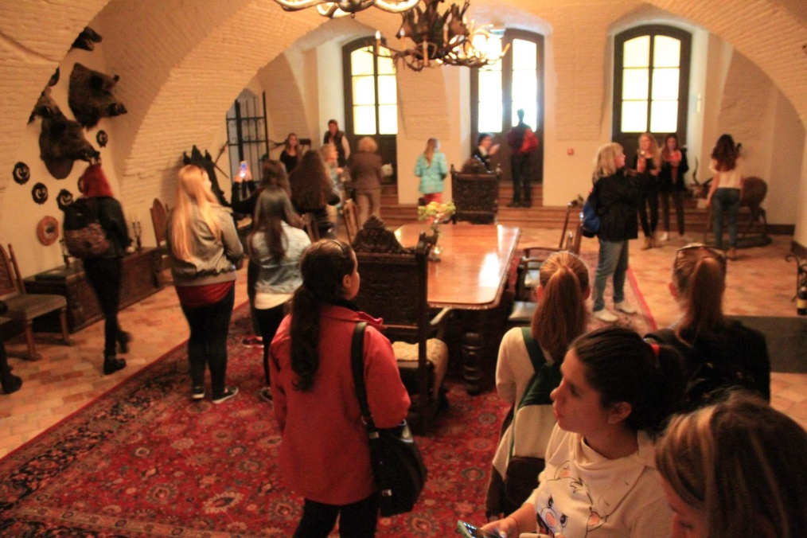
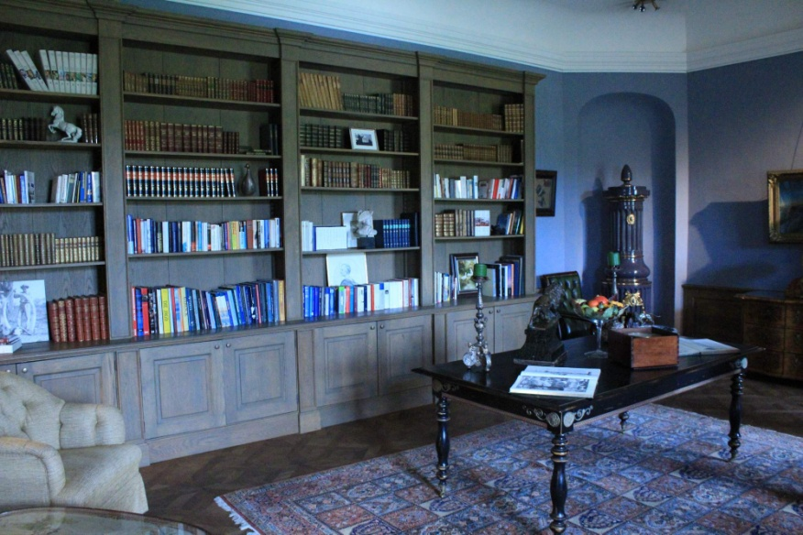
Béla Castle
Construction of Castle Belá started by Mr. János Tertyánsky
1780 Castle Belá was bought by Mr. Pál Serdahely
Countess Ilona von Krockow is the contemporary proprietress

Slide 10
Thank you for your attention!

