Slide 1
Talent show in Pápa
Made by the dark blues.

Slide 2
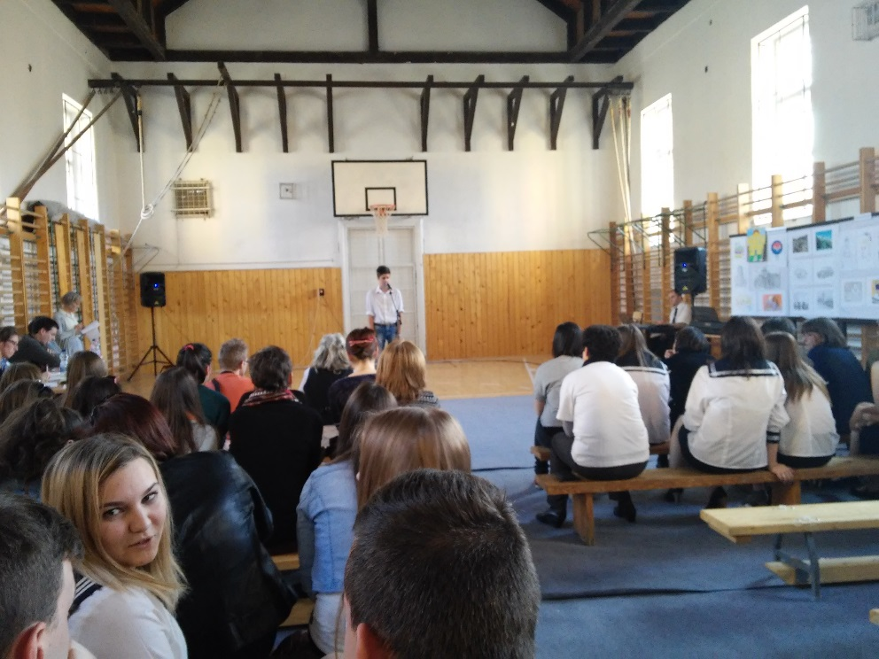
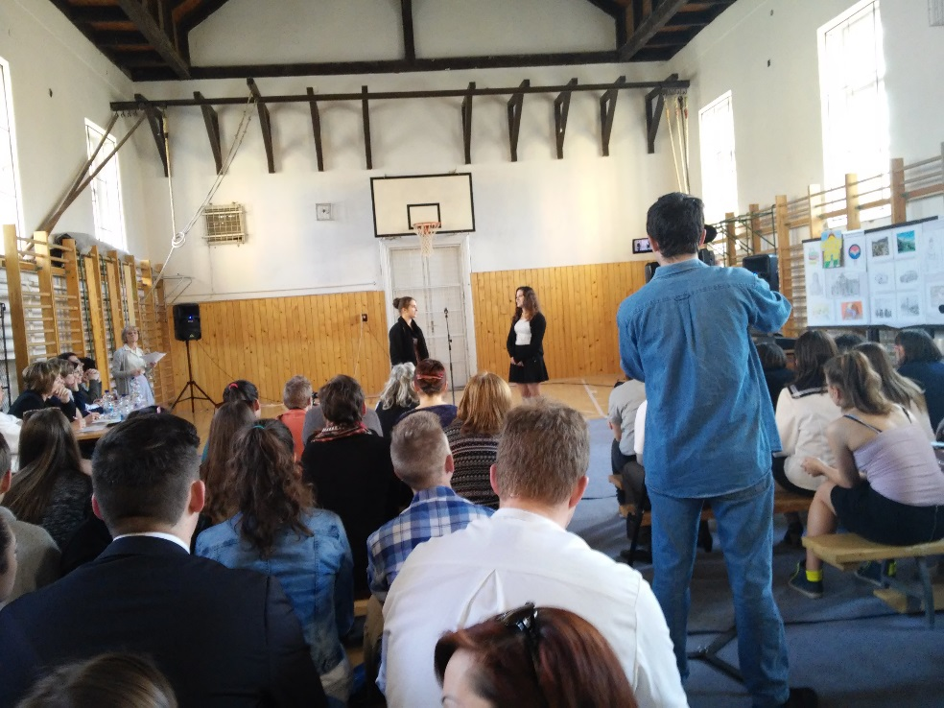
Things to know about the talent show:
Students participated from the cities around Pápa.
They could show their talent in three categories: music/dance, art, play.

Slide 3
In the category of play we could hear languages from Europe, like russian, french, or german.
The dancers showed their talent for expressing music with dance movements.
The two most common languages for the music category were hungarian and english.
Artists could enter the competition with pictures taken with a camera or with paintings.

Slide 4
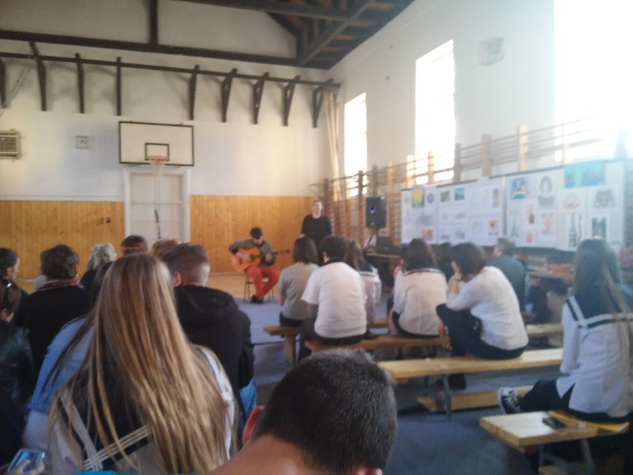
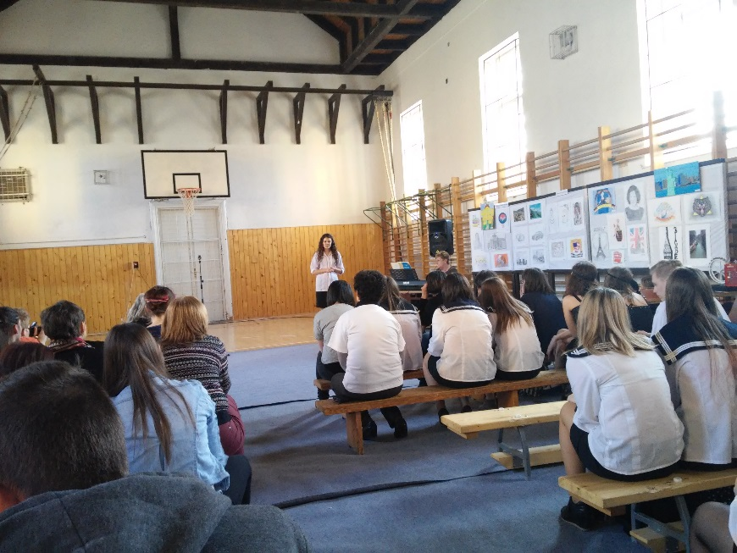
Even some of our ESCAPE students showed their talent.

Slide 5
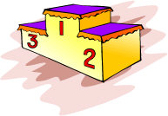
The jury had a tough decision. After the diplomas were given to the participants, and we applauded for the first three bests we went back home tired, but with a great day full of experience,

Slide 6
Thank you for your attention!

