Slide 1
INFRASTRUCTURE AND TRANSPORT
The future is near.

Slide 2
TRANSPORTATION
Most transport media in use today are generally fossil fuel powered.
The reason for this is the ease of use and the existence of mature technologies harnessing this fuel source.
Many ideas exist which try to either harness renewable forms of energy, more efficiently use fossil fuel, or use human power, or some hybrid of these, to move people and things.

Slide 3
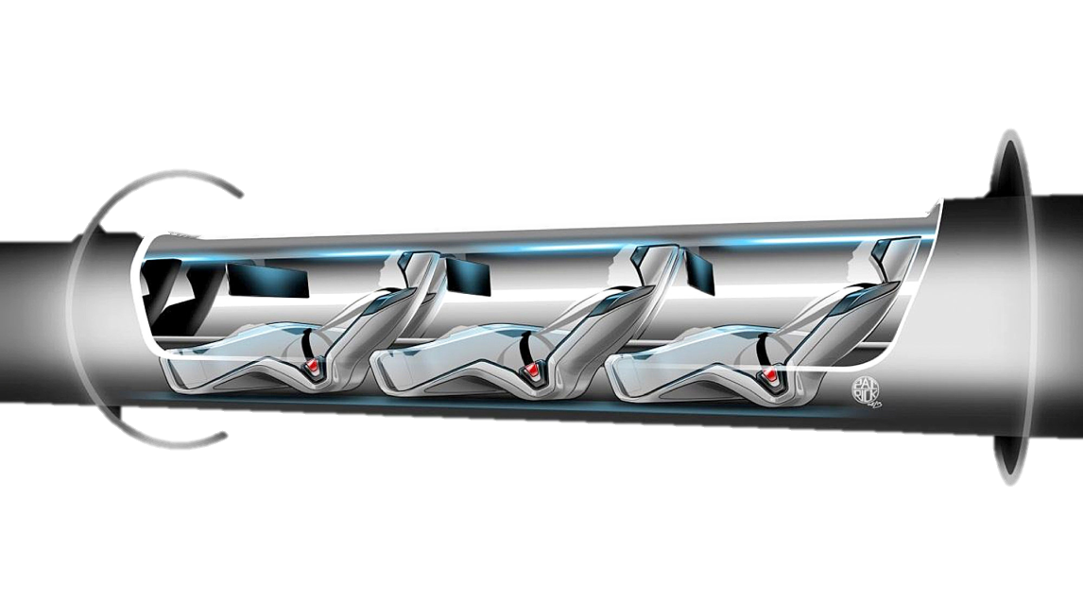
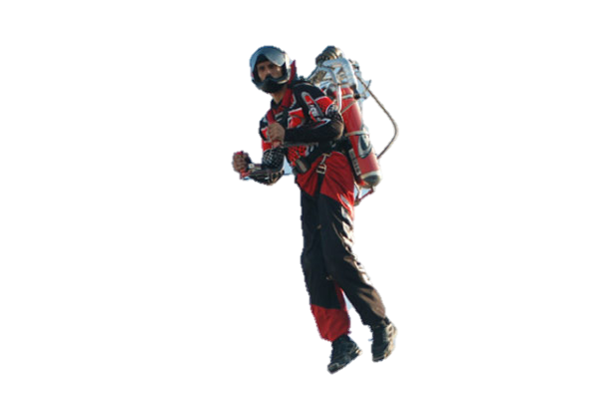
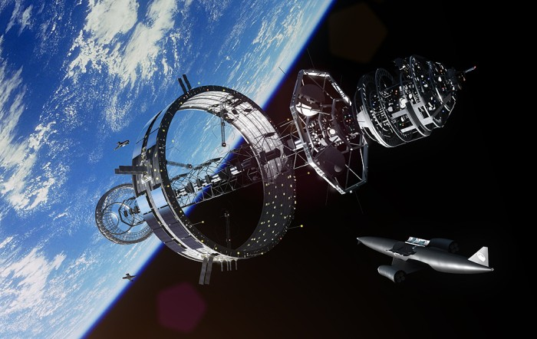
Dual-mode vehicle
Hyperloop
Intelligent Transportation System
Jet pack
Launch loop
Orbital ring

Slide 4
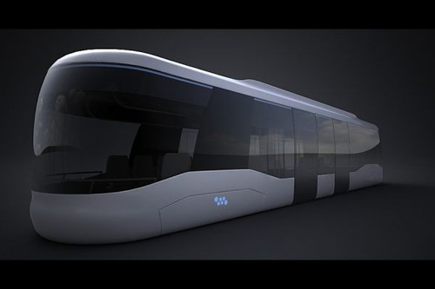

Slide 5
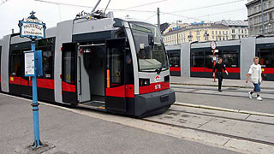
INFRASTRUCTURE
Today's infrastructures - the artery systems of our society - are often strained beyond their originally intended capacities e.g. for private and public transport. Furthermore, large parts of the utility networks require significant refurbishment and adaptation activities.

Slide 6
In the future underground construction will be more costeffective, safer and more environmentally friendly.
The consequence of this will be that underground space will be increasingly used to alleviate pressing problems that will confront the European society in the next 20 years:
Traffic congestion (freight transport is expected to increase by 60% from 2004 to 2020),
Increasing urbanization (mega cities),
Lack of space and pollution of air and water.
In addition, European industry will be more competitive in the world market.

Slide 7
PLANS FOR THE EU INFRASTRUCTURE
Infrastructures are expected to provide reliable service for very long periods of time, covering major technology changes, spanning several generations and experiencing dramatic evolutions of the individual and collective aspirations for quality of life. The increasing demand for mobility and supply is driven first by demographic growth, but also by a number of factors such as urbanisation or macro economic development. Climate change is another major driver which will force us to alter our behavioural patterns regarding consumption of energy, supply and transport of goods, and even our leisure time.

Slide 8
PLANS FOR THE EU INFRASTRUCTURE
Modern energy infrastructure is crucial for the EU to integrate its energy market and to meet its energy and climate goals. To upgrade Europe's infrastructure, the European Commission has estimated that around €200 billion is needed during the current decade for transmission grids and gas pipelines.

Slide 9
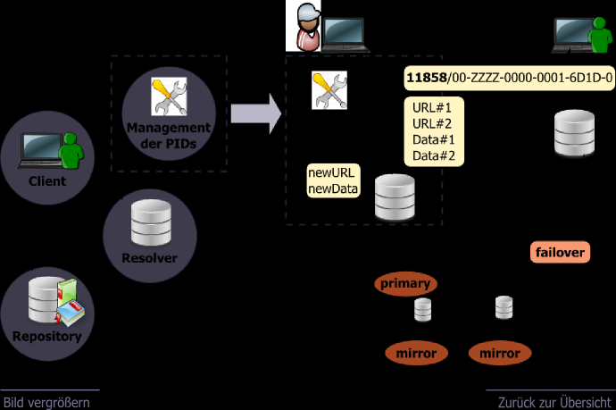
PLANS FOR THE EU INFRASTRUCTURE
The construction of new power grids and other infrastructure projects affects the environment and the daily lives of those who live nearby. Projects should therefore be implemented in a way that achieves a high level of support amongst the local population.

Slide 10
EU PRIORITY CORRIDORS
For electricity:
Transmission lines in South Western Europe such as between Spain and France to transport power between EU countries
Integration of the Baltic electricity market – Lithuania, Latvia, and Estonia – with the rest of the EU

Slide 11
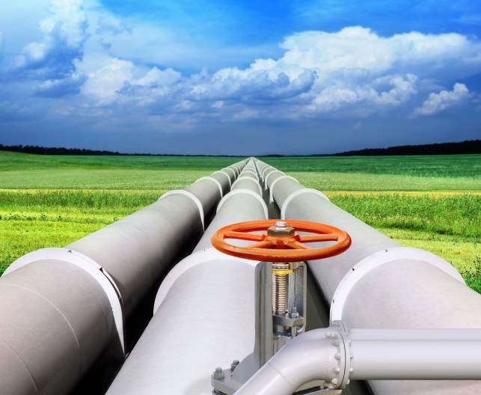
EU PRIORITY CORRIDORS
For gas:
The Southern Corridor to deliver gas directly from the Caspian Sea to Europe
North-South gas pipelines in Central Eastern and South Eastern Europe including regional connections in the Baltic Sea region, the Adriatic and Aegean Seas, the Eastern Mediterranean Sea, and the Black Sea, to help diversify gas sources and increase security of supply

Slide 12
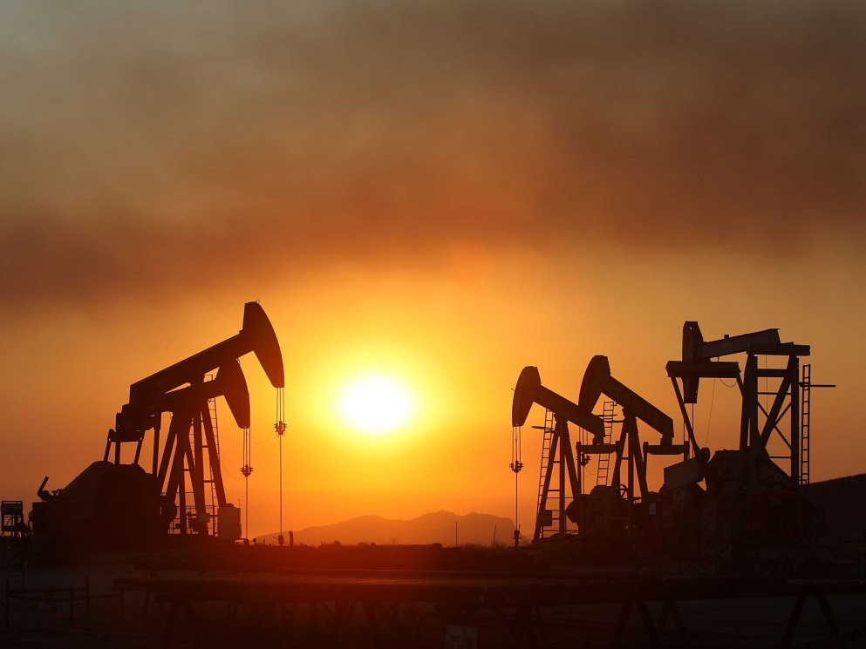
EU PRIORITY CORRIDORS
For oil:
improving interoperability in the oil supply connections in Central Eastern Europe to increase security of supply and reduce environmental risk

Slide 13
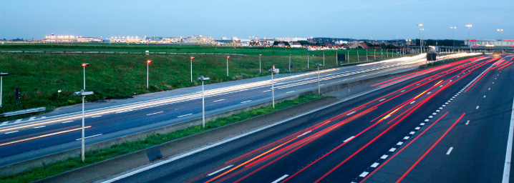
EU PRIORITY CORRIDORS
EU thematic areas that relate to the entire EU:
increased deployment of smart grids to help integrate renewable energy and allow consumers to better regulate their energy consumption
the construction of electricity highways – large grids that allow electricity to be transported over long distances across Europe (ex: from wind farms in the North and Baltic Seas to storage facilities in Scandinavia and the Alps)
the development of transport infrastructure for captured CO₂

Slide 14
THE END. THANK YOU FOR YOUR ATTENTITON!
Nina Petrova
Katerina Durisova
Comanescu Orlando Denis
Viktor Krč
Erik Udvardi
Bye Girls and Boys ^.^

