Slide 1
Pápa

Slide 2
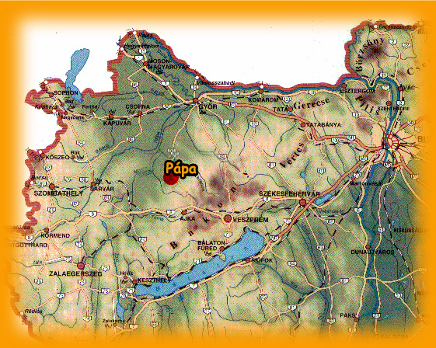
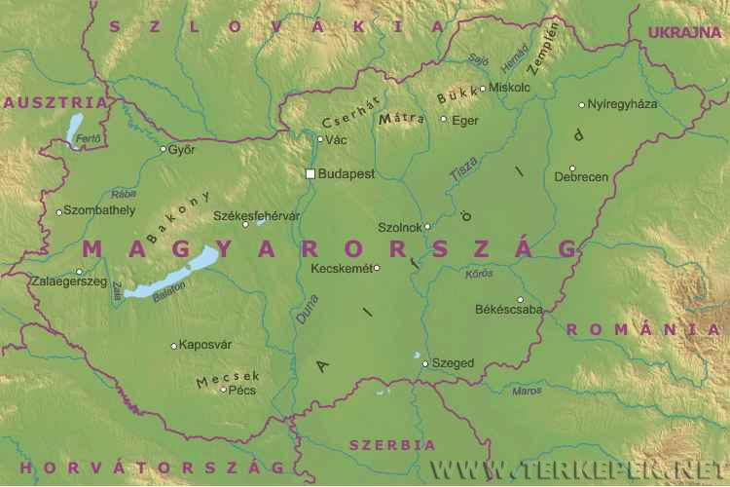
Location
In the north west part of Hungary at the foot of the Bakony Hills.

Slide 3
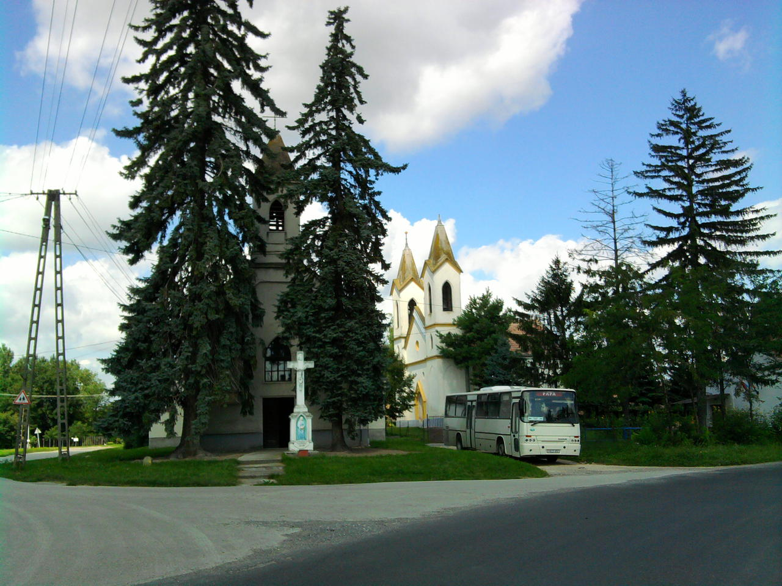
Population
About 33.000 people.
There are a lot of villages around our town.

Slide 4
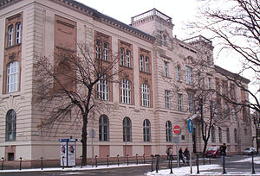
„Athens of Transdanubia”
We have a lot of schools (12).
2 university faculties: Theology, Pedagogy
The oldest and most famous one is the Calvinist Secondary School. It was founded in 1531.

Slide 5
Sights in Pápa
Main Square
Big Church
Museum of Blue Dyeing (blue print)
Calvinist College and Collection
Esterházy Palace
„Castle Park”
Some art galleries
A chemist’s museum

Slide 6
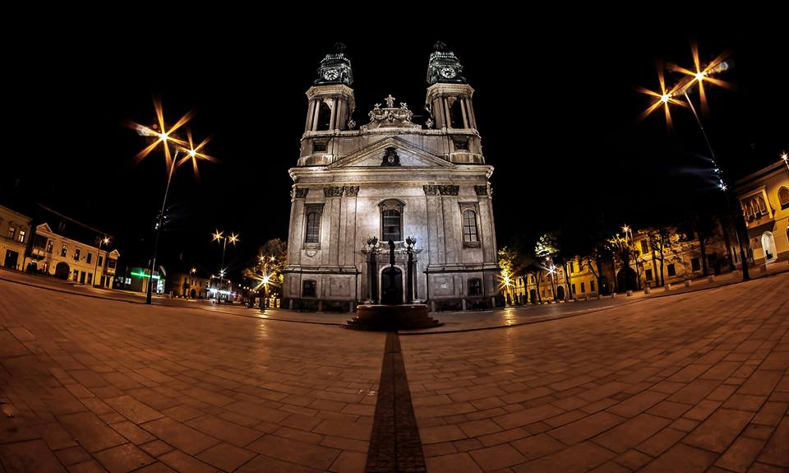
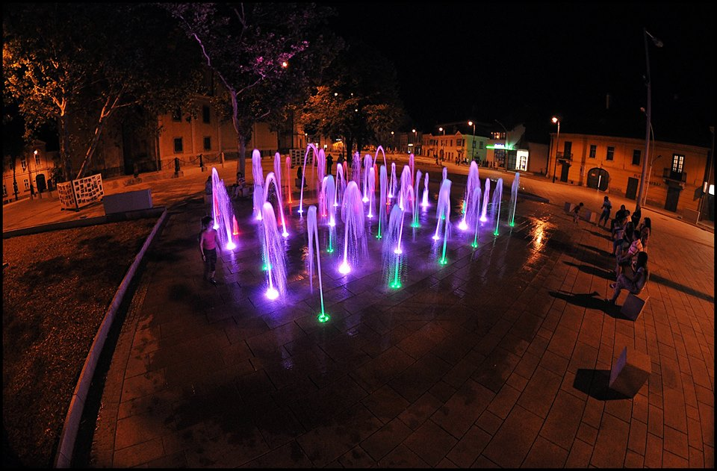
Main Square
This is a „Baroque” square.
There is a Roman Catholic Church (76 m.)
It’s surrounded by beautiful „baroque” buildings.
Our main square was renewed in 2013.

Slide 7
Main square (Before)

Slide 8
Main square (After)

Slide 9
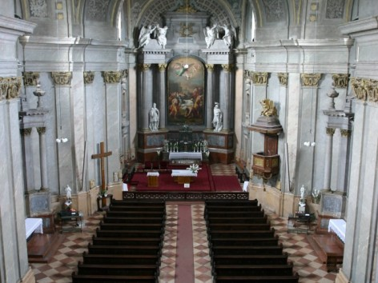
Big church

Slide 10
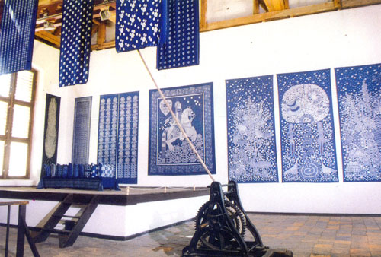
Museum of Blue Dyeing

Slide 11
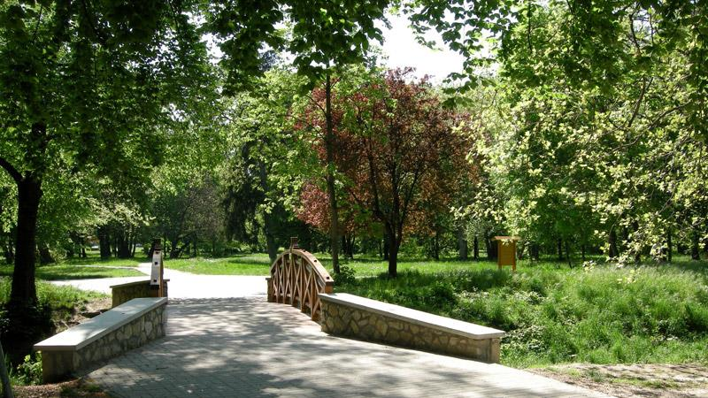
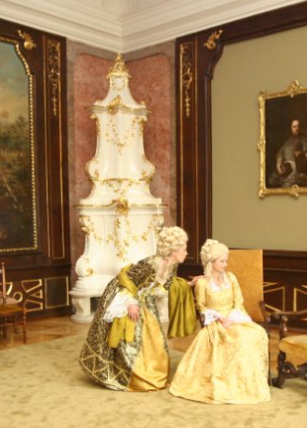
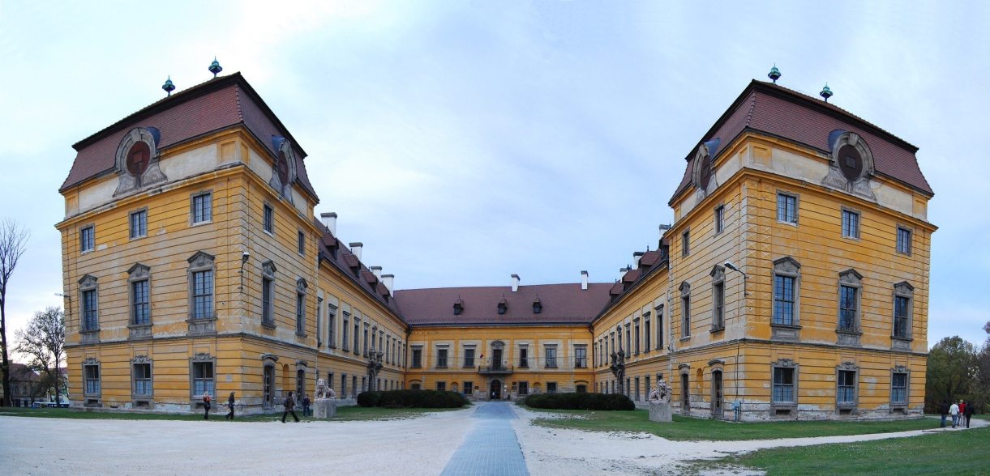
„Castle Park”
This park behind the Esterházy Palace.
The Palace is under reconstruction

Slide 12
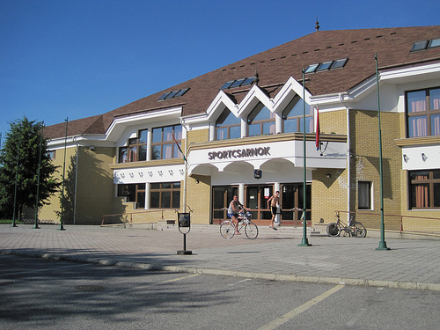
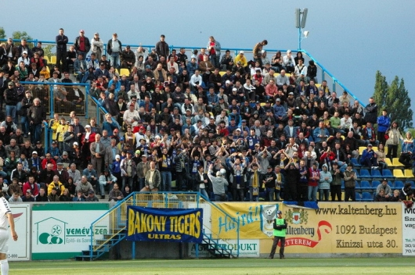
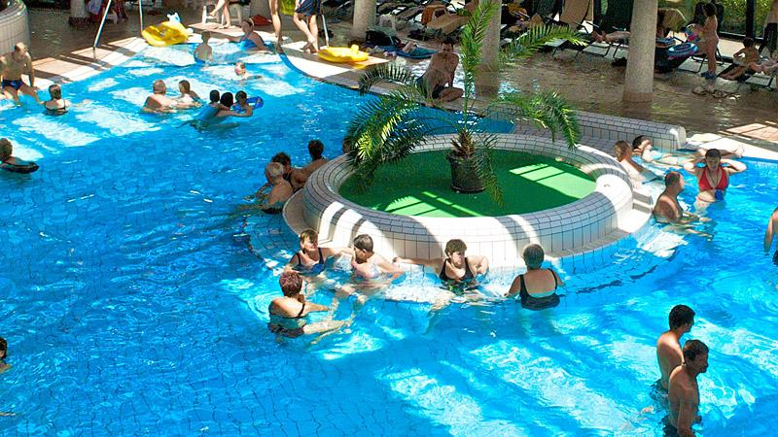
Other Places
Swimming pool and thermal spa.
Football Stadium and Sport Centre.

Slide 13
Our favourite places
Unique café (good service)
Kattani’s (delicious pizza)
Esti Kornél café (good tea, elegant)
James Joyce (elegant and delicious pizza)

Slide 14
Unique café

Slide 15
Kattani’s

Slide 16
Esti Kornél

Slide 17
James Joyce (near the Esti Kornél)

Slide 18
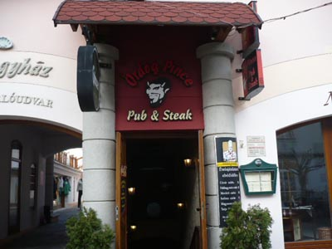
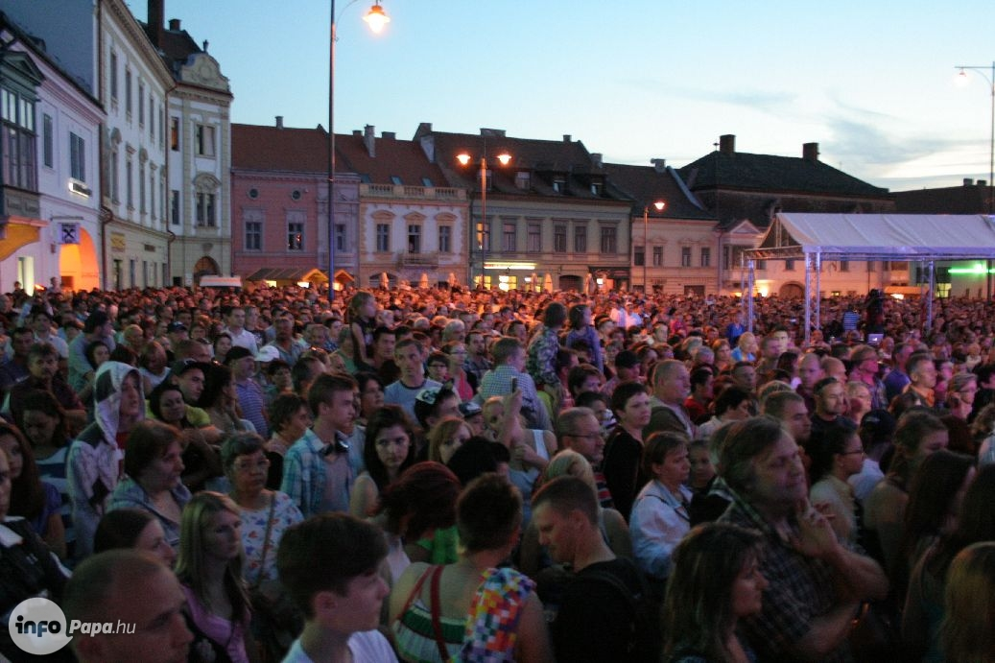
Nightlife
We have a lot of bars, cafés, pubs and 3 nightclubs.
But unfortunately the Nightlife is not very exciting…

Slide 19
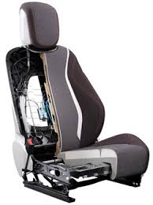
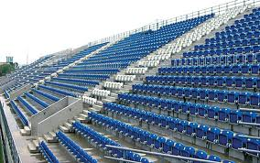
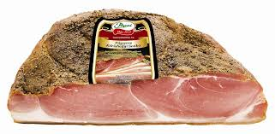
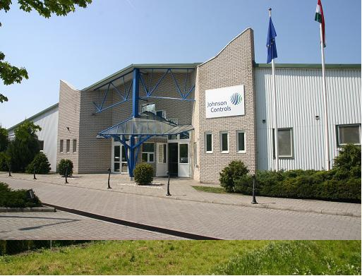
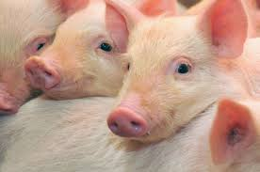
Business and industry
Meat Processing Factory
Johnson Controls
Hirtenberger
Asztalos Ltd. (Joiners) They made seats e.g. in the Allianz Arena in Munich

Slide 20
This year we are 800 years old.

Slide 21
Thank you for watching! ☺
Welcome to Hungary! ;)

