Slide 1
The first day in Lugoj
Secretary Group

Slide 2
Sightseeing
Theatre
Statues
Iron Bridge
Orthodox Church
Catholic Church
Man with the rifle
City Hall
Electric Clock

Slide 3
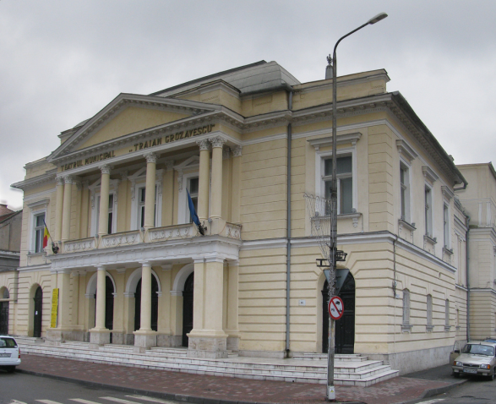
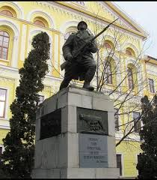
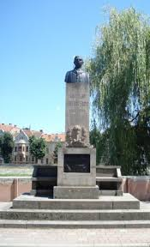
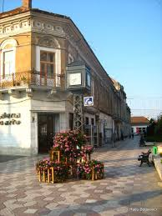
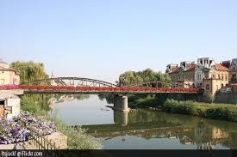
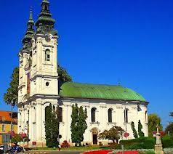
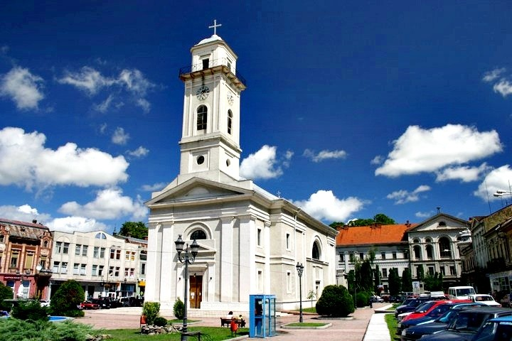
Sights
Theatre
Man with the rifle
Statue of Coriolan Brediceanu
Electric clock
Iron bridge
Catholic church
Orthodox church

Slide 4
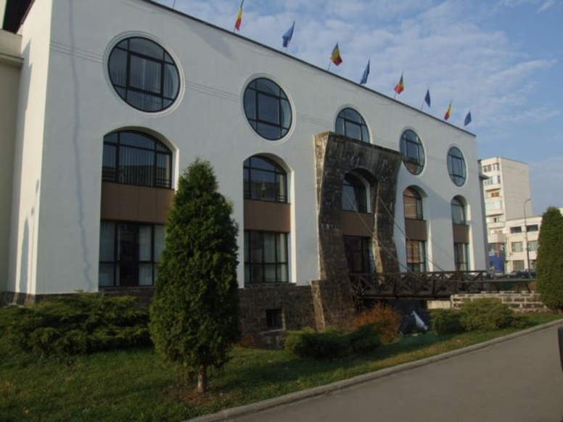
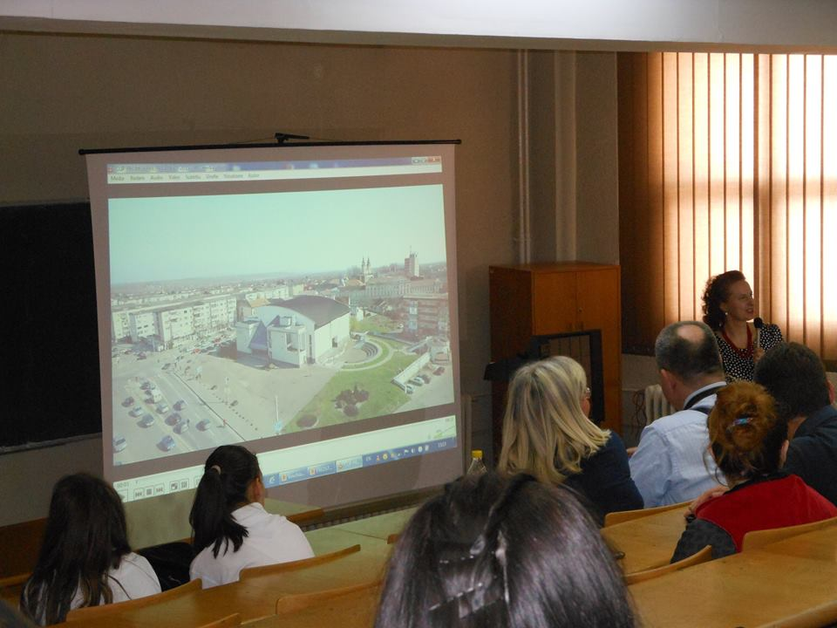
Dragan University

Slide 5
Presentations of the students
Slovakia: Smurfit Kappa, Brewery in Hurbanovo, Winery, Sheep cheese
Bulgaria: Local vs. Imported products
Hungary: Turo Rudi, Somlo wine, Papa Ham
Slovenia: Alpian milk, Jost cheese, Lust tomato, …
Austria: Schärdinger Bergbaron, Spar-Vollmilch\
Romania: Milk, Fruits and vegetables,Dresses
Czech Republic: beer, vegetables, dairy products

Slide 6
Thank you for your attention
Nikola Horvathova, Cyntia Streckova, Robert Mandin, Grad Ana-Maria, Daju Daiandra, Bodai Martin, Simona Valkova, Filip Adamovsky, Monika Rak

