Slide 1
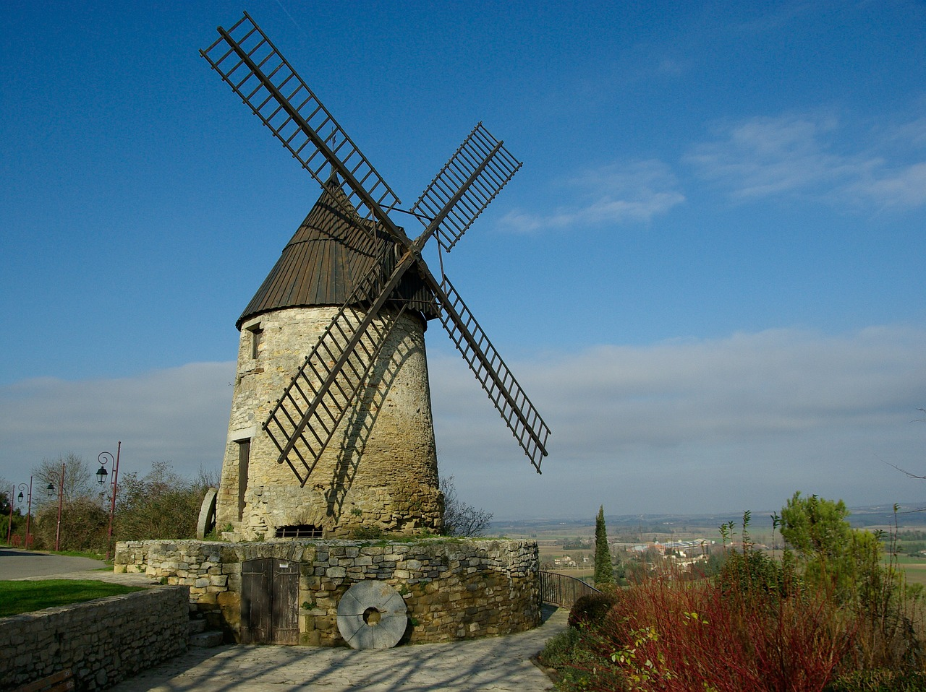
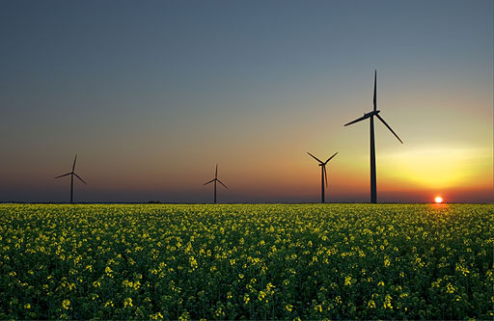
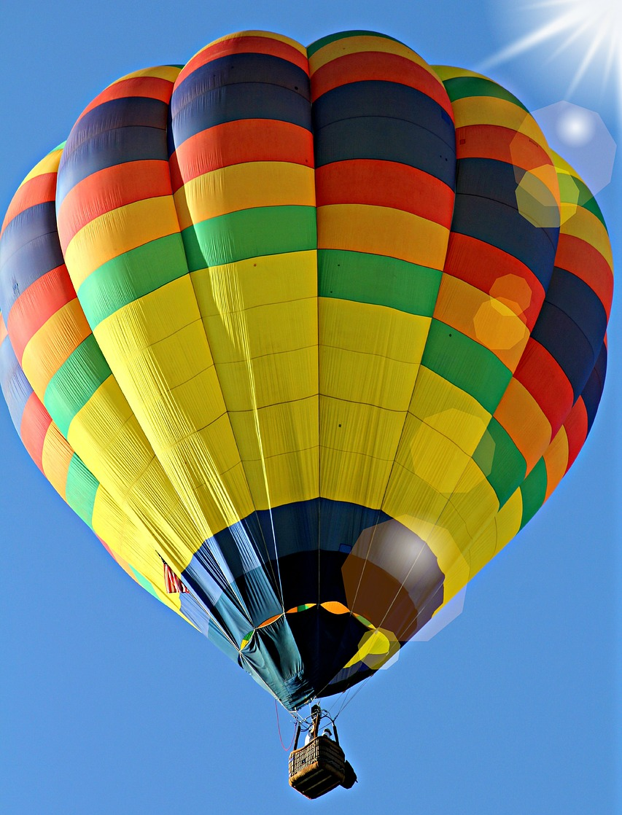

Slide 2
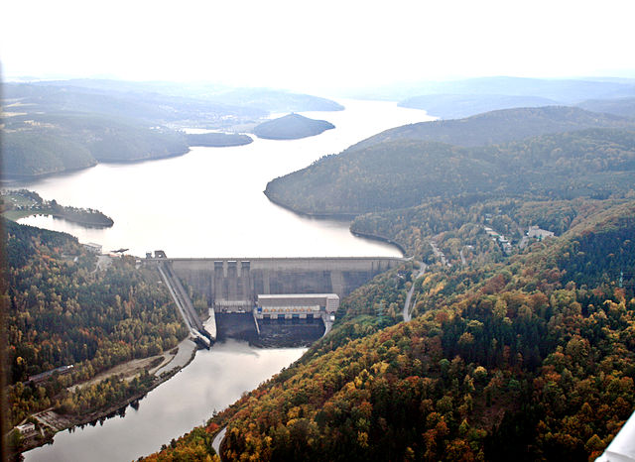
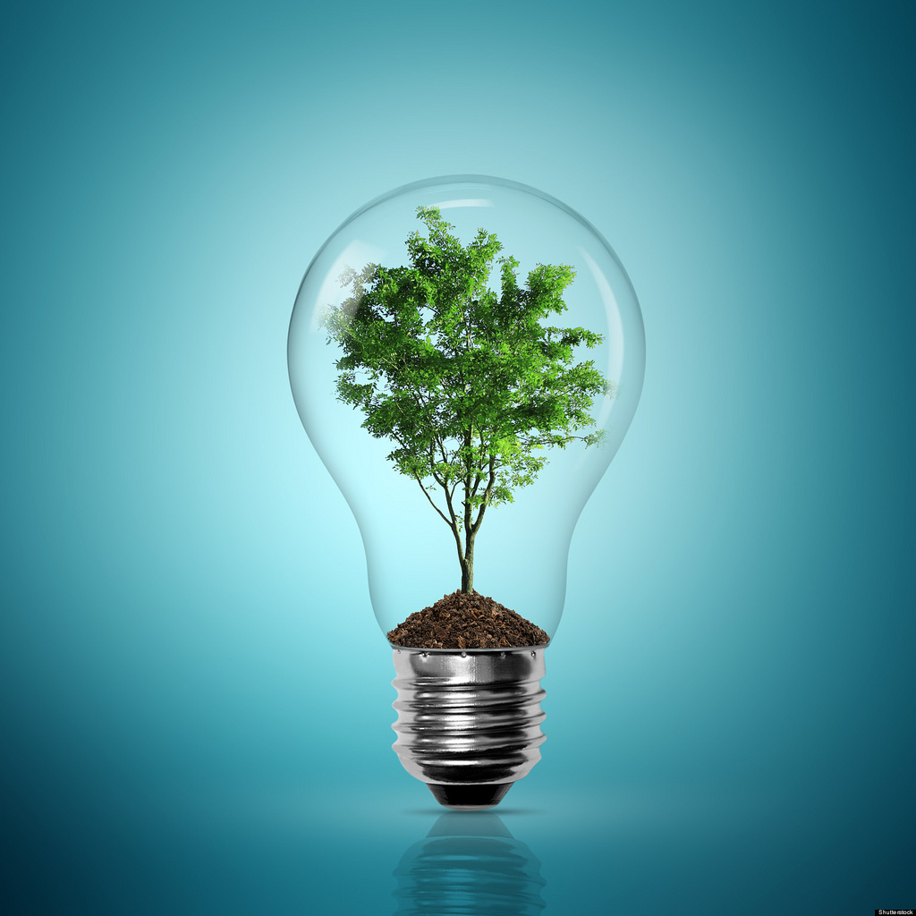
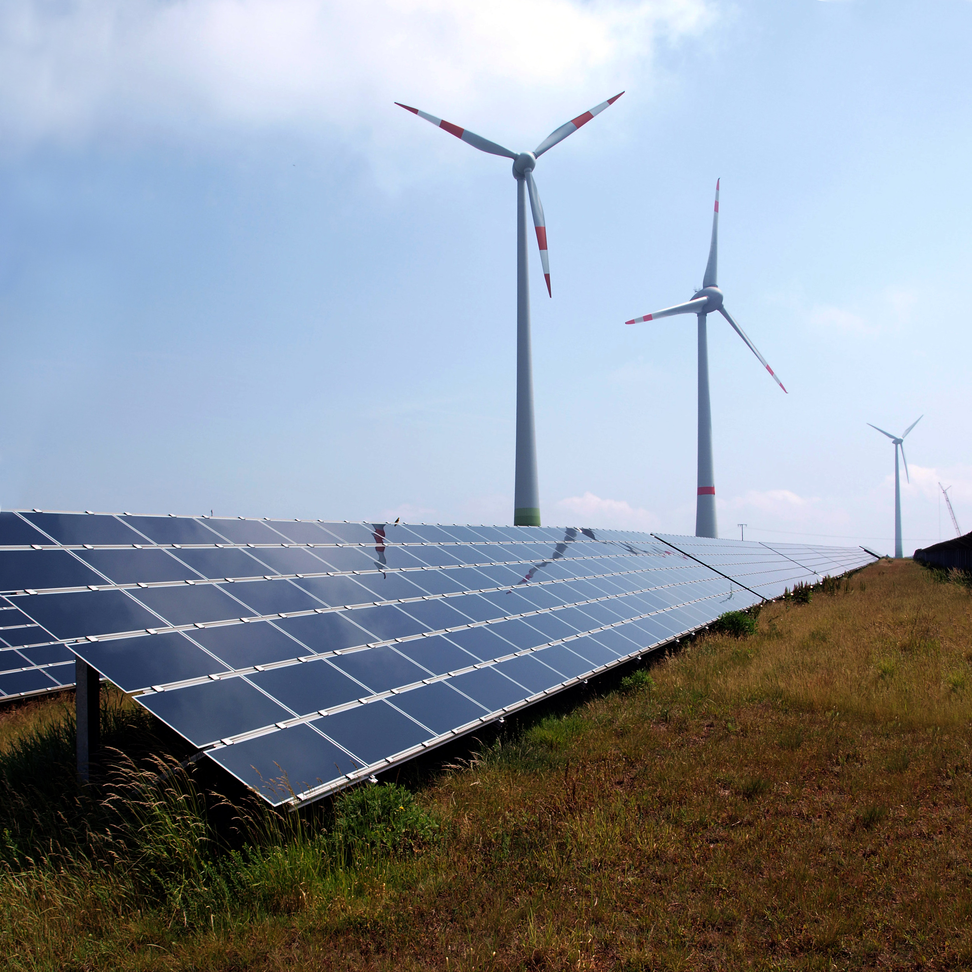
ENERGY
L
Notes:
Definitions of energy: - power made natural resources, especially to provide electricity or heat to work machines
- power which can move objects from one position to another

Slide 3
CONTENT
Energy: non-renewable and renewable
A video on renewable sources in the EU
Important power plants of the Czech Republic
Share of energy sources in partner countries
A video on a green event

Slide 4
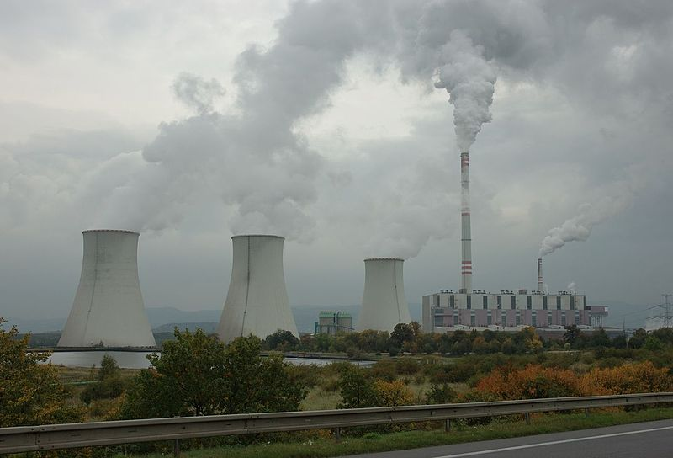
NON- RENEWABLE ENERGY
Taken from fossil fuels (coal, oil, gas)
They exist in limited quantity
Carbon based materials, millions of years old
Products pollute environment
Notes:
Non-renewable energy is taken from a natural resource that cannot be remade, it exists in llimited quantity in the form of fossil fuels (coal, oil or natural gas). Another disadvantage is that they pollute the environment when used.
Fossil fuels are carbon based materials that formed over millons of years from ancient plants and animals.

Slide 5
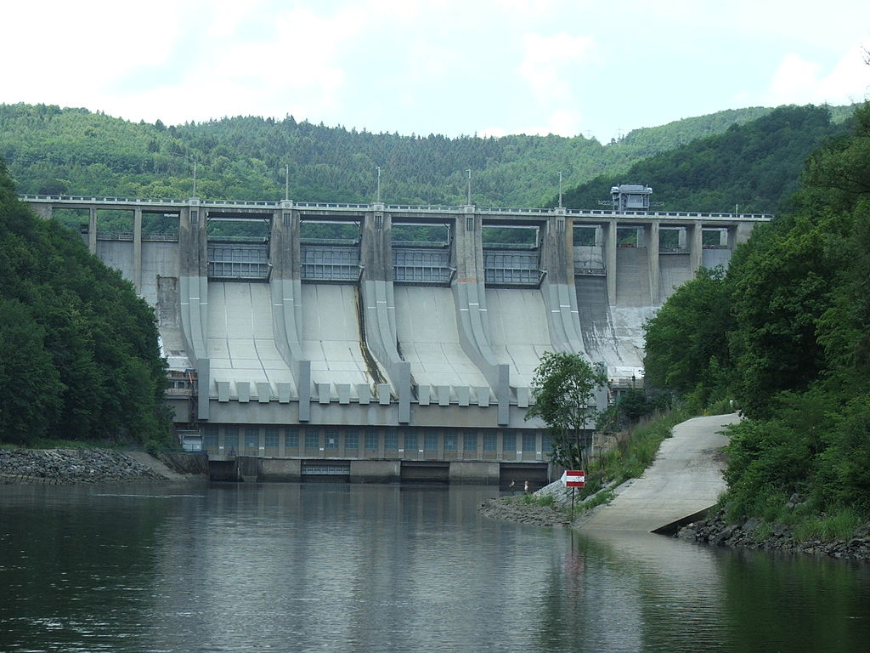
RENEWABLE (GREEN, SUSTAINABLE) ENERGY
Generated from clean natural sources
They will never run out
Sun, wind and water
Energy can be made again and again

Slide 6
WATER POWER
Electricity generated from energy of falling water
Former water mills created mechanical energy
No 1 renewable energy in Czechia
Largest power stations on the Moldau River

Slide 7
SOLAR POWER
Comes from the sun
Photovoltaic system generates electricity, Europe makes 69% of worldwide capacity
Solar panels provide water or space heating
Notes:
Solar power is energy coming from the sun, solar power plants convert sunlight into elektricity using photovoltaic panels.
In Europe we have a photovoltaic system makes 69% of worldwide capacity. This energy is sufficient to cover needs of 20 million households.
There is another system widely used in Europe, namely solar panels which use solar energy and provide water or space heating. We can spot them on roofs of numerous houses.

Slide 8
WIND POWER
Air flow moves blades of wind turbines on wind farms
Creates electricity
Location: offshore, mountainous areas, elsewhere
Notes:
Nowadays wind power is made from air flow which moves blades of wind turbines. Electrical energy from wind is generated on wind farms, which are very often located offshore, in mountainous areas, bur you can find them elsewhere.
In the past there were wind mills creating mechanical energy (Holland -> dry fields/polders; our areas -> make flour from grain: wheat, rye)

Slide 9
RENEWABLE ENERGY IN THE EU https://youtu.be/1cysaOnlv_E

Slide 10
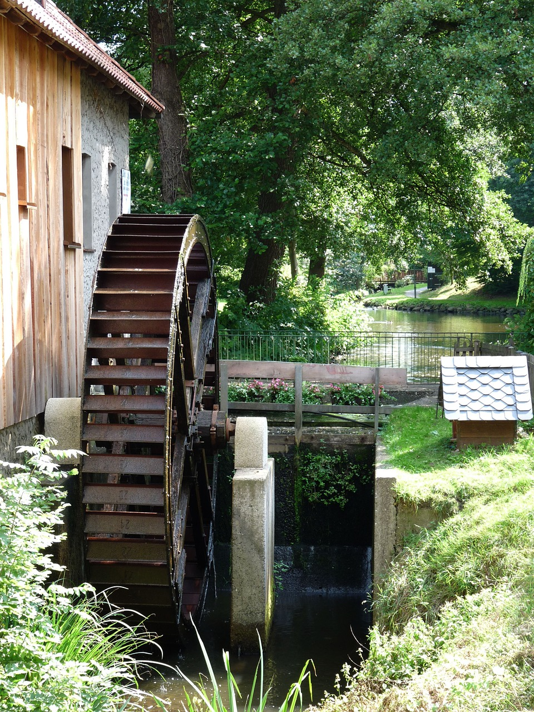
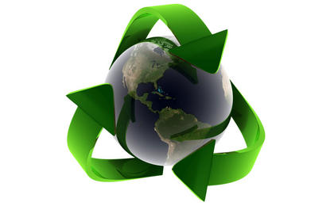
WORKSHEET FOR ENERGY WORKSHOP
VIDEO
1 Complete renewable energy figures for the EU for these years:
2005 __________________
2020 __________________
2 What did water and wind mills produce in the past? _____________________________
What do they produce now? _____________________________

Slide 11
NUCLEAR POWER STATION TEMELÍN CZECH REPUBLIC
Virtual guide Temelín
Opened in 2000, 40 km south of Tábor
2 reactors and 4 cooling towers
Notes:
Nuclear power uses nuclear reactions that release nuclear energy to generate heat which is then used to produce electricity. Nuclear reactors use uranium rods as fuel and heat is generated by nuclear fission.
The Czech Republic has 2 nuclear power stations, Dukovany not far from Brno and Temelín, which is some 40 km south of Tábor.
Temelín is a smaller and newer one, with two reactors and four cooling towers. The country isn´t planning to build new nuclear power plants, but there is a plan to enlarge both of them.

Slide 12
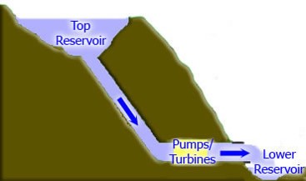
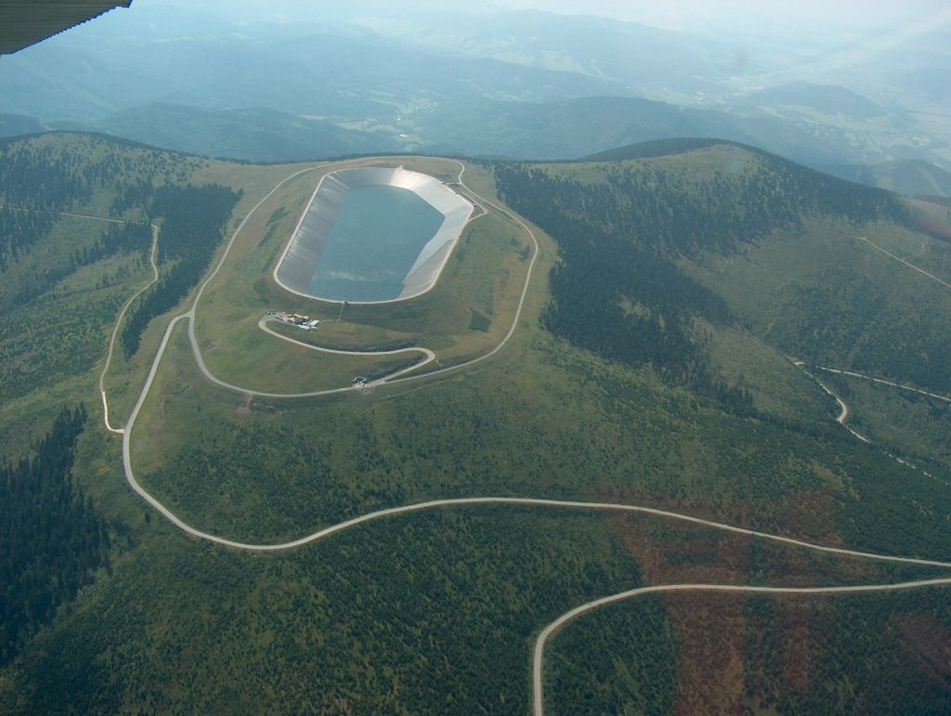
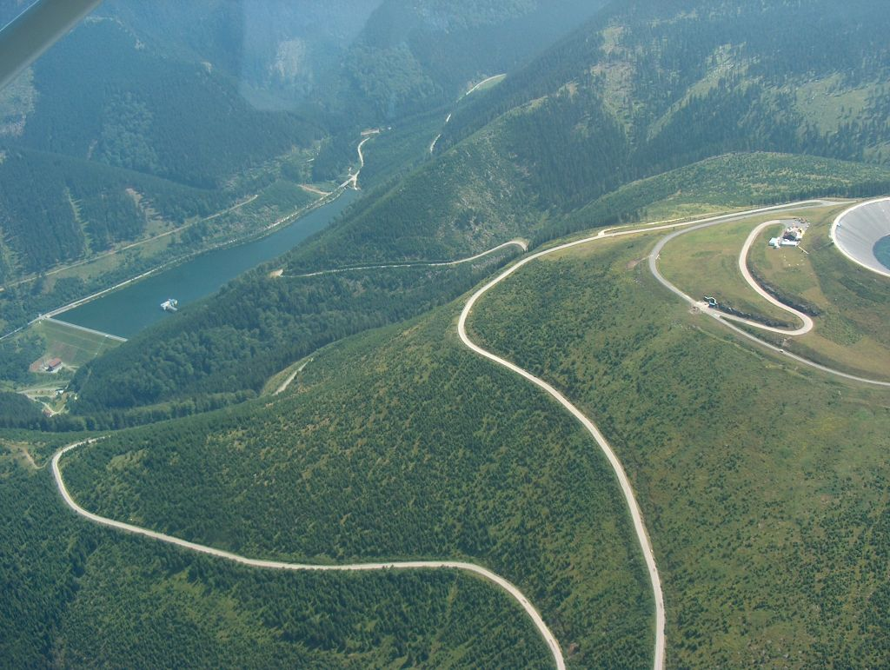
PUMPED STORAGE HYDROPOWER STATION, DLOUHÉ STRÁNĚ, CZECH REPUBLIC
Virtual guide Dlouhé stráně - opened in 1996, Jeseníky Mountains, North Moravia
Notes:
Dlouhé stráně in the Jeseníky Mountains, in the north of the country. There are two reservoirs, top and bottom. Water is pumped up to the top reservoir at night when demand for power is low. Then when there is a sudden demand for power, the gates open and water rushes down to drive the turbine. Finally water is collected in the bottom reservoir and is ready to be pumped back.
Technical info: top reservoir is at 1, 350 m and has capacity of 2.7 mil. m3; underground tunnels are about 2 km long.

Slide 13
SHARE OF ENERGY SOURCES IN THE CZECH REPUBLIC

Slide 15
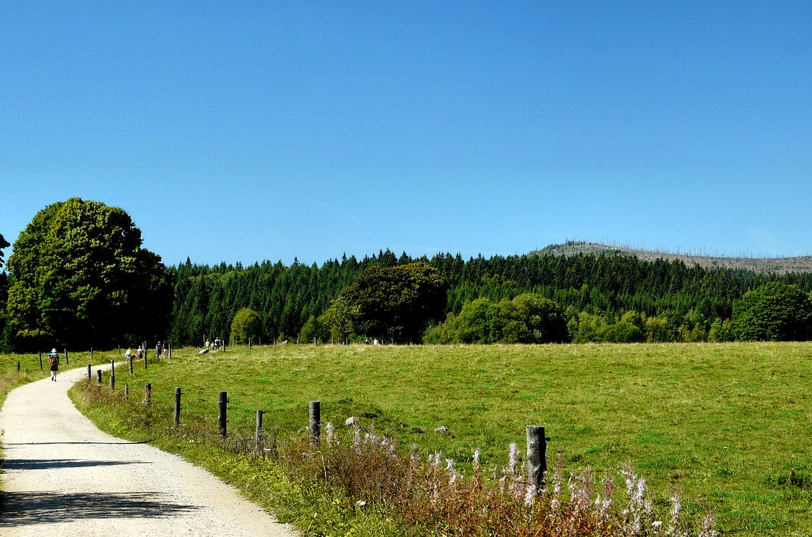
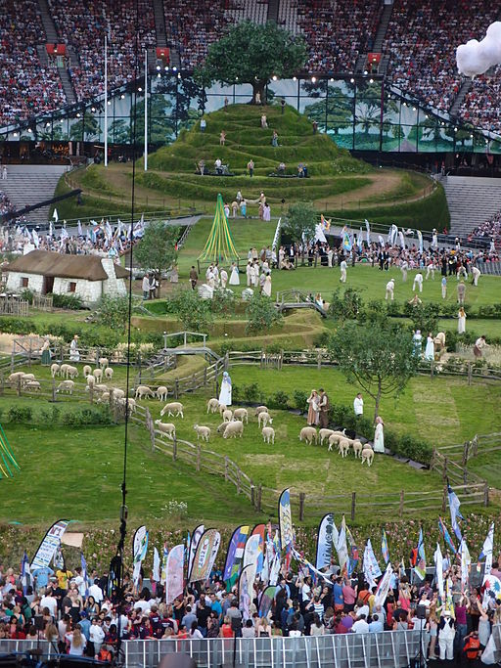
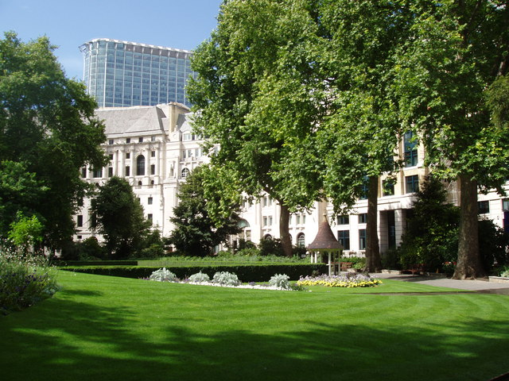
GREEN ENERGY
GREEN CITIES
GREEN TOURISM
GREEN EVENTS

Slide 16
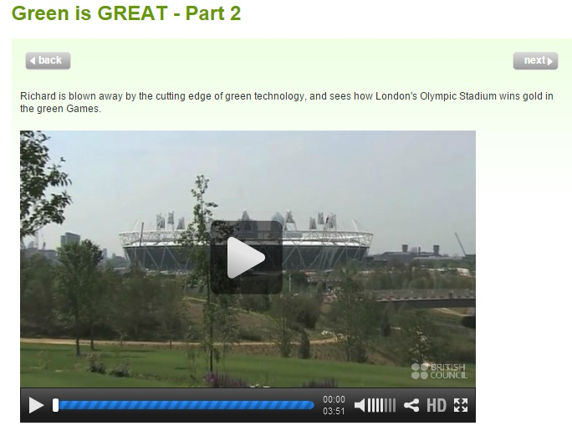
GREEN EVENT – OLYMPIC GAMES
http://learnenglish.britishcouncil.org/en/britain-great/green-great-part-2
VIDEO ON THE GREEN GAMES
Decide if the sentences are true or false.
1 Wind farms are increasingly widespread offshore or on high ground. 2 A new turbine of the Quiet Revolution Company is different because it can be used in cities and tight places.
3 Richard thinks the new turbines are beautiful, but wouldn´t want to live near one because of its noise.
4 The environment is a priority for the design of the Olympic Park.
5 The Olympic Park has been built on an area of open countryside. 6 Local London people like the idea of the green technology used for the Olympic

Slide 17
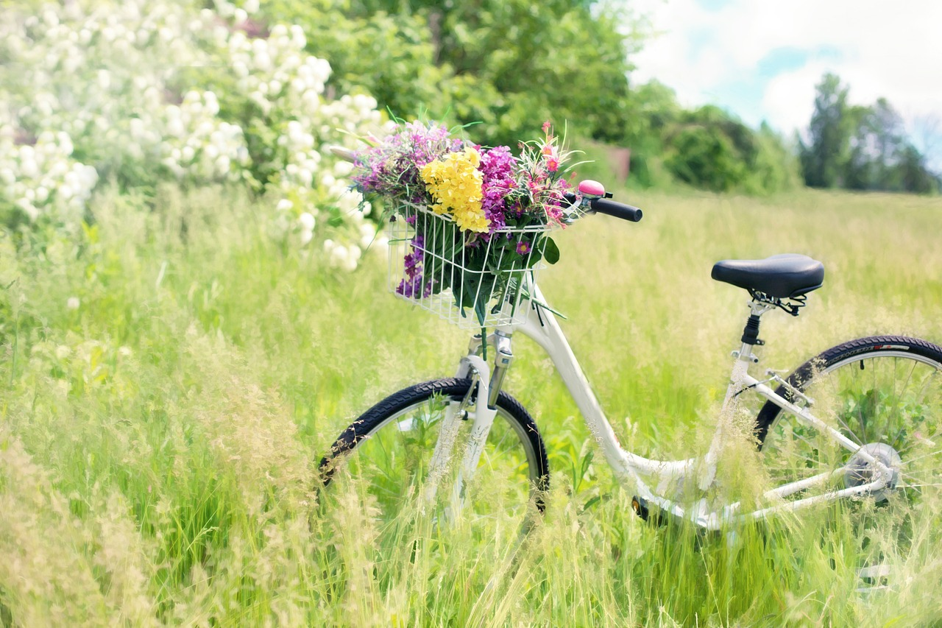
THANK YOU FOR YOUR ATTENTION
Alena Jandlová
OA a VOŠE Tábor
Czech Republic

Slide 18
Resources of photos
Dlouhé stráně (www.cez.cz)
Olympics (Matt Lancashire, commons.wikimedia.org)
Greenery London (David Williams, commons.wikimedia.org)
Windfarm-sun (Jurgen from Sanddeben, commons.wikimedia.com)
Light bulb-tree (MattWalker69, flickr.com)
Energy symbol (neetalparekh, flickr.com)
Solar and wind (Photographer: Armin Kübelbeck, CC-BY-SA, Wikimedia Commons)
Coal, oil, gas (www.slideshare.net)
Photovoltaic plant (Petr Opletal, cs.wikipedia.org)
Pumped storage icon (en.wikipedia.org)
Baloon, bicycle, old water mill, old wind mill, Sumava (pixabay.com)
Lipno plant, Temelín, Ostruzna plants (public domain)

