Slide 1
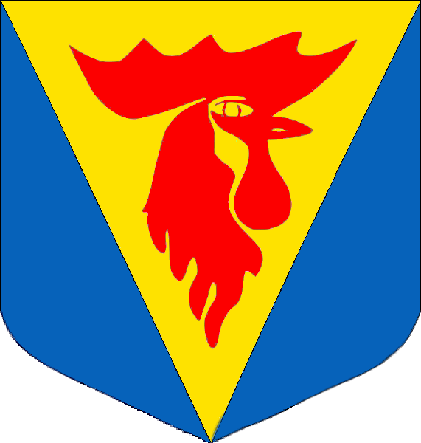
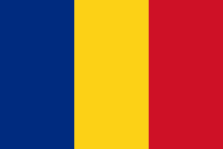
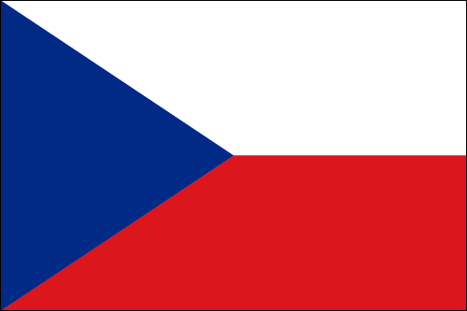
Slovakia – štúrovo 2015 – Gray team
Bettina Ruezhofer, Jaroslava Mládková, Eliška Kašparová, Magyar Anita, Kalina Pekova, Grad Ana-Maria, Robert Hrmo, Dániel Gardenö

Slide 2
Content
Štúrovo
Bridge
Gabčíkovo
Bela Castle

Slide 3
štúrovo
Hungarian name: Párkány
It had names: Kakath, Parkan.
It has approximately 12000 inhabitants.
Rich history since the Dark Ages.
Cultural events – Simon Juda market, festivals…
Nice main street with fountains.
Nice panorama from the nearby hills and a view of Basilika.
Vadaš Thermal Bath – one of the biggest bath in Slovakia.

Slide 4
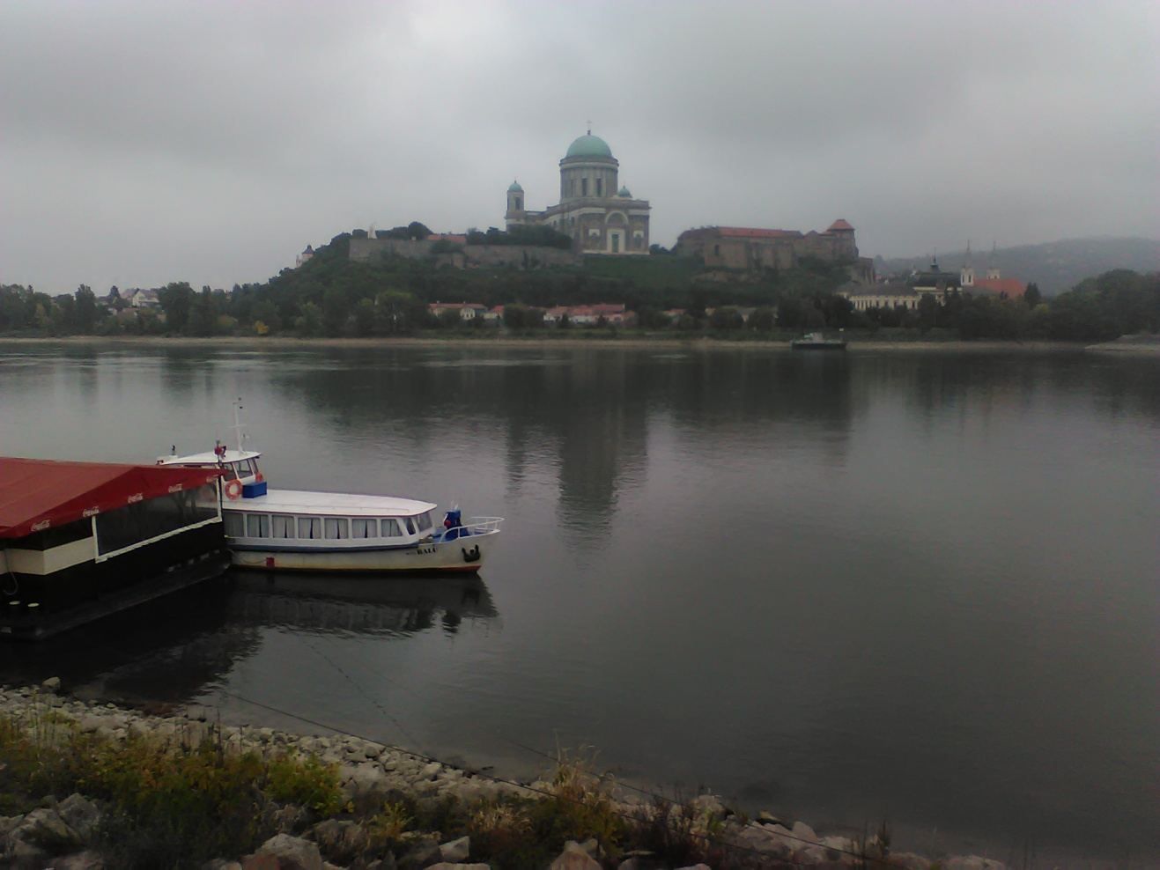
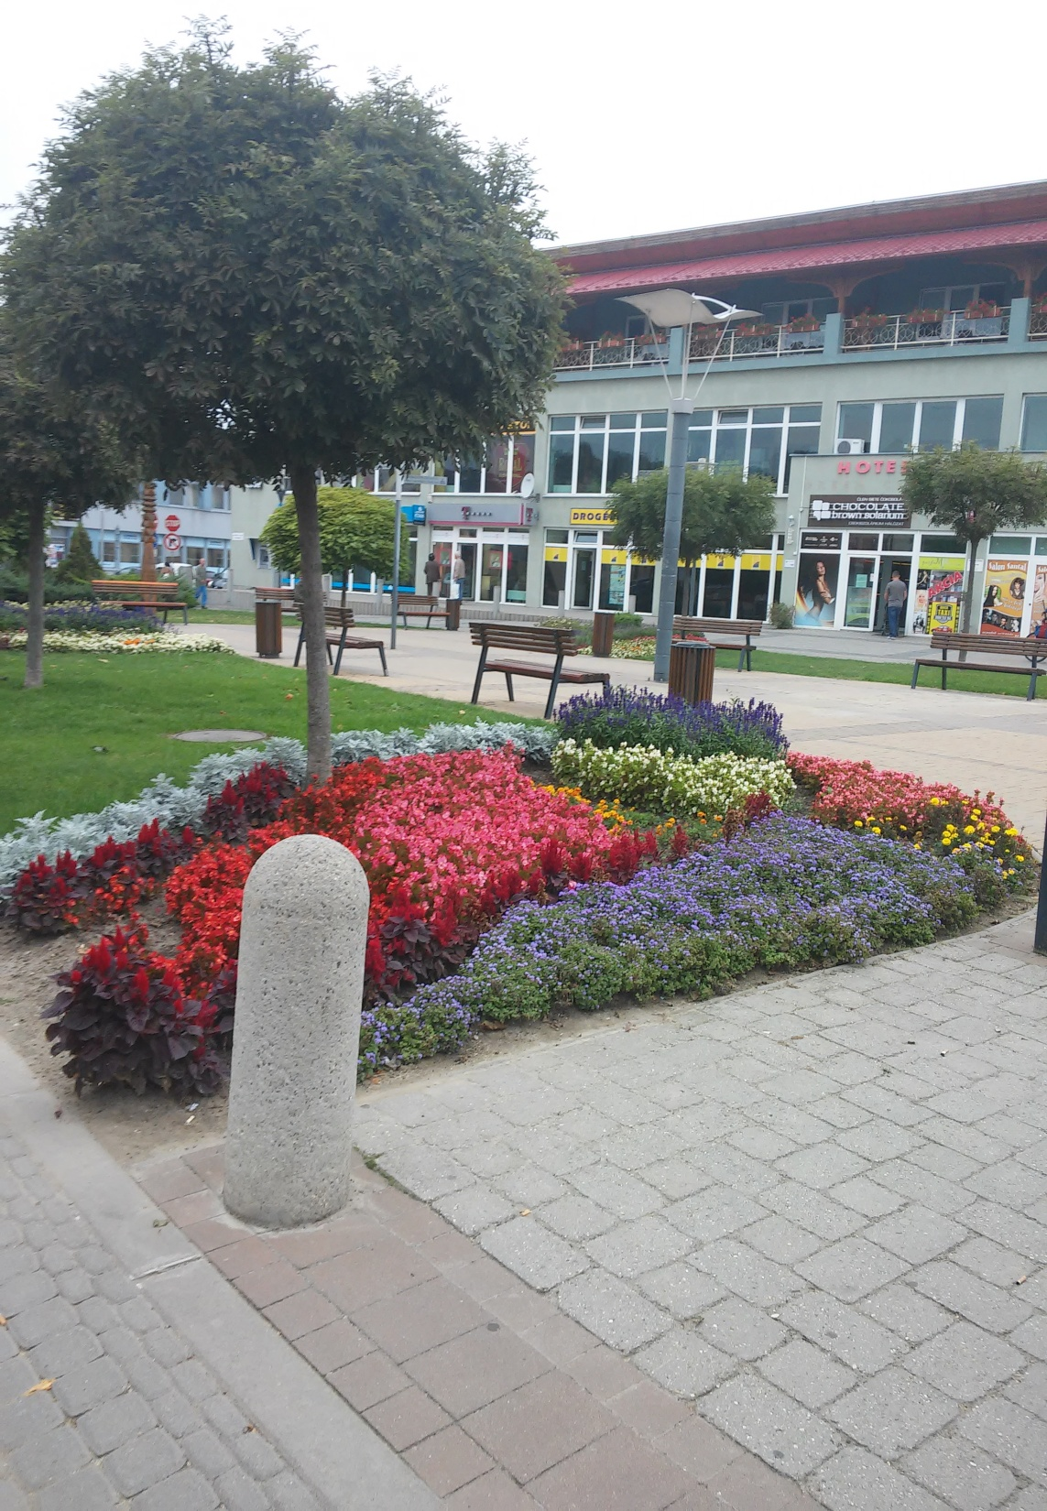
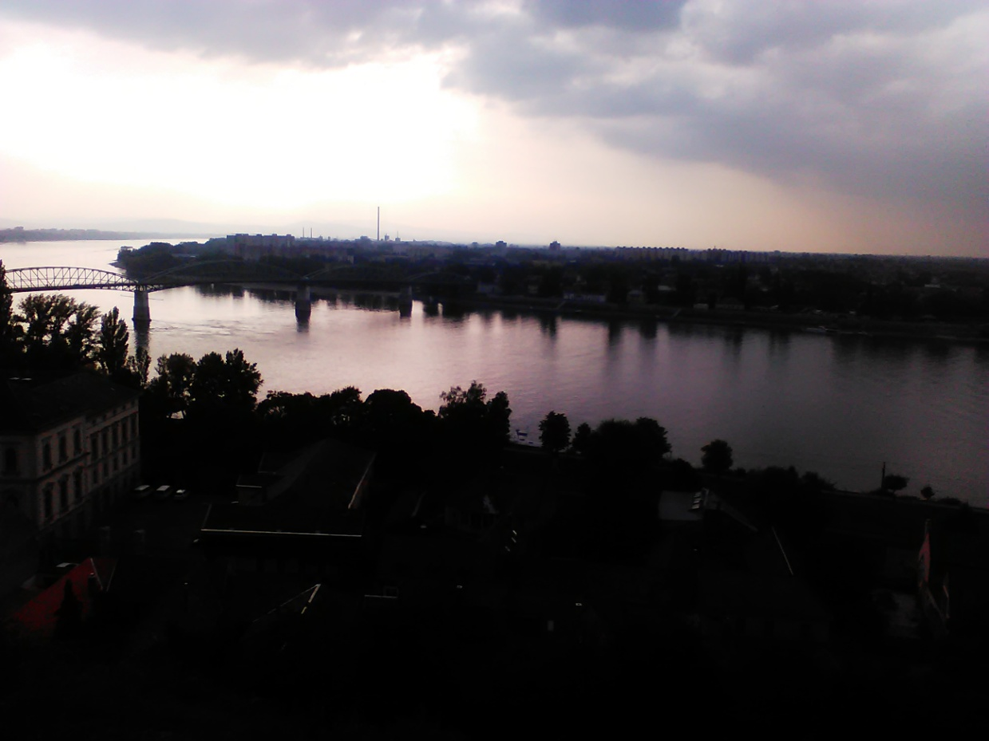

Slide 5
Bridge of Mária Valéria
It was built in 1895 between štúrovo and Esztergom.
It has 5 pillars.
It was demolished by the retreating German troops in 1945.
Reconstructed only in 2001 October.
Named after Emperor Franz Joseph´s daughter: Mária Valéria.

Slide 6
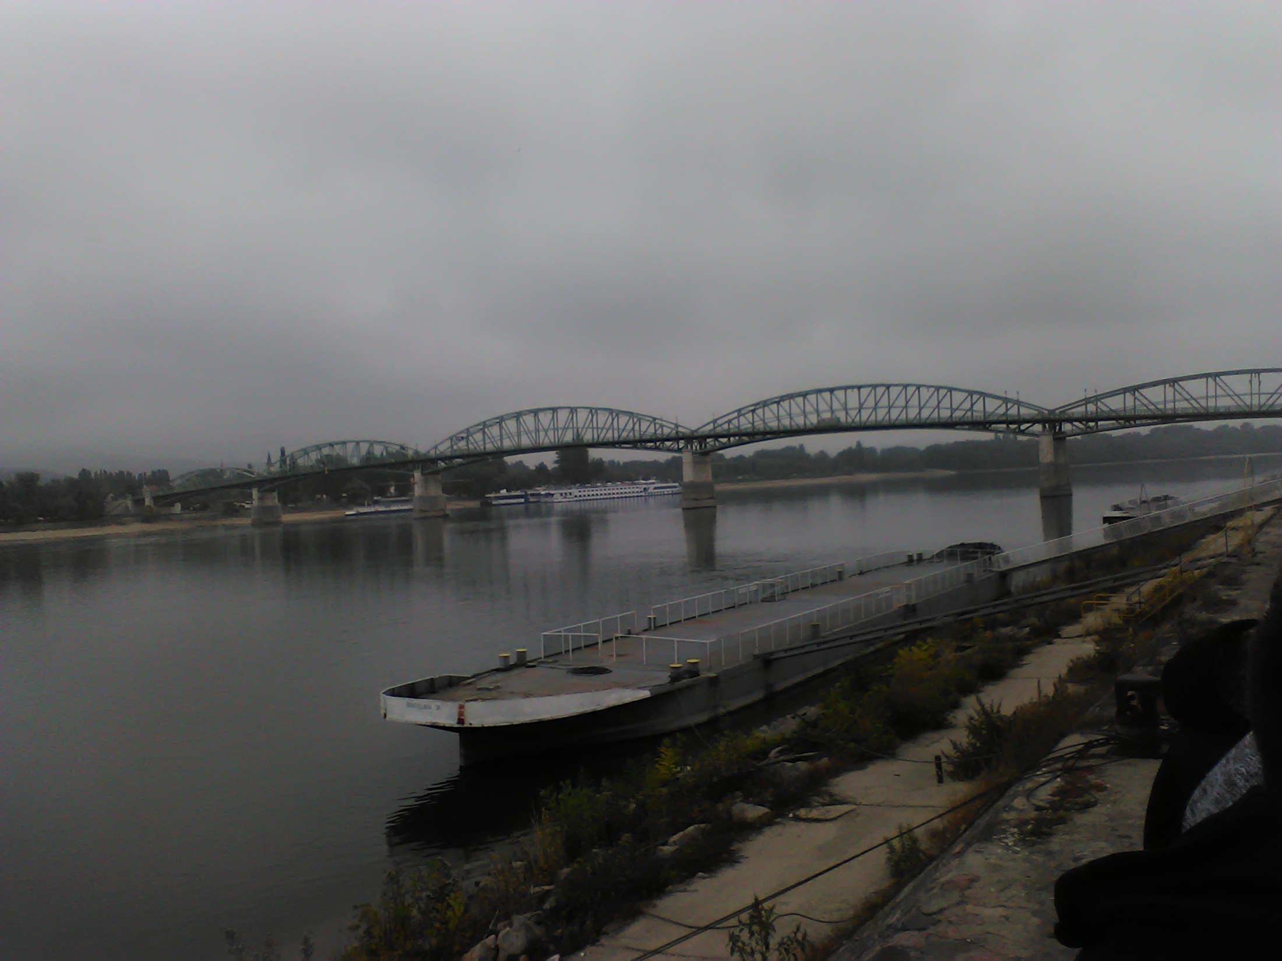

Slide 7
Gabčíkovo Dam
It was constructed in 1986 between Slovakia and Hungary.
Slovak part: Gabčíkovo
Hungarian part: Nagymaros – this was not built.
It gives 8% of electric energy for Slovakia.
It is the biggest dam in Central Europe.

Slide 8
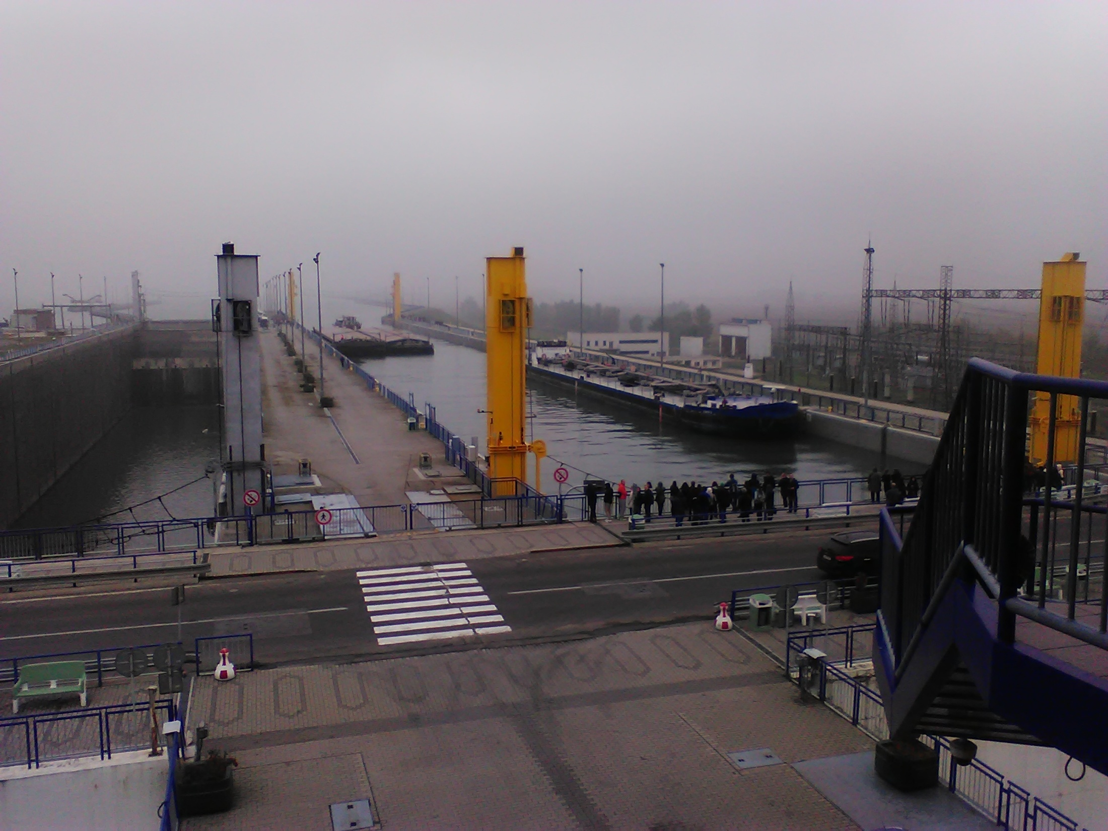

Slide 9
Bela Castle
Construction started around 1770.
It was built in Baroque style.
It was damaged during the World Wars.
Reconstructed since 2000.
Nowadays it is a 5* Hotel: Château Béla
Prince Harry also participated in a wedding which was held here.

Slide 10
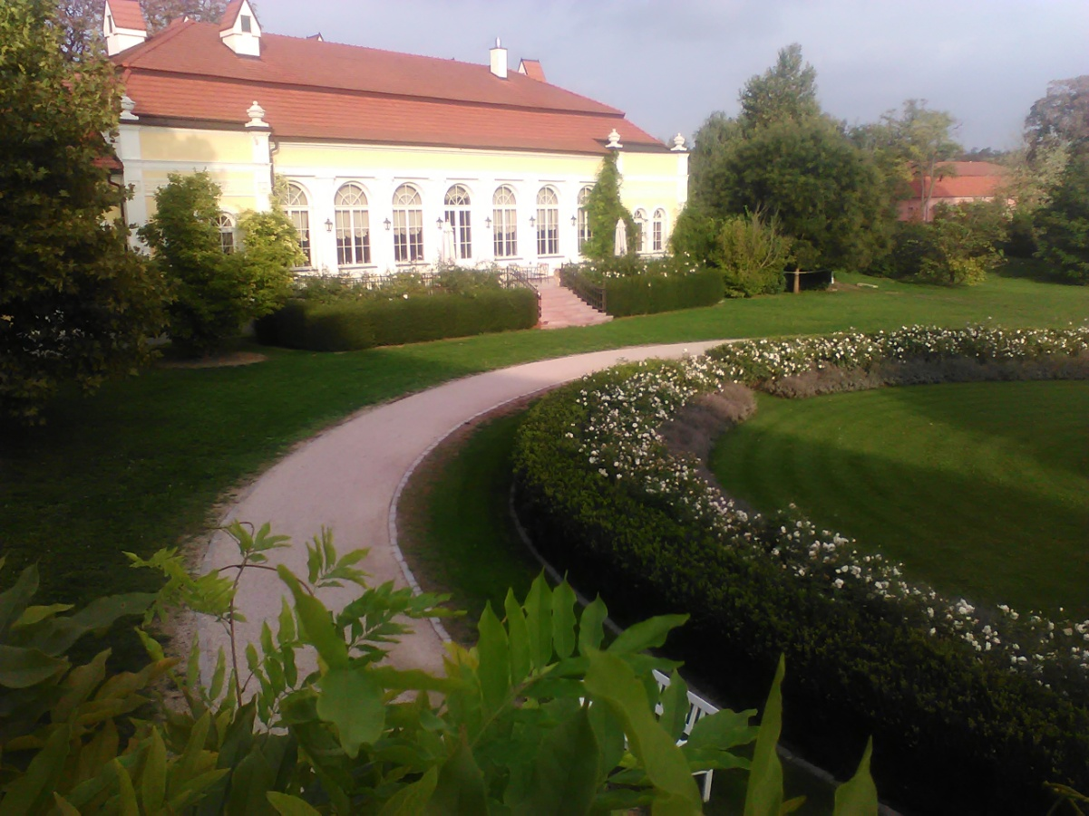
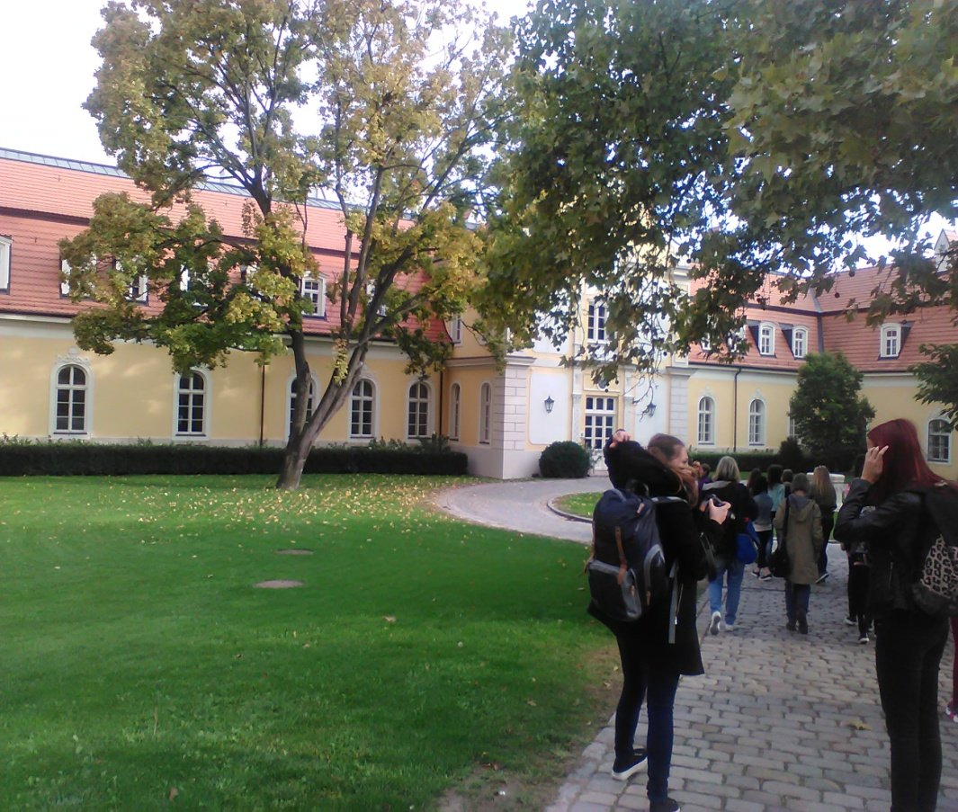
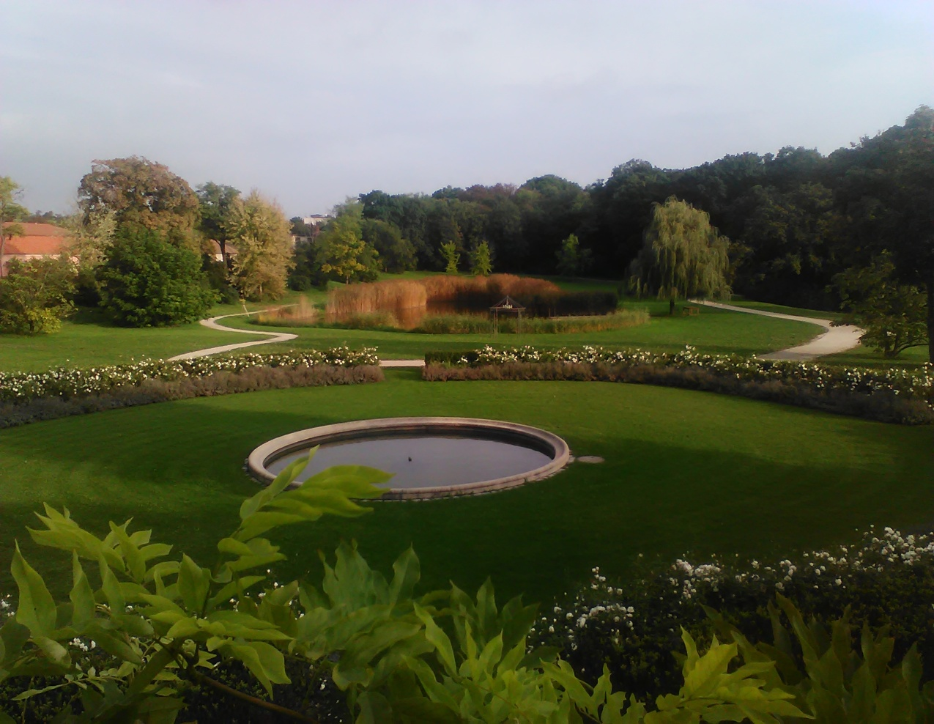

Slide 11
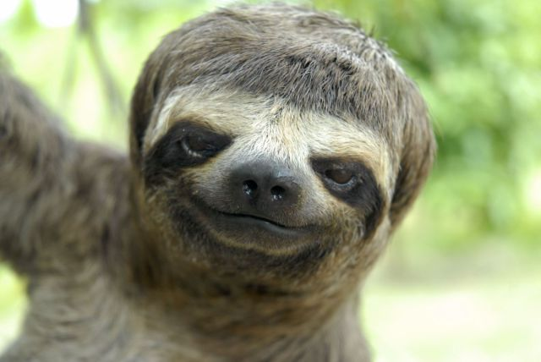
Thank you for paying attention ☺

