Slide 1
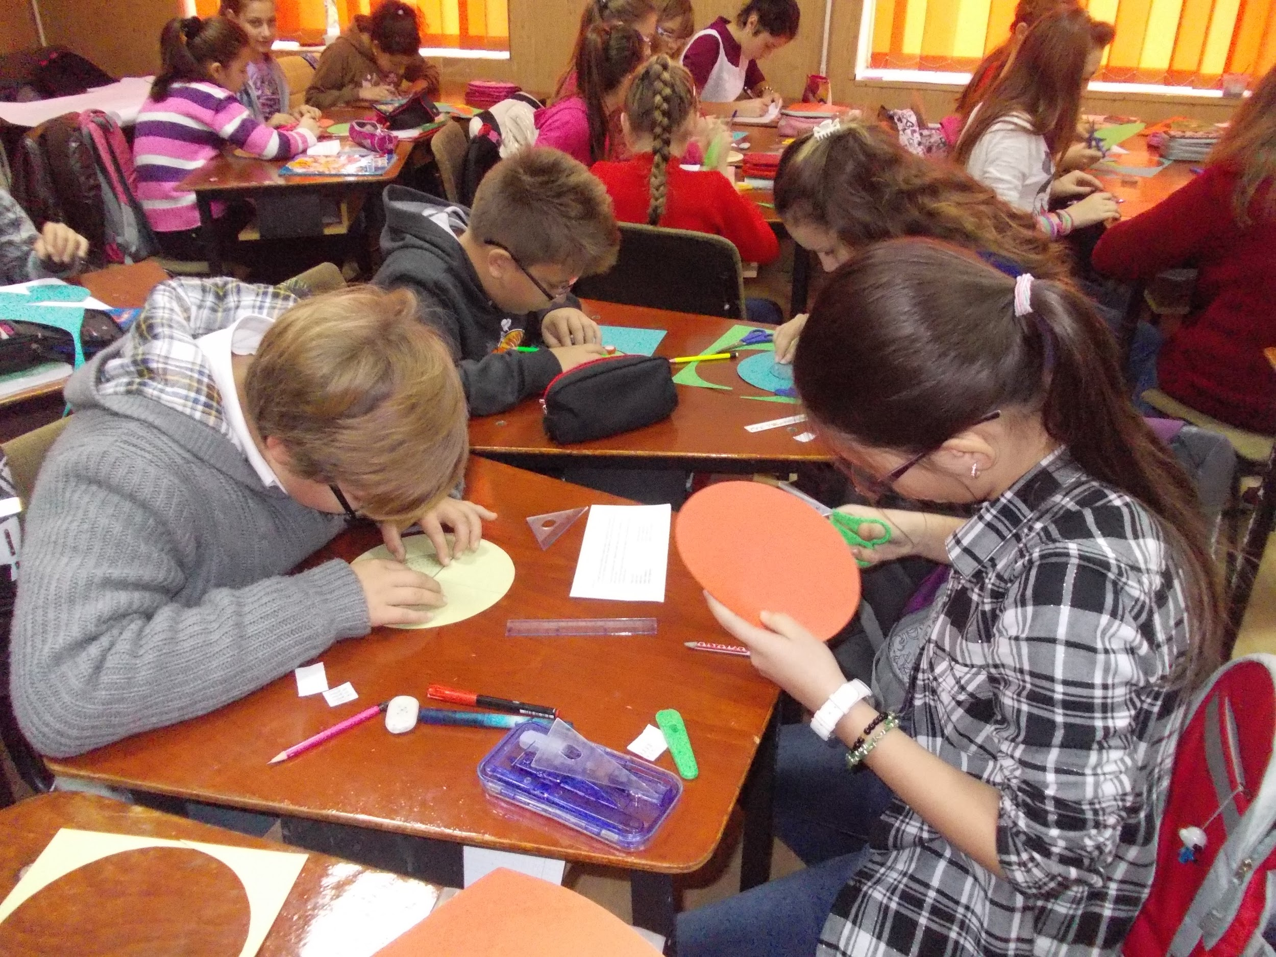
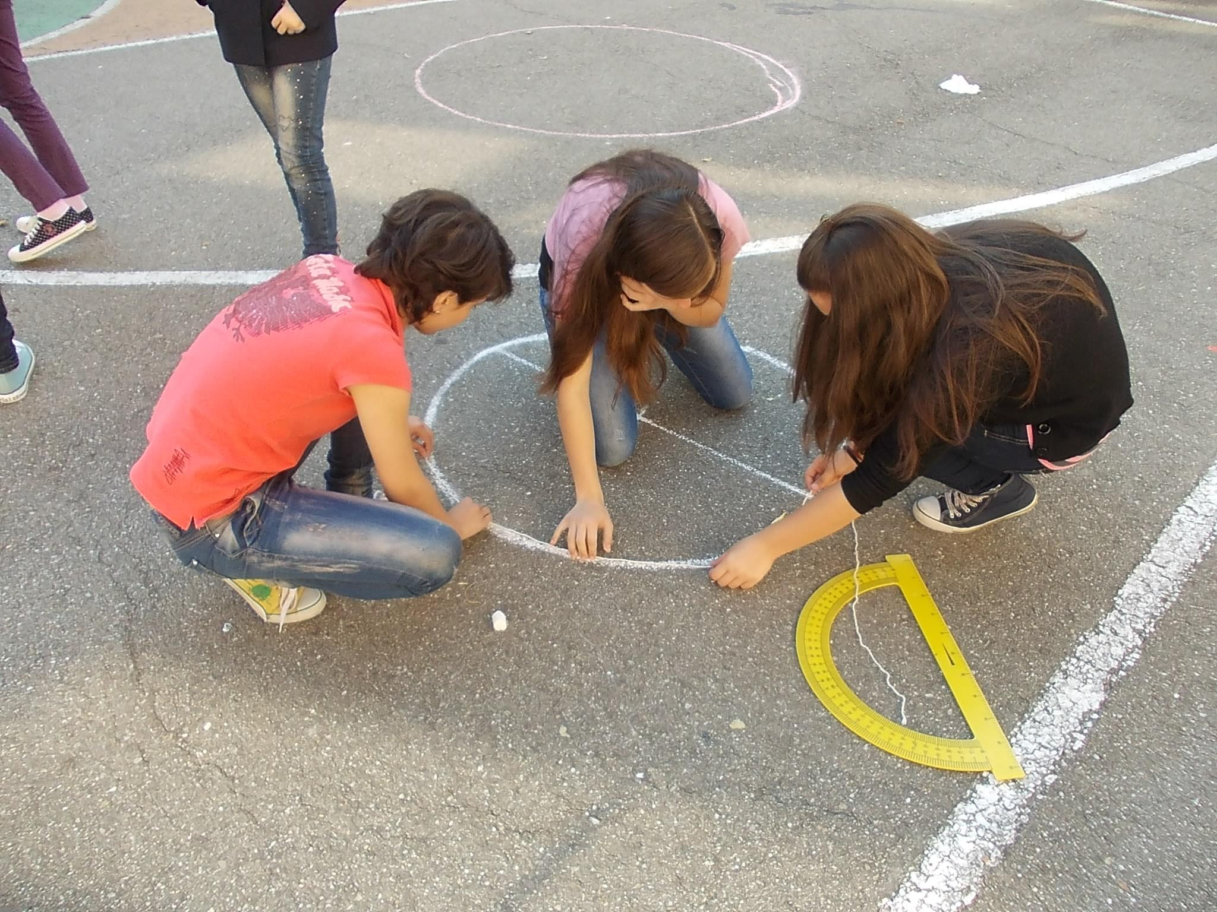
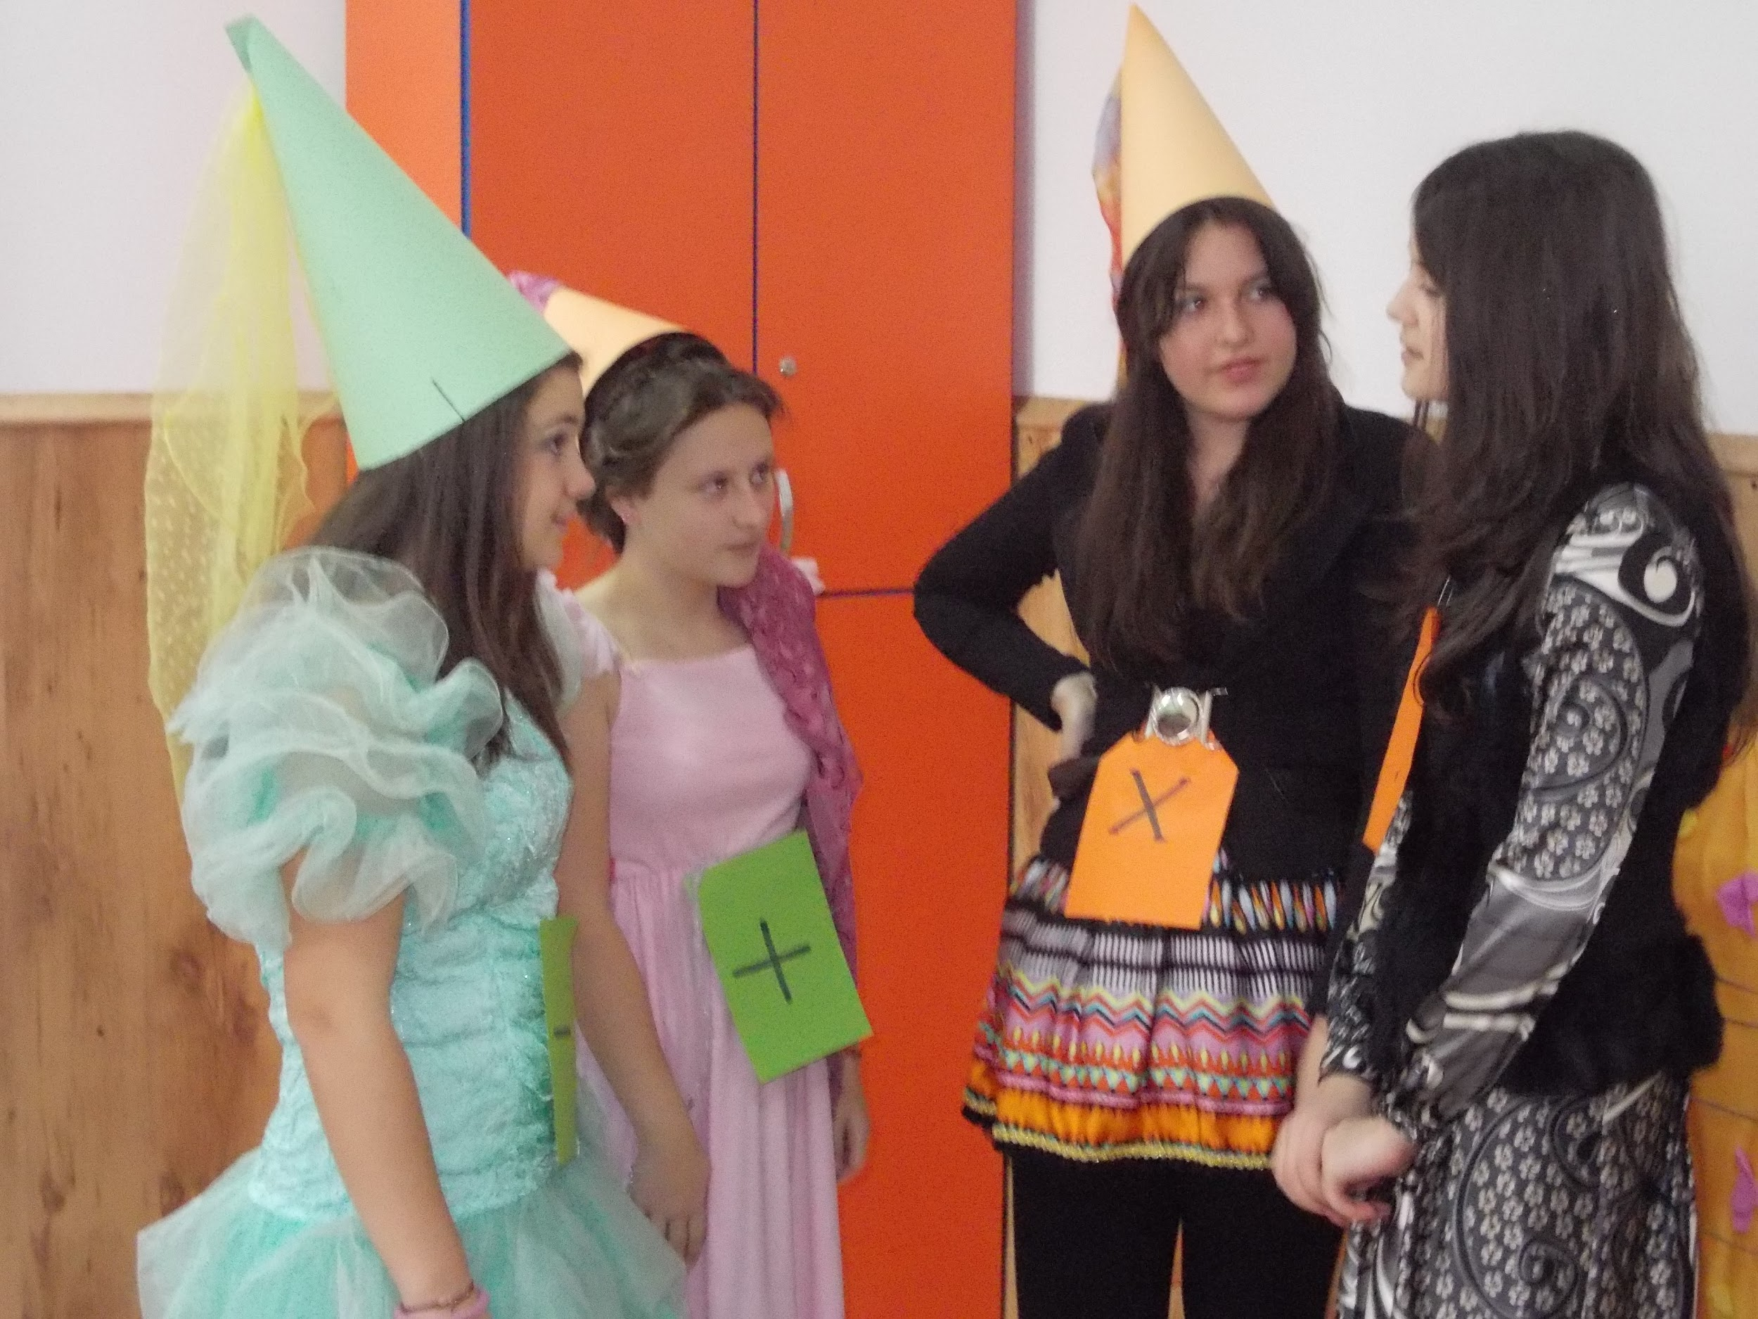
Ideal Teaching Methods in Mathematics
proposed by the Romanian group

Slide 2
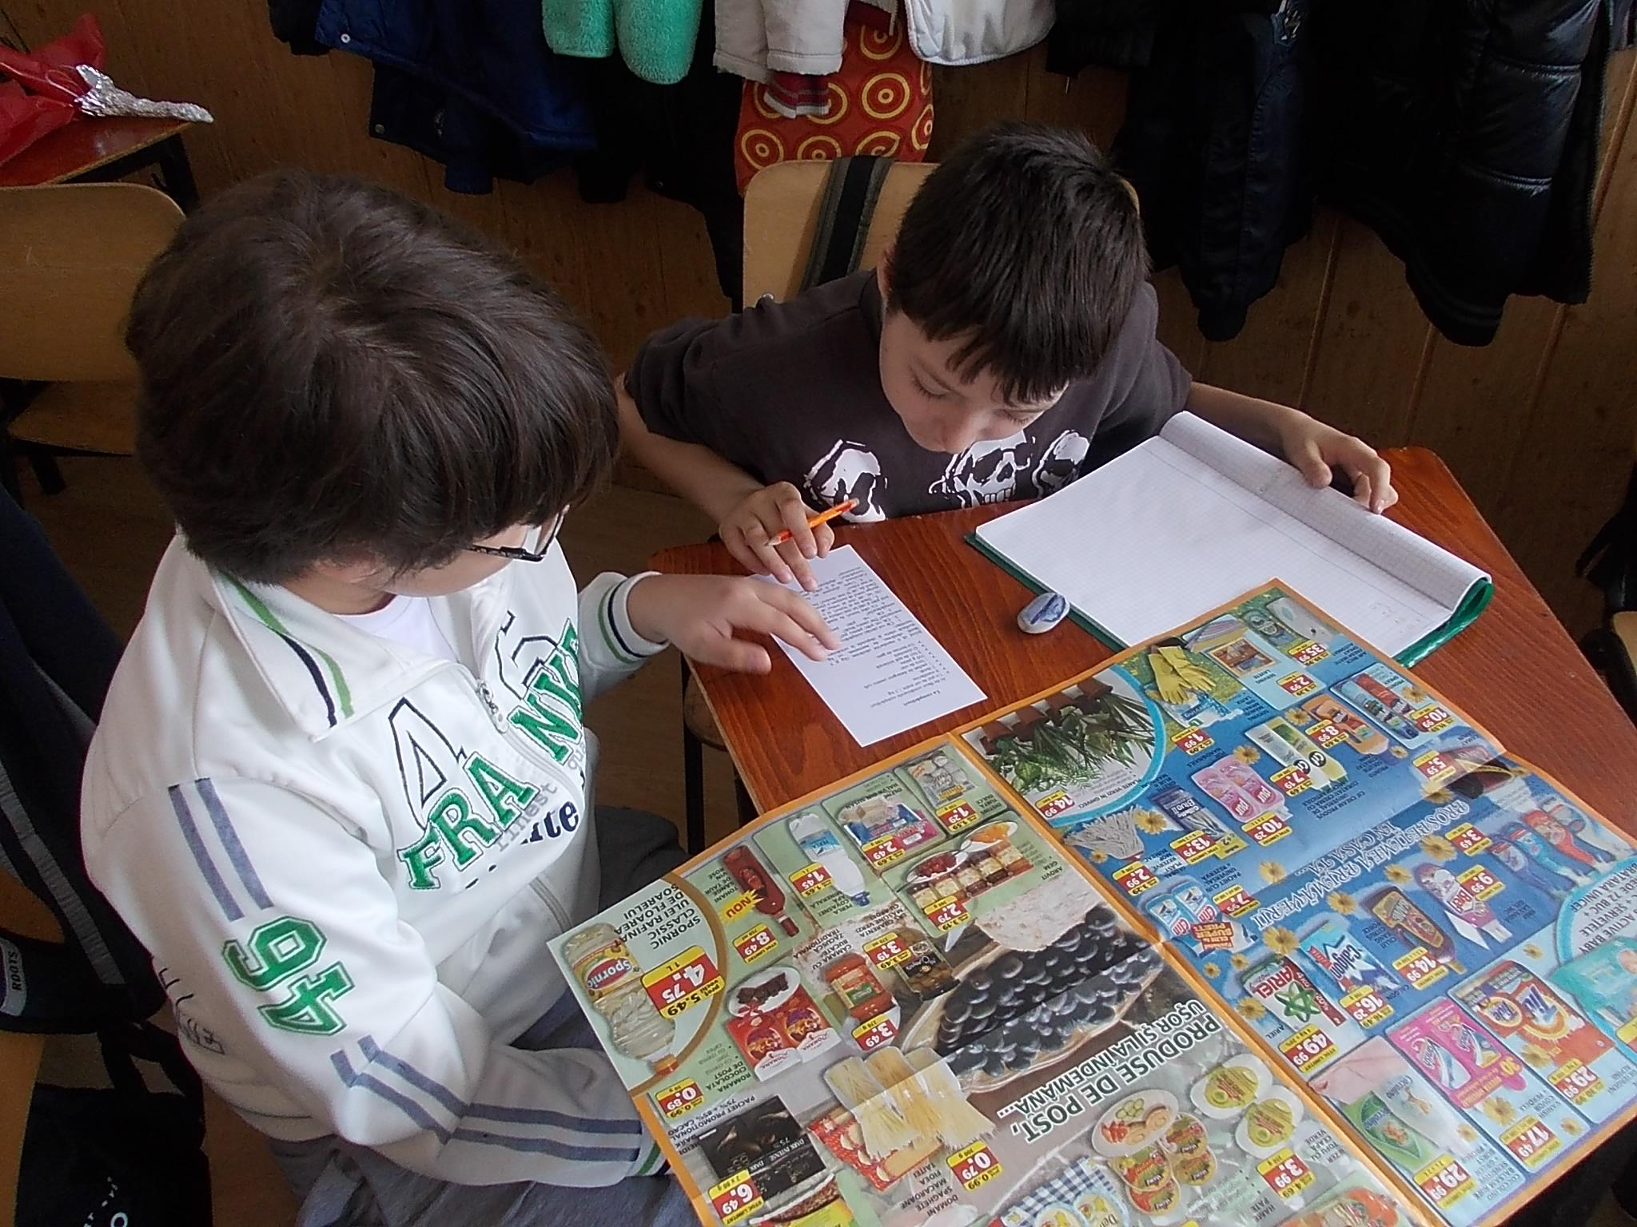
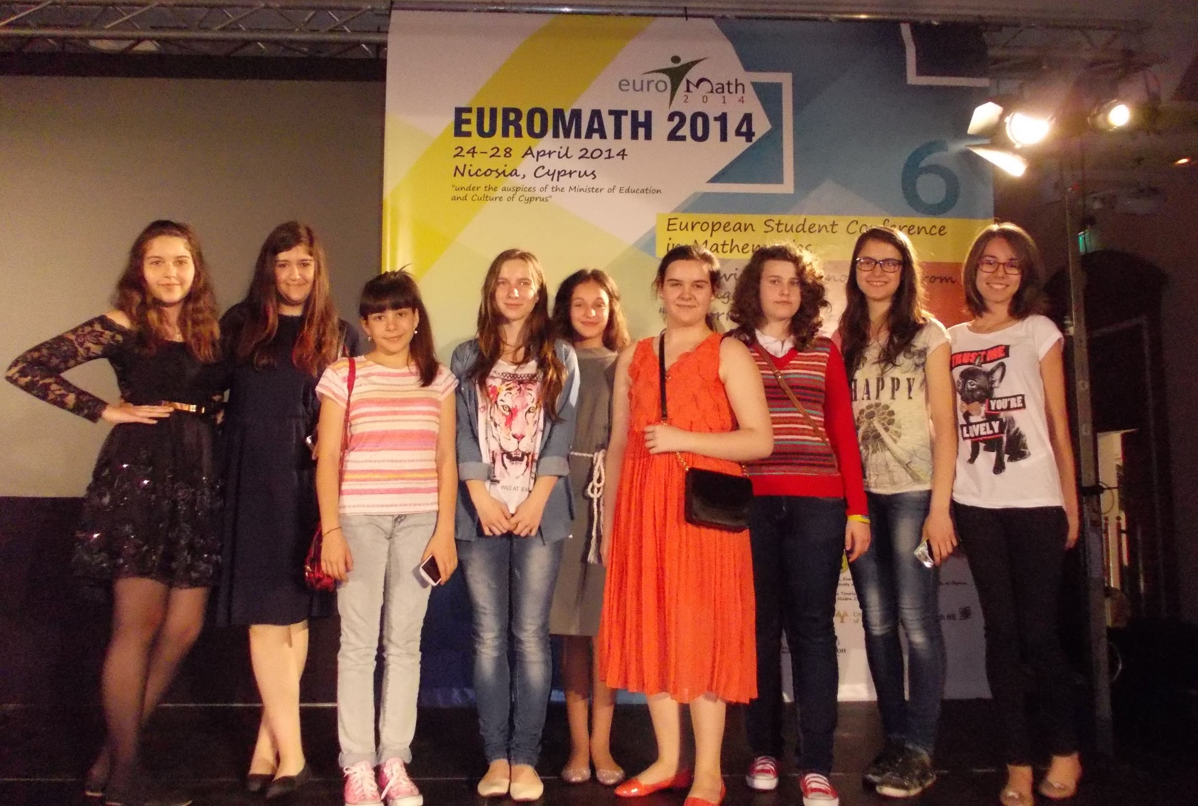
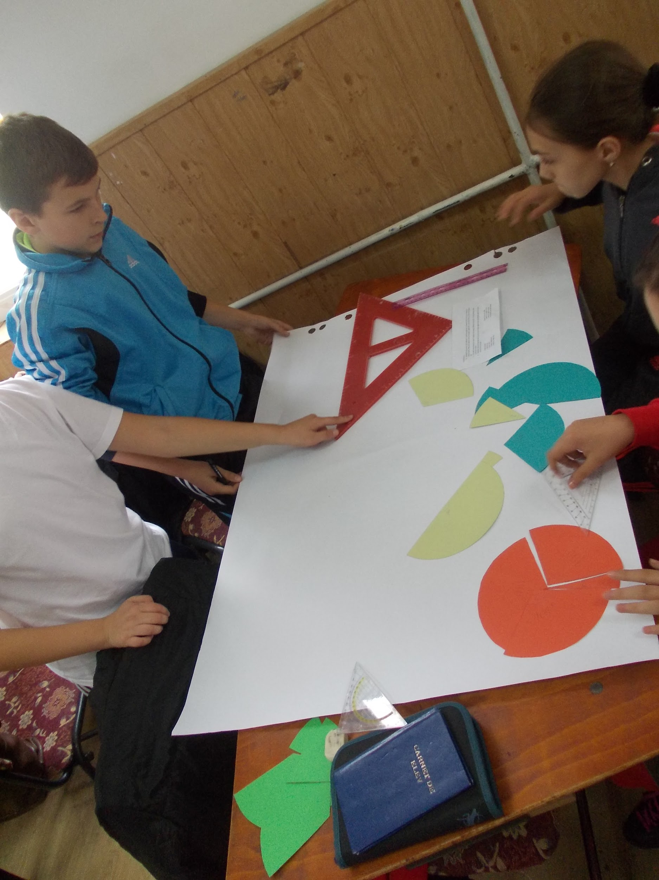
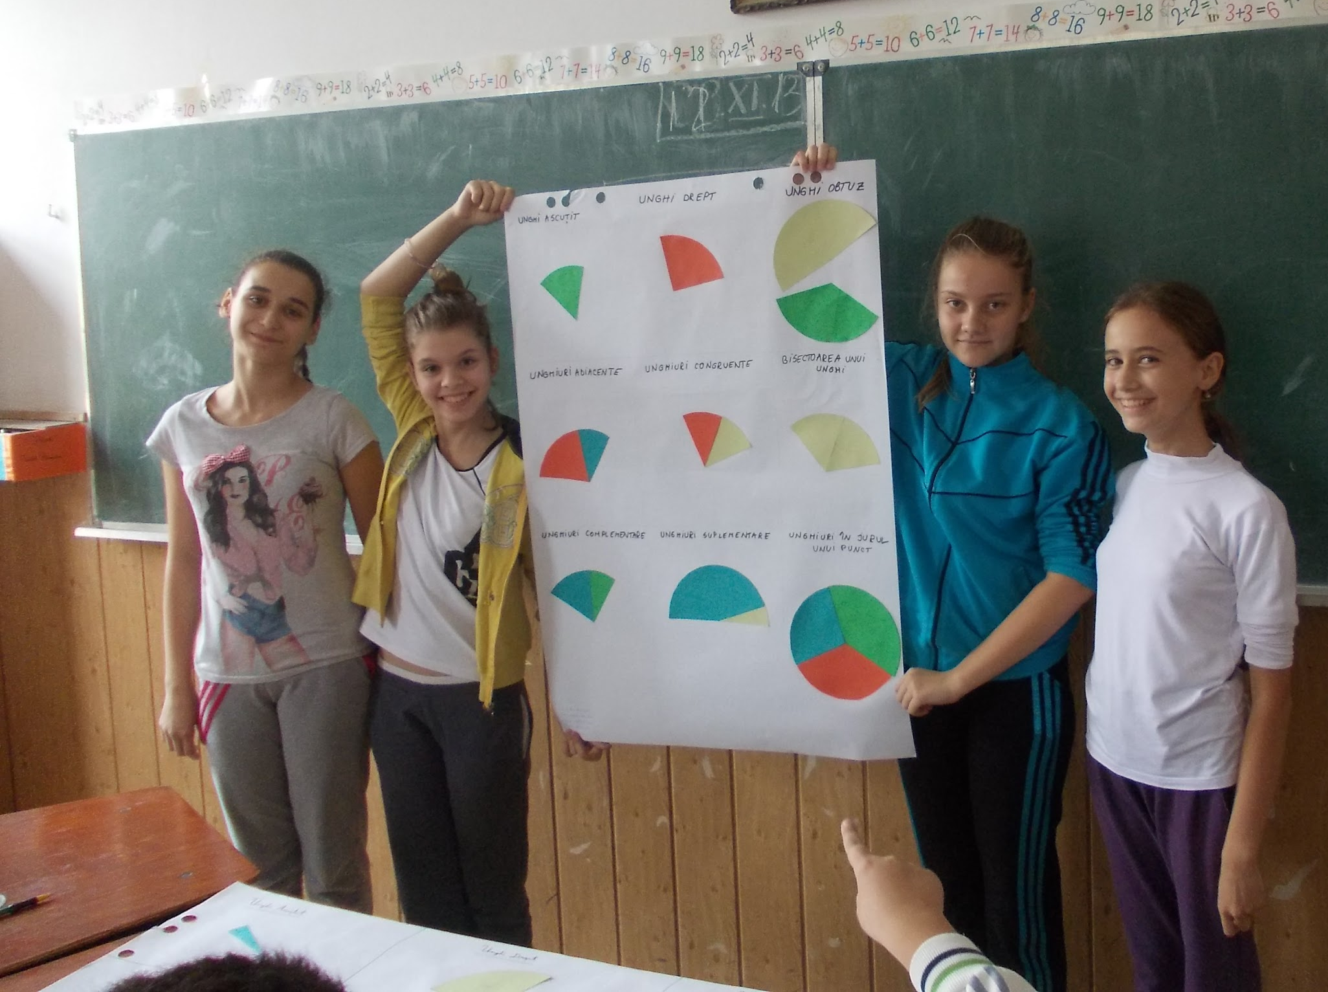
About
importance
theory
practice
application
real life connections
connection with art

Slide 3
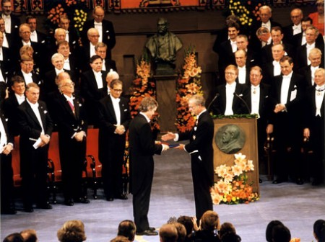
MATHEMATICS REWARDS
.SOLUTIONS
.TEACHERS
.SCIENCE
.NOBEL PRIZE

Slide 4
“Mathematics is the language with which God has written the universe . “ -Galileo Galilei
communication
collaboration
documentation
interact with other students
productive exchange of ideas
debates
working in groups

Slide 5
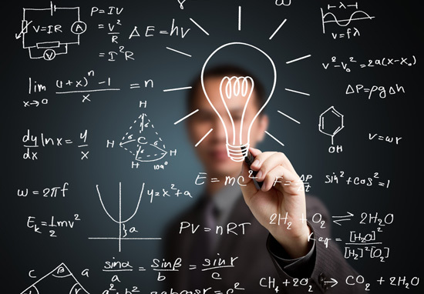
Mathematics and ICT
Educational websites
Interesting and pleasant
Focus better
Work a lot
Think logically
Prepare for future jobs

Slide 6
The ideal method
Fun
Playing games
Less abstract,more appealing
Fun activities
Games
Solution
“You’re never too old to play!”

Slide 7
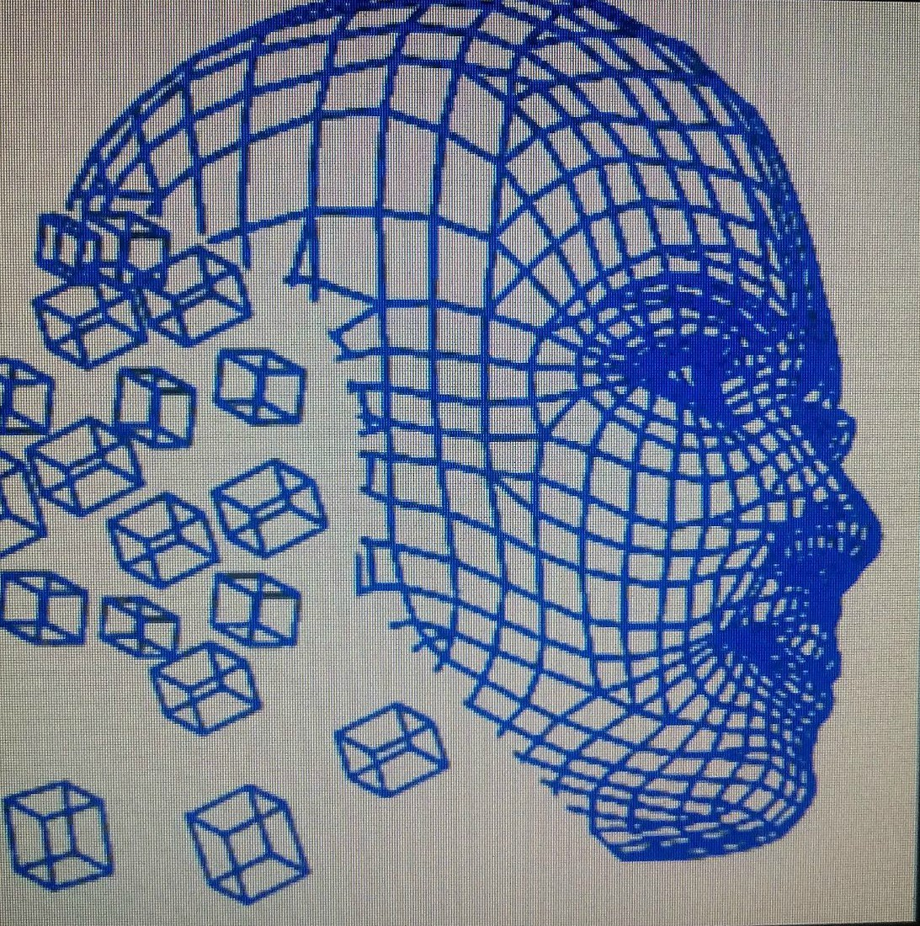
The mathematical nature is the same as the artistic nature.
pattern
symmetry
transformation
shapes
pyramids
entertaining
practical

Slide 8
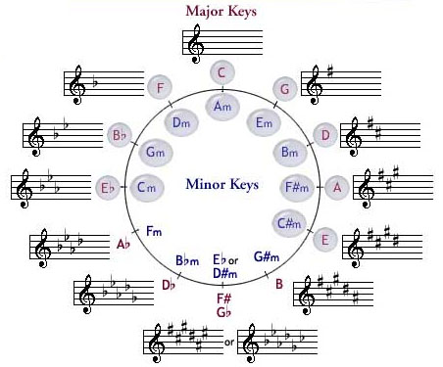
Mathematics and Music
Using music to improve math skills
Ability to understand
Creativity
Inspiration
Rhymes and rhythmic
Critical thinking

Slide 9
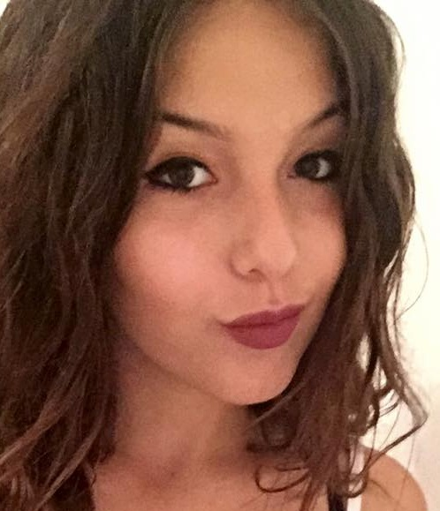
Thank you for your attention!
Laura
Cristi
Raluca
Madalina
Andrei
Amina

