Slide 1
Esztergom and Bratislava
Team pink

Slide 2
Our trip to Esztergom:
Bridge Mária Valéria- The now rebuild bridge which was blowed up by the fleeing germans.
Danube museum- History of the river danube and the people, and the nature of our region.
Bazilika of Esztergom- 18th biggest church in the world.
Statue of St. Istvan- 1st king of Hungary.

Slide 3
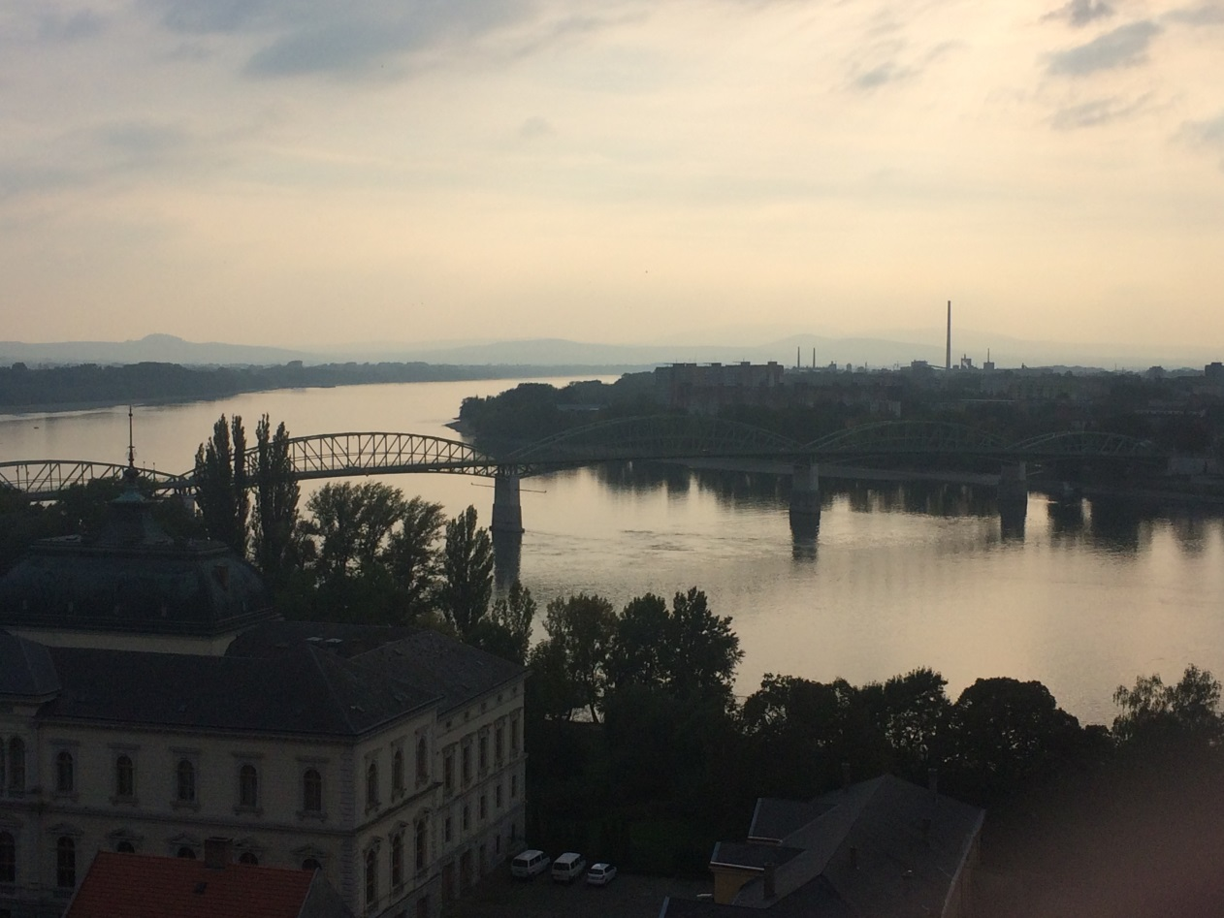
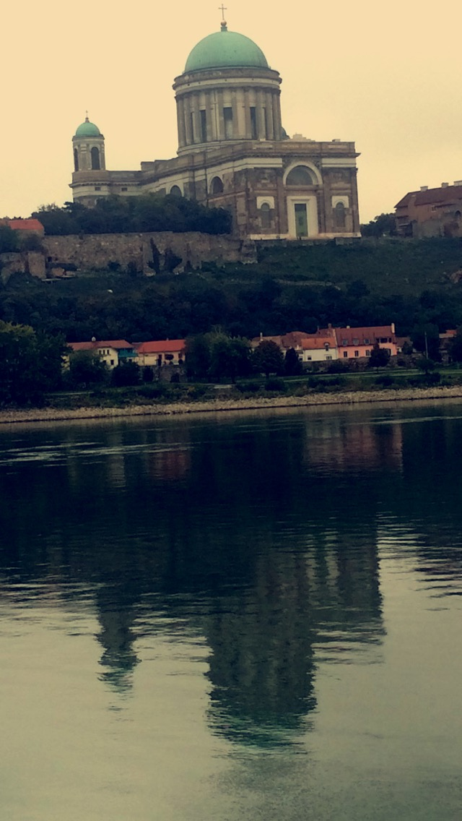
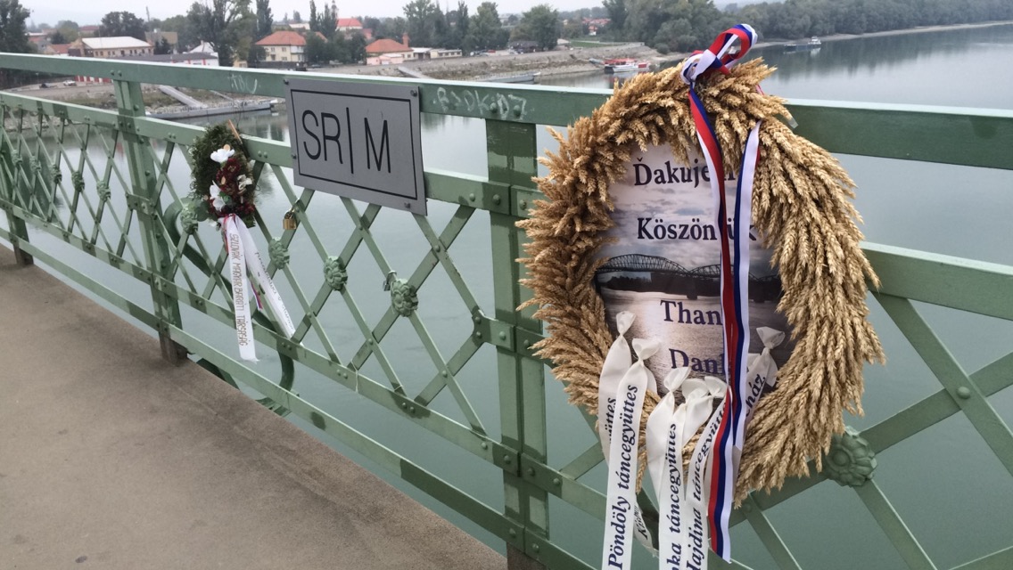

Slide 4
Bratislava, the capital of Slovakia
The castle of Bratislava.
Blue church.
Old town/ Michael´s Gate, Primacial palace, National theatre, Cathedral of St. Martin
Shopping centre next to river Danube.

Slide 5
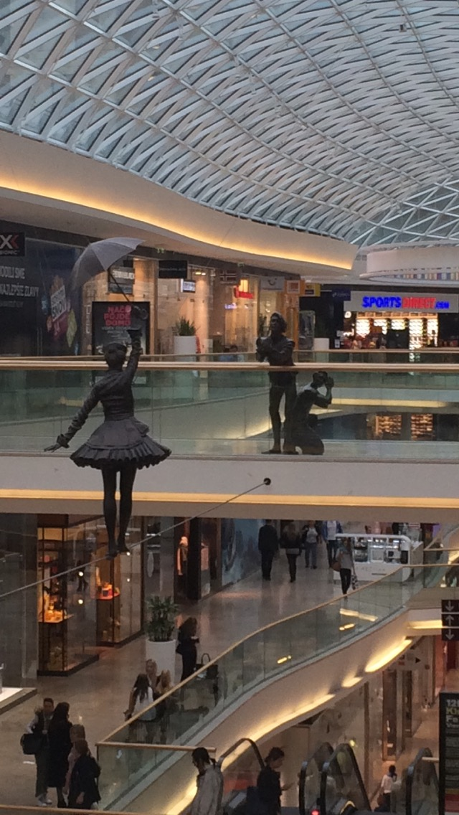
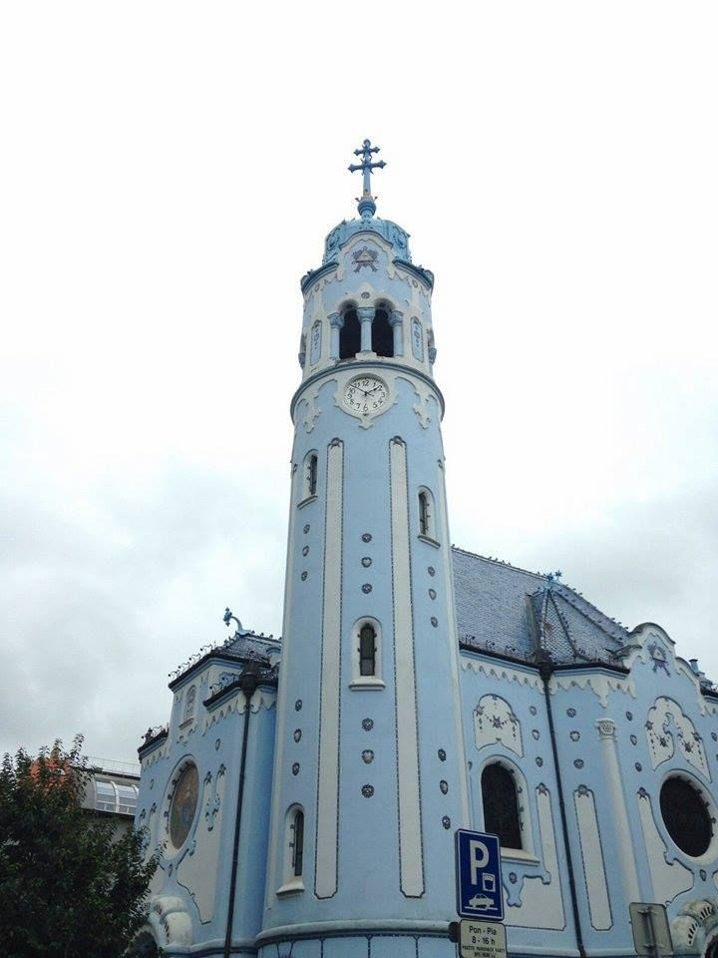

Slide 6
THANK YOU FOR PAYING ATTENTION

