Slide 1
Lugoj
Wednesday
Afternoon
Proposed by PR Group

Slide 2
Introduction
The way we spent the day of Wednesday, on afternoon
First Specimen Lesson:
How to set up a business?!
Second Specimen Lesson:
Honey-Bee Disappearing
Talent Show

Slide 3
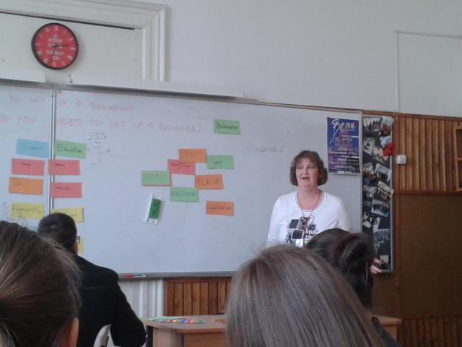
How to set up a business?!

Slide 4
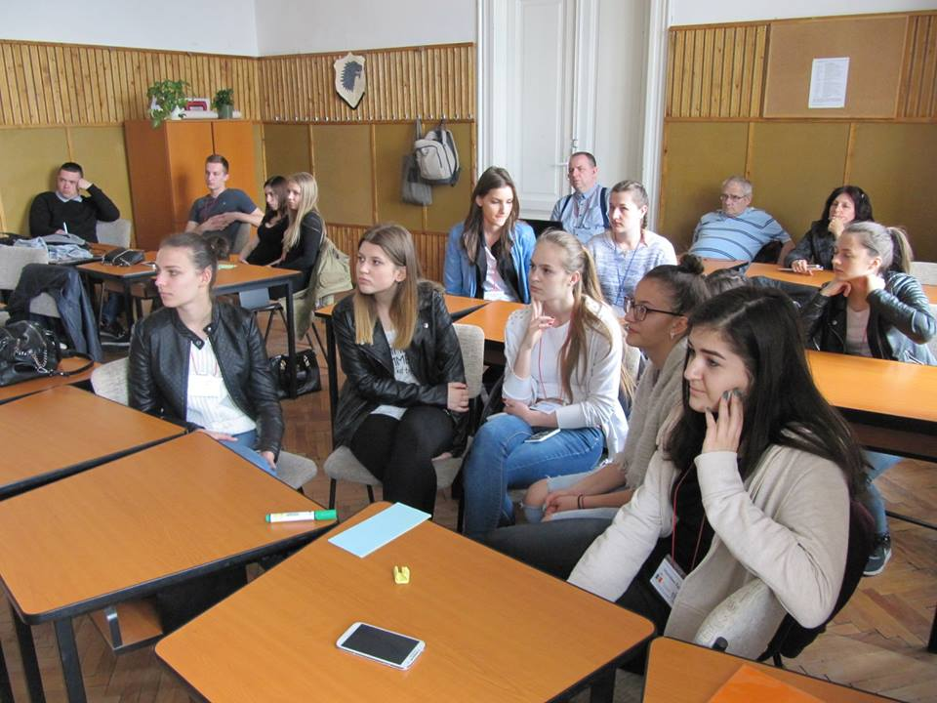
Honey-Bee Disappearing

Slide 5
Talent show

Slide 6
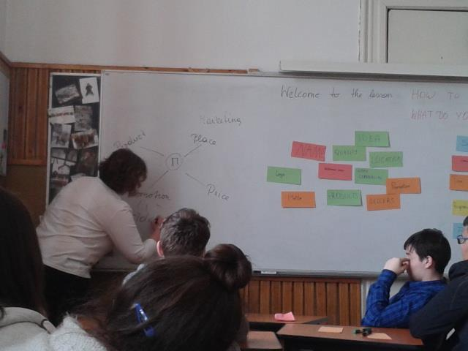
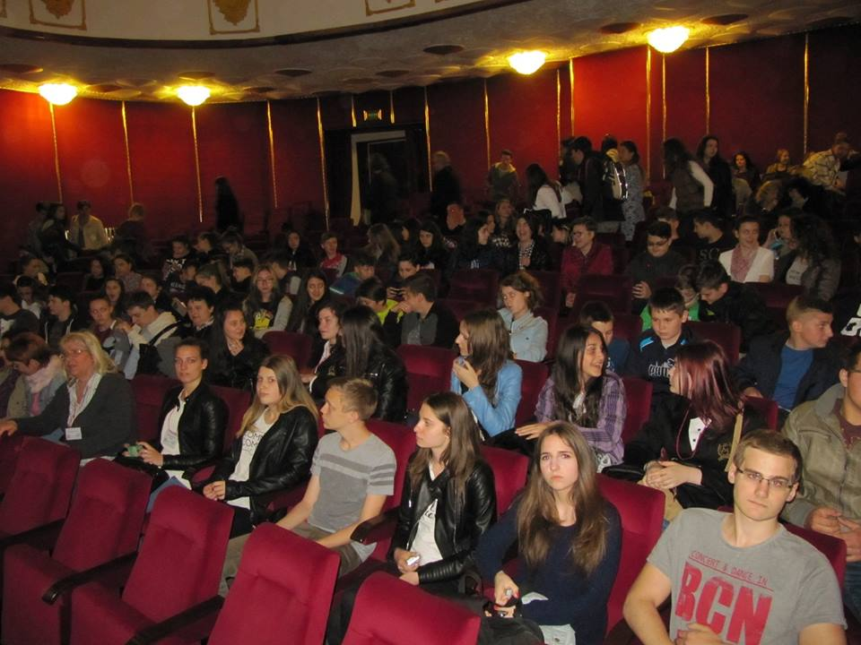

Slide 7
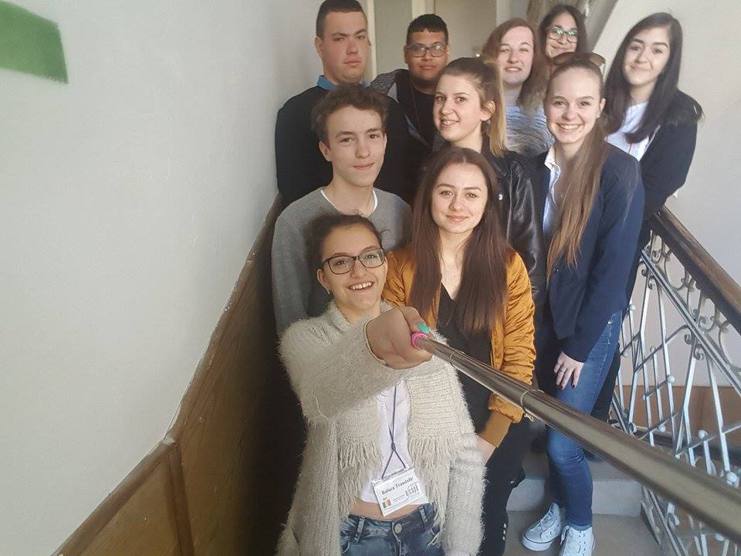
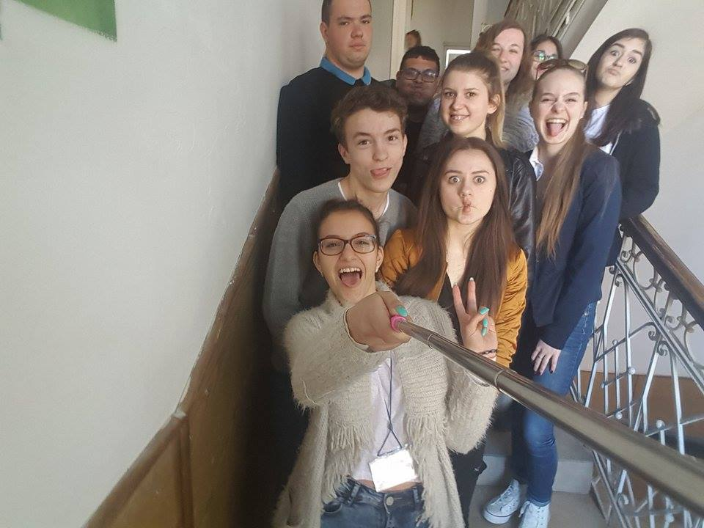
Thank you for your attention!
PR Team Forever!
Andrea, Madalina, Vivi, Timon, Kristian, Raluca, Ralitsa, Andrei, Tereza and Natalia.

