Slide 1
Endangered Species
LESSON PREPARED by:
VERGINIYA KRASTEVA PETROVA - KAMENOVA
Profesionalna gimnazia
Asen Zlatarov - Vidin

Slide 2
What is an endangered species?
A species whose population numbers are so small that it is at risk of extinction

Slide 3
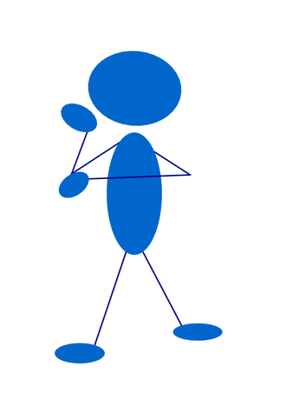
Why Are Species Endangered?

Slide 4
The earth is comprised of many different life forms, including plants, animals, humans, and other organisms. These various life forms are highly interdependent and have formed important systems that continually reshape the planet's landscapes, oceans, and atmospheres.

Slide 5
Booming human population growth over the last two centuries has put, and continues to put, many of these life-sustaining systems out of balance and in serious jeopardy, endangering many of the plant and animal species that human beings directly and indirectly depend upon for long-term survival.

Slide 6
Bigger human populations naturally mean increases in human activities worldwide, leading to changes in landscapes, oceans, atmospheres, and the path of human history. For example, human activities like reducing the amount of forest cover, increasing the amount and variety of chemicals released into the atmosphere, and intensive farming, have changed the earth's land, oceans, and atmosphere. Some of these changes have decreased the capacity of the environment to support some life forms

Slide 7
What does it mean if a species becomes extinct?
The last living member of that species dies and no more members of that species exists, even in zoos or aquariums.

Slide 8
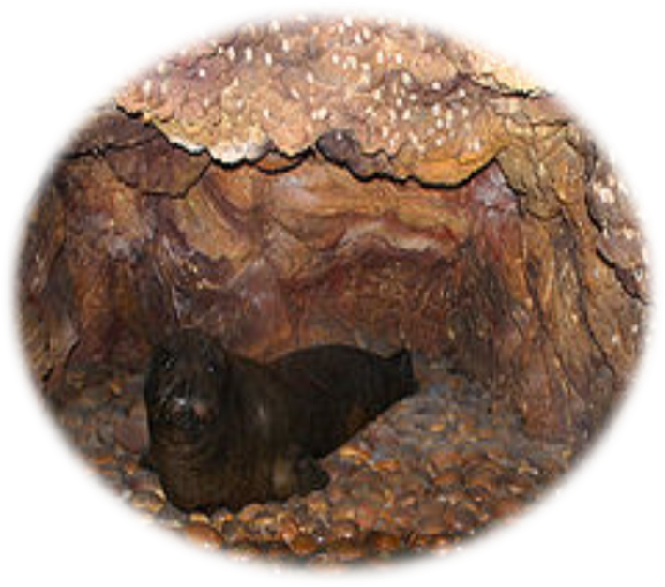
Can you name any extinct species?

Slide 9
Threats to endangered species:
Caused by nature Competition with other species Disease Weather-related catastrophes Natural predators Caused by humans Hunting/poaching Habitat destruction Pollution Competition for habitats

Slide 10
Discussion
What are other threats to endangered species that can alter their population levels?
Which of these species categories surprised you? Critically Endangered? Extinct?
What did you find were common threats to endangered species population sizes?

Slide 11
Is the world a safe place for all animals and plants? Why or why not? What does it mean for a species to be endangered? What, if anything, do you know about this topic? What animal or plant species do you know of that are endangered or extinct?

Slide 12
Why do you think species are endangered? How do you think or feel about this ongoing global problem? What, if anything, happens when an animal or plant species becomes extinct? How do you think this situation can be realistically improved? Why should it be improved?

Slide 13
What is the difference between a threatened species and an endangered species?
Endangered species are those plants and animals that are so rare they are in danger of becoming extinct. Threatened species are plants and animals whose numbers are very low or decreasing rapidly. Threatened species are not endangered yet, but are likely to become endangered in the future.

Slide 14
Why should we protect endangered species?
saving species preserves ecosystems: species are an important part of what make up ecosystems; maintaining healthy ecosystems ensures a healthy biosphere; (
practical uses of species: when species become extinct, we may lose a potentially valuable product; and
aesthetic reasons: when species become extinct, we lose objects of fascination, wonder, and beauty.

Slide 15
As a human being, how do you think or feel about this ongoing global and potentially disastrous problem?

Slide 16
How can you as an individual help this cause?
support zoos, nature centers, nature reserves, or botanical gardens; volunteer money, time, and ideas;
start a native plants garden or use a spot in your backyard to attract wildlife;
avoid buying ivory, snakeskin belts, alligator boots, and other products made from endangered animals; and
keep learning about plants and animals; share what you've learned with others.

Slide 17
